Slide 1
Page Life Expectancy
Kathi Kellenberger
Kellenberger Consulting LLC
http://auntkathisql.com

Slide 2

Data must be in memory to be used by SQL Server
Data Cache

Slide 3

What happens if not enough RAM for the next query?
Data Cache

Slide 4
What if we need the first table again?
Data Cache

Slide 5
How do you know if memory is inadequate?
Page Life Expectancy
*The number of seconds a page is expected to live in memory

Slide 6
PLE
Published value is 300. Inadequate for today’s servers.
Jonathan Keyhaias’ recommendation for minimum
RAM/4 * 300
16 GB = 1,200 minimum
Watch for sustained low values
Use perfmon to measure

Slide 7
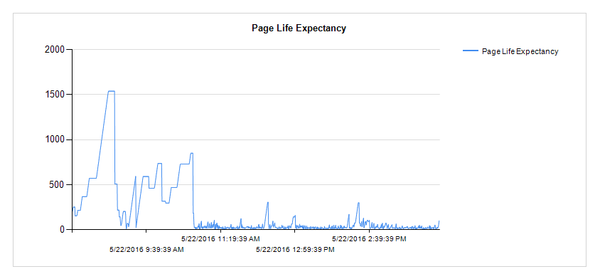
PLE Example

Slide 8

How to set up the collection

Slide 9
How to read the data
Relog path -o destination -f csv

