Slide 1




Performance Tuning 101: Parallelism
Robert L Davis
Database Engineer
@SQLSoldier
www.sqlsoldier.com

Slide 2



Agradecimiento a los patrocinadores
Premium
Silver
Personal

Slide 3



@SQLSoldier
Database Engineer
BlueMountain Capital Management
PASS Security Virtual Chapter
http://security.sqlpass.org
Robert L Davis
Microsoft Certified Master
Data Platform MVP
Volunteers needed
www.sqlsoldier.com
17+ years working with SQL Server
Notes:
Database Engineer at BlueMountain Capital Management
Foremer Principal Database Architect at DB Best Technologies www.dbbest.com
Former Principal DBA at Outerwall, Inc
Former Sr. Product Consultant with Idera Software
Former Program Manager for SQL Server Certified Master program in Microsoft Learning
Former Sr. Production DBA / Operations Engineer at Microsoft (CSS)
Microsoft Certified Master: SQL Server 2008 / MCSM Charter: Data Platform
Co-founder of the SQL PASS Security Virtual Chapter
MCITP: Database Developer: SQL Server 2005 and 2008
MCITP: Database Administrator: SQL Server 2005 and 2008
MCSE: Data Platform
MVP 2014
Co-author of Pro SQL Server 2008 Mirroring
Former Idera ACE (Advisors & Community Educators)
2 time host of T-SQL Tuesday
Guest Professor at SQL University, summer 2010, spring/summer 2011
Speaker at SQL PASS Summit 2010, 2011, and 2012 including a pre-con in 2012
Speaker/Pre-con at SQLRally 2012
17+ years working with SQL Server
Writer for SQL Server Pro (formerly SQL Server Magazine)
Member: Mensa
Dog picture: Maggie and Woody
SQLCruise instructor: Seattle to Alaska 2012
Speaker at SQL Server Intelligence Conference in Seattle 2012
Blog: http://www.sqlsoldier.com
Twitter: http://twitter.com/SQLSoldier

Slide 4
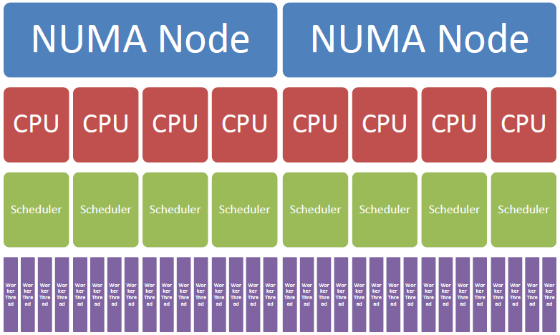
Performance Tuning 101: Parallelism
Parallelism: Architecture

Slide 5
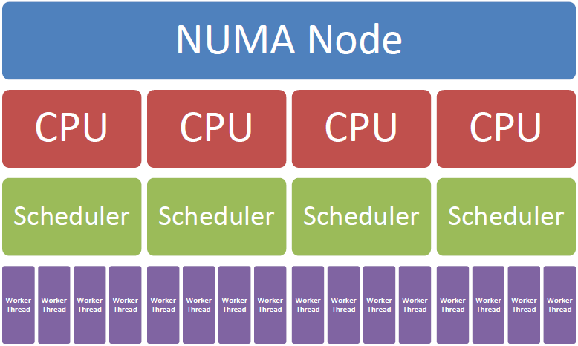
Performance Tuning 101: Parallelism
Parallelism: Architecture

Slide 6
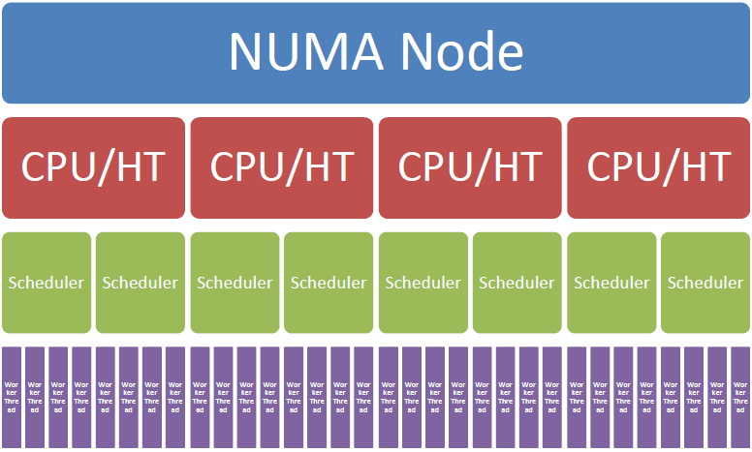
Performance Tuning 101: Parallelism
Parallelism: Architecture

Slide 7
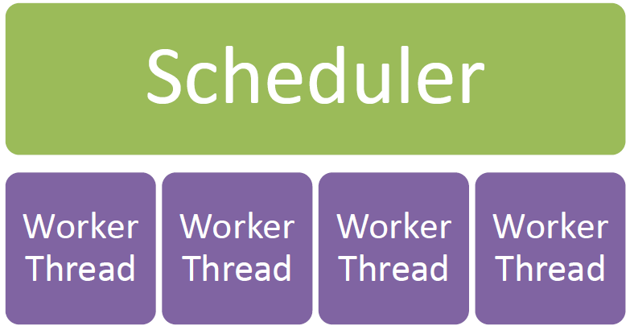
Performance Tuning 101: Parallelism
Parallelism: Architecture

Slide 8
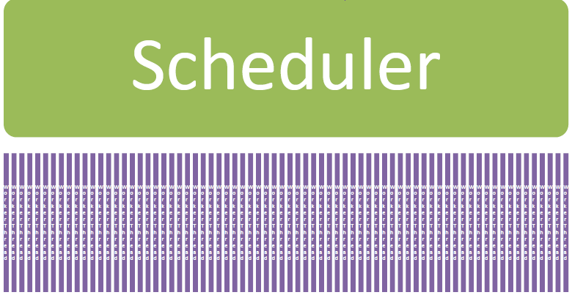
Performance Tuning 101: Parallelism
Parallelism: Architecture
Max Worker Threads = 576 for 8 logical CPUs = 72/scheduler
https://msdn.microsoft.com/en-us/library/ms190219.aspx

Slide 9
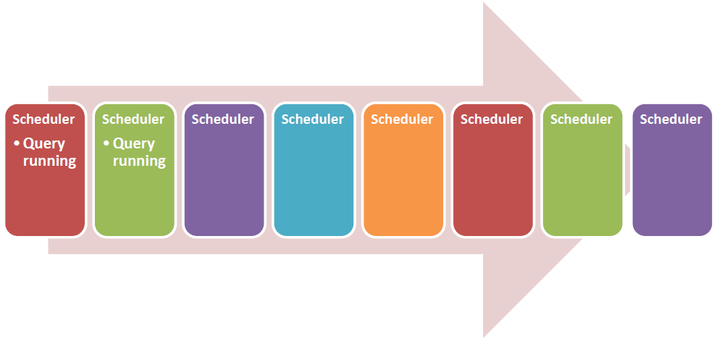
Performance Tuning 101: Parallelism
Parallelism: Architecture

Slide 10
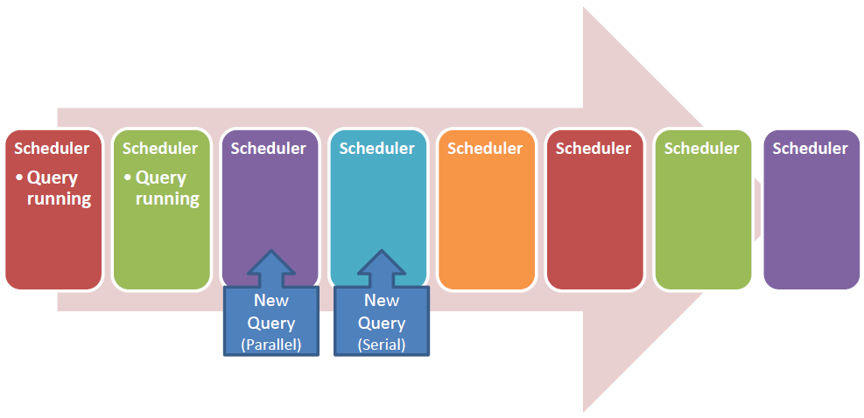
Performance Tuning 101: Parallelism
Parallelism: Architecture

Slide 11
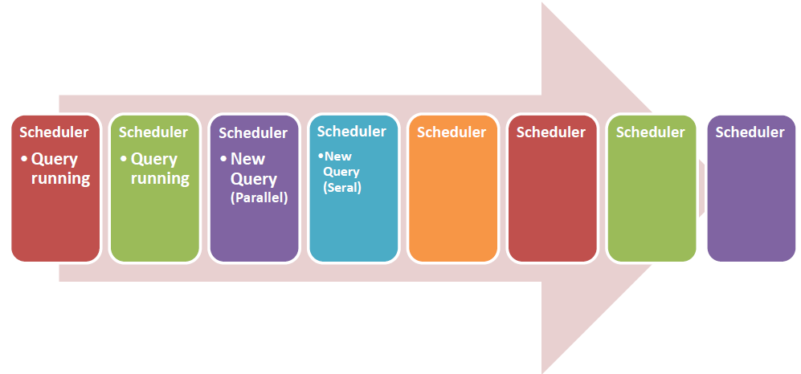
Performance Tuning 101: Parallelism
Parallelism: Architecture

Slide 12
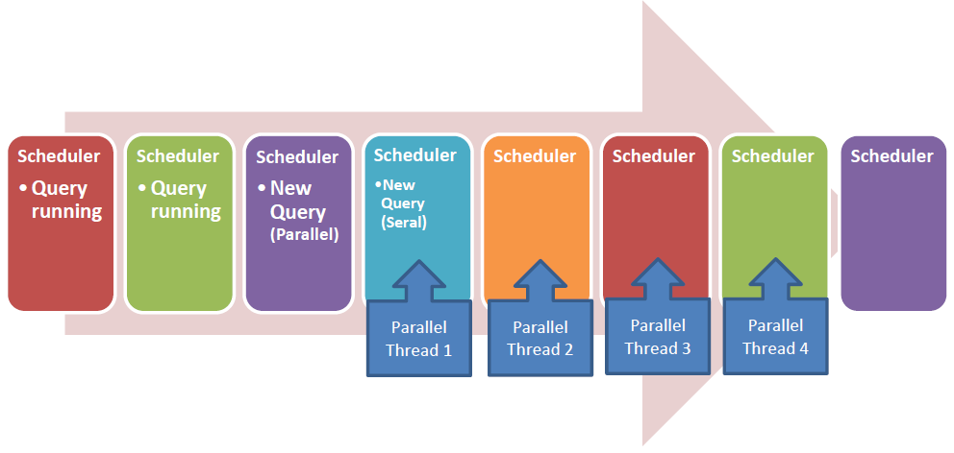
Performance Tuning 101: Parallelism
Parallelism: Architecture

Slide 13
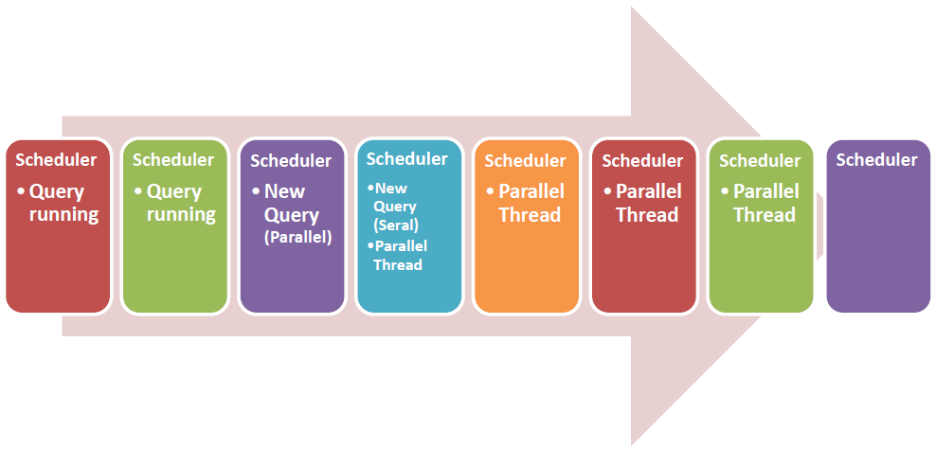
Performance Tuning 101: Parallelism
Parallelism: Architecture

Slide 14
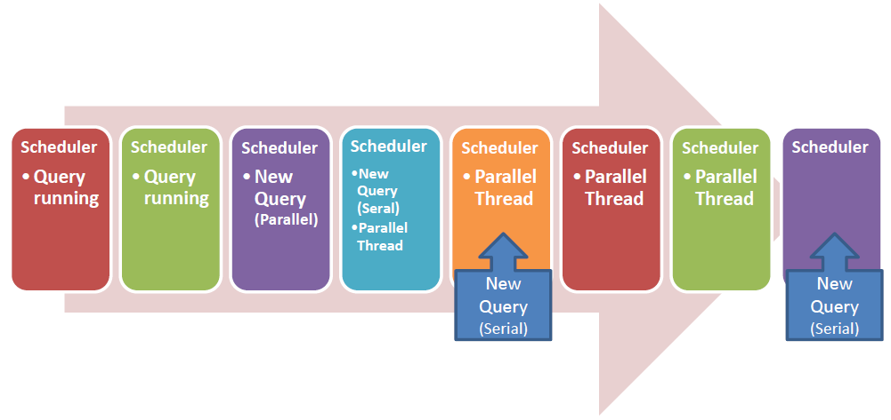
Performance Tuning 101: Parallelism
Parallelism: Architecture

Slide 15
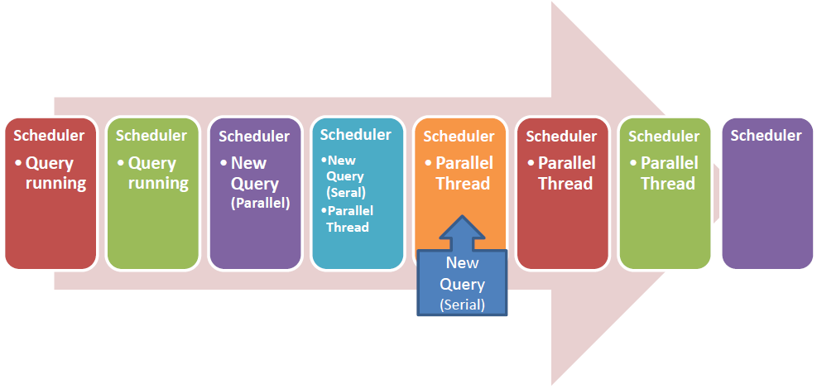
Performance Tuning 101: Parallelism
Parallelism: Architecture

Slide 16
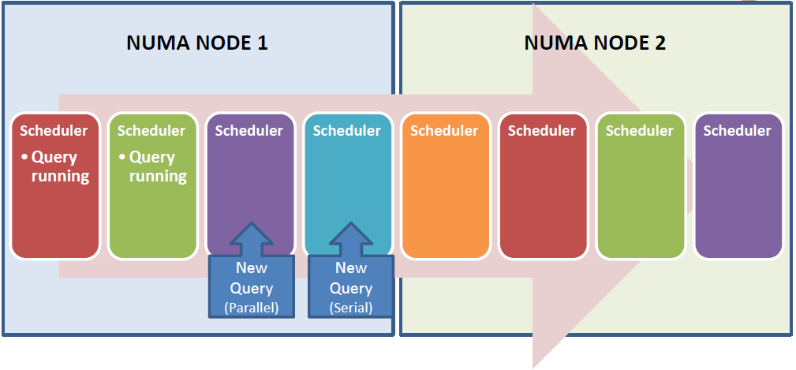
Performance Tuning 101: Parallelism
Parallelism: Architecture

Slide 17
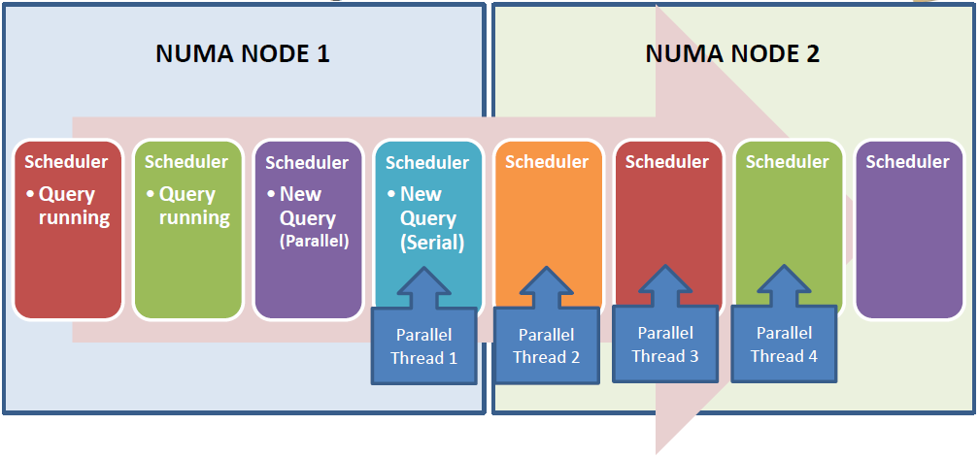
Performance Tuning 101: Parallelism
Parallelism: Architecture

Slide 18
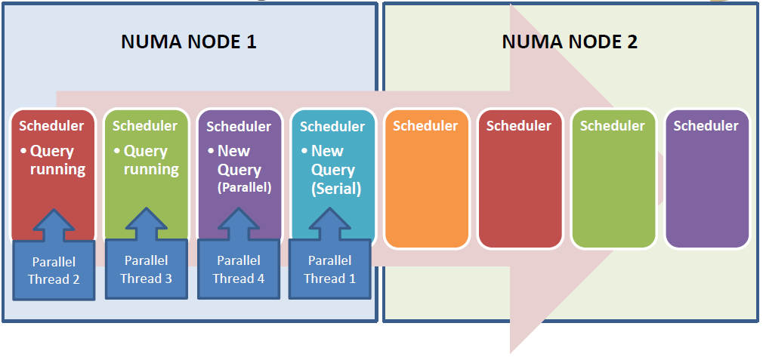
Performance Tuning 101: Parallelism
Parallelism: Architecture

Slide 19
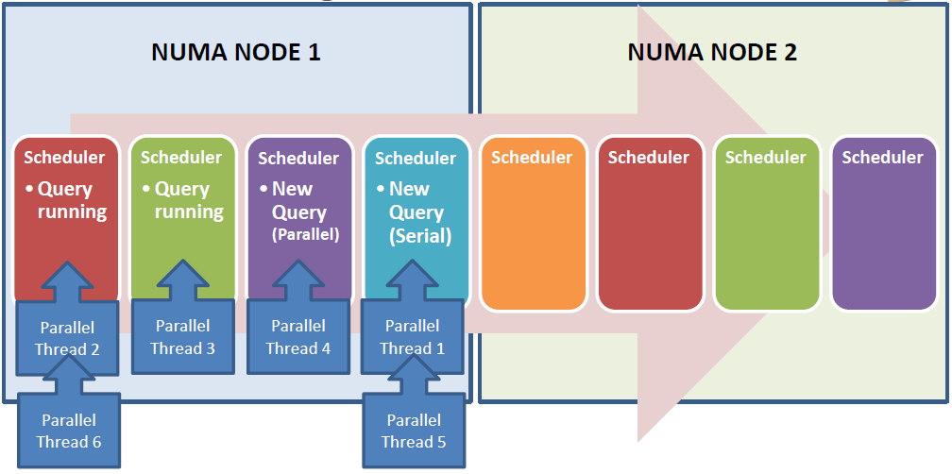
Performance Tuning 101: Parallelism
Parallelism: Architecture

Slide 20
Performance Tuning 101: Parallelism
SQL will generally keep all threads on the same NUMA node

Slide 21
Performance Tuning 101: Parallelism
SQL will generally keep all threads on the same NUMA node
If node is overloaded and other node is not, it may choose to span nodes

Slide 22
Performance Tuning 101: Parallelism
SQL will generally keep all threads on the same NUMA node
If node is overloaded and other node is not, it may choose to span nodes
Memory partitioned per NUMA node though accessible to all nodes

Slide 23
Performance Tuning 101: Parallelism
SQL will generally keep all threads on the same NUMA node
If node is overloaded and other node is not, it may choose to span nodes
Memory partitioned per NUMA node though accessible to all nodes
Local memory access faster than foreign memory access

Slide 24
Performance Tuning 101: Parallelism
SQL will generally keep all threads on the same NUMA node
If node is overloaded and other node is not, it may choose to span nodes
Memory partitioned per NUMA node though accessible to all nodes
Local memory access faster than foreign memory access
Old NUMA (before Nehalem):

Slide 25
Performance Tuning 101: Parallelism
SQL will generally keep all threads on the same NUMA node
If node is overloaded and other node is not, it may choose to span nodes
Memory partitioned per NUMA node though accessible to all nodes
Local memory access faster than foreign memory access
Old NUMA (before Nehalem):
Foreign memory request sent to other node’s CPU for processing

Slide 26
Performance Tuning 101: Parallelism
SQL will generally keep all threads on the same NUMA node
If node is overloaded and other node is not, it may choose to span nodes
Memory partitioned per NUMA node though accessible to all nodes
Local memory access faster than foreign memory access
Old NUMA (before Nehalem):
Foreign memory request sent to other node’s CPU for processing
Current NUMA (after Nehalem):

Slide 27
Performance Tuning 101: Parallelism
SQL will generally keep all threads on the same NUMA node
If node is overloaded and other node is not, it may choose to span nodes
Memory partitioned per NUMA node though accessible to all nodes
Local memory access faster than foreign memory access
Old NUMA (before Nehalem):
Foreign memory request sent to other node’s CPU for processing
Current NUMA (after Nehalem):
Foreign memory request sent directly to other node’s memory

Slide 28
Performance Tuning 101: Parallelism
Max Degree of Parallelism

Slide 29
Performance Tuning 101: Parallelism
Max Degree of Parallelism
Server configuration starting point:

Slide 30
Performance Tuning 101: Parallelism
Max Degree of Parallelism
Server configuration starting point:
8 or less CPUs: leave at 0

Slide 31
Performance Tuning 101: Parallelism
Max Degree of Parallelism
Server configuration starting point:
8 or less CPUs: leave at 0
>8 CPUs: 8

Slide 32
Performance Tuning 101: Parallelism
Max Degree of Parallelism
Server configuration starting point:
8 or less CPUs: leave at 0
>8 CPUs: 8
NUMA: Lesser of number of CPUs per node or 8

Slide 33
Performance Tuning 101: Parallelism
Max Degree of Parallelism
Server configuration starting point:
8 or less CPUs: leave at 0
>8 CPUs: 8
NUMA: Lesser of number of CPUs per node or 8
Can be over-ridden by MaxDOP query hint

Slide 34
Performance Tuning 101: Parallelism
Max Degree of Parallelism
Server configuration starting point:
8 or less CPUs: leave at 0
>8 CPUs: 8
NUMA: Lesser of number of CPUs per node or 8
Can be over-ridden by MaxDOP query hint
Both over-ridden by Resource Governor (RG)

Slide 35
Performance Tuning 101: Parallelism
Max Degree of Parallelism
Server configuration starting point:
8 or less CPUs: leave at 0
>8 CPUs: 8
NUMA: Lesser of number of CPUs per node or 8
Can be over-ridden by MaxDOP query hint
Both over-ridden by Resource Governor (RG)
Will use the lesser of MaxDOP or RG if both defined

Slide 36
Performance Tuning 101: Parallelism
Max DOP: What will it use exactly?
Query Hint (QH) | Resource Governor (RG) | Server Config | Effective MAXDOP of query
Not set | Not set | Not set (0) | Server decides (up to 64)
Not set | Not set | Set | Use server config
Not set | Set | Not set (0) | Use RG
Not set | Set | Set | Use RG
Set | Not set | Not set (0) | Use QH
Set | Set | Not set (0) | Use min(RG, QH)
Set | Set | Set | Use min (RG, QH)
Set | Not set | Set | Use QH
Adapted from http://blogs.msdn.com/b/psssql/archive/2015/04/28/server-s-max-degree-of-parallelism-setting-resource-governor-s-max-dop-and-query-hint-maxdop-which-one-should-sql-server-use.aspx by Jack Li

Slide 37
Performance Tuning 101: Parallelism
Cost Threshold for Parallelism

Slide 38
Performance Tuning 101: Parallelism
Cost Threshold for Parallelism
All operations in an execution plan have an estimated cost value

Slide 39
Performance Tuning 101: Parallelism
Cost Threshold for Parallelism
All operations in an execution plan have an estimated cost value
Based loosely on the CPU ticks of a long-forgotten developer’s desktop who worked on the feature

Slide 40
Performance Tuning 101: Parallelism
Cost Threshold for Parallelism
All operations in an execution plan have an estimated cost value
Based loosely on the CPU ticks of a long-forgotten developer’s desktop who worked on the feature
Used by the query optimizer to determine if a task is a candidate for parallelization

Slide 41
Performance Tuning 101: Parallelism
Cost Threshold for Parallelism
All operations in an execution plan have an estimated cost value
Based loosely on the CPU ticks of a long-forgotten developer’s desktop who worked on the feature
Used by the query optimizer to determine if a task is a candidate for parallelization
Increase setting to cause smaller plans to not parallelize but still allow bigger plans to use parallelism

Slide 42
Performance Tuning 101: Parallelism
Parallelism can be stripped out at run-time if server is short of memory or threads

Slide 43
Performance Tuning 101: Parallelism
Parallelism can be stripped out at run-time if server is short of memory or threads
If cost for a serial plan is above the cost threshold for parallelism, a parallel plan will be generated, but SQL Server will use the lower total costing plan

Slide 44
Performance Tuning 101: Parallelism
Parallelism can be stripped out at run-time if server is short of memory or threads
If cost for a serial plan is above the cost threshold for parallelism, a parallel plan will be generated, but SQL Server will use the lower total costing plan
Will choose the serial plan if cost of parallel plan is higher

Slide 45
Performance Tuning 101: Parallelism
Demo

Slide 46
Performance Tuning 101: Parallelism
Fixing CXPacket Waits

Slide 47
Performance Tuning 101: Parallelism
Fixing CXPacket Waits
Communication eXchange Packet

Slide 48
Performance Tuning 101: Parallelism
Fixing CXPacket Waits
Communication eXchange Packet
CXPacket waits are not what’s broken

Slide 49
Performance Tuning 101: Parallelism
Fixing CXPacket Waits
Communication eXchange Packet
CXPacket waits are not what’s broken
Often indicative of query tuning opportunities

Slide 50
Performance Tuning 101: Parallelism
Fixing CXPacket Waits
Communication eXchange Packet
CXPacket waits are not what’s broken
Often indicative of query tuning opportunities
Over-parallelization can cause excessive waits

Slide 51
Performance Tuning 101: Parallelism
Fixing CXPacket Waits
Communication eXchange Packet
CXPacket waits are not what’s broken
Often indicative of query tuning opportunities
Over-parallelization can cause excessive waits
Beware advice to set Max Degree of Parallelism to 1

Slide 52
Performance Tuning 101: Parallelism
Fixing CXPacket Waits
Communication eXchange Packet
CXPacket waits are not what’s broken
Often indicative of query tuning opportunities
Over-parallelization can cause excessive waits
Beware advice to set Max Degree of Parallelism to 1
Only useful in very rare edge case

Slide 53
Performance Tuning 101: Parallelism
Fixing CXPacket Waits
Communication eXchange Packet
CXPacket waits are not what’s broken
Often indicative of query tuning opportunities
Over-parallelization can cause excessive waits
Beware advice to set Max Degree of Parallelism to 1
Only useful in very rare edge case
Goal most of the time is to find the right balance between execution speed and concurrency

Slide 54
Performance Tuning 101: Parallelism
The little yellow circle with double arrows means it was compiled as a parallel operation

Slide 55
Performance Tuning 101: Parallelism
The little yellow circle with double arrows means it was compiled as a parallel operation
The thicker the arrow between icons, the more work was done

Slide 56
Performance Tuning 101: Parallelism
The little yellow circle with double arrows means it was compiled as a parallel operation
The thicker the arrow between icons, the more work was done
Properties tab can show you stats per thread for the highlighted icon or arrow

Slide 57
Performance Tuning 101: Parallelism
The little yellow circle with double arrows means it was compiled as a parallel operation
The thicker the arrow between icons, the more work was done
Properties tab can show you stats per thread for the highlighted icon or arrow
Thread 0 will always show 0 rows as it is the watcher thread

Slide 58
Performance Tuning 101: Parallelism
The database engine still has the option to run with less threads or in serial even if compiled as a parallel operation

Slide 59
Performance Tuning 101: Parallelism
The database engine still has the option to run with less threads or in serial even if compiled as a parallel operation
Plan details will still show the number of threads from the compiled plan but will only show 0 for all threads not used

Slide 60
Performance Tuning 101: Parallelism
Which operation did the most work?

Slide 61
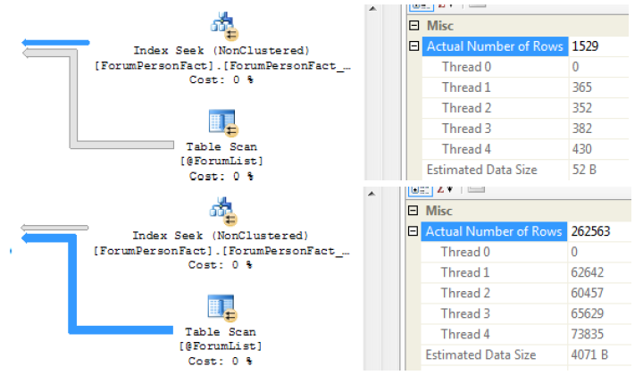
Performance Tuning 101: Parallelism
Which operation did the most work?
Look at the threads in the plan details

Slide 62
Performance Tuning 101: Parallelism
What is the Parallelism (Repartition Streams) operator doing?

Slide 63
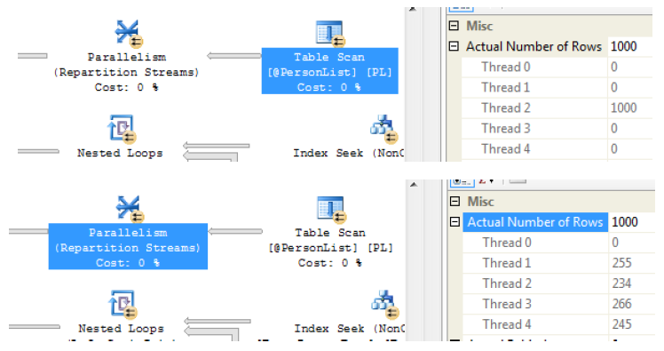
Performance Tuning 101: Parallelism
What is the Parallelism (Repartition Streams) operator doing?
Plan details shows it redistributes the rows more evenly

Slide 64
Performance Tuning 101: Parallelism
Q & A

Slide 65
¡Gracias!
Thank you for attending!
My blog: www.sqlsoldier.com
Twitter: twitter.com/SQLSoldier

