Slide 1

Response Time Analysis A Methodology Around SQL Server Wait Types
Dean Richards

Slide 2
Who Am I
10+ Years SQL Server and 25+ years Oracle
Speak at many user groups throughout US
Founding Partner of DBMS Insights, LLC
Dean.Richards@dbmsinsights.com
Focus on database performance
Revolutionary and Patent Pending Visualizations
Previously at Confio Software and helped build Ignite
Now Solarwinds Database Performance Analyzer (DPA)
Common Question – How do you do performance tuning and what metrics do you use?

Slide 3
Agenda
What is Response Time Analysis (RTA)
What Does this Mean in SQL Server
Collecting RTA Data
Analyzing RTA Data

Slide 4
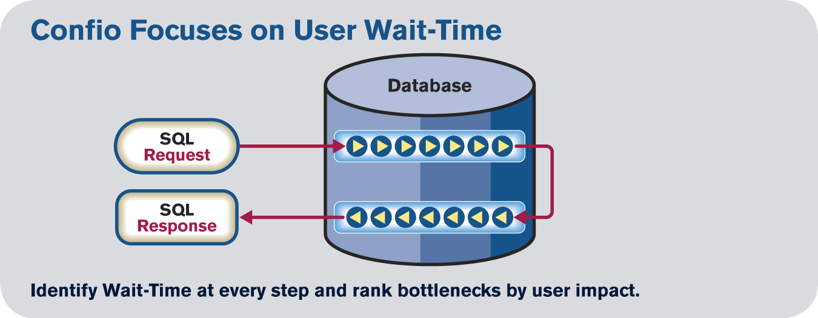
What is Response Time
Focus on End User Response Time
End User Impact is the SQL Response Time
Each wait along the way are bottlenecks
Key data point: which SQLs affect end users the most and what do they wait for

Slide 5
What is Response Time Analysis
A methodology around using wait types to do performance tuning in SQL Server
5 Key Principles of RTA:
SQL Statement – collect data at the SQL level, it is fundamental unit of work in database. Almost all things show up as SQL statements / procedure calls
Wait Type – collect the waits that a SQL incurs as it is executing
Timing – measure how long SQLs and Waits take
History – retain the data
Can spot trends, anomalies, relationships
Point in time view to go back to specific timeframes when problems were occurring
Merge View – must be able to view a timeframe and see combined view of SQLs with wait types and time for each

Slide 6

What Are Wait Types
SQL Server has been instrumented to give clues about what it is doing when processing SQL statements
Wait Types identify a step being taken by SQL statement and its latency
These clues help immensely when doing SQL analysis/tuning
Knowing a SQL waits on locking issues will lead to a different solution than if it were waiting on disk reads
SQL Server 2012 – 649 Wait Types
SQL Server 2014 – 800+ Waits
For a more complete description (for SQL 2005 but still relevant)
Microsoft Waits and Queue Document

Slide 7
Grocery Store Analogy
Cashiers = CPUs - Customers = SQL Statements
Customer #1 checking out is “running”
Customers #2 and #3 waiting in line are “runnable”
Also known as Signal Wait in SQL Server
Customer #1 had something in cart without a barcode
Checkout is “suspended” while a product with barcode is found
Customer #2 starts checkout while Customer #1 waits
Product with barcode is found, Customer #1 completes checkout
When people complain about long checkout lines
Store manager analyzes what is taking so long
Measures each customer and tracks it for a week
Finds that too many products do not have barcodes
Solution is to fix that problem rather than adding more cashiers

Slide 8
Back to SQL Server
SPID 60 is currently executing and “running”
SPID 51, 61 are waiting to run, i.e. “runnable”
Other SPIDs are waiting on other things to complete
_{CPU}
_{SPID 60 – Running}
_{Waiter List}
_{SPID 52 – ASYNC_NETWORK_IO}
_{SPID 53 – OLEDB}
_{SPID 54 – PAGEIOLATCH_SH}
_{SPID 57 – LCK_M_S}
_{SPID 59 – WRITELOG}
_{CPU Queue}
_{SPID 51 – Runnable}
_{SPID 61 – Runnable}

Slide 9
Back to SQL Server
SPID 60 needs to do I/O so it goes into waiting mode
SPID 51 moves onto the CPU, while 61 waits for its turn
SPID 59 completes WRITELOG wait and is runnable
_{CPU 1}
_{SPID 60 – Running}
_{(Needs to perform IO)}
_{SPID 51 - Running}
_{Waiter List}
_{SPID 52 – OLEDB}
_{SPID 53 – WRITELOG}
_{SPID 54 – PAGEIOLATCH_EX}
_{SPID 57 – LCK_M_X}
_{SPID 59 – WRITELOG}
_{SPID 60 – PAGEIOLATCH_SH}
_{CPU 1 Queue}
_{SPID 51 – Runnable}
_{SPID 61 – Runnable}
_{SPID 59 – Runnable}

Slide 10

So Many Wait Types to Learn
From my experience, there is a small list of wait types you need to know well
The other 800+ you can Google or ask Microsoft
Need to know:
What causes these waits
How to reduce / fix these waits
We will discuss the top waits I run into

Slide 11
PAGEIOLATCH_*
Disk read when a page required by a SQL is not in the buffer cache
Where * in:
SH – shared: session reads the data
EX – exclusive: session needs exclusive access to page
UP – update: session needs to update data
DT – destroy: session needs to remove the page
KP – keep: temporary while SQL Server decides
NL – undocumented
The SH, EX and UP latches are by far the most common

Slide 12
PAGEIOLATCH_* Solutions
Do fewer disk reads
Tune the SQL statement to do less I/O
Cache more data, i.e. bigger buffer cache so disk reads no needed
Many SQLs waiting – bigger cache may help
A few SQLs waiting – probably means SQL tuning
Use query in notes to check MB/sec – are you trying to read/write way too much data and overloading disks – tune SQL.
Make disk reads faster
Check file/disk latency with sys.dm_io_virtual_file_stats DMO
Use query in notes
Anything higher than ~ 15 ms would be considered slow on a production class server
Talk to storage team but remember there are many layers between the database and storage, i.e. O/S, virtualization, network, etc
Notes:
select db_name(database_id) [db_name], FILE_NAME(file_id) [file_name],
num_of_reads, num_of_bytes_read / 1048576.0 / sample_ms*1000 [read_mb_per_sec], io_stall_read_ms / num_of_reads read_latency,
num_of_writes, num_of_bytes_written / 1048576.0 / sample_ms*1000 [write_mb_per_sec], io_stall_write_ms / num_of_writes write_latency
from sys.dm_io_virtual_file_stats (null, null)

Slide 13
WRITELOG
Waiting for a log flush to complete
Log flush commonly occurs because of checkpoint or commit
Commits can be explicit (commit) or implicit (auto-commit)

Slide 14
WRITELOG Solutions
Do less work
Develop code to do more batch processing
Single row processing inside loop rather than set based processing?
Make disk writes faster
Avoid RAID5/6 – write I/O penalty
Check file/disk latency with sys.dm_io_virtual_file_stats DMO
Review the write latencies for the transaction logs
Reduce I/O contention on disks containing logs
Solid State? – many questions about this but several test cases have seen good results
Size the transaction logs properly – see notes for a good references on this subject
Notes:
Transaction Log Sizing - http://sqlmag.com/blog/sizing-your-transaction-log
Transaction Log Management – http://www.sqlskills.com/BLOGS/PAUL/post/Importance-of-proper-transaction-log-size-management.aspx

Slide 15
ASYNC_NETWORK_IO
Query produces result set and sends back to client. While client processes data SQL Server waits on this
Often caused by large result sets being returned
Application that queries every row from large tables
MS Access joining SQL Server data to Access data. Access must get all data in SQL table, bring back to Access to join it. Will see “select * from <large table>” queries
Can also apply to linked server queries
Slow client processing
Client machine is very busy and not processing results quickly
Client is reading data and doing processing on it that is slow
Could be a slow network connection from client to server

Slide 16
ASYNC_NETWORK_IO Solutions
Limit the result sets
Some poorly written applications read data from entire table and then filter at client. Filter from database first
Avoid joins across Access to SQL Server data. This also applies to Linked Server and other distributed queries
Check performance of client machine. If it is resource constrained, it may not process results quickly
Check logic of client application and avoid retrieving large result sets if possible. Do more result set processing in database
Check the speed and stability of the network between client and server.

Slide 17
CXPACKET
Session is running a SQL in parallel
More of a status and not necessarily a problem. May be very normal for data warehouse but less so for OLTP
Master process will farm work out to slave processes and then wait on CXPACKET until all have completed
SQL Server will try to parallel-ize big queries up to MAXDOP – can be set instance wide down to this query
MAXDOP = 0 by default meaning unlimited
http://support.microsoft.com/kb/2806535 - recommendations
MAXDOP should not be set higher than 8 in most cases

Slide 18
CXPACKET More Information
Need to understand the slave processes and what they are doing / waiting for
Use sys.dm_os_waiting_tasks
select session_id, exec_context_id, wait_type, wait_duration_ms, resource_description
from sys.dm_os_waiting_tasks
where session_id in (
select session_id from sys.dm_exec_requests
where wait_type='CXPACKET')
order by session_id, exec_context_id
Example Output
session_id exec_context_id wait_type wait_duration_ms resource_description
64 0 CXPACKET 417920
64 1 PAGEIOLATCH_SH 149 5:1:1358830
64 2 PAGEIOLATCH_SH 368 5:1:3514639
64 3 PAGEIOLATCH_SH 84 5:1:3484089
64 4 PAGEIOLATCH_SH 156 5:1:1348098
In this case, tune PAGEIOLATCH_SH waits

Slide 19
LCK_M_*
Classic locking/blocking scenario
Where * is 21 different possibilities. Most common are:
U – trying to update the same resource
S – trying to modify data while it is being read
X – trying to lock a resource exclusively
IU, IS, IX – indicates intent to lock
SCH – schema locks – object is changing underneath
A session waiting on LCK_M_* wait is the victim. Need to use blocking_session_id in dm_exec_request to see the root cause (see query in slide notes)
Not to be confused with deadlocks – special locking case
Notes:
See blocker and blockee sessions and what they are doing
select r1.session_id, SUBSTRING(s1.text, (r1.statement_start_offset/2)+1,
((CASE r1.statement_end_offset
WHEN -1 THEN DATALENGTH(s1.text)
ELSE r1.statement_end_offset
END - r1.statement_start_offset)/2) + 1) AS blocked_sql_text,
r1.blocking_session_id, SUBSTRING(s2.text, (r2.statement_start_offset/2)+1,
((CASE r2.statement_end_offset
WHEN -1 THEN DATALENGTH(s2.text)
ELSE r2.statement_end_offset
END - r2.statement_start_offset)/2) + 1) AS blocker_sql_text,
r1.wait_resource
from sys.dm_exec_requests r1
left outer join sys.dm_exec_requests r2 on r1.blocking_session_id = r2.session_id
outer apply sys.dm_exec_sql_text (r1.sql_handle) s1
outer apply sys.dm_exec_sql_text (r2.sql_handle) s2
where r1.blocking_session_id > 0

Slide 20
LCK_M_* Solutions
Review the wait_description data to understand the locked resource. See slide notes for information.
Review the blocking session and understand the relationship with the blockee. Does the application need to be redesigned?
Blocking issues are often associated with a session holding locks for longer than necessary
Does the blocking session go on to do a lot of other SQLs? Can the transactions be committed sooner?
Does the blocking session execute inefficient SQLs while holding locks? Tuning the poor SQL could reduce the blocking time.
Has the client process waited and finally terminated due to timeouts? The SQL Server session could be left behind (orphaned) and never go away. Terminating the session should release the locks.
Is the client not fetching the whole result set quickly enough? See the ASYNC_NETWORK_IO wait description.
Is the session rolling back data? If so, that process must complete before locks are released
Notes:
Using wait_description data
-- usually in 3 parts separated by colons
-- example: 5:1:4111532
-- 1st number – database_id – select db_name(5)
-- 2nd file number – select * from sys.database_files where file_id=1
-- 3rd page number – see below to get details of that page
dbcc traceon (3604)
go
dbcc page (5, 1, 4111532)
-- get ObjectID from output
select * from sys.objects where object_id=37575172

Slide 21
Useful DMVs for Wait Types
sys.dm_os_wait_stats
Cumulative since instance startup
select * from sys.dm_os_wait_stats order by wait_time_ms desc
Exclude idle wait types in slide notes
Provides a view into what your instance is waiting for
Cleared out at instance startup
sys.dm_exec_requests
Real-time view into what each session/SQL is waiting for
No history, only what is happening now
See slide notes for example query
Suspended state means the session is waiting for the wait_type
Running means the session is on the CPU
Sleeping means the session is idle
Notes:
DM_OS_WAIT_STATS
-- Top waits overall
SELECT * FROM sys.dm_os_wait_stats
-- need to weed out the idle wait types
WHERE wait_type NOT IN ('SLEEP_TASK', 'LOGMGR_QUEUE', 'DIRTY_PAGE_POLL', 'LAZYWRITER_SLEEP', 'REQUEST_FOR_DEADLOCK_SEARCH', 'XE_TIMER_EVENT', 'HADR_FILESTREAM_IOMGR_IOCOMPLETION', 'SQLTRACE_INCREMENTAL_FLUSH_SLEEP', 'CHECKPOINT_QUEUE', 'XE_DISPATCHER_WAIT', 'QDS_PERSIST_TASK_MAIN_LOOP_SLEEP', 'QDS_CLEANUP_STALE_QUERIES_TASK_MAIN_LOOP_SLEEP', 'BROKER_TO_FLUSH', 'BROKER_TASK_STOP', 'PWAIT_ALL_COMPONENTS_INITIALIZED', 'SLEEP_DBSTARTUP', 'SLEEP_MASTERDBREADY', 'SP_SERVER_DIAGNOSTICS_SLEEP') -- and many more
ORDER BY wait_time_ms DESC
-- How long are my disk reads taking
SELECT wait_type, wait_time_ms,
CASE waiting_tasks_count WHEN 0 THEN 0 ELSE 1.0*wait_time_ms / waiting_tasks_count END AS avg_wait_ms
FROM sys.dm_os_wait_stats
WHERE wait_type like 'PAGEIOLATCH%'
ORDER BY wait_time_ms DESC
DM_EXEC_REQUESTS Query
SELECT r.session_id, r.wait_time, r.status, r.wait_type, r.blocking_session_id,
s.text, r.statement_start_offset, r.statement_end_offset, p.query_plan
FROM sys.dm_exec_requests r
OUTER APPLY sys.dm_exec_sql_text (r.sql_handle) s
OUTER APPLY sys.dm_exec_text_query_plan (r.plan_handle, r.statement_start_offset, r.statement_end_offset) p

Slide 22
Useful DMVs for SQL Statements
sys.dm_exec_query_stats
One row for each SQL statement (sql handle with offsets)
Includes stats like execution counts, total elapsed times, CPU time, physical and logical reads, rows returned, min/max, etc
Data since instance startup (see slide notes for query)
Cumulative data since instance startup
See slide notes for useful query
sys.dm_exec_requests
Same as previous slide
Shows which SQL statements are executing and which wait is currently causing delays
Notes:
Query with highest elapsed times since instance startup
These are probably causing end users and batch job problems
select SUBSTRING(ST.text, (QS.statement_start_offset/2) + 1,
((CASE statement_end_offset
WHEN -1 THEN DATALENGTH(ST.text)
ELSE QS.statement_end_offset END
- QS.statement_start_offset)/2) + 1) AS sql_text, total_elapsed_time, execution_count, total_physical_reads, total_logical_reads
from sys.dm_exec_query_stats qs
cross apply sys.dm_exec_sql_text(qs.sql_handle) st
order by qs.total_elapsed_time desc

Slide 23
DMVs Adhere to RTA, Right?
Not Quite, let’s revisit the key principles to RTA
SQL Statement – great information about SQLs from dm_exec_query_stats. Data is cumulative from instance startup but no point in time view. No details about associated waits
Wait Type – good information about waits in dm_os_wait_stats. Data is cumulative from instance startup but no point in time view and no indication which SQLs are suffering from waits
Time – both DMVs above do have a timing component
History – both DMVs show data since instance startup but no point in time information. Cannot use these to go back to 1:12 – 1:37 this morning to look at batch job issues
Merge View – no view of what SQLs wait on typically nor which SQLs suffer from a specific wait type

Slide 24
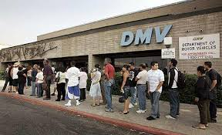
DMV Problems
No Point in Time, No Merge, No Real Historical View
What happened between 3am-5am this morning is not possible to get from the DMV objects
Need to use other tools
Extended Events Session to gather waits and query results
System_health default session gathers wait information but *does not* gather SQLs – much like dm_os_wait_stats.
Other 3rd party products like DBMS Insights
Different DMV Problem

Slide 25
Extended Events Introduction
Lightweight event-handling mechanism
Captures event information like SQL Profiler / SQL Trace
More information plus you can now configure easier
When events are triggered
They can be sent to a target for further analysis
Introduced in SQL Server 2008
Very complex to code and read (parse xml)
Much Improved in 2012 with many more Events
SSMS has Extended Event Interface

Slide 26
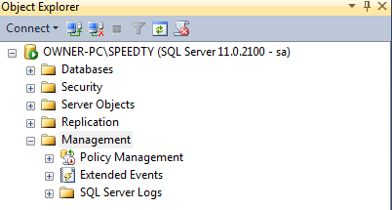

GUI for XE
SQL 2012 and higher has a GUI included in SSMS
SQL 2008 does not
Get one from http://extendedeventmanager.codeplex.com/
Much easier, make XE usable in SQL 2008

Slide 27
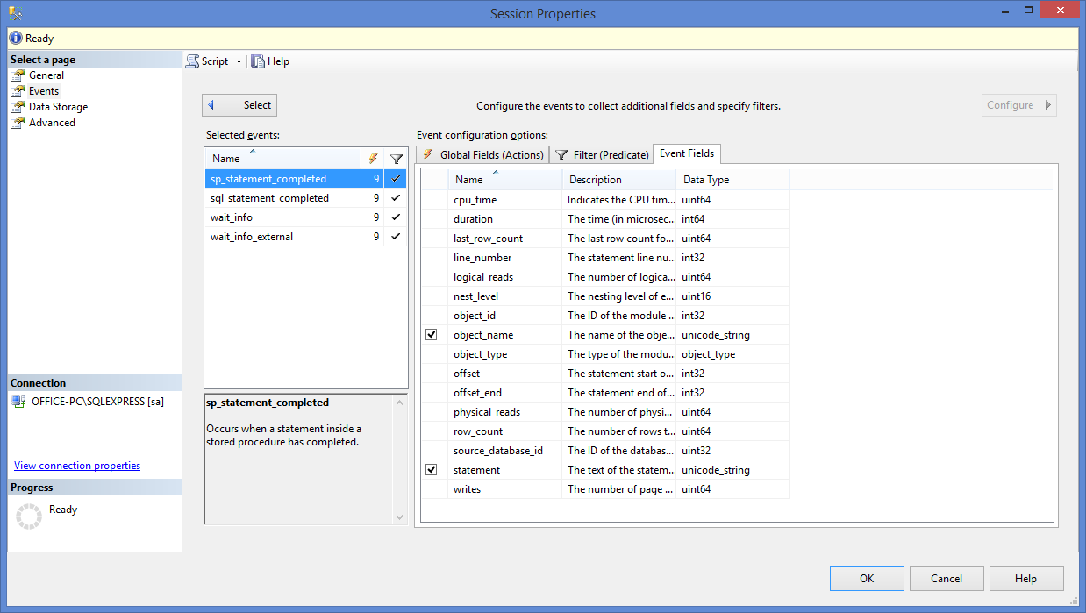
XE Session for SQLs and Waits
Fields defined the default data to collect when the highlighted event fires
These change based on the highlighted event

Slide 28
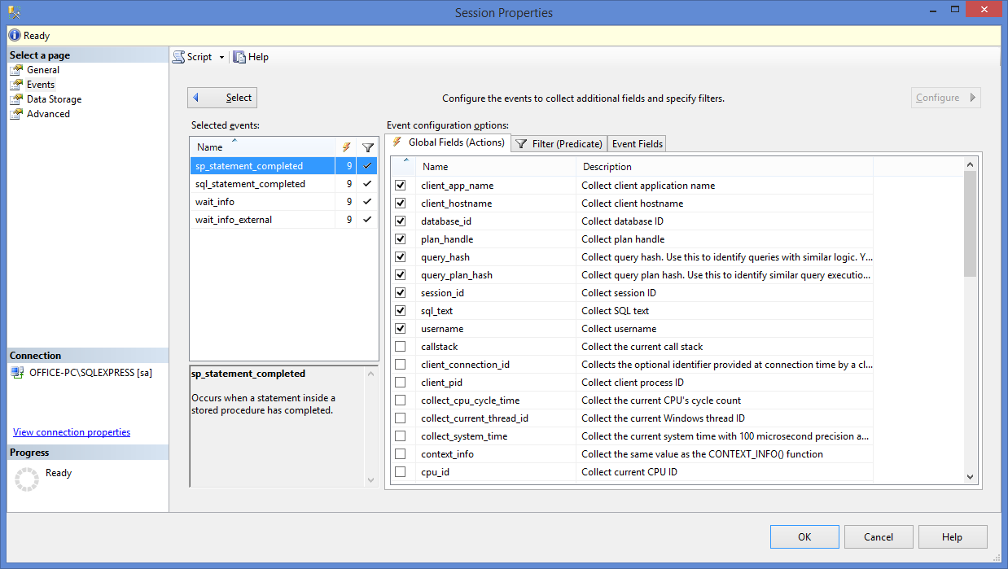
XE Session – Global Fields
Events of when a SQL (sproc or adhoc) or wait (internal or external) completes
Global Fields tab defines the optional data that gets collected when the event fires

Slide 29
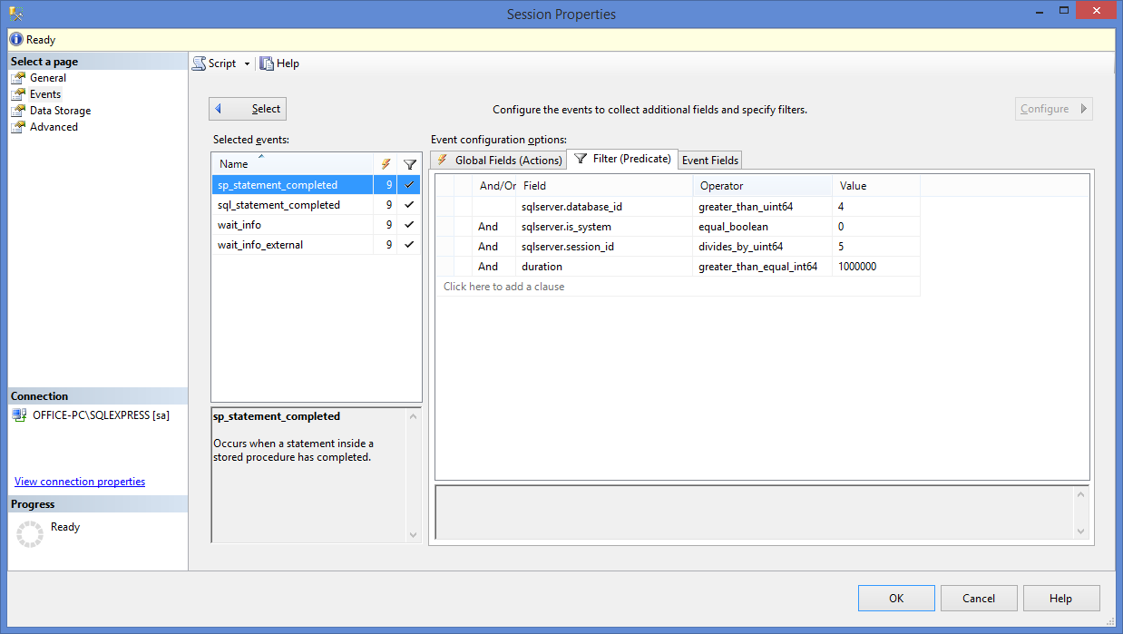
XE Session – Filters
Define the sessions to watch
Do not collect SPIDs doing something in system databases
Do not collect data for background sessions
Collect for 1 out of 5 sessions to reduce load on SQL Server
Collect if the duration is >= 0.1 seconds

Slide 30
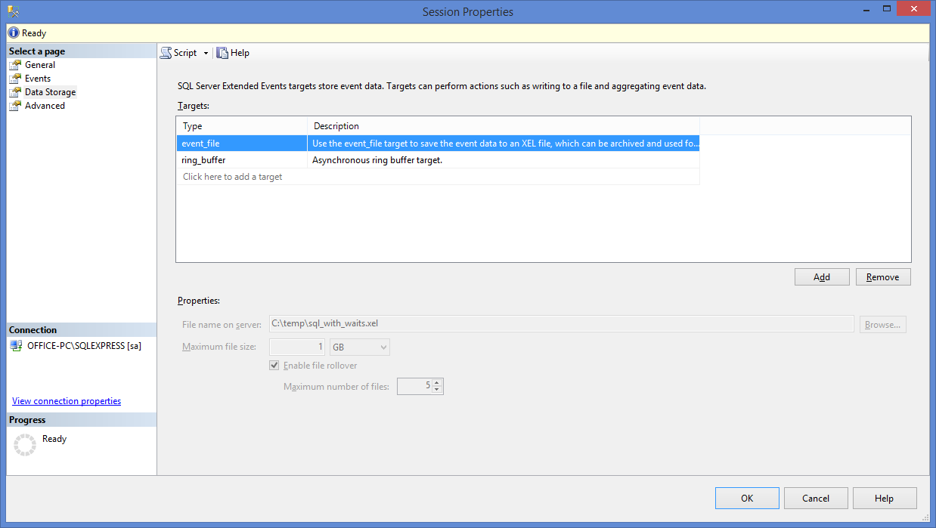
XE Session – Data Storage
File – longer term storage of data
Specify where to store them, how large and retention
Can query it using sys.fn_xe_file_target_read_file
Ring Buffer – shorter term storage in memory

Slide 31
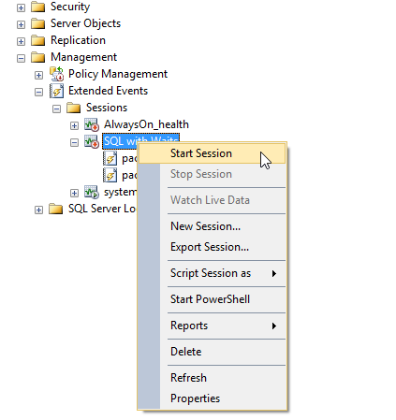
XE Session – Starting
Can manually start when needed
Also an option to start automatically when instance starts
Can export a script for creation on other instances
Modify it with Properties option

Slide 32
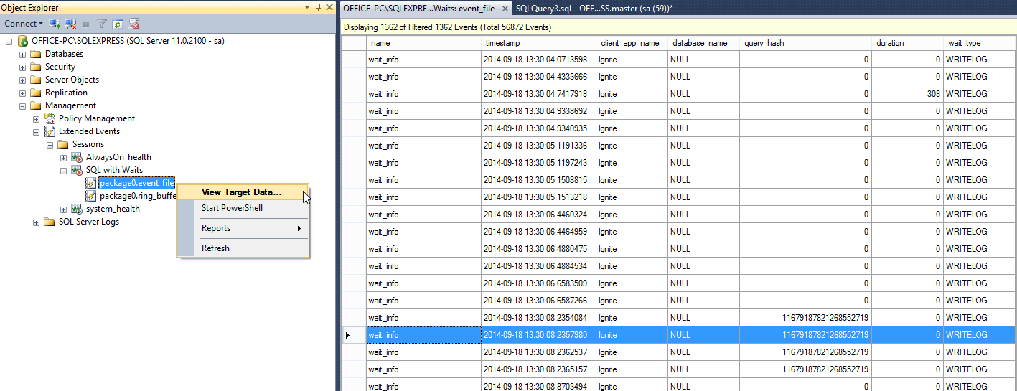
Response Time Analysis
Now that we have data, what do we do with it?
Can analyze from Management Studio
Right-Click on the file output and use View Target Data

Slide 33
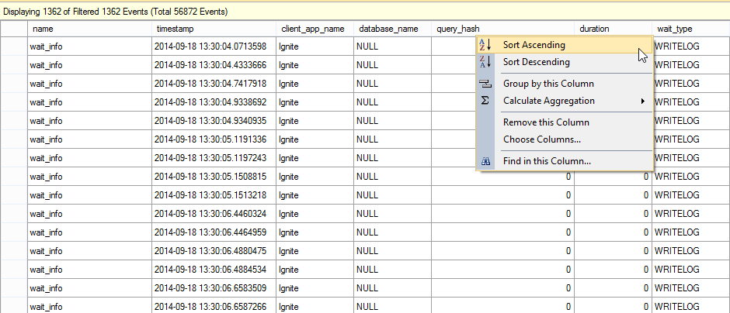
Analysis – Sort, Group, Modify
Left click on any column to sort
Right click on columns to group and aggregate
For example, right click on query_hash and group by it
Right click on duration column and sum it by query_hash
Can also add/remove columns to display

Slide 34
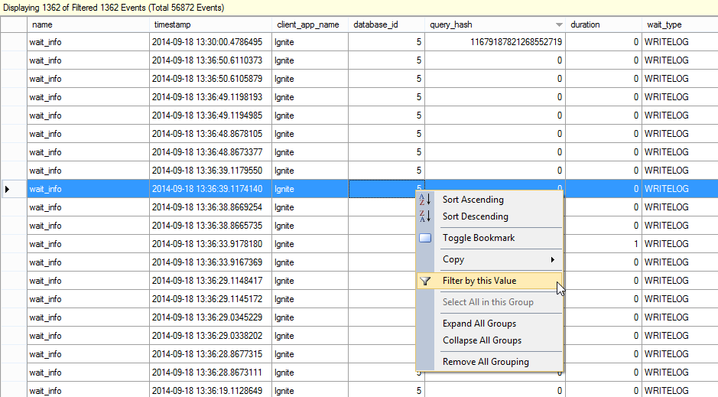
Analysis - Filtering
Having problems with a specific application or database
Filter the response time data by those columns
Can also filter by a point in time when problem was occurring

Slide 35
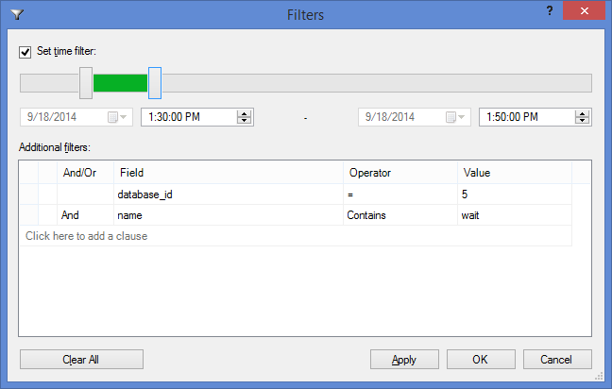
Analysis - Filtering
Filter by a point in time
Filter by any collected value

Slide 36
Analysis - Queries
Can also analyze the data by using XML queries
Read data from the XE files using sys.fn_xe_file_target_read_file
Many queries on the web, but my favorite is from Jeremiah Peschka on brentozar.com
If you are using Ring Buffer output, can also query against that
Data is aged out much quicker
There are limitations as noted by Jonathan Keyhais on sqlskills.com
Notes:
Full link to Jeremiah’s blog on this subject with queries you can use:
http://www.brentozar.com/archive/2014/04/collecting-detailed-performance-measurements-extended-events/
Full link to Jonathan Keyhais article on ring buffer issues
https://www.sqlskills.com/blogs/jonathan/why-i-hate-the-ring_buffer-target-in-extended-events/

Slide 37
Extended Events and RTA
SQL Statement – XE has several events to collect data when a SQL statement completes
Wait Type – wait_info and wait_info_external
Timing – duration column provides the timing
History – retain the data in file or memory
Data ages off based on settings and events being collected
Point in time view using filtering
Can spot trends, anomalies, relationships – this may take a little extra work to save data before it ages out
Merge View – Each event includes SQLs and waits
Rows for *_statement_completed are using CPU
Rows for wait_info are SQLs waiting on something

Slide 38
Summary
Simply using waits (dm_os_wait_stats) or SQLs (dm_exec_query_stats) by themselves is not overly helpful
dm_exec_requests provides only a view of what is happening now
No idea what happened at 1:00 – 3:00 am this morning
Using RTA Methodologies and your favorite tool is much better view into performance
Tools need to adhere to RTA methods to give you a chance
Extended Events and DBMS Insights are two examples

