Slide 1
Troubleshooting With Extended Events
Wellington, SQLSaturday#706
Dharmendra Keshari
Sr. Database Administrator

Slide 2









C:\>
Who Am I
Dharmendra Keshari is a Microsoft Data Platform MVP. He has been organizing world renowned events like SQL Saturday (Singapore), also a co-organizer of KDSSG MSSQL Tech Unite events (in India), and also a core member of “Singapore SQL PASS Chapter”. He also frequently blogs on his website and also a regular contributor at sqlservercentral.com
Currently working as Senior Database Administrator at Micron Technology, Singapore. He has worked in a variety of roles including SQL DBA, Windows/Hyper-V Administrator and also worked very closely with Storage team and vendor management which have given him extensive experience planning and implementing large-scale environment changes and upgrades.
In his free time, Dharmendra loves to hang out with family & friends, joining Marathons
and spend time reading on SQL Server new technology developments.
Reachable at:
https://sg.linkedin.com/in/dharmendra-keshari-a7043398
https://www.facebook.com/dharmendra.keshari.9
dharmendra.keshari@gmail.com | dharmendra.keshari@kdssg.com

Slide 3
Agenda
Introduction
Replace SQL Trace
Enhancements – xEvents Vs SQLTrace
Extended Events Architecture
System Health – Historical Data
TempDB Contention Issue
3 |

Slide 4
Introduction
SQL Server Extended Events is a general event-handling system for SQL Server systems. “The Extended Events infrastructure supports the correlation of data from SQL Server.”
https://technet.microsoft.com/en-us/library/bb630354%28v=sql.105%29.aspx
Simpler version
What is Extended Events
There is an infrastructure within SQLOS known as Extended Events infrastructure. It allows us to create sessions which collect event data for analysis & troubleshooting and helps to understand what’s going on inside SQL Server.

Slide 5
Replace SQL Trace
Implementation of SQL Trace is very limiting to flexibility
Filtering can be only applied once the event has been fired completely; not at the beginning
Negative impacts on performance during event collection
Does not generate trace name globally, you have to code to get it done
Cannot do any kind of analysis without using T-SQL
Cannot capture new features information, like in-memory, AlwaysOn ,and many more …
18 Years old technology (Introduced in 1998)
No enhancements after SQL Server 2005
MSDN says it will be deprecated soon

Slide 6
Enhancements – xEvents Vs SQLTrace
Extended Events
1503
More events introduced
adaptive_join_skipped
excessive_memory spilled_to_workfiles
1301
Number of xEvents or SQLTrace Events
More events introduced
** Insufficient memory to process
hash_spill_details
** Detailed Backup Info
Backup_restore_progress_trace
Database_backup_restore_through put
SSMS Addin
870
625
Adoption increase a lot
compare previous versions
- More events introduced
243
- GUI Option introduced
- Easy to use! A bit more
adoption compare to SQL
2K8 & 2K8R2
- More events introduced
SQL Server 2017
- XEvents introduced
- No GUI option
- T-SQL only option
- Data returned as XML
- Low adoption
262
SQL Server 2016
SQL Server 2014
SQL Server 2012
SQL Server 2008 & R2
SQL Server 2008 & R2
SQL Server 2017
SQL Server 2008
180
180
180
SQL Server 2014
180
SQL Server 2012
SQL Server 2016
180
SQL Server Trace
SQL Server Versions
6 |

Slide 7
Extended Events Architecture
Extended Events Engine
Events
Registered Packages & Medadata
Dispatcher Pool
Event Sessions
Buffers
Targets
Dispatcher
Events
Actions
Types
Maps
Targets
Predicates
Store_Procedure
SP_Started
SP_completed
-
-
etc
Column Selection
Session_ID
Database_ID
-
-
etc
Data Types
It defines the data
Type for an event column, action or global predicate
It provides mapping
from Key value to
text value. For Example Exclusive lock
Key value=5
Text value=‘X’
Target is final destination where you are going to put the data
It is a ‘where’ clause.
7 |

Slide 8


8 |

Slide 9
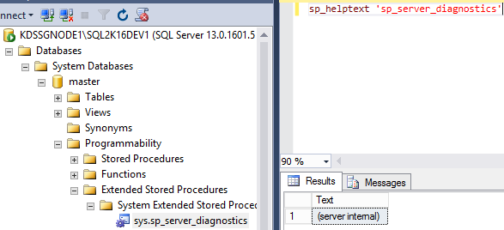
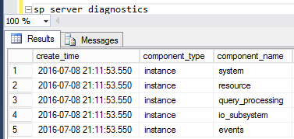
System Health – Historical Data
In SQL 2012 onwards, SP_Server_Diagnostics executes every 5
minus Intervals to check the current health of the SQL Instance
It provides the following sections of health information:
CPU, Page faults, Non-yielding tasks, latches, dumps and spinlock
Physical and Virtual memory usage
Max workers, idle workers, tasks completed in interval
Long interval I/O, I/O Latch timeout, I/O pending requests
Buffer Exception, Ring buffer, Buffer Pool, Scheduler Monitor
SP_Server_Diagnostics is collected by the System_Health session and written to a file which can be trended over
longer period of time. Even it is available, if the SQL instance restart or crash.
Recreating the System_health or other
inbuilt Extended Events sessions:
9 |

Slide 10
10 |

Slide 11
TempDB Contention Issue (1)…
Let’s see what all the activities which uses Tempdb
Service Broker
CHECKDB
Temporary
Tables
Sort
Cursors
Merge Joins
XML Documents
User
Objects
Table
Variables
User Defined
Objects
Version
Store
Internal
Objects
Worktables
Table valued
parameters
Temporary
Procedures
Hash Joins
(Temporary Storage
for hashing)
Online
Index Space
Workfile
11 |

Slide 12



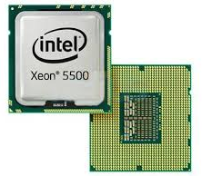

TempDB Contention Issue (2)…
Database
Object
(Table or Index)
PFS tracks allocated pages & heap page free space in a DB.
It can store information about roughly 64MB of pages. (2:1:1)
PFS
8KB
GAM 8KB
Global Allocation Map tracks uniform allocated extents.
A new GAM page store information roughly 4GB intervals
in a data file (2:1:2)
SGAM
8KB
Shared Global Allocation Map tracks mixed allocated extents.
A new SGAM page store information roughly 4GB intervals
in a data file
8KB
8KB
8KB
8KB
8KB
8KB
8KB
8KB
8KB
8KB
8KB
12 |

Slide 13
13 |

Slide 14
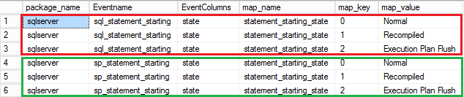
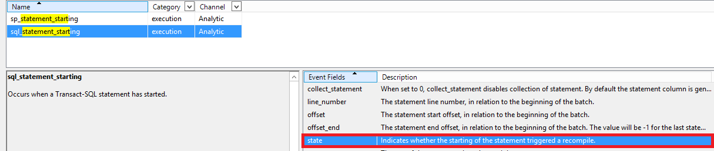
Frequent Recompilation of Queries (1)…
Execution was normal. There was no change which caused to recompile the query plan
When query plan get complied because x change, you will get map value “Recompiled”
When execution plan will be flushed, you will get the map value “Execution Plan Flush”
14 |

Slide 15
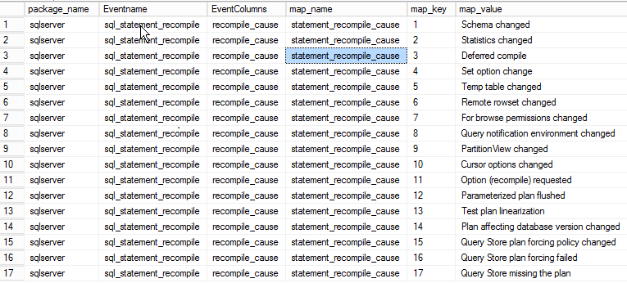
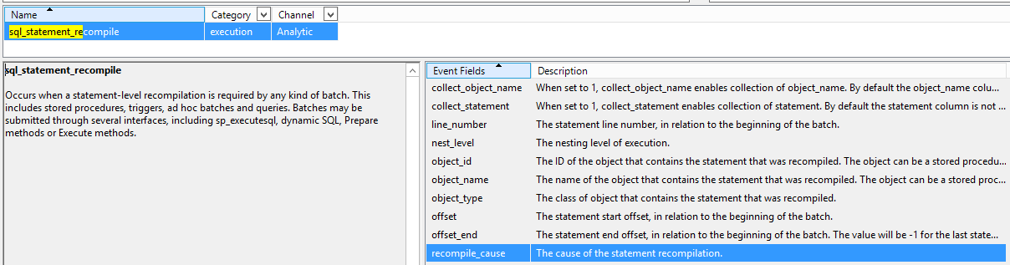
Frequent Recompilation of Queries (2)…
15 |

Slide 16
16 |

Slide 17
Thank you for attending!!!

