Slide 1

Troubleshooting made easier using Extended events
Amit Banerjee
Sr. Program Manager
Microsoft Data Group

Slide 2
C:\Users\> whoami Known on Twitter as @banerjeeamit
An affair with SQL Server for nearly a decade
Was part of SQL Escalation Services and Premier Field Engineering team at Microsoft
Now a Sr. Program Manager on the Microsoft SQL Server (TIGER) product team focusing on HADR and Replication
Speaker at SQL PASS 24HOP TechEd Virtual TechDays User Groups SQL Saturdays
Dabble around with supportability tools and have contributed to SQL Backup Simulator SQLDIAG/PSSDIAG Manager and SQL Nexus
Co-authored “Professional SQL Server 2012: Internals and Troubleshooting”
Own TroubleshootingSQL.com
Also found on http://aka.ms/sqlserverteam
@mssqltiger

Slide 3
What this session is all about
Extended Events in SQL Server 2012 Service Pack 3 and higher which makes working with your database easier!

Slide 4


Availability Group: Lease Timeout
hadr_ag_lease_renewal - Renews every 5 seconds
availability_group_lease_expired – Raised when the lease expires
Root Cause Analysis
SQL Server 2012 Service Pack 3 and above
DBA INVESTIGATION: WILL TAKE TIME
Production Server
Notes:
More information about this improvement can be found in the following articles:
https://blogs.msdn.microsoft.com/alwaysonpro/2016/02/23/improved-alwayson-availability-group-lease-timeout-diagnostics/
https://support.microsoft.com/en-us/kb/3112363
Refer the following for Lease Timeouts: https://blogs.msdn.microsoft.com/psssql/2012/09/07/how-it-works-sql-server-alwayson-lease-timeout/

Slide 5
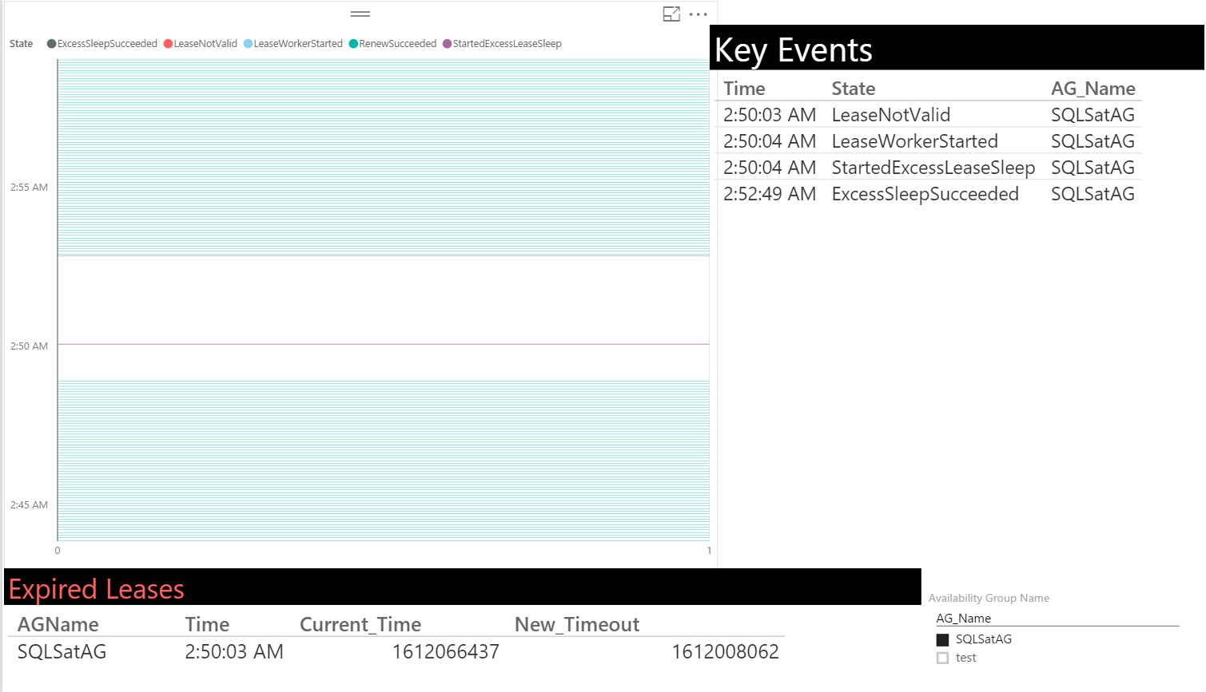
Lease Timeout
Somebody got hurt real bad!!! ☹

Slide 6
Availability Group: Latency
SQL Server 2012 Service Pack 3 and above
Root Cause Analysis
hadr_apply_log_block
hadr_capture_log_block
hadr_capture_vlfheader hadr_database_flow_control_action
hadr_db_commit_mgr_harden
hadr_log_block_compression
hadr_log_block_decompression
hadr_log_block_group_commit
hadr_log_block_send_complete
hadr_lsn_send_complete
hadr_receive_harden_lsn_message
hadr_send_harden_lsn_message
hadr_transport_flow_control_action
hadr_transport_receive_log_block_message
log_block_pushed_to_logpool
log_flush_complete
log_flush_start
recovery_unit_harden_log_timestamps
DBA INVESTIGATION: WILL TAKE TIME
Production Server

Slide 7

Query Memory Grant
query_memory_grant_usage
Column | Description
Sql_handle | Hash map of the SQL text of the request. Is nullable.
Plan_handle | Hash map of the plan for SQL execution. Is nullable.
Query_hash | Binary hash value calculated on the query and used to identify queries that have similar logic. You can use the query hash to determine the aggregate resource usage for queries that differ only by literal values.
Query_plan_hash | Binary hash value calculated on the query execution plan and used to identify similar query execution plans. You can use the query plan hash to find the cumulative cost of queries that have similar execution plans.
Ideal_memory_kb | Ideal memory grant size in KB.
Granted_memory_kb | Granted memory in KB.
Used_memory_kb | Used memory in KB.
Usage_percent | Used/granted memory for easy filtering.
Dop | Degree of parallelism.
Granted_percent | Granted/ideal memory for easy filtering.
Query Performance Investigation
DBA INVESTIGATION: DO NOT CROSS
SQL Server 2012 Service Pack 3 and above
Production Server
Notes:
More information about this improvement can be found in the following articles:
https://support.microsoft.com/en-us/kb/3107173

Slide 8
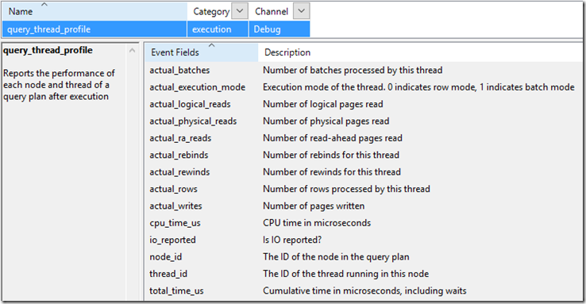
Parallelism
Query_thread_profile
Query Performance Investigation
DBA INVESTIGATION: DO NOT CROSS
SQL Server 2014 Upcoming Service Pack and above
Production Server
Notes:
More information about this improvement can be found in the following articles:
https://blogs.msdn.microsoft.com/sql_server_team/added-per-operator-level-performance-stats-for-query-processing/

Slide 9
Backup & Restore
Root Cause Analysis
database_recovery_progress_report
database_recovery_times
database_recovery_trace
backup_restore_progress_trace
DBA INVESTIGATION: WILL TAKE TIME
Production Server
Notes:
More details about these Xevents are available at:
https://blogs.msdn.microsoft.com/sql_server_team/new-extended-event-to-track-backup-and-restore-progress/
https://blogs.msdn.microsoft.com/sql_server_team/new-extended-events-for-database-recovery-progress/

Slide 10
DEMO

Slide 11

Questions
Blog:
Aka.ms/sqlserverteam
www.troubleshootingsql.com
Twitter:
@banerjeeamit
@mssqltiger
Email: admin@troubleshootingsql.com
Facebook: www.facebook.com/TroubleshootingSQL

