Slide 1

Introduction to the New Data Types in SQL Server 2008
Sarah Dutkiewicz
sarah@codinggeekette.com
Notes:
Presented on April 18, 2009 at Central Ohio Day of .NET

Slide 2



New Types in SQL 2008
DATE/TIME
HIERARCHICAL
GEOSPATIAL
FILESTREAM

Slide 3
New Date/Time Data Types
DATETIME
2008-08-28 12:32:54.720
DATE
TIME
2008-08-28
12:32:54.720
DATETIME2
2008-08-28 12:32:54.7214690
DATETIMEOFFSET
2008-08-28 12:32:54.7214690 -04:00

Slide 4
datetime vs datetime2
 | Datetime 2008-08-28 12:32:54.720 | Datetime2 2008-08-28 12:32:54.7214690
Accuracy | 333 ns | 100 ns
Range | 1753/01/01-9999/12/31 | 0001/01/01 – 9999/12/31
Storage | 8 bytes | 6-8 bytes*
* 6 bytes for precisions less than 3; 7 bytes for precisions 4 and 5. All other precisions require 8 bytes. The default precision is 7.

Slide 5
datetimeoffset
DATETIME2
OFFSET
2008-08-28 12:32:54.7214690
-04:00
DATETIMEOFFSET
2008-08-28 12:32:54.7214690 -04:00
DATETIMEOFFSET is stored in 10 bytes – 8 bytes for the datetime2 part and 2 bytes for the offset.
The offset is based on the UTC and is not fully time-zone aware.

Slide 6
New datetime Functions
Function | Example | Return Datatype
GETDATE() | 2008-08-28 12:32:54.720 | DATETIME
GETUTCDATE() | 2008-08-28 16:32:54.720 | DATETIME
SYSDATETIME() | 2008-08-28 12:32:54.7214690 | DATETIME2
SYSUTCDATETIME() | 2008-08-28 16:32:54.7214690 | DATETIME2
SYSDATETIMEOFFSET() | 2008-08-28 12:32:54.7214690 -04:00 | DATETIMEOFFSET

Slide 7
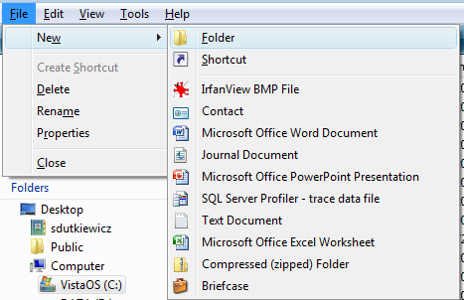
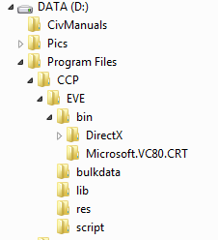
hierarchyid
A data type to store hierarchical representations.
Not limited to organizational charts. Other ideas include:

Slide 8
Hierarchyid Considerations
Provides storage and methods to work with hierarchical data
Indexes are handled in depth-first but can also be set up breadth-first.
Does NOT enforce relationships – that is left for the application
Does NOT enforce uniqueness
No guidance for creating hierarchies – hierarchyid values need to be assigned at the application level.

Slide 9
Hierarchyid Methods
Display
GetRoot
GetAncestor
IsDescendant
GetLevel
GetDescendant
Parse
ToString
Position
Notes:
Move: GetReparentedValue – not covered in this talk due to time constraints

Slide 10
Hierarchyid Representation
 | PositionID | Path | PositionTitle
1 | 0x | / | President
2 | 0x58 | /1/ | Treasurer
Methods
Display
Parse – returns the PositionID (binary data) representation
ToString – returns the Path (human readable) representation
Notes:
\

Slide 11
Hierarchyid Demo
President (/)
Treasurer (/1/)
Speakers Lead (/2/)
Sponsors Lead (/3/)
Venue Lead (/4/)
Volunteers Lead (/5/)
Volunteer 1 (/5/1/)
Volunteer 2 (/5/2/)
Volunteer 3 (/5/3/)
Swag Lead (/6/)
Book Publishers Contact (/6/1/)
Software Contact (/6/2/)

Slide 12



Isn’t that Spatial?
GEOGRAPHY
GEOMETRY

Slide 13
Geography vs Geometry
Great for location-tracking and other mapping applications!
 | Geography | Geometry
Standards | WGS84 (GPS) and Open Geospatial Consortium standards (WKT, WKB, GML) | Well-Known Text (WKT) Well-Known Binary (WKB) Geographic Markup Language (GML)
Type | Geodetic (Round Earth) | Planar

Slide 14
Geospatial Demos
Round Earth Coordinates
Planar Coordinates
Notes:
Show the difference in calculations of area for GEOGRAPHY versus GEOMETRY

Slide 15

Filestream

Slide 16
filestream Instead of blob
 | BLOB | FILESTREAM
Storage | In Database | In NTFS filesystem
Filestreaming | Slow due to storage | Quicker, using NTFS streaming APIs
Caching | Uses SQL caching | Uses Windows caching

Slide 17
filestream Setup
Enable FILESTREAM at the Instance level
Create filegroup
Create table with varbinary(max) column with FILESTREAM attribute

Slide 18
Filestream Advantages
Allows association of unstructured files to structured data
Uses Windows APIs and cache, making it better performance-wise for streaming than from a BLOB for larger files
SQL backup and recovery models support these files
Can use SQL queries to work with the unstructured files
FILESTREAM data is protected by SQL permissions

Slide 19
Filestream Disadvantages
No current support for in-place updates.
"Updates" to columns with FILESTREAM create new files and then change the file pointer.
Old file is deleted at garbage collection – log backup, database backup, or checkpoint for simple recovery.

Slide 20
Filestream Limitations
Databases with FILESTREAM data cannot be configured for database mirroring.
Database snapshots are not supported for FILESTREAM data.
Native encryption is not possible by SQL SERVER for FILESTREAM data.

Slide 21
More SQL Server Presentations
"Query Tuning in SQL Server 2005 and 2005" by Chris Barth
"SQL Server Service Broker" by Josef Finsel
"Automating SQL Server Administrative Tasks with PowerShell" by Allen White
"Test Driven Development for TSQL" by Phil Japikse
Notes:
Other SQL-related presentations at CODODN

Slide 22
Resources
SQL Server 2008 Books Online: http://msdn.microsoft.com/en-gb/library/ms130214.aspx
SQL Server Express WebLog: http://blogs.msdn.com/sqlexpress/
Sample SQL 2008 Databases: http://www.codeplex.com/MSFTDBProdSamples/Release/ProjectReleases.aspx
Jason Follas’ series on Spatial Data: http://tinyurl.com/spatialdataseries
Open Geospatial Consortium: http://www.opengeospatial.org/

Slide 23


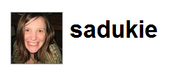
Contact Information
Blog: http://www.codinggeekette.com
Email: sarah@codinggeekette.com

