Slide 1

SQL Server data types - why this is so important?
Level: 300
Katowice, 27.04.2016

Slide 2


What is seequality?
It’s web blog www.seequality.net in two languages
Created by Adrian Chodkowski & Sławomir Drzymała
You can find articles, posts and videos…
You can also write your own articles…
… or ask questions
Contact: slawomirdrzymala@seequality.net

Slide 3

Who is speaking?
Sławomir Drzymała
Technical Expert
Speaker & member of Polish SQL Server User Group
Cofounder of seequality.net
Microsoft technology enthusiast…

Slide 4

Why this session?
Most of you choose that

Slide 5

Agenda

Slide 6




Agenda
Introduction
Data types overview and problems
SQL Server features and data types
Q&A
10 minutes
30 minutes
10 minutes
10 minutes
PMPL SCRA

Slide 7
SCRA
INTRODUCTION (10 minutes)

Slide 8
Introduction
Everybody use data types while creating the objects and quering the database
We have many data types to cover one scenario
Data types can be a big cost
Data types can be dangerous
Level 300, we will talk about SQL Server 2014

Slide 9
Existing data types
Exact numerics – bigint, bit, decimal, int, money, numeric, smallint, smallmoney, tinyint
Approximate numerics – float, real
Date and time – date, datetime2, datetime, datetimeoffset, smalldatetime, time
Character strings – char, varchar, text
Unicode character strings – nchar, ntext, nvarchar
Binary strings – binary, varbinary, image
Other data types – cursor, hierarchyid, sql_variant, table, timestamp, uniquidentifier, xml, Spatial types
Notes:
Source: https://msdn.microsoft.com/en-us/library/ms187752.aspx

Slide 10
Existing data types
Exact numerics – bigint, bit, decimal, int, money, numeric, smallint, smallmoney, tinyint
Approximate numerics – float, real
Date and time – date, datetime2, datetime, datetimeoffset, smalldatetime, time
Character strings – char, varchar(max), text
Unicode character strings – nchar, ntext, nvarchar(max)
Binary strings – binary, varbinary(max), image
Other data types – cursor, hierarchyid, sql_variant, table, timestamp, uniquidentifier, xml, Spatial types
Large value data types large object data type
Notes:
Source: https://msdn.microsoft.com/en-us/library/ms187752.aspx

Slide 11
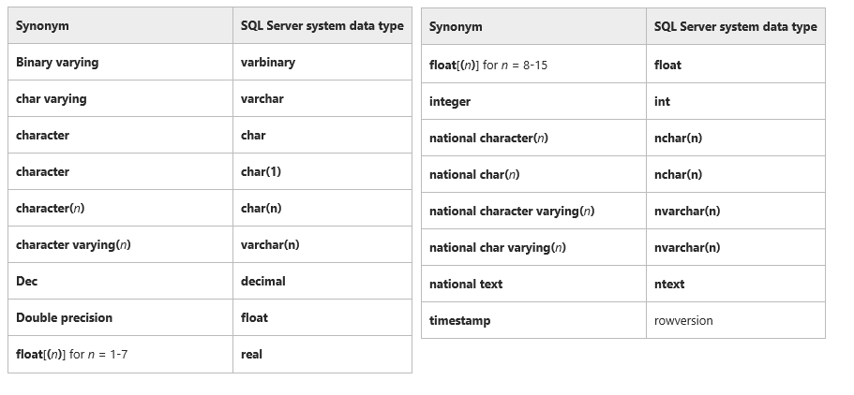
Data types synonyms
DEMO: 1_Data_type_synanyms.sql
All objects that are derived from the original object, such as result set columns or expressions, are assigned the base data type. All subsequent metadata functions performed on the original object and any derived objects will report the base data type, not the synonym.
Notes:
Source: https://msdn.microsoft.com/en-us/library/ms177566.aspx
CREATE TABLE ExampleTable (PriKey int PRIMARY KEY, VarCharCol national character varying(10))

Slide 12
SCRA
Data types overview and problems

Slide 13
Character data types
Data type | Legth | Unicode | Size
Char(n) | Fixed | NO | N bytes
Varchar(n) | Variable | NO | N bytes +2
Nchar(n) | Fixed | YES | 2 * n bytes
Nvarchar(n) | Variable | YES | 2 * n bytes + 2
If we can determine the atribute length and this length is static use char or nchar
Use unicode types only if you really need them
Text and ntext will be removed in the future and we should not use them
Always specify the (n)varchar size
DEMO: 55_character_types.sql
Notes:
Source: https://msdn.microsoft.com/en-us/library/ms177566.aspx

Slide 14
Date and datetime
Data type | Range from | Range to | Size in bytes | Occuracy
Date | 0001-01-01 | 9999-12-31 | 3 | 1 day
Datetime | 1753-01-01 00:00:00 | 9999-12-31 23:59:59 | 8 | ¬ 1 second
Datetime2 | 0001-01-01 00:00:00.0000000 | 9999-12-31 23:59:59.9999999 | ¬8 | 100 nanoseconds
Smalldatetime | 1900-01-01 00:00:00 | 2079-01-01 23:59:59 | 4 | One mintue
Time | 00:00:00.0000000 | 23:59:59.9999999 | ¬5 | 100 nanoseconds
datetimeoffset | 0001-01-01 00:00:00 +-00:00 | 9999-12-31 00:00:00 +-14:00 | 10 | 100 nanoseconds
Do not use date time everywhere
If you need to store the time use smalldatetime or date and store the hour as small int in separate column
Notes:
Source: https://msdn.microsoft.com/en-us/library/ms177566.aspx

Slide 15
Numeric data types
Data type | Range from | Range to | Size in bytes
tinyint | 0 | 255 | 1
smallint | -2^15 (-32,768) | 2^15-1 (32,767) | 2
int | -2^31 (-2,147,483,648) | 2^31-1 (2,147,483,647) | 4
bigint | -2^63 (-9,223,372,036,854,775,808) | 2^63-1 (9,223,372,036,854,775,807) | 8
Remember about tinyint and smallint
You do not need to have an int for many scenario
DEMO:33_whole_number_data_type.sql
Notes:
Source: https://msdn.microsoft.com/en-us/library/ms177566.aspx

Slide 16
Money and numeric
Exact numerics – decimal, money, numeric
Approximate numerics – float, real
Question #1 Should i use float/real or decimal/numeric/money?
Decimal/money/numeric
Question #2 Should i use money or decimal/numeric?
Decimal/numeric
Question #3 Should i use decimal or numeric?
Decimal
DECIMAL(19, 4)
Question #4 Which precision for money?
Additionaly: real and float causing the poor performance for where cluse and we can not use real and float for joining without conversion as well
Check your requirements twice. Read about problem with changing int to bigint – link in the comments
Money is a good choise for views as a data source in SSAS. In another scenarios please do not use them
DEMO: 44_numeric_and_money.sql
More info: http://pl.seequality.net/typy-liczbowe-w-sql-server/ and others about data types
Data sizes: https://technet.microsoft.com/en-us/library/ms172424(v=sql.110).aspx
Notes:
Source: http://stackoverflow.com/questions/582797/should-you-choose-the-money-or-decimalx-y-datatypes-in-sql-server
http://stackoverflow.com/questions/224462/storing-money-in-a-decimal-column-what-precision-and-scale
http://sqlblog.com/blogs/aaron_bertrand/archive/2008/04/27/performance-storage-comparisons-money-vs-decimal.aspx
http://stackoverflow.com/questions/1056323/difference-between-numeric-float-and-decimal-in-sql-server
Real/float vs decimal
https://technet.microsoft.com/en-us/library/ms187912(v=sql.105).aspx
Data types size:
https://technet.microsoft.com/en-us/library/ms172424(v=sql.110).aspx
Decimal and numeric are the same, but decimal is the standard and numeric is microosft implementation
Changing the int to bigint
http://sqlperformance.com/2016/01/sql-indexes/widening-identity-column-1

Slide 17
BLOB
To BLOB or Not To BLOB: Large Object Storage in a Database or a Filesystem http://research.microsoft.com/apps/pubs/default.aspx?id=64525
Varbinary(max)
Stored in SQL Server or disk
According to the whitepaper:
If you have files below 256K store directly in database
If you have files that are above the 1MB store with the filestrem

Slide 18
Bit problem
How many possible values can store the “bit” data type?
Possible values are: 1, 0, NULL
Is that all?
Consider using tinyint beside of bit values for storing the values like status – same size, more possibilities
DEMO: 99_bit_problem.sql
Notes:
Source: https://msdn.microsoft.com/en-us/library/ms177566.aspx

Slide 19
SQL Variant
One type to store all kind of data
DO NOT USE ON THE PRODUCTION CODE There are not supported by many 3rd part tools like ie Entity Freamwork and ODBC drivers, problem with linked servers and many more
DEMO: 66_sql_variant.sql
Notes:
Source: https://msdn.microsoft.com/en-us/library/ms177566.aspx

Slide 20
User defined types
DO NOT USE ON THE PRODUCTION CODE
Notes:
Source: https://msdn.microsoft.com/en-us/library/ms177566.aspx

Slide 21
Data type conversions
Implicit conversion: automatically on the SQL Server side Explicit conversion: cast and convert
Cast: ANSI
Convert: SQL Server only, but contains also additional features like format for dates
https://msdn.microsoft.com/en-us/library/ms187928.aspx
DEMO: 77_data_conversions.sql

Slide 22
SCRA
SQL Server features and data types

Slide 23
In-memory OLTP
Some of the data types are not supported while using in-memory OLTP
Datetimeoffset,
geography,
geometry,
hierarchyid,
varchar(max),
nvarchar(max),
varbinary(max),
image,
xml,
test,
ntext
There is always a workaround: Implementing LOB Columns in a Memory-Optimized Table https://msdn.microsoft.com/en-us/library/dn296676(v=sql.120).aspx
Notes:
Source https://msdn.microsoft.com/en-us/library/dn133179.aspx

Slide 24
Columnstore Index
Columns that use any of the following data types cannot be included in a columnstore index.
ntext, text, and image
varchar(max) and nvarchar(max)
rowversion (and timestamp)
sql_variant
CLR types (hierarchyid and spatial types)
xml
uniqueidentifier (Applies to SQL Server 2012)
Notes:
https://msdn.microsoft.com/en-us/library/gg492153.aspx#LimitRest

Slide 25
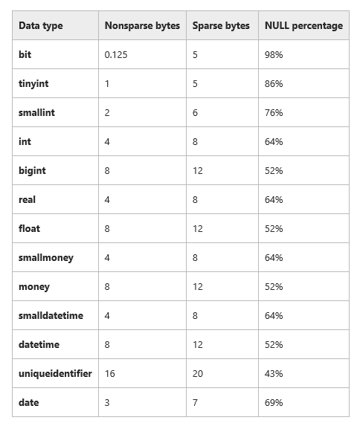
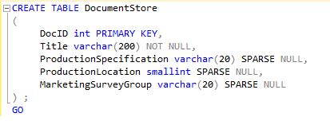
Sparse column

Slide 26
Conclusion
Always think twice while choosing the correct data type
Use the minimum possible size
Save the rule of thumbs from the presentations and resources

Slide 27
Next session?
The possible topics list will be avaliable on the website: www.pl.seequality.pl
You will get an email will further informations!

Slide 28
Thank You! slawomirdrzymala@seequality.net
SQL Server data types - why this is so important?
Katowice, 27.04.2016

