Slide 1


SQL Saturday NYC
May 20th, 2017
This Photo by Unknown Author is licensed under CC BY-SA

Slide 2
Inside SQL Server In-Memory OLTP Turbocharge your Transactions
slideshare.net
http://speakerscore.com/7KKX
http://aka.ms/bobwardms
Based on the SQL PASS 2016 Summit talk and PASS VC talk
Bob Ward
Principal Architect, Microsoft
Data Group, SEALS Tiger Team
bobward@microsoft.com
@bobwardms
#bobsql

Slide 3
Let’s Do This
Check out the Bonus Material Section
Based on SQL Server 2016
The What and Why
Data, Indexes, and Natively Compiled Stored Procedures
Concurrency and Transactions
Logging and Checkpoint

Slide 4
Walk away with this
30x performance gain for your OLTP transactions is possible
“engine within an engine” - lock, latch, and spinlock free
“Look and feel” like “normal” tables but internally different
Use natively compiled stored procedures for max performance
ETL
IOT
Tempdb

Slide 5
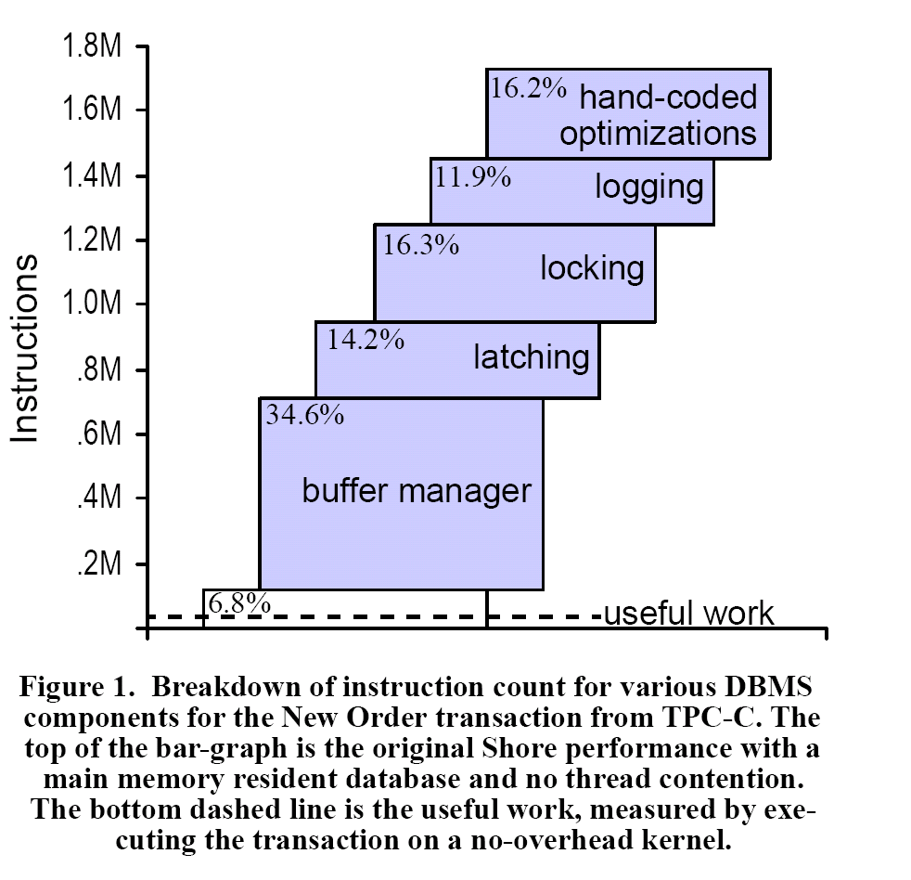
The Path to In-Memory OLTP
OLTP Through the Looking Glass, and What We Found There by Stavros Harizopoulos, Daniel J. Abadi, Samuel Madden, Michael Stonebraker , SIGMOD 2008
Project Verde
2007
“Early” Hekaton
2009/2010
Hekaton becomes In-Memory OLTP
SQL Server 2014
In-Memory OLTP Unleashed
SQL Server 2016

Slide 6
Why In-Memory OLTP?
Keep SQL Server relevant in a world of high-speed hardware with dense cores, fast I/O, and inexpensive massive memory
The need for high-speed OLTP transactions at microsecond speed
Reduce the number of instructions to execute a transaction
Find areas of latency for a transaction and reduce its footprint
Use multi-version optimistic concurrency and “lock free” algorithms
Use DLLs and native compiled procs
XTP = eXtreme Transaction Processing
HK = Hekaton

Slide 7
Demo
Just Show It!
ἑκατόν
Notes:
Following readme.txt in demo1_inmem_oltp_justshowus

Slide 8
What is it Really?
Memory-Optimized Tables
“Feels” like normal disk-based tables but in memory
Internally completely different
Hash or non-clustered index choices (at least one required)
Memory Optimized FILEGROUP
Continuous I/O
Checkpoint Files
Independent of MDF/LDF
An Engine within an Engine
SQLSERVR.EXE
Query Processor
HK Runtime
All other access = Interop Query
Natively Compiled T-SQL Stored Procedure
Storage Engine
HK Compile
Dynamic Linked Library (DLL)
Max performance
HA
HK Engine
Latch and lock free
SQLOS

Slide 9
How is this different?
Can be controlled with Resource Governor
Memory
All data stored in memory separate from Buffer Pool
No “paging” to disk like Buffer Pool under memory pressure
Table data uses different internal structure (no database pages) and DLLs to access
New type of index called hash index
I/O
Transaction logging only at COMMIT
Separate checkpoint processing used to speed startup (continuous I/O)
None required for SCHEMA_ONLY tables
Concurrency
No locking or latching required inside the Hekaton “Engine”
Optimistic (conflict error handling may be required)
Versioning used (but not stored in tempdb)
All data loaded into memory at database startup

Slide 10
In-memory OLTP Threads
10
U
user scheduler
H
hidden scheduler
database
P
preemptive
dm_xtp_threads
USER
XTP_OFFLINE_CKPT
USER
USER
CHECKPOINT
CONTROLLER
H
USER
LOG FLUSH
USER
P
USER
U
U
LOG FLUSH
CHECKPOINT
CLOSE
H
user transactions
P
CHECKPOINT I/O
You could see session_id > 50
In-Memory Thread Pools
Node 0
Node <n>
GC
GC
U
Data Serializer
Data Serializer
U
thread
P
H
thread
thread
Garbage collection one per node
P
Notes:
CHECKPOINT controller will look at committed log records and use a data serializer thread from the pool. These pool threads put work in queues and the LOG FLUSH threads actually perform the checkpoint I/O (which is continuous)
The CHECKPOINT CLOSE thread is the one that actually executes a checkpoint event.
A request with command = XTP_CKPT_AGENT is used to keep FREE files replenished for CHECKPOINT files

Slide 11
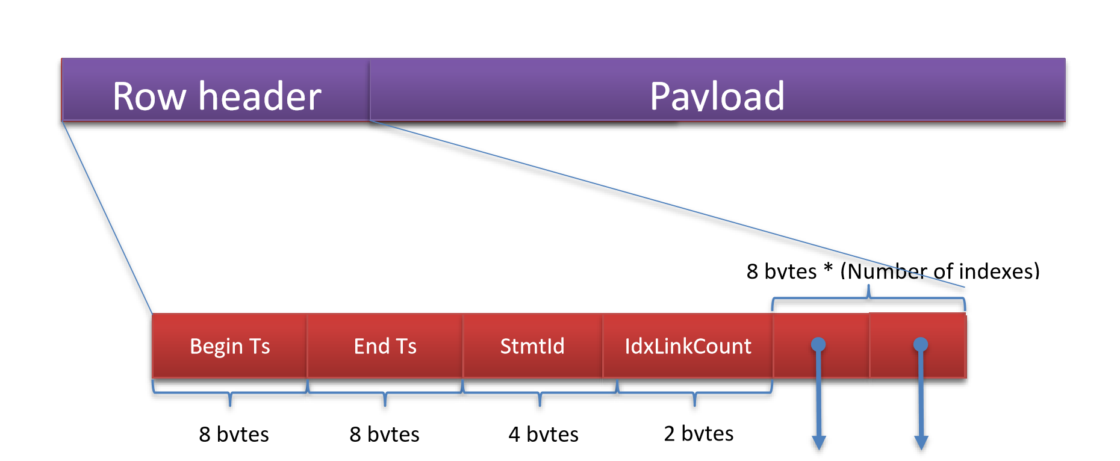
A In-Memory OLTP Data Row
Your data. “bytes” to HK engine
Rows don’t have to be contiguous in memory
Timestamp of DELETE. ∞ = “not deleted”
Timestamp of INSERT
Halloween protection
Points to another row in the “chain”. One pointer for each index on the table
Number of pointers = # indexes

Slide 12
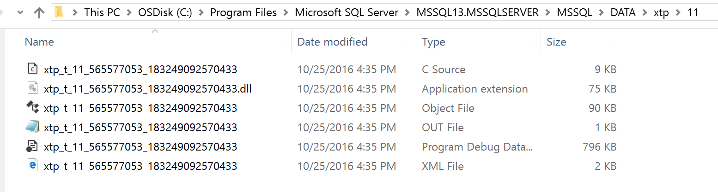
The SCHEMA DLL
The HK Engine doesn’t understand row formats or key value comparisons
So when a table is built or altered, we create, compile, and build a DLL bound to the table used for interop queries
dbid
Generated C source
Symbol file
object_id
Rebuilt when database comes online or table altered
t = schema DLL
p =native proc
cl.exe output
Notes:
We will discuss the compilation process when talking about natively complied DLLs

Slide 13
The Row Payload
create table letsgomavs
(col1 int not null identity primary key nonclustered hash with (bucket_count = 1000000),
col2 int not null,
col3 varchar(100)
)
with (memory_optimized = on, durability = schema_and_data)
struct NullBitsStruct_2147483654
{
unsigned char hkc_isnull_3:1;
};
struct hkt_2147483654
{
long hkc_1;
long hkc_2;
struct NullBitsStruct_2147483654 null_bits;
unsigned short hkvdo[2];
};
nullable
Header
hkc_1
hkc_2
Null bits
Offset array
col3
“your data”

Slide 14
Hash indexes
columns = name char(100), city char (100)
hash index on name bucket_count = 8
hash index on city bucket_count = 8
hash on name
hash on city
0
ts
chain count = 3
0
200,∞
Bob
Fort Worth
duplicate key != collision
100,∞
Bob
Dallas
3
90,∞
Ginger
Austin
4
Hash collision
4
5
5
50,∞
Ryan
Arlington
Begin ts reflects order of inserts
70,∞
Ginger
Houston
Notes:
Hash collision on name index with Ryan because it is a different value than Bob. The first two Bob rows are technically not a collision because they are the same key value

Slide 15
Compiling a native stored procedure
Mixed Abstract Tree (MAT) built
Abstraction with flow and SQL specific info
XML file in the DLL dir
Converted to Pure Imperative Tree (PIT)
General nodes of a tree that are SQL agnostic. C like data structures
Easier to turn into final C code
Final C code built and written
C instead of C++ is simpler and faster compile.
Call cl.exe to compile, link, and generate DLL
Many of what is needed to execute in the DLL
Some calls into the HK Engine
No user defined strings or SQL identifiers to prevent injection
Query trees into MAT nodes
Done in memory
xtp_matgen XEvent
All files in BINN\XTP
Gen has HK header and libs
VC has compiler files, DLLs and libs
Call cl.exe to compile and link

Slide 16
Demo
Debugging Schema DLLs and Natively Compiled Stored Procedures
Notes:
Follow the instructions in readme.txt in demo2_inmem_oltp_debugging

Slide 17
In-memory OLTP versioning
1, ‘Row 1’
Disk based table
In-Mem Table
Time
T1
T2
Time
T1
T2
100
100
BEGIN TRAN
BEGIN TRAN
101
BEGIN TRAN
101
BEGIN TRAN
102
read committed and
SERIALIZABLE = blocked
2, ‘Row 2’
102
2, ‘Row 2’
X
103
SELECT
103
SELECT
104
RCSI = Row 1
Snapshot = Row 1
COMMIT
104
Snapshot always used = Row 1
COMMIT
105
SELECT
RCSI = Row 1 and 2
Snapshot = Row 1
105
SELECT
SERIALIZABLE = Msg 41325
X
106
COMMIT
106
The current transaction failed to commit due to a serializable validation failure.
COMMIT

Slide 18
It is really “lock free”?
The “host” may wait – tLog, SQLOS
Code executing transactions in the Hekaton Kernel are lock, latch, and spinlock free
deadlock free
Locks
Only SCH-S needed for interop queries
Latches
No pages = No page latches
Latch XEvents don’t fire inside HK
Spinlocks
Spinlock class never used
Database locks
We use Thread Local Storage (TLS) to “guard” pointers
Atomic “Compare and Swap” (CAS) to modify
We can “walk” lists lock free. Retries may be needed
*XTP* wait types not in transaction code
Great blog post here
Spinlocks use CAS (‘cmpxchg’) to “acquire” and “release”
CMED_HASH_SET fix
IsXTPSupported() = cmpxchg16b
Notes:
T-SQL IsXTPSupported() = Windows API IsProcessorFeaturePresent(PF_COMPARE_EXCHANGE128)
= _InterlockedCompareExchange128() = Cmpxchg16b instruction

Slide 19
19
The Path of In-Memory OLTP Transactions
“Normal” INSERT
In-Memory OLTP INSERT
INSERT LOG record
Obtain locks
Latch page
Modify page
Update index pages ( more locks and latch )
Release latches and locks
Insert ROW into memory
Maintain index in memory
Page Split
Spinlocks
Sys Tran = Log Flush
No latch
No spinlock
No index logging
LOP
SCHEMA_ONLY no logging
COMMIT Transaction = Log Record and Flush
COMMIT Transaction = Insert HK Log Record and Flush
Notes:
Notice that log records are not even created until COMMIT.

Slide 20
Logging of Multi-row INSERT
100 rows
LOP_BEGIN_XACT
LOP_INSERT_ROWS – heap page
LOP_INSERT_ROWS – ncl index
LOP_COMMIT_XACT
LOP_BEGIN_XACT
LOP_MODIFY_ROW – PFS
LOP_FORMAT_PAGE
LOP_COMMIT_XACT
LOP_HOBT_DELTA
LOP_SET_FREE_SPACE - PFS
1 pair for every row
Alloc new page twice
PFS latch
Metadata access
Log flush
PFS latch multiple times
213 log records @ 33Kb

Slide 21
Compared to Memory Optimized Table
Only inserted into log cache at commit.
LOP_BEGIN_XACT
LOP_HK
LOP_COMMIT_XACT
144
HK_LOP_BEGIN_TX
HK_LOP_INSERT_ROW
HK_LOP_COMMIT_TX
11988
100
84
ROLLBACK = No log records for HK
If LOP_HK too big we may need more than one
Log flush

Slide 22
In-Memory OLTP CHECKPOINT facts
Why CHECKPOINT?
Speed up database startup. Otherwise we would have to keep around a huge tlog around.
We only write data based on committed log records
Independent of SQL recovery intervals
All data written in pairs of data and delta files
Data = INSERTs and UPDATEs
Delta = filter for what rows in Data are actually deleted
Preemptive tasks using WriteFile (async with FILE_FLAG_NO_BUFFERING)
I/O is continuous but CHECKPOINT event based on generated tlog
Periodically we will MERGE several Data/Delta pairs.
No WAL protocol
Typically 128Mb but can be 1Gb
Typically 8Mb but can be 128Mb
The total size of files is roughly = size of memory optimized tables
No index writes. Indexes rebuilt on startup
Notes:
We can switch to “large” files (1Gb) if checkpoint has determine it can read 200Mb/sec and the machine has 16 cores and 128Gb for SQL Server
What is the disk space required for checkpoint files? It is roughly the total size of memory consumed by your table data
I need to make comments here about log truncation and checkpoint files “hanging around”. This has been a problem for some customers

Slide 23
CHECKPOINT FILE types and states
PRECREATED
ACTIVE
After first CREATE TABLE
INSERT data rows
UNDER CONSTRUCTION
Checkpoint File Pair (CFP) and are what is in tlog before CHECKPOINT
WAITING..TRUNCATION
DATA
HK Metadata
DATA
CHECKPOINT event
DELTA
ROOT
FREE
0 to 100 TS
DELTA
DATA
FREE
INSERT more
data rows
0 to 100 TS
FREE
ROOT
FREE
DELTA
ROOT
Any tran in this
range
DATA
These will be used to populate
table on startup and then apply log
ROOT
101 to 200 TS
DATA
DELTA
ROOT
101 to 200 TS
DELTA
This can be reused or deleted at log truncation
We constantly keep PRECREATED, FREE files available
ROOT

Slide 24
More on In-Memory OLTP Checkpoint
Including log records for disk tables
Automatic Checkpoint
Generated when 1.5Gb increase in log since last checkpoint
Independent of recovery interval or target recovery time
Log Truncation
Won’t occur until automatic checkpoint rules apply
Simple recovery truncated on automatic checkpoint
But….Full recovery still needs log backup

Slide 25
Demo
A look inside In-Memory OLTP checkpoint

Slide 26
The Case for In-Memory OLTP
Want a 30x boost in speed for OLTP?
Transactions are truly lock, latch, and spinlock free
Natively compiled stored procedures for super speed
Combine with Columnstore for true HTAP applications
Go after IOT, ETL, and tempdb workloads
SQL Server 2016 is a major step up from 2014

Slide 27
Resources
SQL Server In-Memory OLTP Internals for SQL Server 2016
In-Memory OLTP Videos: What it is and When/How to use it
Explore In-Memory OLTP architectures and customer case studies
Review In-Memory OLTP in SQL Server 2016 and Azure SQL Database
In-Memory OLTP (In-Memory Optimization) docs
Blog post on In-Memory OLTP and checkpoint files
Retry logic for In-Memory OLTP Transactions
slideshare.net
http://speakerscore.com/7KKX
http://aka.ms/bobwardms

Slide 28
Bonus Material

Slide 29
In-Memory OLTP Capabilities
29
Hear the case studies
Supported on Always On Availability Groups
Supports ColumnStore Indexes for HTAP applications
Supported in Azure SQL Database
Cross container transactions (disk and in-memory in one transaction)
Table variables supported
SQL surface area expanded in SQL Server 2016. Complete support here
LOB data types (ex. Varchar(max)) supported
BACKUP/RESTORE complete functionality
Use Transaction Performance Analysis Report for migration

Slide 30
Inside Data and Rows
Compute your estimated row size here
How do you find data rows in a normal SQL table?
Heap = Use IAM pages
Clustered Index = Find root page and traverse index
What about an in-memory table?
Hash index table pointer known in HK metadata for a table. Hash the index key, go to bucket pointer, traverse chain to find row
Page Mapping Table used for range indexes and has a known pointer in HK metadata. Traverse the range index which points to data rows
All data rows have known header but data is opaque to HK engine
Schema DLL and/or Native Compiled Proc DLL knows the format of the row data
Schema DLL and/or Native Compiled Proc DLL knows how to find “key” inside the index
Data exists in memory as pointers to rows (aka a heap). No page structure
Hash index scan is possible
“bag of bytes”

Slide 31
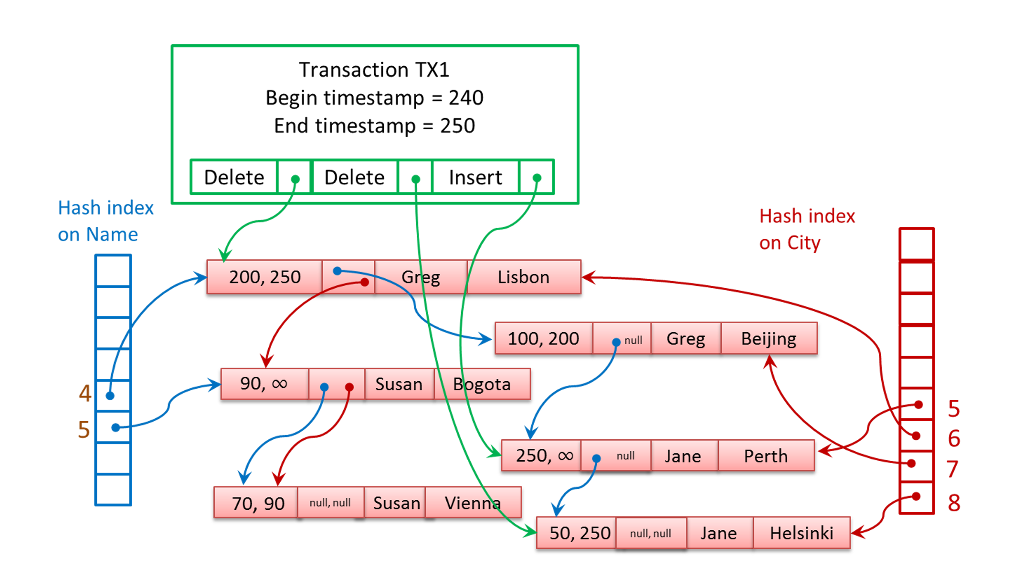
What were those timestamps for?
“read set”
TS = 243
SELECT Name, City FROM T1
Greg, Lisbon
Susan Bogata
Jane Helsinki
“write set” = logged records
BEGIN TRAN TX3 – TS 246
SELECT City FROM T1 WITH (REPEATABLEREAD) WHERE Name = 'Jane';
UPDATE T1 WITH (REPEATABLEREAD) SET City ‘Helinski’ WHERE Name = 'Susan';
COMMIT TRAN -- commits at timestamp 255
FAIL = ‘Jane’ changed after I started
but before I committed and I’m
REPEATABLEREAD. With SQL update to Jane would have been blocked
Commit dependency

Slide 32
The structure of a natively compiled proc
Required. No referenced
object/column
can be dropped or altered.
No SCH lock required
Compile this
Into a DLL
create procedure cowboys_proc_scan
with native_compilation, schemabinding as
begin atomic with
(transaction isolation level = snapshot, language = N'English')
select player_number, player_name from dbo.starsoftheteam
..
end
These are required. There are other options
Everything in
block a single tran
Iso levels still use MVCC
Your queries
No “*” allowed
Fully qualified names
Bigger surface area in SQL Server 2016
Restrictions and Best Practices are here

Slide 33
Inside the Memory of In-Memory OLTP
Hekaton implements its own memory management system built on SQLOS
MEMORYCLERK_XTP (DB_ID_<dbid>) uses SQLOS Page allocator
Variable heaps created per table and range index
Details in dm_db_xtp_memory_consumers and dm_xtp_system_memory_consumers
In-Memory does recognize SQL Server Memory Pressure
Garbage collection is triggered
If OOM, no inserts allowed but you may be able to DELETE to free up space
“System” memory for database independent tasks
Hash indexes using partitioned memory objects for buckets
Memory only limited by the OS (24TB in Windows Server 2016)
Locked and Large apply
Allocated at create index time

Slide 34
Resource Governor and In-Memory OLTP
Remember this is ALL memory
SQL Server limits HK to ~70-90% of target depending on size
Freeing up memory = drop db (immediate) or delete data/drop table (deferred)
Binding to your own Resource Pool
Best way to control and monitor memory usage of HK tables
sp_xtp_bind_db_resource_pool required to bind db to RG pool
What about CPU and I/O?
RG I/O does not apply because we don’t use SQLOS for checkpoint I/O
RG CPU does apply for user tasks because we run under SQLOS host
no classifier function
Not the same as memory

Slide 35
Troubleshooting
From the CSS team
Validation errors. Check out this blog
Upgrade from 2014 to 2016 can take time
Large checkpoint files for 2016 could take up more space and increase recovery times
Log growths, XTP_CHECKPOINT waits. Hotfix 6051103
Checkpoint file shut down and with no detailed info: https://support.microsoft.com/en-us/kb/3090141
Unable to rebuild log 6424109 (by design)
Set filegroup offline. NEVER do it because you can’t set it online again (filestream limitation)
You can’t remove HK filegroup after you add it 2016 LOB can cause memory issues
Other CSS Observations
Hash index doesn’t have a concept of “covered index”
Low memory can cause recovery to fail (because we need everything in memory)
No dbcc checkdb support (but checkpoint files and backup have checksum)

Slide 36
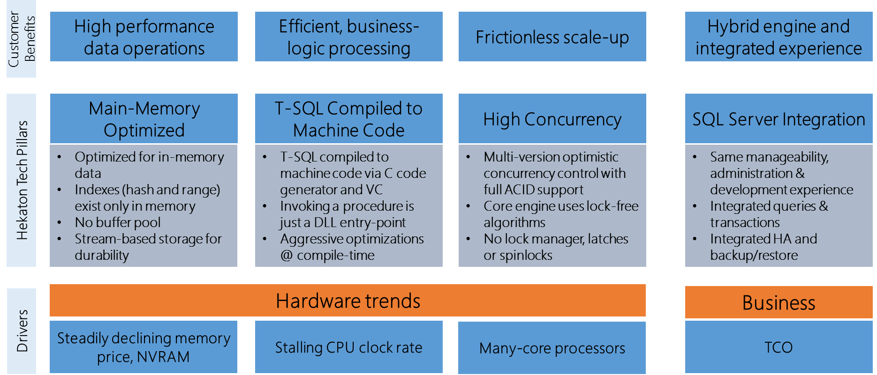
Architecture Pillars
36

Slide 37
The Challenge
Network, TDS
10%
T-SQL interpreter
Query Execution
35%
Expressions
Access Methods
45%
Transaction, Lock, Log Managers
37
SOS, OS and I/O
10%

Slide 38
The In-Memory OLTP Thread Model
38
SQLOS task and worker threads are the foundation
“User” tasks to run transactions
Hidden schedulers used for critical background tasks
Some tasks dedicated while others use a “worker” pool
SQLOS workers dedicated to HK

Slide 39
In-Memory OLTP Thread Pool
39
H
hidden scheduler
U
user scheduler
NON-PREEMPTIVE POOL
Background workers needed for on-demand
Parallel ALTER TABLE
WORKERS POOL
Other workers needed for on-demand (non-preemptive)
Parallel MERGE operation of checkpoint files
PREEMPTIVE POOL
Background workers needed on-demand -preemptive
Serializers to write out checkpoint files
U
U
H
Command = XTP_THREAD_POOL wait_type = DISPATCHER_QUEUE_SEMAPHORE
Command = UNKNOWN TOKEN wait_type = XTP_PREEMPTIVE_TASK
Ideal count = < # schedulers> ; idle timeout = 10 secs

Slide 40
Data Modifications
Multi-version Optimistic Concurrency prevents all blocking
ALL UPDATEs are DELETE followed by INSERT
DELETED rows not automatically removed from memory
Deleted rows not visible to active transactions becomes stale
Garbage Collection process removes stale rows from memory
TRUNCATE TABLE not supported
Page deallocation in SQL Server

Slide 41
Garbage Collection
Stale rows to be removed queued and removed by multiple workers
User workers can clean up stale rows as part of normal transactions
Dedicated threads (GC) per NODE to cleanup stale rows (awoken based on # deletes)
SQL Server Memory pressure can accelerate
Dusty corner scan cleanup – ones no transaction ever reaches
This is the only way to reduce size of HK tables
Long running transactions may prevent removal of deleted rows (visible != stale)
Diagnostics
rows_expired = rows that are stale
rows_expired_removed = stale rows removed from memory
Perfmon - SQL Server 2016 XTP Garbage Collection
dm_db_xtp_gc_cycle_stats
dm_xtp_gc_queue_stats

Slide 42
Diagnostics for Native Procs
Read the docs
Query Plans and Stats
SHOWPLAN_XML is only option
Operator list can be found here
sp_xtp_control_query_exec_stats and sp_xtp_control_proc_exec_stats
Query Store
Plan store by default
Runtime stats store needs above stored procedures to enable (need recompile)
XEvent and SQLTrace
sp_statement_completed works for Xevent but more limited information
SQLTrace only picks up overall proc execution at batch level

Slide 43
Undo, tempdb, and BULK
Undo required 415 log records @46Kb
Hekaton required no logging
Tempdb has similar # log records as disk-based table but less per log record (aka minimal logging).
Multi-row insert test
Remember SCHEMA_ONLY has no logging or I/O
BULK INSERT for in-mem executes and logged just like INSERT
Minimally logged BULK INSERT took 271 log records @ 27Kb
Latches required for GAM, PFS, and system table pates

Slide 44
In-Memory OLTP pushes the log to the limit
Multiple Log Writers in SQL Server 2016
One per NODE up to four
We were able to increase log throughput from 600 to 900Mb/sec
You could go to delayed durability
Database is always consistent
You could lose transactions
Log at the speed of memory
Tail of the log is a “memcpy” to commit
Watch the video

Slide 45
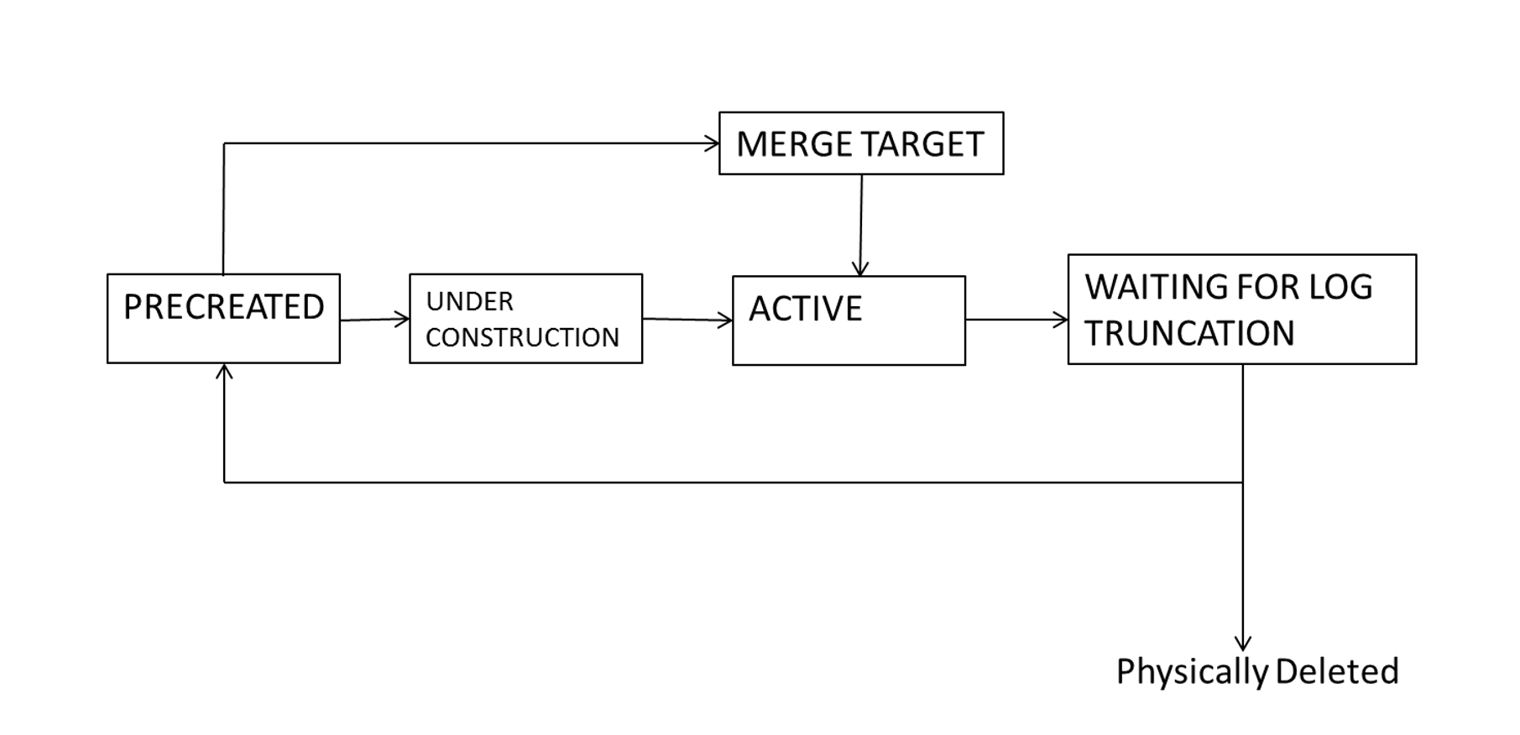
The Merge Process
Over time we could have many CFPs
Why not consolidate data and delta files into a smaller number of pairs?
MERGE TARGET type is target of the merge of files. Becomes ACTIVE
ACTIVE files that were source of merge become WAITING FOR LOG TRUNCATION

