Slide 1
Migrating a Disk-based Table to a Memory-optimized one in SQL Server

Slide 2
Compare Memory Optimized OLTP Table limitations between SQL Server 2014 and SQL Server 2016
Feature/Limit | SQL Server 2014 | SQL Server 2016
Maximum combined size of durable tables | 256 GB | 2 TB
LOB (varbinary(max), [n]varchar(max)) | Not supported | Supported*
Transparent Data Encryption (TDE) | Not supported | Supported
Offline Checkpoint Threads | 1 | 1 per container
ALTER PROCEDURE / sp_recompile | Not supported | Supported (fully online)
Nested native procedure calls | Not supported | Supported
Natively-compiled scalar UDFs | Not supported | Supported
ALTER TABLE | Not supported (DROP / re-CREATE) | Partially supported (offline – details below)
DML triggers | Not supported | Partially supported (AFTER, natively compiled)
Indexes on NULLable columns | Not supported | Supported
Non-BIN2 collations in index key columns | Not supported | Supported
Non-Latin codepages for [var]char columns | Not supported | Supported
Non-BIN2 comparison / sorting in native modules | Not supported | Supported
Foreign Keys | Not supported | Supported
Check/Unique Constraints | Not supported | Supported
Parallelism | Not supported | Supported
OUTER JOIN, OR, NOT, UNION [ALL], DISTINCT, EXISTS, IN | Not supported | Supported
Multiple Active Result Sets (MARS) (Means better Entity Framework support.) | Not supported | Supported
SSMS Table Designer | Not supported | Supported

Slide 3
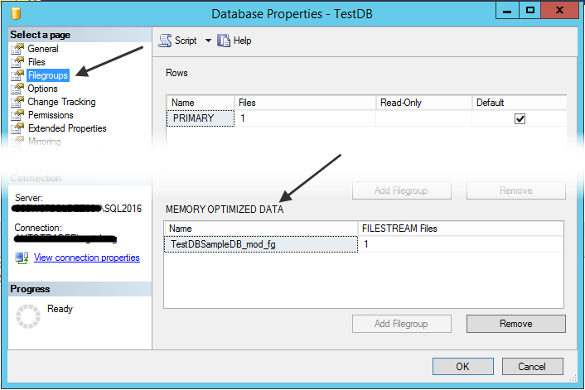
Prepare a database
The database has to be created or altered (if exist) with one MEMORY_OPTIMIZED_DATA filegroup
ALTER DATABASE [TestDB]
ADD FILEGROUP [TestDBSampleDB_mod_fg] CONTAINS MEMORY_OPTIMIZED_DATA;
ALTER DATABASE [TestDB]
ADD FILE (NAME='TestDB_mod_dir', FILENAME='C:\SQL2016\TestDB_mod_dir')
TO FILEGROUP [TestDBSampleDB_mod_fg];

Slide 4
Differences between disk-based tables and memory-optimized tables
MEMORY_OPTIMIZED property
DURABILITY property - memory-optimized tables can be either:
durable (SCHEMA_AND_DATA)
non-durable (SCHEMA_ONLY)
Indexes – no CLUSTERED indexes are implemented on memory-optimized tables. Indexes are not stored as traditional B-trees

Slide 5
Memory Optimized OLTP Table supported datatypes
bit, tinyint, smallint, int, bigint. Numeric and decimal
money and smallmoney
float and real
date/time types: datetime, smalldatetime, datetime2, date and time
char(n), varchar(n), nchar(n), nvarchar(n), sysname, varchar(MAX) and nvarchar(MAX)
binary(n), varbinary(n) and varbinary(MAX)
uniqueidentifier
The following data types are not supported:
datetimeoffset,
geography
geometry
hierarchyid
rowversion
xml
sql_variant
User-Defined Types and all legacy LOB data types (including text, ntext, and image)

Slide 6
Indexing memory-optimized tables
There two types of memory optimized table indexes:
• HASH
• RANGE
HASH index requires the user to specify the BUCKET_COUNT property value. The HASH indexes are more efficient with the equal (=) operator. The BUCKET_COUNT is calculated with the number of unique values multiplied by 2 for tables with fewer than 1 million rows, or multiplied by 1.5 for tables that have more than 1 million rows.
RANGE indexes are optimized for the BETWEEN predicate. If are unsure of the number of buckets you’ll need for a particular column, or if you know you’ll be searching for your data based on a range of values, you should consider creating a range index instead of a hash index. Range indexes are implemented using a new data structure called a Bw-tree, originally envisioned and described by Microsoft Research in 2011. A Bw-tree is a lock- and latch-free variation of a B-tree.

Slide 7
SQL Server Features Not Supported for In-Memory OLTP
Unsupported Feature | Feature Description
Data compression for memory-optimized tables. | You can use the data compression feature to help compress the data inside a database, and to help reduce the size of the database. For more information, see Data Compression.
Partitioning of memory-optimized tables. | The data of partitioned tables and indexes is divided into units that can be spread across more than one filegroup in a database. For more information, see Partitioned Tables and Indexes.
Replication | Replication configurations other than transactional replication to memory-optimized tables on subscribers are incompatible with tables or views referencing memory-optimized tables. Replication using sync_mode=’database snapshot’ is not supported if there is a memory-optimized filegroup. For more information, see Replication to Memory-Optimized Table Subscribers.
Multiple Active Result Sets (MARS) | Multiple Active Result Sets (MARS) is not supported with memory-optimized tables. This error can also indicate linked server use. Linked server can use MARS. Linked servers are not supported with memory-optimized tables. Instead, connect directly to the server and database that hosts the memory-optimized tables.
Linked Server | For more information, see Linked Servers (Database Engine).
DDL triggers | Both database-level and server-level DDL triggers are not supported with In-Memory OLTP tables and natively compiled stored procedures.
Database Containment | Database containment is not supported in a database that has natively-compiled stored procedures and memory-optimized tables. For more information, see Contained Databases
Context Connections | Accessing memory-optimized tables using the context connection from inside CLR stored procedures is not supported.
Cursors | Keyset and dynamic cursors on queries accessing memory-optimized tables. These queries are degraded to static becoming read-only.
TABLESTAMP | TABLESTAMP is not supported. See FROM (Transact-SQL) for more information.
Database Snapshots | Database Snapshots are not supported. For more information, see Database Snapshots (SQL Server).
Transactional DDL | Transactional DDL is not supported in In-Memory OLTP.

