Slide 1
Taking your application to memory
- A case study
Rasmus Reinholdt

Slide 2



A word about me
Worked with BI and SQLServer for 12 years
Primarily with ETL and relational datawarehousing
Datawarehouse Architect
At UNOPS – the implementation arm of the UN
Contact
@RasmusReinholdt
dk.linkedin.com/in/rasmusreinholdt/
RasmusReinholdt.wordpress.com

Slide 3
What will this talk bring you
A talk for developers
Introduction to In-memory tables and natively compiled stored procedures
How we went about converting our application to utilize the power of being memory based
Tips and tricks to overcome the shortcomings of the product
Going forward – what to expect of SQL 2016
Not a deep-dive into In-memory tables

Slide 4
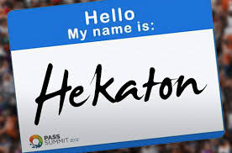
In-Memory tables overview
Notes:
This slide is optional

Slide 5
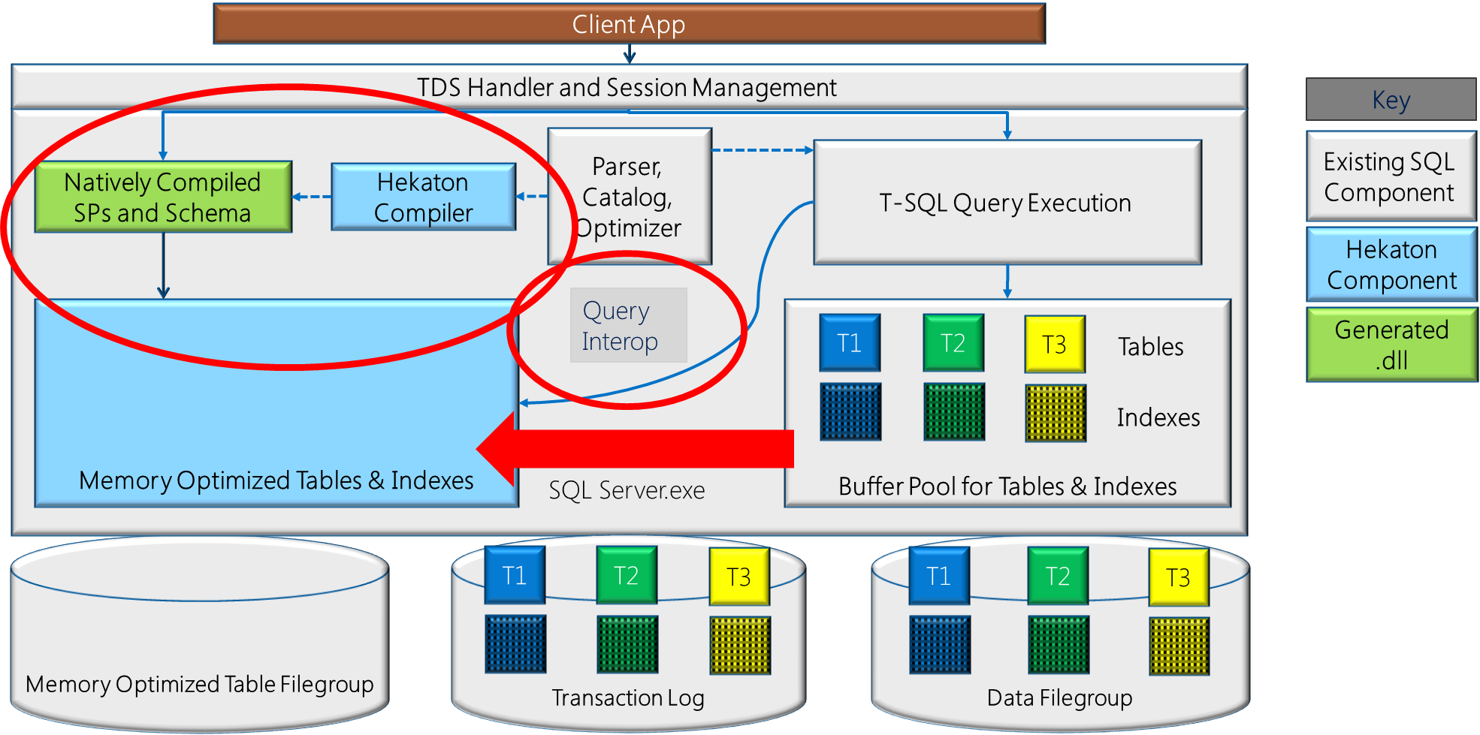
In-Memory integration with SQL Server
Notes:
SQL Server Integration
Same sql server.exe
Query interop
Native Compiled Stored Procedures
Can only access In-memory tables
Not all functions supported (outer joins, window functions etc)
Check point files, consists of checkpoints and delta files, always only append data, never updates to the delta
Only sequential IO
Filestream is the underlying storage mechanism – consist of
Data files
Store inserted records
Data written only upon commit
Delta files
Store deleted records (updates are an insert/delete pair)
Uses SQL transaction log to store content
All logging is logical
No log records for physical structure modifications.
No index-specific / index-maintenance log records.
No UNDO information is logged

Slide 6

Demo
Create an In-memory optimized database, tables and native SPs

Slide 7
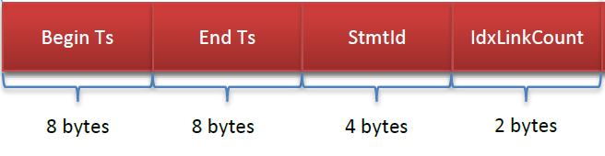
Using Row Versions instead of locks
Notes:
Row header
The header contains two 8-byte fields holding timestamps: a Begin-Ts and an End-Ts. Every database that supports memory-optimized tables manages two internal counters that are used to generate these timestamps.
the Begin-Ts and End-Ts values determine which other transactions will be able to see this row – kind a like slowly changing type 2 dimensions
SQL Server 2014 In Memory tables do not use or create locks
Row versioning is used to maintain Consistency
Row Versions no longer referenced are garbage collected.

Slide 8
Considerations for in-memory tables
No Foreign Key and Check Constraints
No IDENTITY
No ALTER objects
No Add/Remove Index
All data has to fit in-memory
Notes:
Row Sizes can’t be larger than 8060 bytes (incl. Variable Length Columns)
LOB, XML Data Types are not supported
No Foreign Key and Check Constraints
No IDENTITY – But SEQUENCE and uniqueidentifier are supported
No DML Triggers
No ALTER objects (Need to recreate them)
No Add/Remove Index (Need to recreate table)
Indexes are rebuilt on boot (consider startup time)
All data has to fit in-memory

Slide 9
Considerations for Natively compiled SPs
If it worked in SQL Server 2000
it will properbly also work in Natively compiled SPs
But that is changing…….
Notes:
If it worked in sql2000 chances are it also work in Natively copiled SPs
No Subquery, CTEs
No outer joins, APPLY, contains, OR and IN
NO delete or Update with FROM clause
NO Union, Intersect or Except
Query plan evaluated at create time and used ever after….
Executed as machine code not T-SQL
Natively stored SPs can only access in-memory tables

Slide 10
Works seamlessly with current SQL Server objects
Is fully ACID compliant
You can mix in-memory and disk based tables in the same database
Your transactions can span in-memory and disk based tables in the same database
Works with high availability

Slide 11
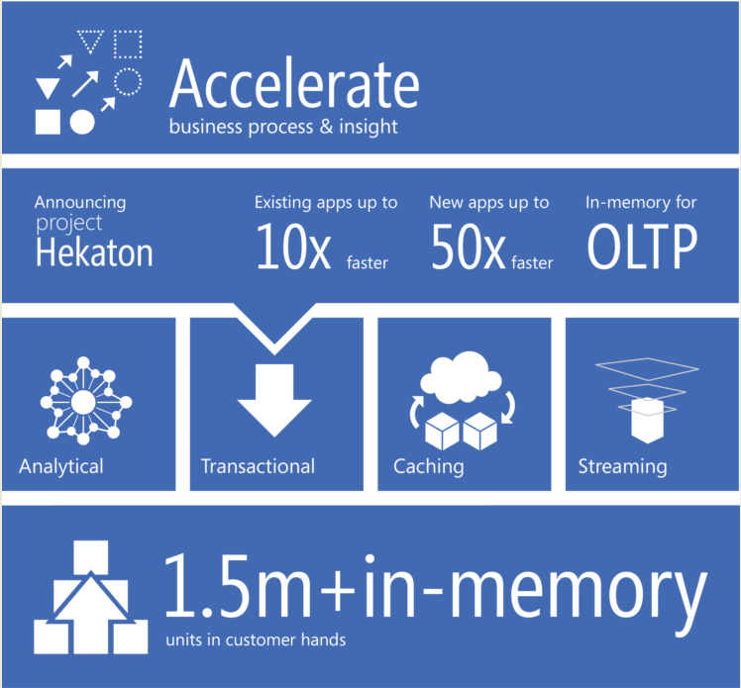
WHY

Slide 12
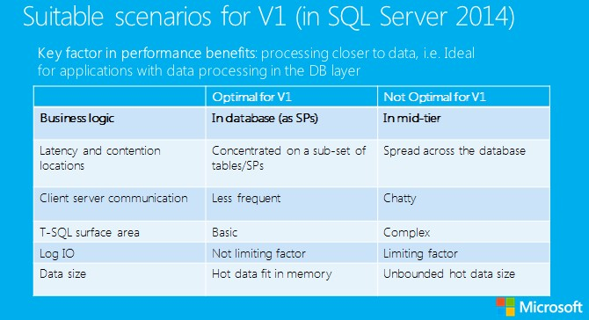
WHAT
Notes:
Step wise, no need for a big bang, so we could start on the spots most likely to give the best response

Slide 13

Demo
How does In-memory tables perform

Slide 14

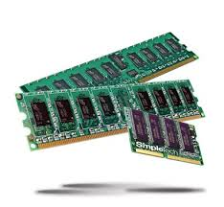
Converting our application

Slide 15
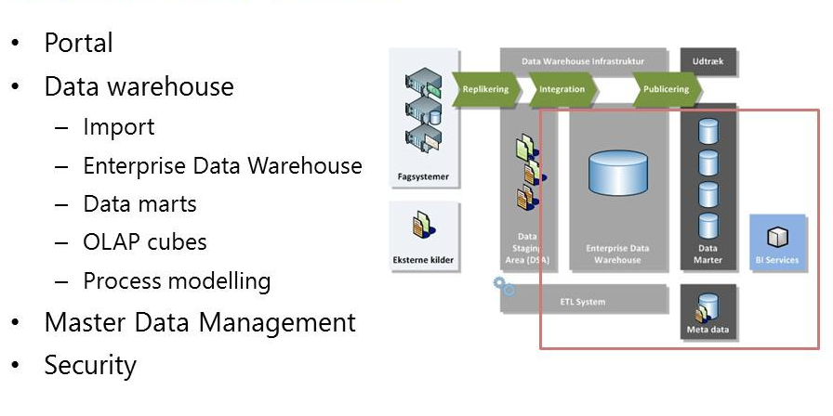

Slide 16



GAP analysis
Effektor
In-memory supported
Dynamic sql
Foreign keys
Primary keys
Inner joins
Outer joins
Truncates
Moving large amounts of data
Merge
Notes:
Supported if not natively compiled

Slide 17
Demo
Converting our application to in-memory

Slide 18
Use your imagination….
Natively compiled stored procedures are NOT T-SQL
Notes:
Things that will work with t-sql might not work in native compiled – and stuff that we usualy go to great lengths to avoid i t-sql might performe very well in native compiled SPs

Slide 19
BUT
Things are changing
SQL server 2016 is just around the corner…
Notes:
Things that will work with t-sql might not work in native compiled – and stuff that we usualy go to great lengths to avoid i t-sql might performe very well in native compiled SPs

Slide 20
Feature/Limit | SQL Server 2014 | SQL Server 2016
Maximum size of durable table | 256 GB | 2 TB
LOB (varbinary(max), [n]varchar(max)) | Not supported | Supported
Transparent Data Encryption (TDE) | Not supported | Supported
Offline Checkpoint Threads | 1 | 1 per container
ALTER PROCEDURE / sp_recompile | Not supported | Supported (fully online)
Nested native procedure calls | Not supported | Supported
Natively-compiled scalar UDFs | Not supported | Supported
ALTER TABLE | Not supported (DROP / re-CREATE) | Partially supported
DML triggers | Not supported | Partially supported (AFTER, natively compiled)
Indexes on NULLable columns | Not supported | Supported
Non-BIN2 collations in index key columns | Not supported | Supported
Non-Latin codepages for [var]char columns | Not supported | Supported
Non-BIN2 comparison / sorting in native modules | Not supported | Supported
Foreign Keys | Not supported | Supported
Check/Unique Constraints | Not supported | Supported
Parallelism | Not supported | Supported
OUTER JOIN, OR, NOT, UNION [ALL], DISTINCT, EXISTS, IN | Not supported | Supported
Multiple Active Result Sets (MARS) (Means better Entity Framework support.) | Not supported | Supported
SSMS Table Designer | Not supported | Supported
http://sqlperformance.com/2015/05/sql-server-2016/in-memory-oltp-enhancements
Notes:
ALTER TABLE dbo.InMemoryTable ALTER INDEX IX_NC_Hash REBUILD WITH (BUCKET_COUNT = 1048576);

Slide 21
GAP analysis – 2016
Effektor
In-memory supported
Dynamic sql
Foreign keys
Primary keys
Inner joins
Outer joins
Truncates
Moving large amounts of data
Merge

Slide 22
Demo
Sql server 2016
– going upward and onward
Notes:
How much easier has it become

Slide 23
Wrap up and key findings
Notes:
This slide is optional

Slide 24














Slide 25
Stick around for SWAG! (Prize drawing at 5.00 p.m)
All our volunteers and organisers do not get paid for running SPS SQLSaturday Cambridge and do it because they believe in the power of community (or are just plain nuts). Please show your gratitude for making this possible by:
Giving them a hug
Shaking their hand
Saying thank you
Coming back next year
Consider getting your company to pay for a precon next year
Speading the word
Getting involved yourself
But most of all, by enjoying the day!
Don’t forget to thank the sponsors for their support
Thank the speakers for donating their time, energy and expenses

Slide 26
Stick around for SWAG! (Prize drawing at 5.00 p.m)
SQLCloud — XBox One!!! (make sure you know how to play the Jet Set Willy vendor competition!)
SQLCloud—Dark Side Of The Moon, The Wall and Wish You Were Here
Microsoft — MCP Voucher
Data Idols — Supercar Driving Experience
Profisee — Signed MDS Book and £50 Amazon Voucher
SQLSentry — Plan Explorer PRO License
Pyramid Analytics—Coffee Machine
Effektor — Lego Big Ben
Rencore — SPCAF Professional License (valued at $2099!)
Axioworks — Amazon Fire TV and £75 Amazon Voucher
DELL — Beats by Dr Dre Headphones
Redgate — DLM Workshop
Pluralsight — Annual Plus subscriptions
All Your Base Conference — 3 x Conference Tickets
VisualSP—Annual training subscription
Loads of books and much much more!!!

Slide 27
References
http://blogs.technet.com/b/dataplatforminsider/archive/2013/06/26/sql-server-2014-in-memory-technologies-blog-series-introduction.aspx
http://sqlblog.com/blogs/kalen_delaney/archive/2013/06/05/hekaton-whitepaper.aspx
http://blogs.technet.com/b/dataplatforminsider/archive/2013/10/09/troubleshooting-common-performance-problems-with-memory-optimized-hash-indexes.aspx
http://blogs.technet.com/b/dataplatforminsider/archive/2013/06/26/getting-started-with-sql-server-2014-in-memory-oltp.aspx
http://msdn.microsoft.com/en-us/library/dn246937%28v=sql.120%29.aspx
https://msdn.microsoft.com/en-us/library/dn133186.aspx <- sql server2016

