Slide 1
Architecting Availability Groups
An analysis of Microsoft SQL Server Always-On Availability Group architectures

Slide 2

Derik Hammer
@sqlhammer
derik@sqlhammer.com
www.sqlhammer.com
Database Administrator (Traditional/Operational/Production)
Specialize in High-Availability, Disaster Recovery, and Maintenance Automation
User group leader of FairfieldPASS in Stamford, CT.
Friend of Redgate
SentryOne Product Advisory Console
BS in Computer Information Systems with a focus in Database Management
Querying Microsoft SQL Server 2012 Databases (70-461)
Administering Microsoft SQL Server 2012 Databases (70-462)

Slide 3
Goals
Skill level: 200-300, assuming some familiarity
Not a “how to”, but there are demos
Architecture
Stand-alone instances
Stand-alones with multiple subnets
AG with Failover Cluster Instances
Distributed AG
AG Specific features, i.e.
Read-only routing

Slide 4

Notes:
** 3 min

Slide 5
Benefits of Availability Groups
When should you use them?
Automatic failover between local replicas.
Manual failover between DR sites.
Group databases together and failover separately from other groups.
Off-load backups
Off-load read loads.
Fail-over to differing Windows versions.

Slide 6
Stand-alone instances
Notes:
Simplest architecture which equates to being the most stable, easiest to maintain, and has the least limitations.
Explain the physical structure ONLY on this slide.
-- Local storage, not required to be shared like FCIs.
-- Can be physically attached or attached with ISCSI.
-- -- Life event: Liberty Tax VB servers rebooted. SAN storage didn’t come back up. Required Windows reboot, extending outage.

Slide 7
Stand-alone instances (cont.)
Database level automatic fail-over available with synchronous commit.
Data duplication - a complete set of drives and data per replica.
Must synchronize server objects between nodes manually.
The beauty of this architecture is everything that it is not.
Notes:
Explain pros and cons here.

Slide 8

Stand-alone instances – multi-subnet
Notes:
Explain the cross-subnet information here and introduce the listener.
Mention how the listener has multiple IPs but don’t get too deep yet.
Mention the AND / OR dependency for cluster resources which was available in Windows Server 2008
but multi-subnet was not supported by SQL Server until 2012.

Slide 9
Stand-alone instances – multi-subnet (cont.)
Nodes synchronize from the primary, remote nodes don’t speak to each other.
Even more data duplication.
One of the few reasons that I might consider favoring a hybrid with FCIs.
Availability Group Listener handles multiple IPs across multiple subnets.
Asynchronous Commit recommended for remote site, which only supports manual failover.
Notes:
Explain the cross-subnet information here and introduce the listener.
Mention how the listener has multiple IPs but don’t get too deep yet.
Mention the AND / OR condition which was available in Windows Server 2008 (confirm it didn’t come out with R2) but was not supported by SQL Server until 2012.

Slide 10
AG with Failover Cluster Instances
Subnet 1
Subnet 2
Notes:
Discuss physical architecture ONLY.
** Remember animated pieces **
Local failover arrows fly in.
Subnet labels fall in.

Slide 11
AG with Failover Cluster Instances (cont.)
No need to synchronize server objects within subnet.
Still need to across the subnets.
Instance level failovers within subnets.
Shared storage can’t cross subnets.
Shared storage dependency.
Can’t ever have one AG replica reside on the same node as another.
Forces you to have more nodes to your cluster.
Configurations where all nodes are active are no longer as possible.
Can’t group DBs for failover, entire instance moves.
Notes:
-- Use Liberty Bank Cluster as example for bullets on bottom.
-- You should still use the AGL for connection, if you can, because of manual failover events.
-- Shared storage goes over the network, network usage might be a bottle neck.
-- -- Recommend that ISCSI connections are on dedicated NIC with redundancy.

Slide 12
Distributed Availability Group

Slide 13
Distributed Availability Group (cont.)
Is an Availability Group of Availability Groups
Can be used to connect two different WSFC which are running two different major versions of Windows Server.
Cuts down on outgoing data charges between Azure regions.
Each Availability Group has a primary.
The primary on the secondary side of the Distributed Availability Group (DAG) is read-only, except to the replication process.
No GUI to configure it.
Only supports manual failover.
Does support asynchronous and synchronous commit modes.

Slide 14
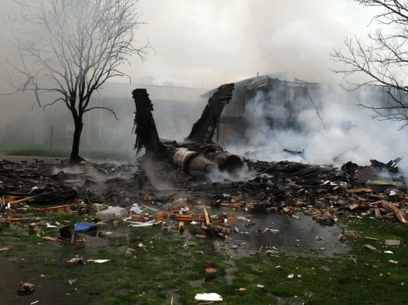
Quorum
Voting mechanism
Prevents “split-brain”
Node majority is typical
Potential voters include
Servers (physical or virtual)
File shares
Remote shared disks
Weight your votes for a complete drop of your connection to your disaster recovery site
Notes:
Connection drops between sites happen.
That F-18 crash is from Virginia Beach, VA in Jan, 2014.
6 miles from my primary production data center.

Slide 15
Why you need to use Windows Server 2012 R2 and above
Quorum Demo
Dynamic Quorum
Dynamic Witness
Tie breaker
Notes:
1. 3 nodes (odd #)
2. Drop a node
3. Watch the votes recalculate
Can also manually remove votes from servers.

Slide 16
Why use the Listener?
Read-only routing.
It is capable of faster failovers.
Your applications do not have to wait for DNS time to live to expire.
One virtual network name (VNN), regardless of where the Availability Group (AG) lives.
Configuration files between DR sites can be identical.
Different VNN for each AG on the cluster.
Allows for groups of databases to failover to different servers.
No instance names to worry about.
Notes:
** 55 min
Mention that the listener is optional. You don’t have to use it nor do you have to have one.

Slide 17
Listener Demos
SQL Server Management Studio
Persist parameters – Supposedly fixed in vNext as per MS Connect. http://bit.ly/1wKPucP
Not available yet.
Reference the workarounds - http://www.sqlhammer.com/store-optional-connection-parameters-in-sql-server-management-studio/
SQLCMD.exe
SQLPS module’s Invoke-SqlCmd
MultiSubnetFailover and ApplicationIntent options now available by using the ConnectionString parameter.

Slide 18
Read-only routing
Manually configured and optional.
Must connect using an Availability Group database context.
Common stumbling point.
No SSMS wizard for configuration.
Incurs a round-robin connection performance hit.

Slide 19
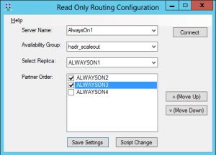
Read-only Routing Demos
Configure - T-SQL
(Non-demo reference) AlwaysOn Tools - Denny Cherry and Associates - http://dcac.co/applications/hosted-by-you/alwayson-tools

Slide 20
Read-only routing connection flow
Step 1: Client connects using
ApplicationIntent=ReadOnly
Step 2: Primary replica replies
with IP for redirection
Step 3: Connection is made with
read-only instance
Notes:
If you have a servers in the routing list which take a long time to connect this might cause connection timeouts.
I recommend not allowing your routing configurations to cross data centers.

Slide 21
References of interest
Syncing server objects between sites
http://www.sqlhammer.com/synchronizing-server-objects-for-availability-groups/
PowerShell driven desired state Availability Group failover test
http://www.sqlhammer.com/failing-over-alwayson-availability-groups/
SSMS AG Listener connection work around
http://www.sqlhammer.com/store-optional-connection-parameters-in-sql-server-management-studio/
Lazy log truncation and filestream
http://www.sqlhammer.com/filestream-garbage-collection-with-alwayson-availability-groups/
Step-by-step work through of the AG + FCI architecture
http://www.sqlhammer.com/how-to-configure-sql-server-2012-alwayson-part-1-of-7/

Slide 22
Materials
Slide deck and demo material available at:
This deck
http://www.sqlhammer.com/presentation-architecting-availability-groups/
All presentations
http://www.sqlhammer.com/community/
This material has already been posted.
When I update the material, the most recent updates will be available.
My Contact Information:
@SQLHammer
derik@sqlhammer.com
www.sqlhammer.com

