Slide 1
Fun Facts about Availability Groups
or: How I Learned to Stop Worrying and say “It Depends”

Slide 2
Thank you! Sponsors, Event Organizers, and Attendees
Joe Hellsten Rackspace SQL Server DBA
~20000 instances of SQL Server
MCP, MCTS (x2), MCITP, Charter MCSA SQL 2012, Charter MCSE Data Platform
Hellsten@texas.net
Tweet @SQLTex
Linkedin, Facebook, yaba daba do.

Slide 3
Agenda
If you walk out of this session with one thing.
More information than you walked in with.
“When you offload a reporting workload to a secondary replica, a common expectation and experience is that the primary workload performs better because it does not have to complete for resources with a reporting workload. Similarly, the reporting workload performs better because it has access to more resources on the secondary replica.. The primary goal of AlwaysOn technology is to provide high availability for mission-critical workloads. The ability to offload reporting workloads and database/transaction log backups onto secondary replicas is useful, but only if it does not compromise high availability. ”
AlwaysOn Solution Guide: Offloading Read-Only Workloads to Secondary Replicas
https://msdn.microsoft.com/en-us/library/jj542414.aspx

Slide 4
Terms
AlwaysOn Failover Cluster Instances (FCI)
AlwaysOn Availability Groups (AG)
Windows Server Failover Clustering (WSFC)
MultiSubnetFailover
A “multi-subnet” environment is defined when the OS cluster used as the backbone for AlwaysOn has server nodes that are located in multiple, different subnets.
AG listener is a virtual network name (VNN) which has a Virtual IP (VIP)
Your Mileage may vary…”IT Depends” on the ___________?
Overview of Transact-SQL Statements for AGs
https://msdn.microsoft.com/en-us/library/ff877941.aspx
AG Dynamic Management Views and Functions
https://technet.microsoft.com/en-us/library/ff877943.aspx
Notes:
setting MultiSubnetFailover=true provides faster detection of and connection to the (currently) active server
It dpends on application
Connection string
Hardware software network

Slide 5
Setting the Stage
AlwaysOn ≠ Availability Groups
AlwaysOn = { SQL Server Failover Cluster Instances, Availability Groups }
Availability Groups ≠ Failover Cluster Instances
Availability Groups ≠ Database Mirroring
AG listener similar to FCI virtual IP.
Fun Fact: NO RT click rename of AG or AG listener. SO PLAN AHEAD…

Slide 6
Prerequisites for Availability Groups
Microsoft Links that describes prerequisites, restrictions, and recommendations for Availability Groups (AGs), this should be helpful.
The List of prerequisites, restrictions, and recommendations covers 9 different categories of which SQL server is just one.
https://msdn.microsoft.com/en-us/library/ff878487%28SQL.110%29.aspx#ServerInstance
All nodes need to belong to the same Windows Server cluster
To administer a WSFC, the user must be a system administrator on every cluster node.
AD permissions required to create AG listener ("Create Computer object" permission).
https://msdn.microsoft.com/en-us/library/hh213080.aspx --as well as Cluster permissions
Fun Fact: If you delete and recreate a WSFC you must disable and re-enable the AG feature per instance.
The maximum number of threads used by availability groups is the configured setting for the maximum number of server threads ('max worker threads') minus 40.
Can be part of an FCI but limitations
No automatic failover of AG
Network Name change must remove AG first
https://msdn.microsoft.com/en-us/library/ff878487(v=sql.110).aspx#NetworkConnect
Please consider Server 2012 r2 to take advantage of dynamic quorum. Loss of quorum is one of the most significant challenges with AGs and this feature addresses part of the issue.
< Patches
https://technet.microsoft.com/en-us/library/dn265972.aspx

Slide 7
SQL Prerequisites for Availability Groups
SQL Enterprise Edition (until 2016)
Static Port recommended and becomes mandatory with Read only routing (URL requires port)
SQL Server Collation needs to be the same on each instance
Availability groups on each instance must be enabled
Each SQL Server instance requires a database-mirroring endpoint
If FILESTREAM is required, it needs to be configured on each instance
Contained databases require the Contained Database Authentication server option be set to 1 on each instance
An additional item for consideration is that Cross-Database Transactions and distributed transactions are Not Supported For Database Mirroring or AlwaysOn Availability Groups (SQL Server)
http://msdn.microsoft.com/en-us/library/ms366279.aspx
This link discusses performance considerations and capacity planning. Please notice heavy use of tempdb
http://technet.microsoft.com/en-us/library/ff878253.aspx#Performance
Notes:
Prerequisites for Availability Groups
SQL Server Availability Groups have the following prerequisites:
SQL Server 2012 Enterprise Edition.
SQL Server 2012 Enterprise Edition must be installed as standalone instance on each cluster node (although clustered instances are also supported). You can combine standalone instance and clustered instances as discussed previously.
All nodes must be in the same Active Directory domain. This is a requirement of WSFC, not of SQL Server.
All nodes must be part of the same Windows Server cluster. Even if a node is in a different site, it must be part of the same Windows Server cluster. This is now easier to achieve because Windows Server 2008 and later support multiple subnets using OR dependencies and because you can configure the cluster without a witness (quorum) disk. SQL Server availability groups do not require shared storage.
All of the SQL Server instances that host availability replicas for an availability group must use the same SQL Server collation.
Enable the Availability Groups feature on each instance.
To participate in AlwaysOn Availability Groups, a SQL Server instance needs its own, dedicated database-mirroring endpoint. This endpoint is a special-purpose endpoint that is used exclusively to receive connections from other server instances. On a given server instance, every AlwaysOn Availability Groups connection to any other server instance uses a single database-mirroring endpoint.

Slide 8
SP
Very nice because it list CUs & fixes to CUs
http://blogs.sqlsentry.com/team-posts/latest-builds-sql-server-2012/
http://blogs.sqlsentry.com/team-posts/latest-builds-sql-server-2014/
http://sqlserverupdates.com/
Notes:
Mention do your own due diligence

Slide 9
DB Prerequisites for AGs
Be a user database. System databases cannot belong to an availability group.
Reside on the instance of SQL Server where you create the availability group and be accessible to the server instance.
Be a read-write database. Read-only databases cannot be added to an availability group.
Be a multi-user database.
Does not use AUTO_CLOSE.
Use the full recovery model (also known as full recovery mode).
Possess at least one full database backup. -- AFTER SETTING TO FULL
After setting a database to full recovery mode, a full backup is required to initiate the full-recovery log chain.
Not belong to any existing availability group.
Not be configured for database mirroring.
The name of the secondary database must be the same as the name of the primary database.
Different file paths OK but
can not use part of the wizard (full option of data synchronization.
adding additional files may fail causing.....not synchronizing state
https://msdn.microsoft.com/en-us/library/hh510190(v=sql.110).aspx
Using Log shipping yes it is possible.
https://msdn.microsoft.com/en-us/library/hh758463(v=sql.110).aspx
SharePoint yes depending on version and function <=PLEASE, PLEASE ensure the SharePoint type database supports the type of DR or HA
Consider the database properties before you restore b\c certain alter statements are
either not supported (alter database set enable_broker -- this is tricky cause you have to restore with enable broker)
do not carry over to secondary (alter authorization DB Owner )
SQL 2014 Delayed Durability IS supported.
Drop database remove from AG first.
Notes:
What other set option. Cross database.

Slide 10
Availability Groups Best Practices/Considerations
Use a sufficient number of cluster nodes
Automatic Failover is not available when using FCI and availability groups together
Run replicas on comparable systems
Consider a Dedicated Network for Availability Group Data Synchronization (guarantee good bandwidth)
Do not move the AG between nodes using Windows Failover Cluster Manager. The recommended ways to perform AG failover include SQL Server Management, PowerShell and Transact-SQL
Notes:
It is important to understand that there are no right answers here, and the optimized setting may vary by your specific business requirements and service level agreements.

Slide 11
Availability Modes, Failover, and Failover Modes
asynchronous-commit mode
Manual failover
synchronous-commit mode
Automatic (healthy synchronization state) and manual
The break with mirroring becomes very apparent here:
Multiple Modes, Multiple Replicas
Fun Fact: If primary's session-timeout period is exceeded by a secondary replica, the primary replica temporarily shifts into asynchronous-commit mode for that secondary replica. When the secondary replica reconnects with the primary replica, they resume synchronous-commit mode.
BUT this does not mean other issues won’t occur soon after!
Fun Fact: AGs ship log blocks not log records
https://msdn.microsoft.com/en-us/library/ff877931(v=sql.110).aspx
https://msdn.microsoft.com/en-us/library/hh213151(v=sql.110).aspx
http://blogs.msdn.com/b/psssql/archive/2011/04/01/alwayson-hadron-learning-series-how-does-alwayson-process-a-synchronous-commit-request.aspx
Notes:
the availability mode must be configured for either synchronous-commit mode or asynchronous-commit mode. If the primary replica is configured for asynchronous-commit mode, it does not wait for any secondary replica to write incoming transaction log records to disk (to harden the log). If a given secondary replica is configured for asynchronous-commit mode, the primary replica does not wait for that secondary replica to harden the log. If both the primary replica and a given secondary replica are both configured for synchronous-commit mode, the primary replica waits for the secondary replica to confirm that it has hardened the log (unless the secondary replica fails to ping the primary replica within the primary's session-timeout period).

Slide 12
Quorum Recommendations
Never use the Disk Only quorum model cause admit it disk(s) never fail.
Use Node Majority with an odd number of nodes
Use Disk+Node Majority with an even number of nodes & single DC
Use Node+File Share Majority if nodes are geographically dispersed and odd number –We tend to use this one most of the time
Never place the file share on the same cluster nodes
https://technet.microsoft.com/en-us/library/cc770620(v=ws.10).aspx
Notes:
This slide discusses the most common quorum best practices.
Never use the Disk Only quorum model. The Disk Only quorum model is available in Windows Server 2003, and it is maintained for compatibility reasons, but we strongly recommend that you never use it unless a storage vendor directs you to. In this model, only the witness disk can vote. There are no other voters in the cluster. This means that the witness disk is a single point of failure, because if it becomes unavailable, the entire cluster goes offline. Some customers choose to deploy this configuration to get a “last man standing” configuration, where the cluster remains online so long as any one node is operational and can access the cluster disk. However, with this deployment objective, it is important to consider whether that last remaining node can even handle the capacity of all the workloads that move to it from other nodes.
Check that you are using the correct quorum model. Cluster configuration automatically chooses the appropriate quorum model, based on the number of nodes in the cluster when you configure the cluster. But use the following list to ensure that you are using the right quorum model when you add or remove nodes from an existing cluster.
Use Node Majority with an odd number of nodes.
Use Disk+Node Majority with an even number of nodes & single site.
Use Node+File Share Majority if nodes are geographically dispersed or odd number.
Never place the file share on the same cluster nodes. The file-share witness may not provide you any benefit if you place it on one of the cluster nodes, because losing that node makes you lose two votes for the quorum (one for the file share and one for the node).

Slide 13
SharePoint
SharePoint >= 2010 sp1 are required for SQL Server 2012.
There may come a time when the decisions made may lead to “best effort support” from MS.
AGs require full recovery model not all SharePoint databases “officially support” full recovery model for instance Search_Service_Application_DB
https://technet.microsoft.com/en-us/library/cc678868.aspx
https://technet.microsoft.com/en-us/library/cc298801.aspx#section1a
Certain SharePoint databases do not support Asynchronous replication/communication to a DR location.
https://technet.microsoft.com/en-us/library/cc748824.aspx
https://technet.microsoft.com/en-us/library/jj841106.aspx

Slide 14
Other Considerations
It is important to understand that there are no right answers here, and the optimized setting may vary by your specific business requirements and service level agreements.
http://blogs.msdn.com/b/clustering/archive/2012/11/21/10370765.aspx
Adjust Heartbeat if Cross DC or multi-subnet, by default your WSFC connection will fail when 5 pings are lost (1 ping per second for a total of 5 seconds)
Lease time out ARGH the dreaded it depends. Resource bottleneck including a busy SQL Server
https://blogs.msdn.microsoft.com/psssql/2012/09/07/how-it-works-sql-server-alwayson-lease-timeout/
DNS Time to Live (TTL)
https://technet.microsoft.com/en-us/library/dd197562%28v=ws.10%29.aspx
AG session time out similar to mirroring timeout. 10 secs or >
https://technet.microsoft.com/en-us/library/hh213612(v=sql.110).aspx

Slide 15
Backups
Strategy? Be consistent there are a lot of options and preferences, which are just that…preferences.
Fun Fact: When you create an availability group, the availability group's AUTOMATED_BACKUP_PREFERENCE is set. If not specifically configured, the default through T-SQL or using the New Availability Group wizard, is 'SECONDARY.‘
Backup preferences are:
Prefer Secondary - Will backup on secondary with highest priority. If no secondary's are available, it will backup on primary.
Secondary Only - Will backup on secondary with highest priority. If no secondary's are available, no backups will occur.
Primary - Backups will occur on the primary only, whichever instance that happens to be at the time of the backup.
Any Replica - Looks just at the backup priority and backups on the replica with the highest priority.
https://msdn.microsoft.com/en-us/library/hh213244%28v=SQL.110%29.aspx
Backup types supported on secondaries:
BACKUP DATABASE supports only copy-only full backups of databases, files, or file groups when it is executed on secondary replicas. Note that copy-only backups do not impact the log chain or clear the differential bitmap.
Differential backups are not supported on secondary replicas.
BACKUP LOG supports only regular log backups (the COPY_ONLY option is not supported for log backups on secondary replicas).
OH boy but wait for it.
A consistent log chain is ensured across log backups taken on any of the replicas (primary or secondary), irrespective of their availability mode (synchronous-commit or asynchronous-commit).
Secondary replica must be able to communicate with the primary replica and must be SYNCHRONIZED or SYNCHRONIZING.
Be aware of Lazy Log Truncation on replicas, status does not change to 0 for VLFs, Lazy Log Truncation marks the VLFs for truncation, but it does not actually truncate the log unless those VLFs are necessary.
http://blogs.msdn.com/b/sql_pfe_blog/archive/2013/06/27/lazy-log-truncation-clearing-of-sql-transaction-log-vlf-status-deferred.aspx
Test backups and Test recovery
Oh I like this link
http://blogs.msdn.com/b/sqlgardner/archive/2012/07/21/sql-2012-alwayson-and-backups-part-2-configuring-backup-preferences-and-automating-backups.aspx
Notes:
Top 3 things a DBA Does?
Who decides recovery point objective?
DBA one of the top functions has to be to meet the recovery point objective.
Survey says

Slide 16
Backups
Fun Fact: If you add a DB to an AG and the DB is configured to backup (full or T log) via a maintenance plan. The database may stop backing up, the maint. plan does not fail, and the T log stops truncating. It depends on the automated backup preference setting. Maint plans are AG aware through sys.fn_hadr_backup_is_preferred_replica
Fun Fact: Copy-Only full backups on secondary BUT not copy-only T log backups.
A copy-only full backup cannot serve as a differential base and does not affect the differential base.
Fun Fact: If you take Full backups on one replica and T log backups on another…
There are multiple issues that can occur:
GUI can’t produce restore chain because it uses local msdb tables
Complex recovery scenarios—late night you have to recover critical db who wants complex
Must run custom stored procedure sp_updateresume
Fun Fact: There is an option 'For availability databases, ignore Replica Priority for Backup and Backup on Primary Settings' check box. If you use this option…
There are multiple issues that can occur:
T log backups can be taken on any instance
Cause Log backup for database ''DB NAME'‘ on a secondary replica failed because the last backup LSN (0x00001fa5:00001d6a:0001) from the primary database is greater than the current local redo LSN (0x00001fa5:00001d68:0003). No log records need to be backed up at this time. Retry the log-backup operation later. BACKUP LOG is terminating abnormally.“
Complex recovery scenarios—late night you have to recover critical db who wants complex

Slide 17
Backups
Check your third party tools!!
sys.fn_hadr_backup_is_preferred_replica
The function that is called by the backup to determine primary replica
Multiple FUN Facts
If server is case sensitive, this is case sensitive.
Can be extremely slow cross DC
Depends on @@SERVERNAME which in turn depends on catalog view sys.servers, if that is wrong due to cloning or renaming or not setting to 0
https://social.msdn.microsoft.com/Forums/sqlserver/en-US/7cb08c5c-30b7-40d1-97e7-3302675a9d0e/sysfnhadrbackupispreferredreplica-returns-0-on-both-nodes-of-cluster?forum=sqldatabaseengine
https://connect.microsoft.com/SQLServer/feedback/details/765317/sys-fn-hadr-backup-is-preferred-replica-always-return-zero-for-availabilty-database
What to do? Back up to an HA share? Then use DFS or other technology to copy files to secondary site???
Notes:
Try to demo slowness

Slide 18
Connections
BOOM MultiSubnetFailover
.Net Try to specify MultiSubnetFailover=True when connecting to a SQL Server availability group listener or SQL Server FCI. MultiSubnetFailover enables faster failover for all Availability Groups and or Failover Cluster Instance in SQL Server and will significantly reduce failover time for single and multi-subnet AlwaysOn topologies.
WHAT?? Single subnet
https://msdn.microsoft.com/en-us/library/hh205662(v=vs.110).aspx
You can connect to directly use SQL Instance name.
Having said that AG Listener is the feature that you can avail if you want. This allows a single connection string between fail overs from Primary and DR Site. For this you might want to check your application compatibility.
Should have retry logic
ADO.NET (4.5.1) connection resiliency
EF6 Connection Resiliency
Notes:
When MultiSubnetFailover=True is specified for a connection, the client retries TCP connection attempts faster than the operating system’s default TCP retransmit intervals.

Slide 19
Listener
An availability group listener enables a client to connect to an availability replica without knowing the name of the physical instance of SQL Server to which the client is connecting. The client connection string does not need to be modified to connect to the current location of the current primary replica.
An availability group listener consists of a Domain Name System (DNS) listener name, listener port designation, and one or more IP addresses.
Should BE a descriptive name.
Port??? If you use 1433 no need to designate port in connection string and it will share the port with SQL Server IF there are no other services (including additional instances of SQL Server) on the computer listening on port 1433
http://www.sqlserverfaq.net/2012/09/29/gotcha-listening-sql-server-availability-group-listener-on-non-default-port/
This gives some great examples of different port numbers.
http://blogs.msdn.com/b/sqlcat/archive/2014/02/03/alwayson-availability-groups-listener-named-instances-port-numbers-etc.aspx
Great info here ⬅
https://msdn.microsoft.com/en-us/library/hh213417.aspx
Rarely are creation errors due to SQL Server.
https://support.microsoft.com/en-us/kb/2829783
Notes:
https://msdn.microsoft.com/en-us/library/hh213417.aspx
One stop shop AG Listner Read only routing behavior

Slide 20
Read-only routing
Read-only routing refers to the ability of SQL Server to route qualifying read-only connection requests to an available AlwaysOn readable secondary.
Must have a listener and use it.
Must have a read-only routing URL.
https://msdn.microsoft.com/en-us/library/hh710054.aspx
http://blogs.msdn.com/b/alwaysonpro/archive/2013/07/01/end-to-end-using-a-listener-to-connect-to-a-secondary-replica-read-only-routing.aspx
http://blogs.msdn.com/b/mattn/archive/2012/04/25/calculating-read-only-routing-url-for-alwayson.aspx
Careful consideration multi AGs multi node. (2016 load-balancing across read-only replicas)
Test –K application intent –M multisubnetfailover
cmd prompt
sqlcmd -S <AG Listener> port -E -d <read only database> -K readonly -M
1> select @@servername
2> go
Troubleshooting Read-Only Routing
https://msdn.microsoft.com/en-us/library/ff878308.aspx#ROR

Slide 21
Maintenance Jobs
Script to check on primary
http://blogs.msdn.com/b/saponsqlserver/archive/2014/12/03/sql-agent-jobs-in-an-alwayson-mirroring-environment.aspx
Index
Switch to async
Only do necessary
Set maxdop=1
http://blogs.msdn.com/b/alwaysonpro/archive/2015/03/03/recommendations-for-index-maintenance-with-alwayson-availability-groups.aspx

Slide 22
Random Fun
Fun Fact: After a forced failover you have to resume data movement
Some of the MSDN links are broken.
Fun Fact: Changing the SQL Server versions in the web page may fix this.
SPN can be critical.
Fun fact: Has to be correct for Kerberos.
TDE
Fun fact: Can’t use wizard.
http://blogs.msdn.com/b/alwaysonpro/archive/2014/01/28/how-to-enable-tde-encryption-on-a-database-in-an-availability-group.aspx
Steps to decrypt
https://msdn.microsoft.com/en-us/library/hh510178.aspx
Fun Fact: There can be data latency on a readable secondary on a ‘sync’ replica.
http://blogs.msdn.com/b/sqlserverstorageengine/archive/2013/07/26/10250460.aspx
Which leads to redo thread blocking.
http://blogs.msdn.com/b/sqlserverstorageengine/archive/2011/12/22/alwayson-minimizing-blocking-of-redo-thread-when-running-reporting-workload-on-secondary-replica.aspx
And to increased use of tempdb
http://blogs.msdn.com/b/sqlserverstorageengine/archive/2011/12/22/alwayson-impact-of-mapping-reporting-workload-to-snapshot-isolation-on-readable-secondary.aspx
Finally, there is a log transport limit in 2012 & 2014. Log transport ~ 40 -50 mbps
600 mbps & multiply redo threads in SQL 2016
SQL 2012 => SQL 2014 reduced errors by 50% anticipate another 50% reduction ➔SQL 2016
Kevin Farlee at Summit 2015 “AlwaysOn in SQL Server 2016”
Feed
http://blogs.msdn.com/b/alwaysonpro/rss.aspx

Slide 23
Demo
WSFC
Node 1
Node 2
Node 3
Node 4
FCI
AG1=========== > Asynch == > Asynch
AG2=========== > Asynch == > Asynch
Asynch<========== AG3===== >Synch
Asynch<==========Synch<===== AG4
North East
Mid West

Slide 24
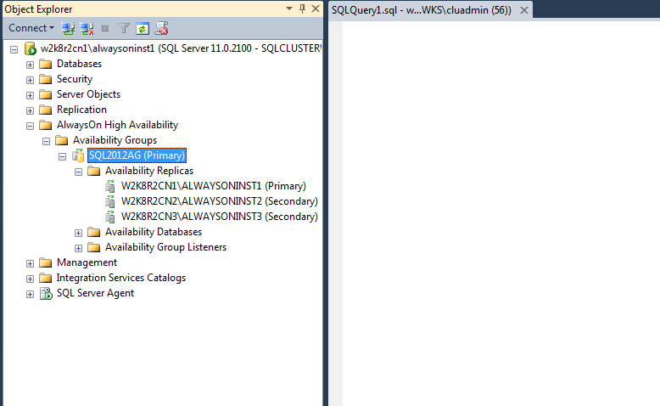
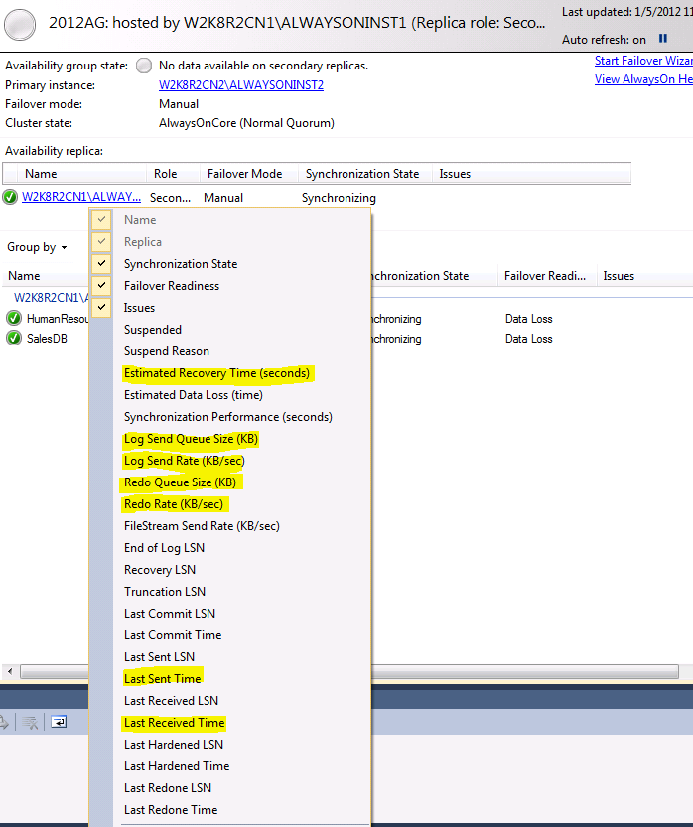
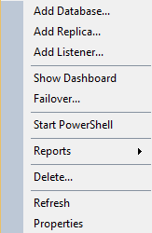
AlwaysOn Availability Groups Dashboard

Slide 25
More Information
More information and more links.
Evals
http://www.sqlsaturday.com/461/eventeval.aspx
http://www.sqlsaturday.com/461/sessions/sessionsevalation.aspx
THANK YOU!!!!

Slide 26
Links WOW so many in no particular order
http://www.sqlhammer.com/how-to-configure-sql-server-2012-alwayson-part-2-of-7/
https://msdn.microsoft.com/en-us/library/windows/desktop/aa369087%28v=vs.85%29.aspx
https://msdn.microsoft.com/en-us/library/hh205662(v=vs.110).aspx
http://blogs.msdn.com/b/alwaysonpro/archive/2014/06/03/connection-timeouts-in-multi-subnet-availability-group.aspx
https://msdn.microsoft.com/en-us/data/dn456835.aspx
http://blogs.msdn.com/b/alwaysonpro/archive/2013/08/02/connect-to-sql-server-using-application-intent-read-only.aspx
http://blogs.msdn.com/b/arvindsh/archive/2012/09/13/alwayson-connectivity-cheat-sheet.aspx
https://popbi.wordpress.com/2014/06/26/always-on-availability-groups-do-i-need-a-file-share-witness-or-no/
http://www.mssqltips.com/sqlservertip/2573/monitor-sql-server-alwayson-availability-groups/
https://msdn.microsoft.com/en-us/library/hh510238%28v=sql.110%29.aspx
https://msdn.microsoft.com/en-us/library/ff877941.aspx
http://blogs.msdn.com/b/alwaysonpro/archive/2013/07/01/end-to-end-using-a-listener-to-connect-to-a-secondary-replica-read-only-routing.aspx
https://www.simple-talk.com/sql/database-administration/alwayson-availability-groups---what-not-to-do-when-adding-databases/
http://blogs.msdn.com/b/sql_pfe_blog/archive/2013/07/15/monitoring-sql-server-2012-alwayson-availability-groups-worker-thread-consumption.aspx
http://blogs.msdn.com/b/psssql/archive/2012/05/17/alwayson-hadron-learning-series-worker-pool-usage-for-hadron-enabled-databases.aspx
http://sqlturbo.com/sql-server-alwayson-availability-groups-cheat-sheet/
http://blogs.sqlsentry.com/team-posts/latest-builds-sql-server-2012/
http://blogs.sqlsentry.com/team-posts/latest-builds-sql-server-2014/
https://support.microsoft.com/en-us/kb/2964518
http://blogs.msdn.com/b/psssql/archive/2012/05/17/alwayson-hadron-learning-series-worker-pool-usage-for-hadron-enabled-databases.aspx
http://blogs.msdn.com/b/sql_pfe_blog/archive/2013/07/15/monitoring-sql-server-2012-alwayson-availability-groups-worker-thread-consumption.aspx
http://sqlturbo.com/sql-server-alwayson-availability-groups-cheat-sheet/
http://blogs.msdn.com/b/alwaysonpro/archive/2013/11/01/configuring-a-dedicated-network-for-replicating-changes-from-primary-to-secondary-replica.aspx
http://blogs.msdn.com/b/sqlalwayson/archive/2012/02/03/how-to-create-multiple-listeners-for-same-availability-group-goden-yao.aspx
http://blogs.msdn.com/b/saponsqlserver/archive/2014/12/03/sql-agent-jobs-in-an-alwayson-mirroring-environment.aspx
https://technet.microsoft.com/en-us/library/dn135338%28v=sql.110%29.aspx
https://vijayrod.wordpress.com/2013/07/17/troubleshooting-sql-server-alwayson/
https://msdn.microsoft.com/en-us/library/ff878487%28SQL.110%29.aspx#ServerInstance
https://technet.microsoft.com/en-us/library/dn265972.aspx
http://msdn.microsoft.com/en-us/library/ms366279.aspx
https://msdn.microsoft.com/en-us/library/hh510190(v=sql.110).aspx
https://msdn.microsoft.com/en-us/library/ff929171.aspx
https://msdn.microsoft.com/en-us/library/hh270280(v=sql.110).aspx
https://support.microsoft.com/en-us/kb/2829783
https://msdn.microsoft.com/en-us/library/ff878308.aspx#ROR
http://blogs.msdn.com/b/clustering/archive/2012/11/21/10370765.aspx
https://msdn.microsoft.com/en-us/library/hh710054.aspx
https://msdn.microsoft.com/en-us/library/hh213417.aspx
http://www.sqlserverfaq.net/2012/09/29/gotcha-listening-sql-server-availability-group-listener-on-non-default-port/
http://blogs.msdn.com/b/alwaysonpro/rss.aspx
http://blogs.msdn.com/b/alwaysonpro/archive/2014/01/28/how-to-enable-tde-encryption-on-a-database-in-an-availability-group.aspx
https://www.mssqltips.com/sqlservertip/2880/backing-up-sql-server-databases-participating-in-alwayson-availability-groups/
https://msdn.microsoft.com/en-us/library/hh710053.aspx
http://blogs.msdn.com/b/alwaysonpro/archive/2014/01/02/maintenance-plan-does-not-backup-database-or-log-of-database-that-belongs-to-availability-group.aspx
https://msdn.microsoft.com/en-us/library/hh245119.aspx
http://blogs.msdn.com/b/sqlgardner/archive/2012/07/21/sql-2012-alwayson-and-backups-part-2-configuring-backup-preferences-and-automating-backups.aspx
https://msdn.microsoft.com/en-us/library/hh213244%28v=SQL.110%29.aspx
http://sqlmag.com/blog/alwayson-availability-groups-and-sql-server-jobs-part-21-assigning-backup-preferences
http://clusteringformeremortals.com/
http://blogs.msdn.com/b/sambetts/archive/2014/08/21/sql-server-alwayson-asynchronous-vs-synchronous-performance-for-sharepoint.aspx
https://www.google.com/?gws_rd=ssl#q=DELAYED_DURABILITY+and+availbility+groups
http://sqlperformance.com/2014/04/io-subsystem/delayed-durability-in-sql-server-2014

Slide 27
Log Records & LSNs vs Log Blocks
AGs ship “log blocks” not LSNs or log records.
What is an LSN and what is a log block?
log block is a logical collection of log records that are flushed together from RAM to disk.
An LSN is a sequential representation of the log record for an action that is hardened.
AG – does not wait for a transaction to complete before it ships log blocks.
AG– ships log blocks when they are flushed to disk – regardless of when the transaction is committed.
Log Blocks are flushed when:
they are full
a transaction commit log record is written to the block
http://blogs.msdn.com/b/psssql/archive/2011/04/01/alwayson-hadron-learning-series-how-does-alwayson-process-a-synchronous-commit-request.aspx
http://blogs.msdn.com/b/alwaysonpro/archive/2013/09/27/performing-transaction-log-backups-using-alwayson-availability-group-read-only-secondary-replicas-part-1.aspx

Slide 28
Thread consumption
Pool usage
http://blogs.msdn.com/b/psssql/archive/2012/05/17/alwayson-hadron-learning-series-worker-pool-usage-for-hadron-enabled-databases.aspx
Link below has XE session to create to monitor
http://blogs.msdn.com/b/sql_pfe_blog/archive/2013/07/15/monitoring-sql-server-2012-alwayson-availability-groups-worker-thread-consumption.aspx

Slide 29
Dedicated NIC
http://sqlperformance.com/2012/10/system-configuration/dedicated-network-availability-group
http://blogs.msdn.com/b/alwaysonpro/archive/2013/11/01/configuring-a-dedicated-network-for-replicating-changes-from-primary-to-secondary-replica.aspx

Slide 30
Quorum voting
No vote by default. Assume that each node should not vote without explicit justification.
Include all primary replicas. Each WSFC node that hosts an availability group primary replica or is the preferred owner of an FCI should have a vote.
Include possible automatic failover owners. Each node that could host a primary replica, as the result of an automatic availability group failover or FCI failover, should have a vote. If there is only one availability group in the WSFC cluster and availability replicas are hosted only by standalone instances, this rule includes only the secondary replica that is the automatic failover target.
Exclude secondary site nodes. In general, do not give votes to WSFC nodes that reside at a secondary disaster recovery site. You do not want nodes in the secondary site to contribute to a decision to take the cluster offline when there is nothing wrong with the primary site.
Odd number of votes. If necessary, add a witness file share, a witness node, or a witness disk to the cluster and adjust the quorum mode to prevent possible ties in the quorum vote.
Re-assess vote assignments post-failover.
https://msdn.microsoft.com/en-us/library/hh270280(v=sql.110).aspx
https://technet.microsoft.com/en-us/library/cc770620(v=ws.10).aspx

Slide 31
Quorum
To set a quorum for an availability group:
Select nodes to vote (see KB 2494036)
1 vote for a node that hosts a replica that is currently one of the following:
Primary (if the primary is an FCI, include all possible owner nodes for that FCI)
An automatic failover target if the primary is also configured for automatic failover
0 votes for the rest of the nodes
Select the quorum type:
Odd number of votes, use “Node Majority”
Even number of votes, add a witness by either:
Adding an additional witness node and using “Node and Disk Majority”
Using “Node and File Share Majority” with a protected file share
https://popbi.wordpress.com/2014/06/26/always-on-availability-groups-do-i-need-a-file-share-witness-or-no/
https://technet.microsoft.com/en-us/library/cc770620(v=ws.10).aspx

Slide 32
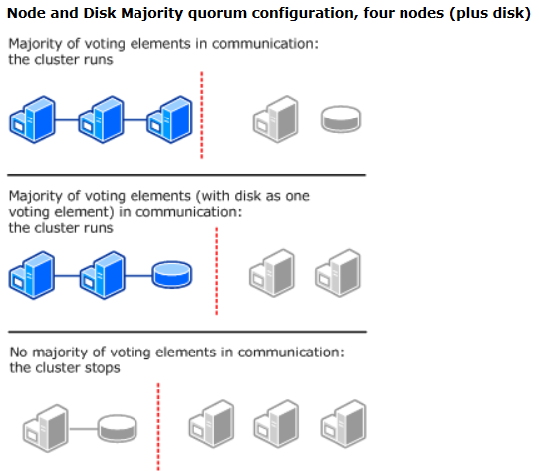
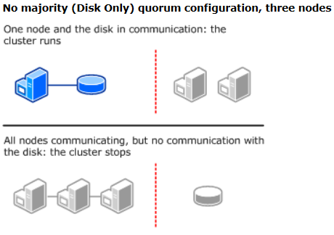
Quorum
Notes:
This slide depicts the disadvantage of the Disk Only quorum model. As shown on the left side of the slide, the cluster survives even if it loses one node and the disk witness or if it loses two nodes. But as shown on the right side, the entire cluster goes down if the witness disk goes down.

Slide 33
SharePoint Links
http://blogs.msdn.com/b/sambetts/archive/2015/04/24/setting-up-sharepoint-disaster-recovery-sites-with-sql-alwayson.aspx
http://blogs.msdn.com/b/sambetts/archive/2013/04/24/sharepoint-2013-and-sql-server-alwayson-high-availability-sharepoint.aspx
https://technet.microsoft.com/en-us/library/hh913923(v=office.14).aspx

Slide 34
Cluster heartbeat
By default your WFC connection will fail when 5 pings are lost (1 ping per second for a total of 5 seconds). This can be changed via Powershell or Cluster.exe
Run command prompt as administrator.
Execute the following to change the same-site heart beat to 2 seconds (replace clustername with theactualWFC name).
cluster /cluster:clustername /prop SameSubnetDelay=2000:DWORD
Execute the following to change the cross-site heart beat to 4 seconds (replace clustername with theactualWFC name).
cluster /cluster:clustername /prop CrossSubnetDelay=4000:DWORD
Execute the following to change the same-site ping loss threshold to 10 lost pings (replace clustername with theactualWFC name).
cluster /cluster:clustername /prop SameSubnetThreshold=10:DWORD
Execute the following to change the cross-site ping loss threshold to 10 lost pings (replace clustername with theactualWFC name).
cluster /cluster:clustername /prop CrossSubnetThreshold=10:DWORD
https://msdn.microsoft.com/en-us/library/windows/desktop/aa369087%28v=vs.85%29.aspx
http://www.sqlhammer.com/how-to-configure-sql-server-2012-alwayson-part-2-of-7/
Notes:
From command prompt:
cluster /cluster:clustername /prop SameSubnetDelay=2000:DWORD
cluster /cluster:clustername /prop CrossSubnetDelay=4000:DWORD
cluster /cluster:clustername /prop SameSubnetThreshold=10:DWORD
cluster /cluster:clustername /prop CrossSubnetThreshold=10:DWORD
From Powershell:
(get-cluster).SameSubnetDelay = 2000
(get-cluster).CrossSubnetDelay = 4000
(get-cluster).SameSubnetThreshold = 10
(get-cluster).CrossSubnetThreshold = 10

Slide 35
Session_timeout
ALTER AVAILABILITY GROUP [<AG Name>]
MODIFY REPLICA ON 'instance_name' WITH (SESSION_TIMEOUT = 15);

Slide 36
Connections
Argh!!!! No support of MultiSubnetFailover
This link gives proven workaround and Appendix of driver support.
http://blogs.msdn.com/b/alwaysonpro/archive/2014/06/03/connection-timeouts-in-multi-subnet-availability-group.aspx
Connection trouble shooting
http://blogs.msdn.com/b/arvindsh/archive/2012/09/13/alwayson-connectivity-cheat-sheet.aspx

Slide 37
Connections
Should have retry logic
ADO.NET connection resiliency
EF6 Connection Resiliency
In .NET Framework 4.5.1, Microsoft has provided EF/ADO.NET Connection Resiliency feature out-of-box
When using SQL Native Access Client SQL OLE DB, the application intent connection string should be specified with a space: 'Application Intent'
When connecting using SQLClient or ODBC specify 'ApplicationIntent' with no space
Example:
server=AGListener;database=ag;trusted_connection=yes; MultiSubnetFailover=True;applicationintent=ReadOnly
Or in ADO.net
Server=tcp:AGListener,1433;Database=ag;IntegratedSecurity=SSPI; ApplicationIntent=ReadOnly ; MultiSubnetFailover=True
http://blogs.msdn.com/b/alwaysonpro/archive/2013/08/02/connect-to-sql-server-using-application-intent-read-only.aspx
Notes:
Port is optional in ado.net example

Slide 38
Connections
Here are the specific resources with respect to client connectivity to Always on. This explains different drivers that support and different connection string formats. You might want to check with your development team which drivers are being currently used and can they need to be modified. Please let me know if you need any more information here.
Always On Client Connectivity (SQL Server)
https://msdn.microsoft.com/en-us/library/hh510238%28v=sql.110%29.aspx
About Client Connection Access to Availability Replicas (SQL Server)
https://msdn.microsoft.com/en-us/library/hh510184%28v=sql.110%29.aspx
SQL Server Native Client Support
https://msdn.microsoft.com/en-us/library/gg471494%28v=sql.110%29.aspx
Using Connection String Keywords with SQL Server Native Client
https://msdn.microsoft.com/en-us/library/ms130822%28v=sql.110%29.aspx

Slide 39
Multiple Listeners
http://blogs.msdn.com/b/sqlalwayson/archive/2012/02/03/how-to-create-multiple-listeners-for-same-availability-group-goden-yao.aspx

Slide 40
Quorum loss
https://blogs.technet.microsoft.com/sqlcontent/2015/03/17/determine-availability-group-synchronization-state-minimize-data-loss-when-quorum-is-forced/
https://msdn.microsoft.com/en-us/library/hh270277.aspx
http://joeydantoni.com/2013/11/08/recovering-from-cluster-quorum-loss-with-sql-server-alwayson-availability-groups/

Slide 41
"recovery pending" or "suspect" state
https://support.microsoft.com/en-us/kb/2857849

Slide 42
Create an AlwaysOn Availability Group in Windows Azure
http://blogs.msdn.com/b/sqlalwayson/archive/2013/01/23/test-lab-create-an-alwayson-availability-group-in-windows-azure-end-to-end.aspx

Slide 43
Steps to Perform Force Failover for SQL Server AlwaysOn Availability Groups
https://www.mssqltips.com/sqlservertip/3437/manual-sql-server-availability-group-failover/
https://msdn.microsoft.com/en-us/library/ff877957.aspx
http://blogs.msdn.com/b/arvindsh/archive/2012/09/26/failover-cluster-instance-alwayson-availability-group-dr-scenario.aspx

Slide 44
Troubleshooting
SQL Server AlwaysOn Availability Group deployment in Azure – A PowerShell quick reference guide– http://www.amazon.com/dp/B012OOZ88I (direct link)
Troubleshooting SQL Server AlwaysOn on MS.com– http://download.microsoft.com/download/0/F/B/0FBFAA46-2BFD-478F-8E56-7BF3C672DF9D/Troubleshooting%20SQL%20Server%20AlwaysOn.pdf (direct link)
Troubleshooting SQL Server AlwaysOn on MS.com– http://social.technet.microsoft.com/wiki/contents/articles/11608.e-book-gallery-for-microsoft-technologies.aspx (link to Gallery that has download link)
Troubleshooting SQL Server AlwaysOn ebook 20131105 Troubleshooting SQL Server AlwaysOn 20130921
Troubleshooting SQL Server AlwaysOn v1.1
Troubleshooting SQL Server AlwaysOn v1.0
More details of AlwaysOn at below links: http://msdn.microsoft.com/en-us/library/ff877884.aspx Overview of AlwaysOn Availability Groups (SQL Server) http://www.microsoft.com/en-us/sqlserver/solutions-technologies/mission-critical-operations/high-availability.aspx
Look at HA Features in link below.
http://sqlperformance.com/2013/01/io-subsystem/trimming-more-transaction-log-fat

Slide 45
Monitoring
http://www.mssqltips.com/sqlservertip/2573/monitor-sql-server-alwayson-availability-groups/
https://technet.microsoft.com/en-us/library/dn135338%28v=sql.110%29.aspx

Slide 46
Waits
List the wait types for AlwaysOn:
SELECT * FROM sys.dm_os_wait_stats
WHERE wait_type LIKE '%hadr%'
http://msdn.microsoft.com/en-us/library/dn135332.aspx
http://msdn.microsoft.com/en-us/library/ms179984.aspx#waittypes
HADR_SYNC_COMMIT
HADR_SYNCHRONIZING_THROTTLE
HADR_CLUSAPI_CALL
https://www.simple-talk.com/sql/database-administration/a-first-look-at-sql-server-2012-availability-group-wait-statistics/

