Slide 1
Cardinality Estimator (CE)
Susantha Bathige (MSc,BCS,MCITP)
Sr. DBA

Slide 2
About me
MCITP Database Administrator (SQL Server 2005)
Sr. DBA Specialized in SQL Server
Working as a Production DBA at Pearson
Has more than 10+ years of experience in SQL Server starting with SQL Server 7.0
Writer: Personal blog (www.sqlservertorque.net), MSSQLTips.com, etc
Active member in SQL Server User Groups in Sri Lanka and Denver
I also work on NoSQL DB systems like Cassandra and MongoDB
Twitter: @sbathige

Slide 3
In this session
Query Execution
Estimates
Statistics
New C.E model

Slide 4

How many records this will return
SELECT COUNT(*)
FROM [Sales].[SalesOrderDetail]
WHERE ProductID=870

Slide 5
How SQL Server generates an Exec. Plan
Parse
Check for language syntax
Bind
Series of validation steps
Columns and tables in the tree are compared
Optimize
Evaluate different possible plans
Use statistics to evaluate different plans
Execute
Executes the plan
Output: Query Tree
Output: Algebrizer tree
Output: Execution Plan

Slide 6
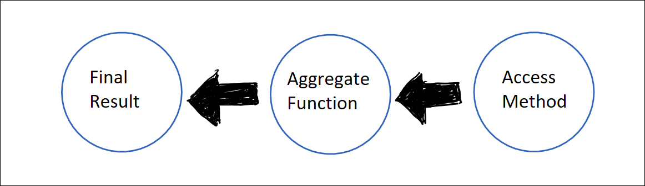
Execution Plan
SELECT COUNT(*)
FROM [Sales].[SalesOrderDetail]
WHERE ProductID=870

Slide 7
What is Execution Plan…
Creates before the actual execution of the query
It specifies the access methods, join types and various other types of operators
Created by Query Processor in SQL Server
Uses STATISTICS of actual data to decides the estimated no.of rows (cardinality estimates) that is output by each operator

Slide 8
DEMO 1
Estimated rows

Slide 9
Why Exec. Plan is so important?
Server Performance
Query
Exec. Plan

Slide 10
Query Execution
Step 1 Submit
Query
Step 2
Generate Execution Plan
Step 3
Execution
Step 4
Results

Slide 11
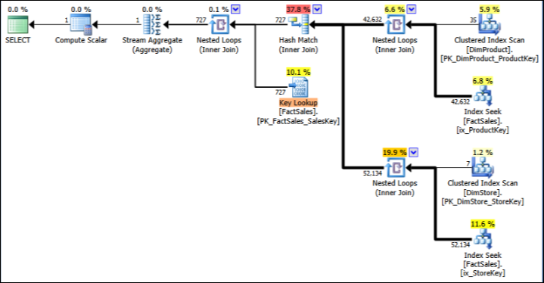
What is Execution Plan

Slide 12
Cardinality Estimator and Estimates
How many rows will satisfy a single filter predicate? Or multiple filter predicates?
How many rows will satisfy a join predicate between two tables?
How many distinct values do we expect from a specific column? A set of columns?
Major factor in deciding which physical operator and plan shapes

Slide 13
Cardinality Estimator
Calculate estimated no.of row counts for each operator within a query Exec. Plan
Statistics
C.E
Estimated row counts

Slide 14

Execution plan is created based on statistical understanding of actual data.

Slide 15
What is Statistics?
Type of object exists in the database
Can be associated with and index or they can exists independently
Can create manually of query optimizer will create it for you
Has three main areas;
Header
Density Vector
Histogram

Slide 16
Statistics and Estimates
Statistics
Automatic
Manual
Estimates
Row count
Distribution of values
Distinct value counts
Execution plan
Optimal
Non-optimal

Slide 17
Execution plan
Optimal
Fast execution
Less resource consumption
Non optimal
Slow execution
High resource consumption

Slide 18
Importance of accurate cardinality estimates
Memory
Access Method
Table Scan
Index Scan
Clustered Index Scan
Index Seek
Clustered Index Seek
RID Lookup
Join Type (Nested Loop, Merge, Hash)

Slide 19
New CE Model
Introduced in SQL Server 2014 (C.L 120)
Major redesign of CE model after SQL Server 7.0 (C.L 70)
Affect Exec. Plan quality

Slide 20
How To Activate New CE Model
ALTER DATABASE [AdventureWorks2012] SET COMPATIBILITY_LEVEL = 120;
TF 2312
Server level - DBCC TRACEON(2312,-1)
Session level - DBCC TRACEON(2312)
Query level - QUERYTRACEON 2312
To revert – TF 9481

Slide 21
Precedence
Query Level Trace Flag
Server or Session Level Trace Flag
Database Compatibility Level

Slide 22
DEMO 2
The effect of new CE model

Slide 23
Under Estimates and Over Estimates of Row Counts
Under Estimates
Over Estimates
Selection of serial plan when parallelism would have been an optimal
Inappropriate join strategies
Inefficient index selection and navigation strategies
Selection of parallel plan when serial plan would be optimal
Inappropriate join strategies
Inefficient index navigation strategies
Inflated memory grants

Slide 24
How to tell which CE model is using
In XML plan
XE
Plan property window

Slide 25
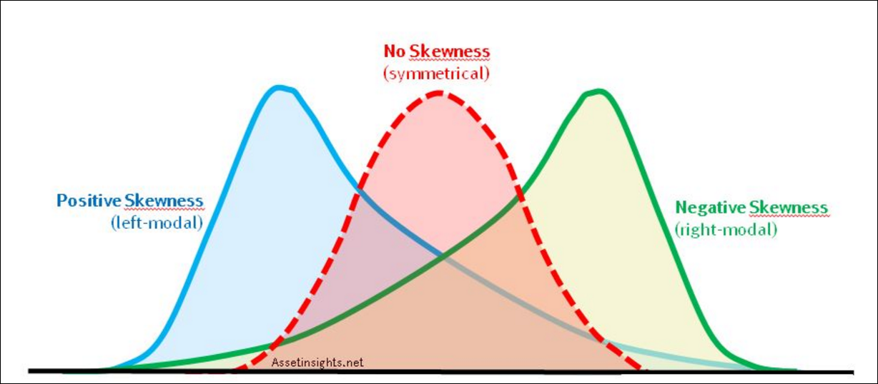
Why accurate estimates are not possible always?

Slide 26
Questions
Question: Let’s assume you have db1 with compatibility level of 120 and db2 with compatibility level of 110, and you have a query that references two databases. What is the CE model uses for this situation?
Answer: If the query is compiled under db1, new cardinality estimator will be used. But if the query is compiled under db2, old cardinality estimator will be used.

Slide 27
Questions…
Question: In SQL Server 2016 database, you want to use new features of SQL Server 2016 and also you want to use the legacy CE model. How can you achieve this?
Answer: You can use Database Scoped Configuration option as below; ﻿
ALTER DATABASE SCOPED CONFIGURATION SET LEGACY_CARDINALITY_ESTIMATION = ON;

Slide 28
Conclusion
While many workloads will benefit from the new Cardinality Estimator changes, in some cases, workload performance may degrade without a specific tuning effort.

Slide 29
References
SQL Server Technical Article:
Optimizing Your Query Plans with the SQL Server 2014 Cardinality Estimator
Research paper:
A BlackBox Approach to Query Cardinality Estimation
Testing Cardinality Estimation Models in SQL Server
https://blogs.msdn.microsoft.com/psssql/2014/04/01/sql-server-2014s-new-cardinality-estimator-part-1/

Slide 30
END.

