Slide 1

Cardinality Estimator 2014/2016
Dean Savović

Slide 2









Our Partners
Notes:
If you think, that a SQL Saturday is a nice possibility to learn from and network with fellow SQL Server enthusiasts FOR FREE,
I just ask you one thing: Visit the sponsor booths and chat with the sponsors!
They are covering the expenses for each and every of you, with is around EUR 60 …

Slide 3
Overview
CE Intro
CE Model Assumptions
CE Calculation Direction
CE Model Version
Improvements (SQL 2014)
Improvements (SQL 2016)
Improvements (SQL 2017)
Troubleshooting
Conclusion

Slide 4
CE Intro
How many rows will satisfy a single filter predicate? Multiple filter predicates?
How many rows will satisfy a join predicate between two tables?
How many distinct values do we expect from a specific column? A set of columns?
Under estimating rows
The selection of serial plan when parallelism would have been more optimal.
Inappropriate join strategies.
Inefficient index selection and navigation strategies.
Over estimating rows
Selection of a parallel plan when a serial plan might be more optimal.
Inappropriate join strategy selection.
Inefficient index navigation strategies (scan versus seek).
Inflated memory grants.
Wasted memory and unnecessarily throttled concurrency.

Slide 5
CE Model Assumptions
Independence
Data distributions on different columns are independent unless correlation information is available.
Uniformity
Within each statistics object histogram step, distinct values are evenly spread and each value has the same frequency.
Containment
If something is being searched for, it is assumed that it actually exists.
Inclusion
For filter predicates involving a column-equal-constant expression, the constant is assumed to actually exist for the associated column.

Slide 6
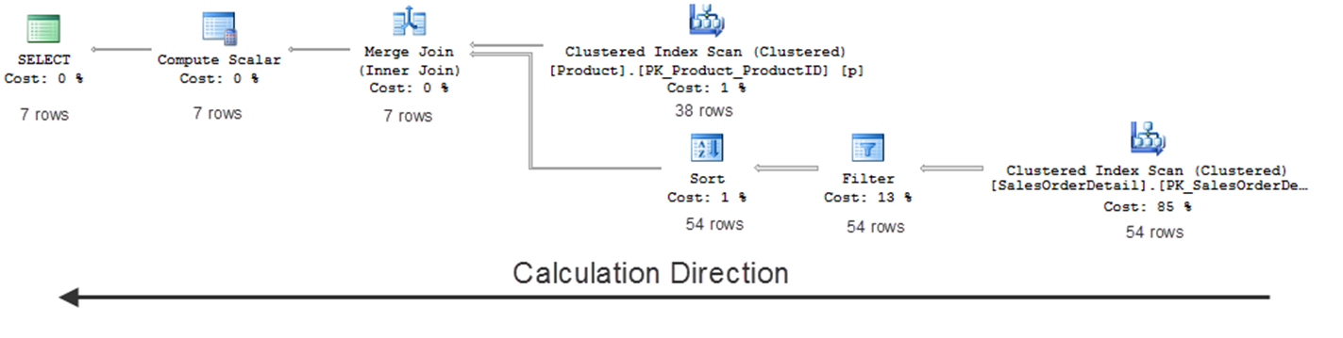
CE Calculation Direction

Slide 7
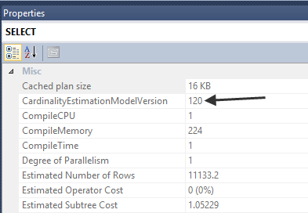
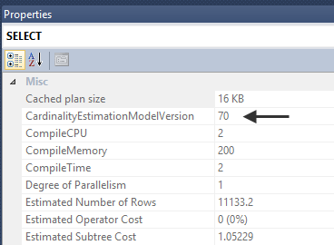
CE Model Version
Database compatibility level
>=120 – 120
<= 110 - 70
Trace Flags
9481 – legacy CE (CE 70)
2312 – new CE (CE 120)
SQL Server 2016 SP1+
USE HINT FORCE_LEGACY_CARDINALITY_ESTIMATION
Database Scoped Configuration LEGACY_CARDINALITY_ESTIMATION

Slide 8
Improvements (SQL 2014)
Increased Correlation Assumption for Multiple Predicates (demo)
CE 70 – data contained across different columns as uncorrelated with one another
CE 120 – correlation between data; exponential back-off
Modified Ascending Key and Out-Of-Range Value Estimation (demo)
the “ascending key problem” arises when query predicates reference newly inserted data that fall out of the range of a statistic object histogram
CE 70 – estimates 1 row
CE 120 – assumes that data exists (average frequency = table cardinality * density)

Slide 9
Improvements (SQL 2014) (2)
Distinct Value Count Estimation Changes (demo)
No many-to-many join operations - difference is small
Advanced Diagnostic Output
XE Event - query_optimizer_estimate_cardinality

Slide 10
Improvements (SQL 2016)
Compatibility Level Guarantess
No plan changes if we stick with older compatibility level
QO Improvements under flag 4199
Parallel Update of Sampled Statistics
Auto update stats
Sublinear Threshold for Update of Statistics
Previous 20% of the table
TF 2371 in previous releases
Misc
Batch query processing in serial queries
Sort operators in batch mode
Window aggregates in batch mode
Distinct aggregates in batch mode
Parallel INSERT SELECT into heaps and CCI
Heap scans for memory-optimized tables
Parallel scans for memory-optimized tables
Sampled and auto-update stats for memory-optimized tables

Slide 11
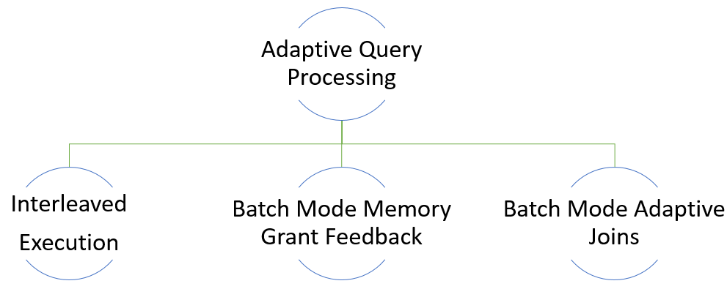
Improvements (SQL 2017)

Slide 12
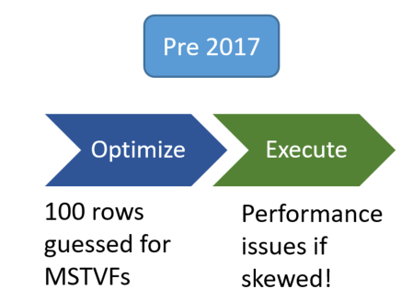
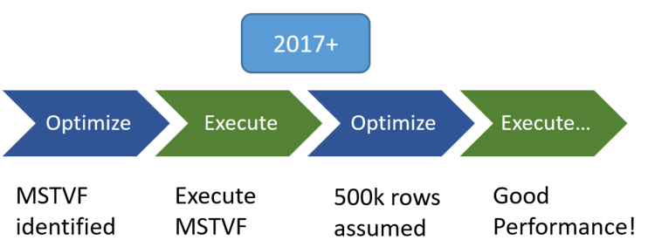
Interleaved Execution

Slide 13
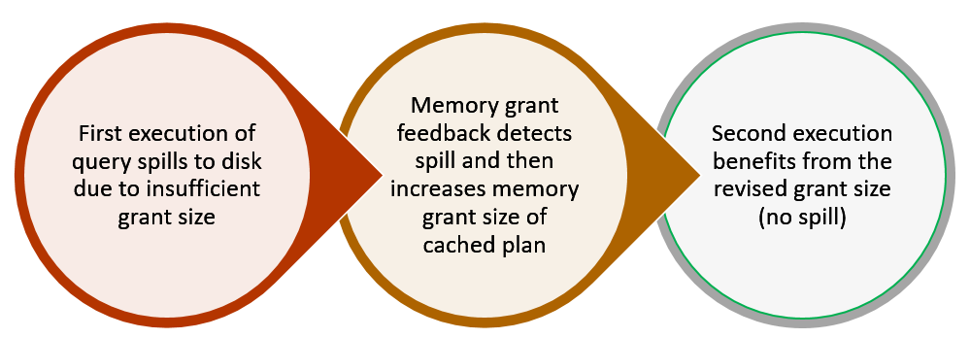
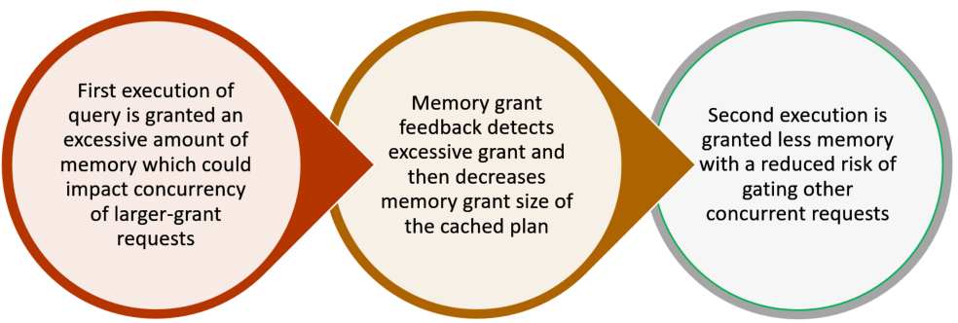
Batch Mode Memory Grant Feedback

Slide 14
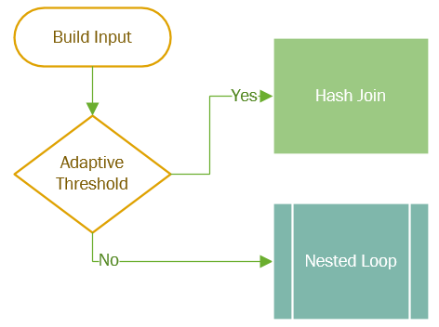
Batch Mode Adaptive Joins

Slide 15
Troubleshooting (1)
Changing DB compatibility level
Trace Flags
Missing Statistics
Stale Statistics
Statistic Object Sampling Issues
Filtered Statistics
Filtered statistics may help address statistics quality issues for very large tables that contain uneven data distributions
Multi-column Statistics
Parameter Sensitivity
Trace flag 4136 – disable parameter sniffing
Table Variables
Multi-statement User-defined Table Functions
Fixed cardinality = 100 (previous 1)

Slide 16
Troubleshooting (2)
Recursive CTE
if non-unique parent/child keys are used for recursion
Predicate Complexity
Query Complexity
XML Reader Table-Valued Function Operations
XML index
Data Type Conversions
Intra-table Column Comparison
Computed columns
Query Hints
Use with caution
Distributed Queries
User rights (db_ddladmin)
SQL Server 2012 SP1 reduces user rights to SELECT permission

Slide 17
Conclusion
CE 120 brings improvements
Also can bring problems ☺
Trace flags and hints for control
Various troubleshooting methods

Slide 18
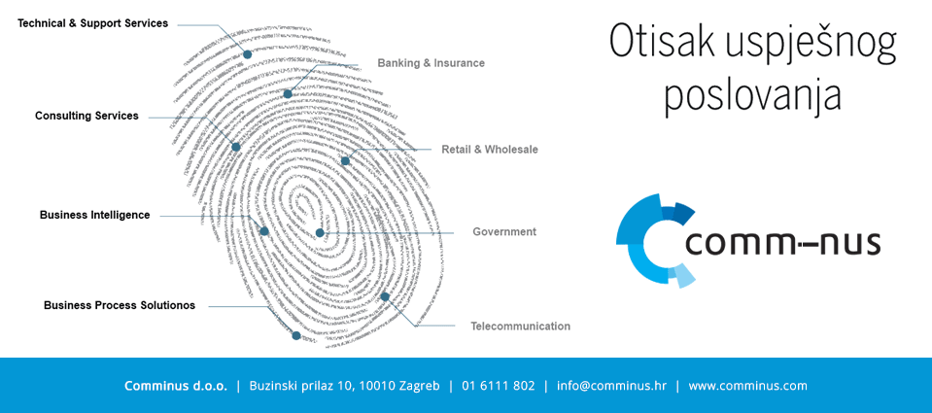
Thank You ☺
email: dean.savovic@comminus.hr
web: www.comminus.hr
blog: www.savovic.com.hr

