Slide 1
Beyond the Where
Full Text Search Tips & Tricks
Kris Hokanson

Slide 2
Who is Kris Hokanson?
Sr. BI Systems Developer for Kelsey-Seybold Clinics
SQL Server user since 1998 on SQL 7
Projects range from simple database design and existing performance improvement to advanced BI integration solutions using SSIS
Email: kris386@gmail.com
2 |

Slide 3


Thank You Sponsors!
Visit the Sponsor tables to enter their end of day raffles.
Turn in your completed Event Evaluation form at the end of the day in the Registration area to be entered in additional drawings.
Want more free training? Check out the Houston Area SQL Server User Group which meets on the 2nd Tuesday of each month. Details at http://houston.sqlpass.org

Slide 4
What are we doing here?
What Integrated Full Text Search (iFTS) is (and isn’t)
The Basics
Full Text Catalogs & Indexes
Predicates & Functions
The Tips
Stoplists
Thesauruses
Filters
The Tricks
WARNING
Derived columns
Indexed Views
Multiple Searches via cursors
4 |

Slide 5
What is iFTS?
A tool for performing common language based searches against textual data
A way to catalog and index the contents of unstructured data within a relational database
A method for simplifying global searches across many columns in one or more tables
Is not a real-time solution for immediate exact matching in high transaction volume environments

Slide 6
The Basics – Full Text Catalogs
Contained at the database level as opposed to being an object within a table
Contain listing of all tables and columns included in the full text indexes
As of SQL 2008 are stored as containers within the database
Like any table, storage location should be well thought out

Slide 7
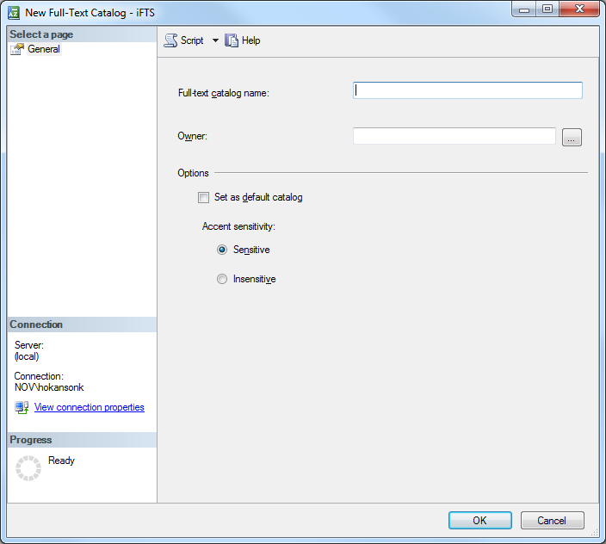
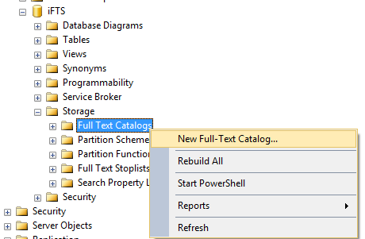
The Basics – Full Text Catalogs

Slide 8
The Basics – Full Text Catalogs
CREATE FULLTEXT CATALOG [iFTSExample]
WITH ACCENT_SENSITIVITY = OFF
AS DEFAULT;

Slide 9
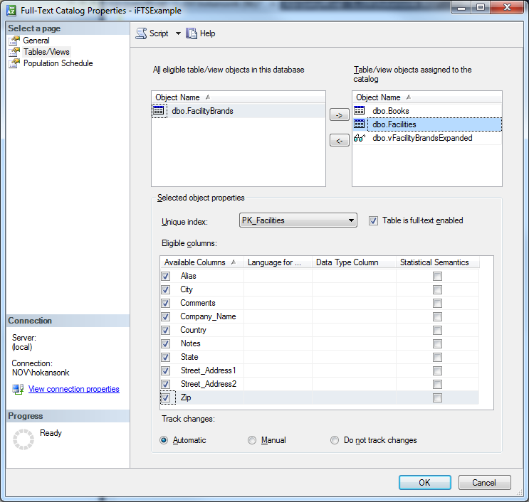
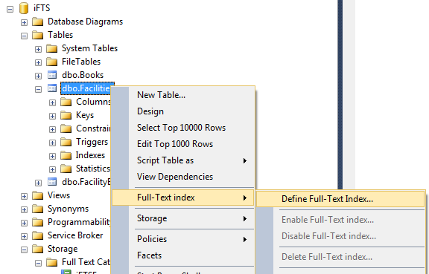
The Basics – Full Text Indexes

Slide 10
The Basics – Full Text Indexes
CREATE FULLTEXT INDEX ON [dbo].[Names](
[Address1] LANGUAGE [English],
[Address2] LANGUAGE [English],
--...
[Name] LANGUAGE [English])
KEY INDEX [PK_Name_Address_Master]ON ([iFTSExample], FILEGROUP [PRIMARY])
WITH (CHANGE_TRACKING = AUTO, STOPLIST = SYSTEM)

Slide 11
The Basics – Predicates & Functions
Predicates
CONTAINS
FULLTEXT
Table-Valued Functions
CONTAINSTABLE & FULLTEXTTABLE

Slide 12
The Basics – Predicates
Classic SQL Search
SELECT *
FROM dbo.Names
WHERE Address1 LIKE '%Houston%'
OR Address2 LIKE '%Houston%'
OR Name LIKE '%Houston%'
OR City LIKE '%Houston%'
OR State LIKE '%Houston%'
OR Zip LIKE '%Houston%'
OR Country LIKE '%Houston%'
OR Fax LIKE '%Houston%'
OR Telephone LIKE '%Houston%'

Slide 13
The Basics – Predicates
Full Text Equivalent
SELECT *
FROM dbo.Names
WHERE CONTAINS(*,'Houston')

Slide 14
The Basics – Predicates
SELECT *
FROM dbo.Names
WHERE CONTAINS((*),'Engineer')
SELECT *
FROM dbo.Names
WHERE FREETEXT((*),'Engineer')

Slide 15
The Basics – Functions
SELECT *
FROM dbo.Names n
INNER JOIN
CONTAINSTABLE(dbo.Names,(Name,City),'Houston')
ft ON ft.[KEY] = n.NAME_ID
ORDER BY RANK DESC

Slide 16
The Tips – Stoplists/Stopwords
Words which are tossed out by the FTS engine for various reasons
Each language has its own set of stopwords
Can be easily tailored to meet the needs of an organization

Slide 17
The Tips – Stoplists/Stopwords
SELECT * FROM sys.dm_fts_parser
(' "Houston and Built" ', 1033, 0, 0)

Slide 18
The Tips – Stoplists/Stopwords
CREATE FULLTEXT STOPLIST CustomStop
FROM SYSTEM STOPLIST;
SELECT * FROM sys.fulltext_stoplists
SELECT * FROM sys.fulltext_stopwords
WHERE language = 'English'
ALTER FULLTEXT INDEX ON dbo.Names SET STOPLIST = CustomStop;
ALTER FULLTEXT STOPLIST CustomStop DROP 'can' LANGUAGE 'English';

Slide 19
The Tips - Thesauruses
Can be used to provide alternate search terms or replace terms entirely
Not quite fully integrated into SQL Engine yet but easy to get to nonetheless
Used in FREETEXT searches by default and CONTAINS searches using a FORMSOF clause
Language specific or global thesaurus
Default location: <SQL_Server_data_files_path>\MSSQLxx.MSSQLSERVER\MSSQL\FTDATA\

Slide 20
The Tips - Thesauruses
<XML ID="Microsoft Search Thesaurus">
<thesaurus xmlns="x-schema:tsSchema.xml">
<diacritics_sensitive>0</diacritics_sensitive>
<replacement>
<pat>NT5</pat>
<pat>W2K</pat>
<sub>Windows 2000</sub>
</replacement>
<expansion>
<sub>can</sub>
<sub>canada</sub>
</expansion>
</thesaurus>
</XML>

Slide 21
The Tips - Filters
Components which allow SQL Server to decipher files saved in varbinary fields
DLL files shared by all Microsoft search tools
SQL Server comes stocked with several common ones for interpreting the basic files
Can quickly turn on 3rd party filters installed at the OS level.

Slide 22
The Tips - Filters
SELECT * FROM sys.fulltext_document_types
SELECT * FROM dbo.Books
WHERE CONTAINS(*,'SQL')

Slide 23
The Tips - Filters
EXEC sys.sp_fulltext_service 'load_os_resources',1;
EXEC sys.sp_fulltext_service 'update_languages', NULL;

Slide 24
The Tricks - Warning
Some of these methods are known to the state of California to cause poor insert/update query execution, violate several principals of relational design and use unnecessarily high amounts of disk space. Use at your own risk.

Slide 25
The Tricks – Derived Columns
Can help make full text searches on a single table more closely mimic a standard where clause
Allow for easier matching on all search parameters at once

Slide 26
The Tricks – Derived Columns
SELECT *
FROM [dbo].[Names]
WHERE CONTAINS((*),'Houston AND holdings AND McKinney')

Slide 27
The Tricks – Derived Columns
ALTER TABLE [dbo].[Names]
ADD AllText AS ISNULL([Address1],'') + ' '
+ ISNULL([Address2],'') + ' '
+ ISNULL([City],'') + ' '
+ ISNULL([State],'') + ' '
+ ISNULL([Zip],'') + ' '
+ ISNULL([Country],'') + ' '
+ ISNULL([Name],'') + ' '
+ ISNULL([Telephone],'')
PERSISTED

Slide 28
The Tricks – Indexed Views
Handy when trying to search multiple tables at once
Tricky but potentially very useful

Slide 29
The Tricks – Indexed Views
SELECT *
FROM [dbo].[vName]
WHERE CONTAINS((*),'Houston AND Holdings AND McKinney')

Slide 30
The Tricks – Multiple Searches
Poor (or impatient) man’s MDM solution
Cannot use outer apply with FTS table valued functions
Instead use cursors to execute individual searches, store results in temp table/variable and join back to destination

Slide 31
Further Reading
Coles, Michael, and Hilary Cotter. Pro full-text search in SQL Server 2008. Berkeley, CA: Apress, 2009. Print.
" Full-Text Search (SQL Server)." MSDN – Explore Windows, Web, Cloud, and Windows Phone Software Development. N.p., n.d. Web. 21 Apr. 2012. <http://msdn.microsoft.com/en-us/library/ms142571.aspx>.

Slide 32
Questions/comments/snide remarks

Slide 33
Thank you!
Kris Hokanson
kris386@gmail.com

