Slide 1





SQL Server Mythconceptions And Mythteries
Robert L Davis
Principal Database Architect
robertd@dbbest.com
@SQLSoldier
www.sqlsoldier.com

Slide 2












Robert L Davis Principal Database Architect at DB Best Technologies Greater Seattle Area | Information Technology and Services
Past:
Blog:
Twitter:
LinkedIN:
Principal DBA at Outerwall, Inc.
P.M. SQL Server Master Certification Program at Microsoft
Sr. Database Administrator at Microsoft
www.SQLSoldier.com
@SQLSoldier
www.linkedin.com/in/robertldavis
Notes:
Principal Database Architect at DB Best Technologies www.dbbest.com
Former Principal DBA at Outerwall, Inc
Former Sr. Product Consultant with Idera Software
Former Program Manager for SQL Server Certified Master program in Microsoft Learning
Former Sr. Production DBA / Operations Engineer at Microsoft (CSS)
Microsoft Certified Master: SQL Server 2008 / MCSM Charter: Data Platform
Co-founder of the SQL PASS Security Virtual Chapter
MCITP: Database Developer: SQL Server 2005 and 2008
MCITP: Database Administrator: SQL Server 2005 and 2008
MCSE: Data Platform
MVP 2014
Co-author of Pro SQL Server 2008 Mirroring
Former Idera ACE (Advisors & Community Educators)
2 time host of T-SQL Tuesday
Guest Professor at SQL University, summer 2010, spring/summer 2011
Speaker at SQL PASS Summit 2010, 2011, and 2012 including a pre-con in 2012
Speaker/Pre-con at SQLRally 2012
13+ years working with SQL Server
Writer for SQL Server Pro (formerly SQL Server Magazine)
Member: Mensa
Dog picture: Maggie and Woody
SQLCruise instructor: Seattle to Alaska 2012
Speaker at SQL Server Intelligence Conference in Seattle 2012
Blog: http://www.sqlsoldier.com
Twitter: http://twitter.com/SQLSoldier

Slide 3

SQL Server Mythconceptions And Mythteries
“Of all the various unpleasant ways to be aroused from a sound sleep, one of the worst is the noise of a dragon and a unicorn playing tag.”

Slide 4
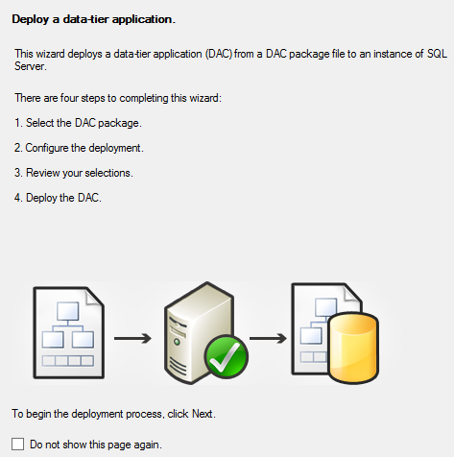
SQL Server Mythconceptions And Mythteries
Data-tier Application

Slide 5
SQL Server Mythconceptions And Mythteries
Data-tier Application

Slide 6
SQL Server Mythconceptions And Mythteries
Data-tier Application
DAC for short

Slide 7
SQL Server Mythconceptions And Mythteries
Data-tier Application
DAC for short
“…because DTA was already an established acronym in SQL Server.”*
* Paraphrasing, the blog post was later deleted

Slide 8
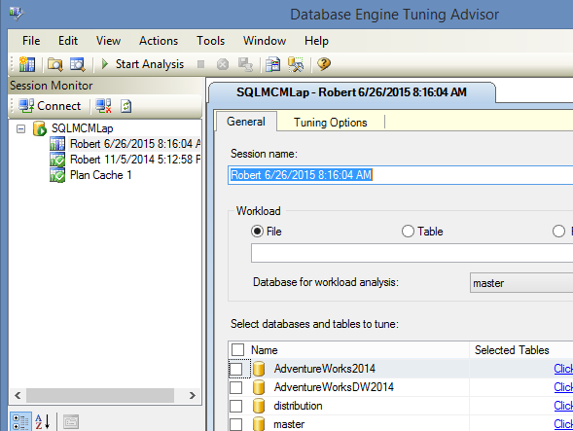
SQL Server Mythconceptions And Mythteries
Database Engine Tuning Advisor

Slide 9
SQL Server Mythconceptions And Mythteries
Database Engine Tuning Advisor
DTA for short

Slide 10
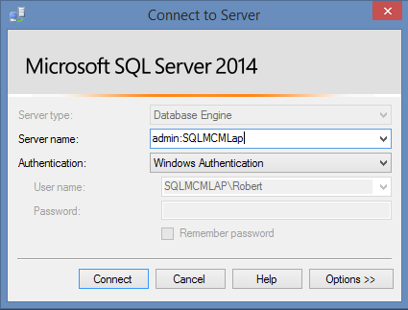
SQL Server Mythconceptions And Mythteries
Dedicated Admin Connection

Slide 11
SQL Server Mythconceptions And Mythteries
Dedicated Admin Connection
DAC for short

Slide 12
SQL Server Mythconceptions And Mythteries
Sweet Mythtery that is Parallelism

Slide 13
SQL Server Mythconceptions And Mythteries
Sweet Mythtery that is Parallelism
If you want a query to run in serial you have to change the Max DOP setting

Slide 14
SQL Server Mythconceptions And Mythteries
Sweet Mythtery that is Parallelism
If you want a query to run in serial you have to change the Max DOP setting
MaxDOP query always overrides Max DOP server setting

Slide 15
SQL Server Mythconceptions And Mythteries
Sweet Mythtery that is Parallelism
If you want a query to run in serial you have to change the Max DOP setting
MaxDOP query always overrides Max DOP server setting
MaxDOP query hint cannot override Max DOP resource group settings

Slide 16
SQL Server Mythconceptions And Mythteries
Sweet Mythtery that is Parallelism
If you want a query to run in serial you have to change the Max DOP setting
MaxDOP query always overrides Max DOP server setting
MaxDOP query hint cannot override Max DOP resource group settings
Parallel plans are always executed in parallel

Slide 17
SQL Server Mythconceptions And Mythteries
Sweet Mythtery that is Parallelism
If you want a query to run in serial you have to change the Max DOP setting
MaxDOP query always overrides Max DOP server setting
MaxDOP query hint cannot override Max DOP resource group settings
Parallel plans are always executed in parallel
And more!

Slide 18
SQL Server Mythconceptions And Mythteries
DEMO

Slide 19
SQL Server Mythconceptions And Mythteries
What will it use exactly?
Query Hint (QH) | Resource Governor (RG) | Server Config | Effective MAXDOP of query
Not set | Not set | Not set (0) | Server decides (up to 64)
Not set | Not set | Set | Use server config
Not set | Set | Not set (0) | Use RG
Not set | Set | Set | Use RG
Set | Not set | Not set (0) | Use QH
Set | Set | Not set (0) | Use min(RG, QH)
Set | Set | Set | Use min (RG, QH)
Set | Not set | Set | Use QH
Adapted from http://blogs.msdn.com/b/psssql/archive/2015/04/28/server-s-max-degree-of-parallelism-setting-resource-governor-s-max-dop-and-query-hint-maxdop-which-one-should-sql-server-use.aspx by Jack Li

Slide 20
SQL Server Mythconceptions And Mythteries
Parallelism can be stripped out at run-time if server is short of memory or threads

Slide 21
SQL Server Mythconceptions And Mythteries
Parallelism can be stripped out at run-time if server is short of memory or threads
If cost for a serial plan is above the cost threshold for parallelism, a parallel plan will be generated, but SQL Server will use the lower total costing plan

Slide 22
SQL Server Mythconceptions And Mythteries
New indexes may not be recognized right away on a busy server

Slide 23
SQL Server Mythconceptions And Mythteries
New indexes may not be recognized right away on a busy server
Modifying an index causes all plans that reference the index to be marked for recompilation

Slide 24
SQL Server Mythconceptions And Mythteries
New indexes may not be recognized right away on a busy server
Modifying an index causes all plans that reference the index to be marked for recompilation
New indexes are not referenced in any query plans and may not be noticed if the server is busy

Slide 25
SQL Server Mythconceptions And Mythteries
And yet sometimes the index is still not used…

Slide 26
SQL Server Mythconceptions And Mythteries
And yet sometimes the index is still not used…
DEMO

Slide 27
SQL Server Mythconceptions And Mythteries
And yet sometimes the index is still not used…
Index does not provide all columns needed for result set
Clustered index or table scan
Index seek plus Key/RID lookups
Tipping point is generally between 2% and 3% of total rows

Slide 28
SQL Server Mythconceptions And Mythteries
Q & A

Slide 29










Thank You! local PASS Community & Sponsors!

Slide 30
Thanks!
Thank you for coming!
My blog: www.sqlsoldier.com
Twitter: twitter.com/SQLSoldier
Engage me on your project: www.DBBest.com

