Slide 1
Policy Based Management: Introduction & implementation
With
Ryan Brickey
Notes:
Done!

Slide 2
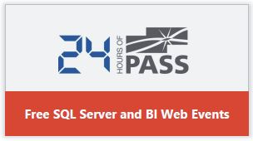
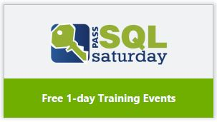


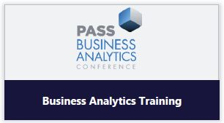

Notes:
Done!

Slide 3



Who is this guy?
Ryan Brickey
SQL Saturday speaker
MCITP: SQL Server Database Administrator 2008 (since 2012)
Wells Fargo: Database Analyst (2013 – present)
SQL Sentry: Software Support Engineer (2010 – 2013)
Living Well Health Solutions: Data Analyst (2007 – 2010)
Networking
SQLBrickey
http://www.linkedin.com/in/ryanbrickey/
http://mindofadba.blogspot.com/
Notes:
Done!

Slide 4
What are we going to look at
What is Policy-Based Management
My business case for using with Policy-Based Management
Benefits
Terms and concepts
Scenario breakdowns
DEMO
Implementation architecture
DEMO
Recap / Questions
Resources
Notes:
Done!

Slide 5

Before we start…..
How many people have never used Policy-Based Management?
Who is currently using Policy-Based Management in some way?

Slide 6
What is Policy-Based Management
Policy-Based Management:
The ability to evaluate policies (rules) against SQL Server instance(s) in an environment
When was it introduced?
SQL Server 2008
Can be created via GUI / T-SQL

Slide 7

My Business case for using policies
Why did I start using policies?
Annual SQL Server policy updates
New servers coming online that needed to comply with policies
Audit-Prep
How did I get started?
Trial and error
PASS Summit
Blogs – links included at the end
Notes:
Done!

Slide 8

Benefits of Policies based mgmt.
Compliance / Audit Prep
Consistent Implementation
Removes tribal knowledge
Cost / Time
Great Performance Review / Bonus / Raise

Slide 9
Key Terms & Concepts
Facet: Set of logical properties which can be evaluated
Condition: Expression that sets or compares a facet to a value
Policy: Evaluates configured condition(s) in an environment
Evaluation modes:
On Demand – Ad-Hoc
On Schedule – Scheduled through Agent job
On Change: Prevent
DDL events ONLY
Requires the enabled nested triggers feature on SQL Server
On Change: Log only
DDL events ONLY
Requires the enabled nested triggers feature on SQL Server
Notes:
On Demand > ad-hoc / On Schedule > agent job / On Change: Prevent > DDL trigger / On Change: Log > Event Notifications
Policy must include: name / target / facet / condition / eval mode

Slide 10
Scenario - 1
We want to audit all servers to make sure that the SA account is disabled.
Policy:
Confirm that the ‘SA’ account is disabled by comparing the Login = ‘SA’ condition to the Login Option – IsDisabled = True condition
Condition:
Login – Name = ‘SA
Login Option – IsDisabled = True
Facet:
Login
Login Options
Notes:
On Demand > ad-hoc / On Schedule > agent job / On Change: Prevent > DDL trigger / On Change: Log > Event Notifications
Policy must include: name / target / facet / condition / eval mode

Slide 11
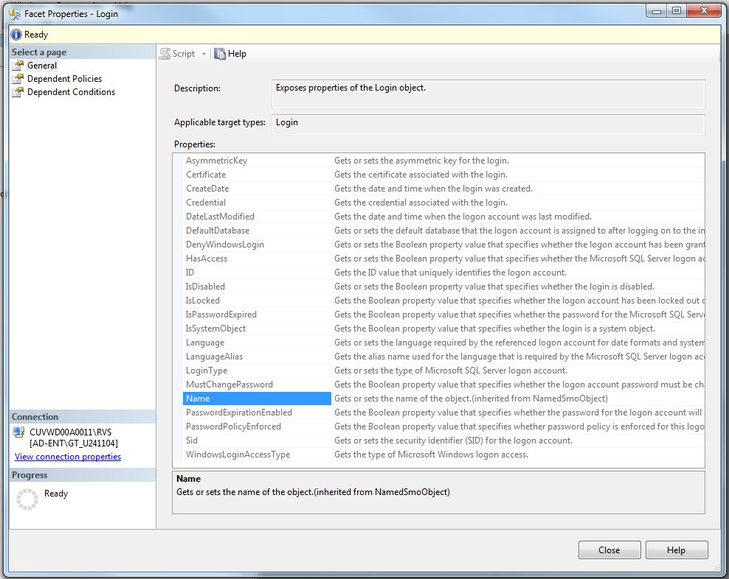
Scenario - 1
We want to audit all servers to make sure that the SA account is disabled.
Policy:
Confirm that the account is disabled
Condition:
Login = ‘SA;
Login Option = Disabled
Facet:
Login
Login Options
Notes:
On Demand > ad-hoc / On Schedule > agent job / On Change: Prevent > DDL trigger / On Change: Log > Event Notifications
Policy must include: name / target / facet / condition / eval mode

Slide 12
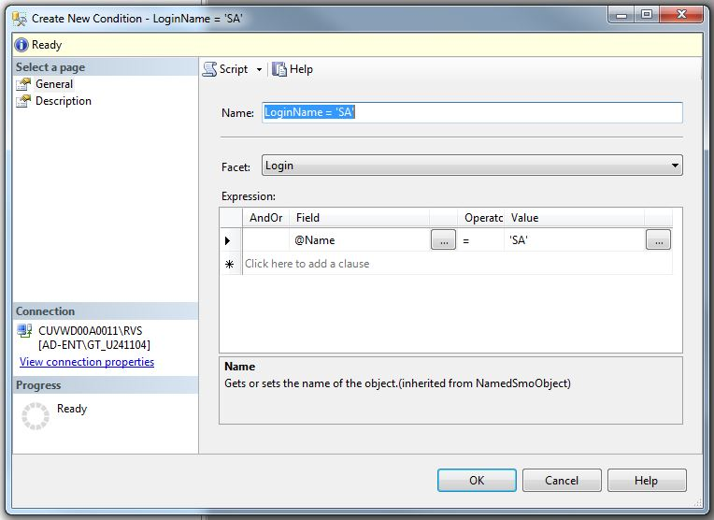
Scenario - 1
We want to audit all servers to make sure that the SA account is disabled.
Policy:
Confirm that the account is disabled
Condition:
Login = ‘SA;
Login Option = Disabled
Facet:
Login
Login Options
Notes:
On Demand > ad-hoc / On Schedule > agent job / On Change: Prevent > DDL trigger / On Change: Log > Event Notifications
Policy must include: name / target / facet / condition / eval mode

Slide 13
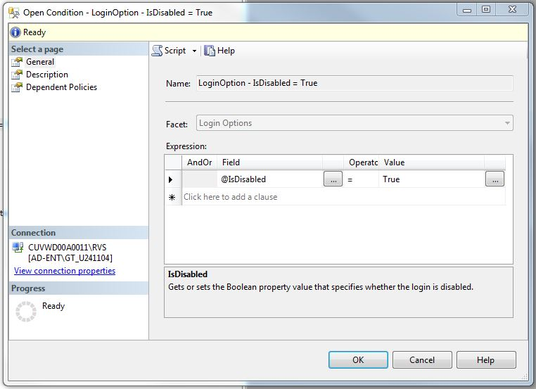
Scenario - 1
We want to audit all servers to make sure that the SA account is disabled.
Policy:
Confirm that the account is disabled
Condition:
Login = ‘SA;
Login Option = Disabled
Facet:
Login
Login Options
Notes:
On Demand > ad-hoc / On Schedule > agent job / On Change: Prevent > DDL trigger / On Change: Log > Event Notifications
Policy must include: name / target / facet / condition / eval mode

Slide 14
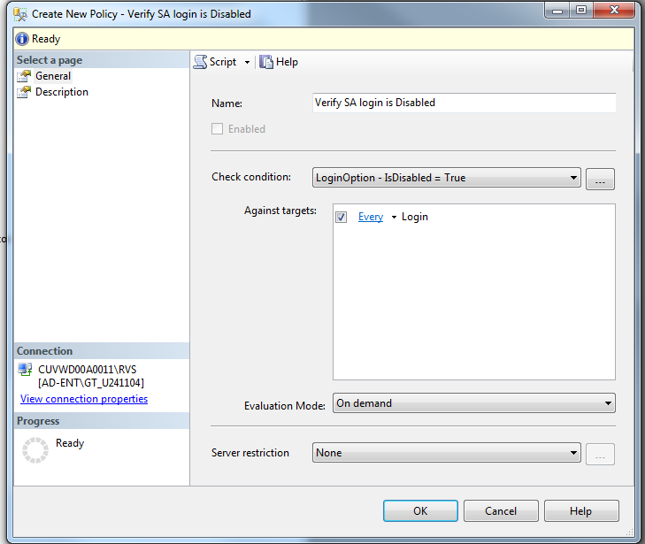
Scenario - 1
We want to audit all servers to make sure that the SA account is disabled.
Policy:
Confirm that the account is disabled
Condition:
Login = ‘SA;
Login Option = Disabled
Facet:
Login
Login Options
Notes:
On Demand > ad-hoc / On Schedule > agent job / On Change: Prevent > DDL trigger / On Change: Log > Event Notifications
Policy must include: name / target / facet / condition / eval mode

Slide 15
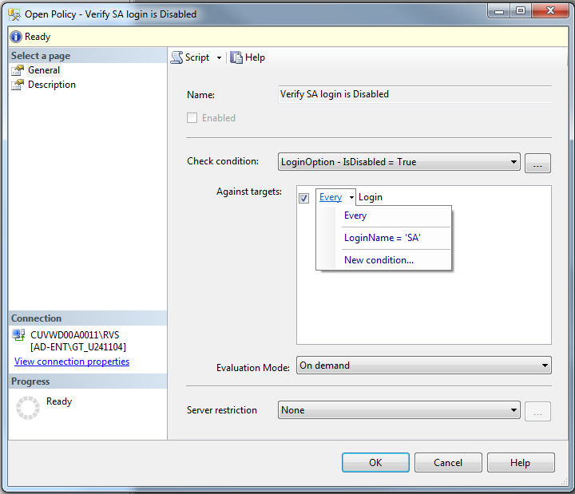
Scenario - 1
We want to audit all servers to make sure that the SA account is disabled.
Policy:
Confirm that the account is disabled
Condition:
Login = ‘SA;
Login Option = Disabled
Facet:
Login
Login Options
Notes:
On Demand > ad-hoc / On Schedule > agent job / On Change: Prevent > DDL trigger / On Change: Log > Event Notifications
Policy must include: name / target / facet / condition / eval mode

Slide 16
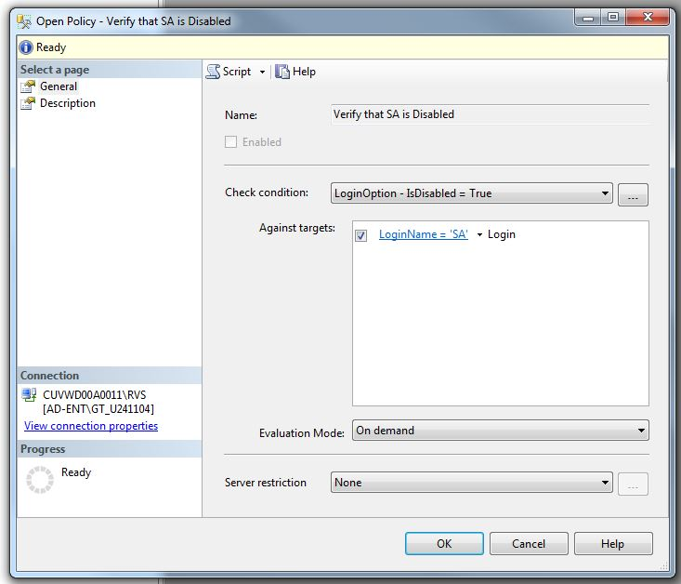
Scenario - 1
We want to audit all servers to make sure that the SA account is disabled.
Policy:
Confirm that the account is disabled
Condition:
Login = ‘SA;
Login Option = Disabled
Facet:
Login
Login Options
Notes:
On Demand > ad-hoc / On Schedule > agent job / On Change: Prevent > DDL trigger / On Change: Log > Event Notifications
Policy must include: name / target / facet / condition / eval mode

Slide 17
Scenario - 2
Due to performance concerns we must ensure that Auto-Shrink is disabled.
Policy:
Verify Auto-Shrink is disabled against all databases
Condition:
Auto-Shrink = False
Facet:
Database
Notes:
On Demand > ad-hoc / On Schedule > agent job / On Change: Prevent > DDL trigger / On Change: Log > Event Notifications
Policy must include: name / target / facet / condition / eval mode

Slide 18
Scenario - 3
New naming convention to use RPT schema to qualify all reporting stored procedures and remove ‘rpt%’ from the names.
Policy:
Verify that no current stored procedures begin with ‘rpt’ and no NEW stored procedures begin with ‘rpt’
Condition:
Procedure names are not like ‘rpt%’
Facet:
Stored Procedure
Notes:
USE [RVS_VIP]
GO
CREATE PROCEDURE [dbo].[rpt_TestPolicy]
AS
BEGIN
SET NOCOUNT ON;
select
*
FROM MIDE.APPR
WHERE APPR_RCV_DT >= GETDATE()-30
END
GO

Slide 19
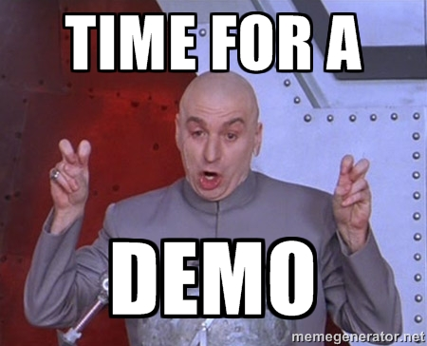
Notes:
USE [RVS_VIP]
GO
CREATE PROCEDURE [dbo].[rpt_TestPolicy]
AS
BEGIN
SET NOCOUNT ON;
select
*
FROM MIDE.APPR
WHERE APPR_RCV_DT >= GETDATE()-30
END
GO

Slide 20
Implementation Architecture
Locally Managed Policies
Allows for policies specific to the server hosting it
Supports evaluation modes: On Demand; On Schedule,
On Change – Prevent; and On Change - Log only
Central Management Server (CMS)
Leverages registered servers
Offers ability to evaluate multiple servers at once
Provides central location for all policies
Supports evaluation mode: On Demand

Slide 21
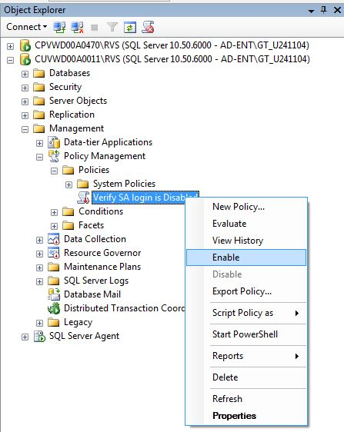
Implementation Architecture
Locally Managed Policies
On Demand
SSMS > Object Explorer

Slide 22
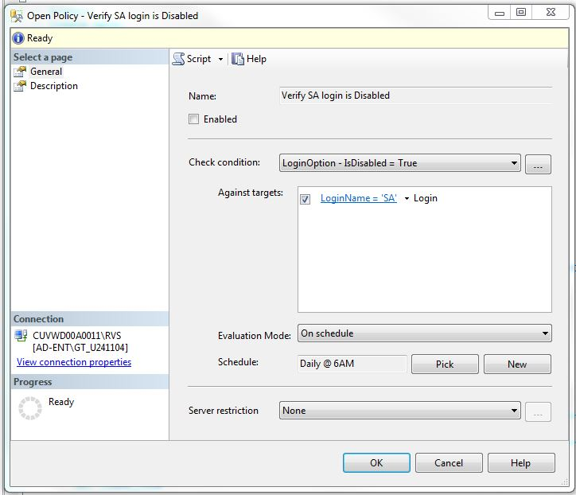
Implementation Architecture
Locally Managed Policies
On Demand
SSMS > Object Explorer
On Schedule
Policy Properties

Slide 23
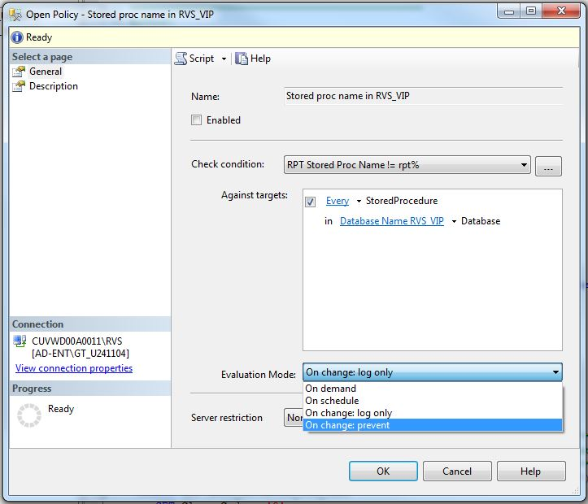
Implementation Architecture
Locally Managed Policies
On Demand
SSMS > Object Explorer
On Schedule
Policy Properties
On Change: Prevent
On Change: Log Only

Slide 24
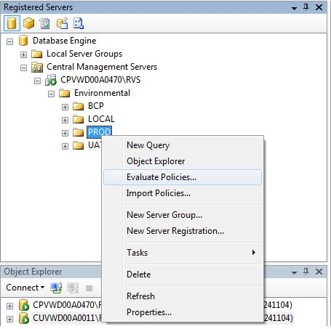
Implementation Architecture
Central Management Server (CMS)
On Demand – All registered servers
SSMS > Registered Servers

Slide 25
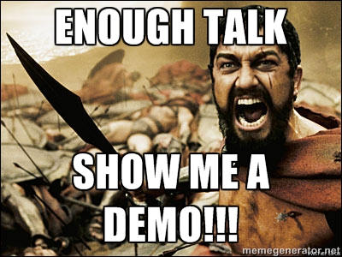
Notes:
USE [RVS_VIP]
GO
CREATE PROCEDURE [dbo].[rpt_TestPolicy]
AS
BEGIN
SET NOCOUNT ON;
select
*
FROM MIDE.APPR
WHERE APPR_RCV_DT >= GETDATE()-30
END
GO

Slide 26
Potential policies & Uses
Auto Shrink Disabled
Authentication Mode
SQL Password Expiration
SQL Password Policy
Guest Permissions
Last Backup Time
Enforce Naming Convention
Database Compatibility Level
Database Encryption
Is Trustworthy Option
Login Auditing
Database Mail Enabled
Extended Stored Procedures Disabled
Backup Compression
Agent jobs have notification on failure
Monitor SQL Agent Jobs
Notes:
Leveraging PowerShell to Schedule OnDemand Evlauations against CMS registered groups!!!

Slide 27
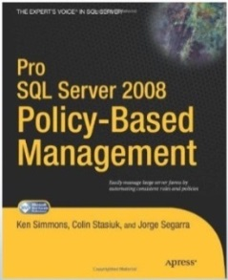
Links/Scripts
Books Online:
http://msdn.microsoft.com/en-us/library/bb510667.aspx
http://blogs.msdn.com/b/sqlpbm/
Jens Suessmeyer
http://blogs.msdn.com/b/jenss/archive/2009/04/18/getting-a-list-of-all-facets-and-its-properties.aspx
Colin Stasuik:
Author: Pro SQL Server Policy Based Management
Twitter: @ColinStasiuk
http://benchmarkitconsulting.com/
Ryan Adams
http://www.ryanjadams.com/
Policy-Based Management White Paper (http://www.ryanjadams.com/2014/04/policy-based-management-white-paper/#axzz34GR4BaDi)
CMS White Paper (http://www.ryanjadams.com/2014/04/central-management-server-white-paper/#axzz34GQwozzW)
Enterprise Policy Management
http://epmframework.codeplex.com/

Slide 28
Thanks Everyone slide deck is available on SQLSaturday.com & Please complete a survey
Notes:
10th chair

