Slide 1

RESOURCE GOVERNOR
SQL SERVER 2008
Aaron Shilo, Database Consultant Oracle & MS Sql Server Certified
aaron.shilo@gmail.com 050-4477117

Slide 2

WHY A RESOURCE GOVERNOR?
Every DBA wants more control over resource usage on their SQL Server instances. Pressure comes from:
IT : reducing data center footprint, hosting more instances on less hardware
Other departments : sales, marketing, finance who want better performance
Customers : my web report timed out
Aaron Shilo, Database Consultant Oracle & MS Sql Server Certified

Slide 3
WHAT IS THE RESOURCE GOVERNOR?
A technology that enables you to manage SQL Server workload and
resources by specifying limits on resource consumption
… or…
The new way to prevent your peons and pointy- haired bosses from bringing
down your server
Aaron Shilo, Database Consultant Oracle & MS Sql Server Certified

Slide 4
BEFORE RESOURCE GOVERNOR…
What we did before to control resource usage was inflexible and largely
reactive:
  Kill SPIDs with “runaway” queries
  utilize SET QUERY_GOVERNOR_COST_LIMIT per query (or per instance with sp_configure)
  use separate instances with affinity to separate workloads
  juggle scheduled jobs to avoid peak activity times
  schedule creation / destruction of procedures or even changing passwords to block certain groups during peak load times
Aaron Shilo, Database Consultant Oracle & MS Sql Server Certified

Slide 5
WHAT ARE THE GOALS?
To classify and prioritize workloads
To make resource usage more balanced and predictable
To help prevent, or at least to minimize, the “run away query”
To monitor and adapt the above tactics to further smooth resource usage
Aaron Shilo, Database Consultant Oracle & MS Sql Server Certified

Slide 6
THREE COMPONENTS OF RESOURCE GOV.
Resource pools. Two resource pools (internal and default) are created
when SQL Server 2008 is installed.
Workload groups. Two workload groups (internal and default) are created
and mapped to their corresponding resource pools when SQL Server 2008
is installed.
Classifier. There are internal rules that classify incoming requests and route
them to a workload group.
Aaron Shilo, Database Consultant Oracle & MS Sql Server Certified

Slide 7
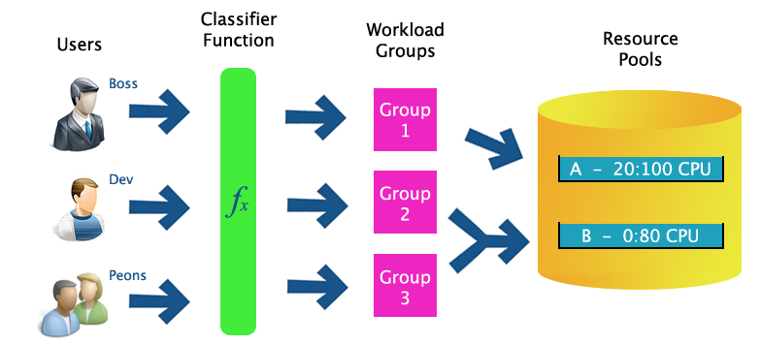
HOW DO THEY WORK TOGETHER?
Aaron Shilo, Database Consultant Oracle & MS Sql Server Certified

Slide 8
WHAT ARE THE BASIC STEPS?
Create resource pools
Create workload groups
Create classifier function
Enable resource governor
Monitor and adapt
Aaron Shilo, Database Consultant Oracle & MS Sql Server Certified

Slide 9
WHAT IS A RESOURCE POOL?
Provides a “slice” of a SQL Server instance’s resources (min/max CPU, memory, or both)
Pools can overlap or be isolated
% of resources based on amount “left over” – not being used by internal processes
Allows for aggregate monitoring of all requests utilizing the pool
RESOURCE POOL SYNTAX
CREATE RESOURCE POOL pool_name
[ WITH
( [
MIN_CPU_PERCENT =value ][[,]
MAX_CPU_PERCENT =value ][[,]
MIN_MEMORY_PERCENT =value ][[,]
MAX_MEMORY_PERCENT =value ]
)];
Aaron Shilo, Database Consultant Oracle & MS Sql Server Certified

Slide 10
WHAT IS A WORKLOAD GROUP?
This acts as a bucket for requests of a similar type (as defined by the
“classifier function”) and to place constraints on those requests
Allows for aggregate monitoring of all requests from all the members of
the group
WORKLOAD GROUP SYNTAX
CREATE WORKLOAD GROUP group_name
[ WITH
([ IMPORTANCE ={ LOW|MEDIUM|HIGH } ][[,]
REQUEST_MAX_MEMORY_GRANT_PERCENT =value][[,]
REQUEST_MAX_CPU_TIME_SEC =value][[,]
REQUEST_MEMORY_GRANT_TIMEOUT_SEC =value][[,]
MAX_DOP =value][[,]
GROUP_MAX_REQUESTS =value] )][
USING { pool_name| "default"}
];
Aaron Shilo, Database Consultant Oracle & MS Sql Server Certified

Slide 11
WHAT IS A CLASSIFIER FUNCTION?
User-defined scalar function that allows you to customize how incoming
requests are routed
Function returns a workload group name, which tells Resource Governor
which pool to associate the request with
Needs to be very efficient
Aaron Shilo, Database Consultant Oracle & MS Sql Server Certified

Slide 12
CLASSIFICATION PROCESS
In the context of Resource Governor, the login process for a
session consists of the following steps:
Login authentication
LOGON trigger execution
Classification
Aaron Shilo, Database Consultant Oracle & MS Sql Server Certified

Slide 13
WHAT ARE SOME CLASSIFICATION EXAMPLES?
You can segregate incoming requests using a whole slew of
criteria:
LOGINPROPERTY (DefaultLanguage, DefaultDatabase)
ORIGINAL_DB_NAME()
HOST_NAME(), APP_NAME() *
CONNECTIONPROPERTY() –IP address, protocol, etc.
[S]USER_[S]NAME()
IS_SRVROLEMEMBER(), IS_MEMBER()
Also intrinsic functions, DATEPART, GETDATE(), etc.
.Examples…
Aaron Shilo, Database Consultant Oracle & MS Sql Server Certified

Slide 14
CLASSIFIER FUNCTION EXAMPLE #1
.Give Aaron priority, and non-sa low priority
CREATE FUNCTION dbo.Classifier()
RETURNS SYSNAME
WITH SCHEMABINDING
AS
  BEGIN
  RETURN (SELECT CASE SUSER_SNAME()
  WHEN ‘sa’ THEN ‘HighPriorityGroup’
  ELSE ‘LowPriorityGroup’
  END
);
END
GO
Aaron Shilo, Database Consultant Oracle & MS Sql Server Certified

Slide 15
CLASSIFIER FUNCTION EXAMPLE #2
.Give ad hoc Management Studio queries low priority during business hours, and high priority otherwise
CREATE FUNCTION dbo.Classifier()
RETURNS SYSNAME
WITH SCHEMABINDING
AS
  BEGIN
  RETURN (SELECT CASE
  WHEN APP_NAME() LIKE ‘%Management Studio%’
  AND DATEPART(HOUR, GETDATE()) BETWEEN 9 AND 17
  THEN ‘LowPriorityGroup’
  ELSE ‘HighPriorityGroup’
  END
);
END
GO
Aaron Shilo, Database Consultant Oracle & MS Sql Server Certified

Slide 16
CLASSIFIER FUNCTION EXAMPLE #3
.Get the DallasAtlanta office back for that April Fool’s joke they played
on the DBA
CREATE FUNCTION dbo.Classifier()
RETURNS SYSNAME
WITH SCHEMABINDING
AS
  BEGIN
  RETURN (SELECT CASE
  WHEN CONNECTIONPROPERTY(‘Local_Net_Address’)
  LIKE ‘192.168.2.%’ THEN ‘Group_With_Max_CPU_1_Percent’
  ELSE ‘HighPriorityGroup’
  END
);
END
GO
Aaron Shilo, Database Consultant Oracle & MS Sql Server Certified

Slide 17
USER-DEFINED FUNCTION CHARACTERISTICS :
The user-defined function is evaluated for every new session, even when
connection pooling is enabled.
The user-defined function gives workload group context for the session.
After group membership is determined, the session is bound to the
workload group for the lifetime of the session.
If the user-defined function returns NULL, default, or the name of non-existent
group . the session is given the default workload group context.
The session is also given the default context if the function fails for any reason.
Only one user-defined function can be designated as a classifier at a time.
The classifier user-defined function cannot be dropped or altered unless its
classifier status is removed.
Aaron Shilo, Database Consultant Oracle & MS Sql Server Certified

Slide 18
THE DEFAULT WORKLOAD GROUP
Requests are classified into the default group when the
following conditions exist:
There are no criteria to classify a request.
There is an attempt to classify the request into a non-existent group.
There is a general classification failure.
Aaron Shilo, Database Consultant Oracle & MS Sql Server Certified

Slide 19
HOW DO I MONITOR?
New Perfmonobjects with lots of counters:
SQLServer: Resource Pool Stats
SQLServer: Workload Group Stats
New trace events (e.g. CPU Threshold Exceeded)
There are also new DMVs:
sys.dm_resource_governor_workload_groups
sys.dm_resource_governor_resource_pools
sys.dm_resource_governor_configuration
Aaron Shilo, Database Consultant Oracle & MS Sql Server Certified

Slide 20
DEMO
Aaron Shilo, Database Consultant Oracle & MS Sql Server Certified

Slide 21
Step 1: Initial Demo Setup
On a newly installed server (i.e. no prior Resource Governor configuration)
demo on a dual core laptop and for the sake of simplicity I'm using a single CPU for SQL Server. To do so, I adjust CPU affinity mask as follows:
-- first enable advanced options in sp_configure
Using 1 CPU for SQL Server on a dual proc machine has an interesting side-effect: we normalize "CPU usage %" counter to number of CPUs on the box and thus, the values will hover around 50% as maximum and not 100% as you might expect. I will illustrate this below.
sp_configure 'show advanced', 1
GO
RECONFIGURE
GO
-- use only 1 CPU on demo machine
sp_configure 'affinity mask', 1
GO
RECONFIGURE
GO
Aaron Shilo, Database Consultant Oracle & MS Sql Server Certified

Slide 22
In addition to that for demo purposes I will set min/max server memory to a fixed value, since it will improve predictability of the demo on the laptop.
-- 512 Mb is suitable for laptop demo
sp_configure 'min server', 512
GO
sp_configure 'max server', 512
GO
RECONFIGURE
GO
Aaron Shilo, Database Consultant Oracle & MS Sql Server Certified

Slide 23
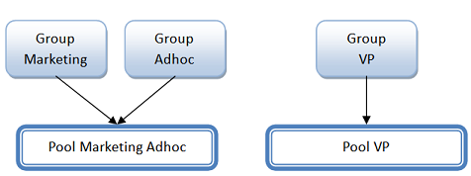
Step 2: Workload groups and Resource Pools
Now we will be setting up the following hierarchy of workload groups and resource pools:
Each corresponding workload group contains queries of the corresponding class or department (i.e. Marketing, Adhoc, and VP). Note that, Marketing and Adhoc queries share the same resource pool, while workload group VP has its own similarly named pool. The reason of such separation will become clear as we see how we adjust Resource Governor controls.
Aaron Shilo, Database Consultant Oracle & MS Sql Server Certified

Slide 24
You will start building the above configuration in a bottom up manner (i.e. starting from pools and going up)
To do so, we execute the following T-SQL:
-- create user pools
-- note that we are using all default parameters
CREATE RESOURCE POOL PoolMarketingAdhoc
CREATE RESOURCE POOL PoolVP
-- create user groups
-- also note that all groups created with default parameters
-- only pointing to the corresponding pools (and not 'default')
CREATE WORKLOAD GROUP GroupMarketing
USING PoolMarketingAdhoc
CREATE WORKLOAD GROUP GroupAdhoc
USING PoolMarketingAdhoc
CREATE WORKLOAD GROUP GroupVP
USING PoolVP
GO
Aaron Shilo, Database Consultant Oracle & MS Sql Server Certified

Slide 25
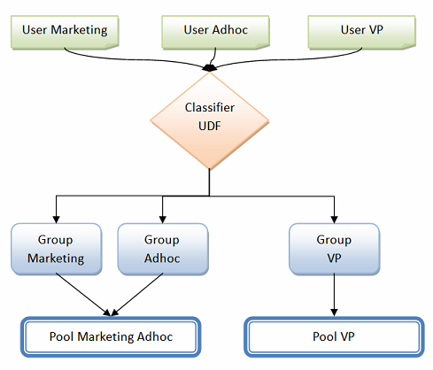
Step 3: Classification
Now, what you have just done is created hierarchy of the groups and pools, however, how does the server know about which query goes where? This is where classification comes in. The above picture becomes:
Aaron Shilo, Database Consultant Oracle & MS Sql Server Certified

Slide 26
There is a couple of things:
To do the classification you will need to create a user-defined function that will be executed for every new connection and it will place these new connections in the corresponding workload groups.
How will we separate different connections?
For demo purposes we will use 3 separate login names which we will check and use inside of the function
To implement the above 2 steps we will run the following:
-- classifier function should be created in master database
-- switch to master unless you are there already
USE master
GO
-- create logins to separate users into different groups
-- note that we disabled strong password checking for demo purposes
-- but this is against any best practice
CREATE LOGIN UserMarketing WITH PASSWORD = 'UserMarketingPwd', CHECK_POLICY = OFF
CREATE LOGIN UserAdhoc WITH PASSWORD = 'UserAdhocPwd', CHECK_POLICY = OFF
CREATE LOGIN UserVP WITH PASSWORD = 'UserVPPwd', CHECK_POLICY = OFF
GO
-- note that this is just a regular function
CREATE FUNCTION CLASSIFIER_V1 ()
RETURNS SYSNAME WITH SCHEMABINDING
BEGIN
DECLARE @val varchar(32)
SET @val = 'default';
if 'UserVP' = SUSER_SNAME() SET @val = 'GroupVP';
else if 'UserMarketing' = SUSER_SNAME() SET @val = 'GroupMarketing';
else if 'UserAdhoc' = SUSER_SNAME() SET @val = 'GroupAdhoc';
return @val;
END
GO
Aaron Shilo, Database Consultant Oracle & MS Sql Server Certified

Slide 27
Step 4: Are we there yet?
After all this work, can we start workloads and see what happens? The answer, as you have guessed by the question is - no. What's left? Again, a couple of steps:
We need to tell Resource Governor to use the function that we just created Make all the changes effective
First step is done by
-- make function known to the Resource Governor
ALTER RESOURCE GOVERNOR
WITH (CLASSIFIER_FUNCTION = dbo.CLASSIFIER_V1)
GO
For the second step, let's compare output of catalog views with in-memory information (note difference in names of catalog views and dynamic management views (DMVs) which are prefixed with dm_:
-- metadata information
SELECT * FROM sys.resource_governor_workload_groups
SELECT * FROM sys.resource_governor_resource_pools
SELECT * FROM sys.resource_governor_configuration
-- in-memory information
SELECT * FROM sys.dm_resource_governor_workload_groups
SELECT * FROM sys.dm_resource_governor_resource_pools
SELECT * FROM sys.dm_resource_governor_configuration
Aaron Shilo, Database Consultant Oracle & MS Sql Server Certified

Slide 28
Now transfer changes from metadata to memory by running the following statement. Also, do not confuse it with already existing RECONFIGURE command:
-- make the changes effective
ALTER RESOURCE GOVERNOR RECONFIGURE
GO
And rerun the above query on metadata and DMVs and you should see that new groups, pools and classifier function ID are present in corresponding DMVs.
Aaron Shilo, Database Consultant Oracle & MS Sql Server Certified

Slide 29
Step 5: Running the workloads
The easiest way to simulate a CPU intensive workload is to run the following in a loop:
set nocount on
declare @i int
declare @s varchar(100)
set @i = 100000000
while @i > 0
begin
select @s = @@version;
set @i = @i - 1;
end
Also, instead of running this query from the Management Studio, consider saving it in a file and running from a command prompt by using a script similar to the below. Note that we are using 3 different user names to connect to the server.
echo "Press any key to start Marketing workload"
pausestart sqlcmd -S <your_server_name> -U UserMarketing -P UserMarketingPwd -i "CPU intensive loop.sql"
echo "Press any key to start VP workload"
pause
start sqlcmd -S <your_server_name> -U UserVP -P UserVPPwd -i "CPU intensive loop.sql"
echo "Press any key to start Adhoc workload"
pause
start sqlcmd -S <your_server_name>" -U UserAdhoc -P UserAdhocPwd -i "CPU intensive loop.sql"
Aaron Shilo, Database Consultant Oracle & MS Sql Server Certified

Slide 30
To observe the effects of the load, add the following performance counters in the perfmon:
We will monitor CPU usage per group in the 1st instance of perfmon;
add "SQLServer:Workload Group Stats object", "CPU usage %" counter for "GroupMarketing", "GroupAdhoc" and "GroupVP" instances
We will monitor CPU usage per pool 2nd instance of perfmon,
add "SQLServer:Resource Pool Stats object", "CPU usage %" counter for "PoolMarketingAdhoc" and "GroupVP" instances
Before you start the next workload, observe the counters for pools and groups for a number of seconds, you should see approximately the following:
Aaron Shilo, Database Consultant Oracle & MS Sql Server Certified

Slide 31
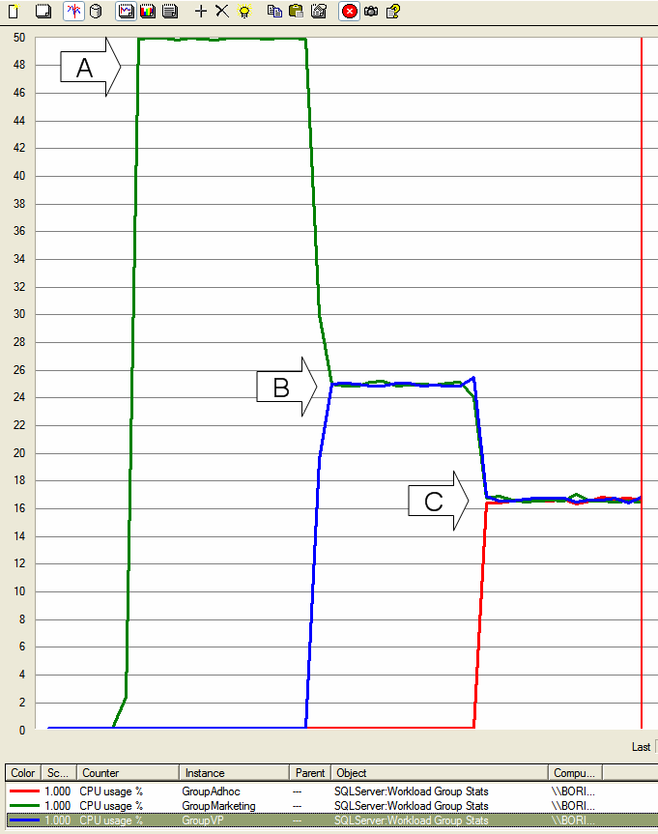
G R O U P S
Aaron Shilo, Database Consultant Oracle & MS Sql Server Certified

Slide 32
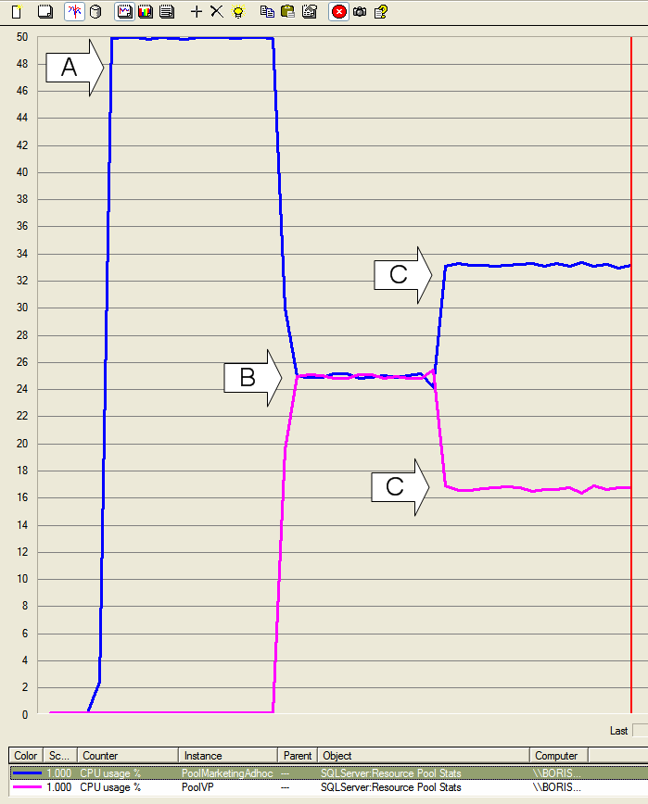
P O O L S
Aaron Shilo, Database Consultant Oracle & MS Sql Server Certified

Slide 33
Few things to note:
Remember I set affinity mask to 1? This is why the maximum on the figures is only 50% (it is for a single CPU while usage is normalized to all CPUs on the machine, 2 in my case)
At point A, I started Marketing workload, CPU usage went to the maximum on the CPU for a single workload, 50% in this case
At point B, I started VP workload, which, as you remember, belongs to a separate resource pool and it made Marketing group share half of the CPU with VP group. The same is true for the pools (because we have 1 to 1 match of active requests in groups to pools at this point)
At point C, I started Adhoc workload, which has its own group but shares the pool with Marketing workload. What happened here on the groups is that all 3 of them are now sharing the CPU getting approximately 1/3 of it or roughly 17%. On the pool side, however, we can see that Marketing Adhoc pool which shows aggregate resource usage by all groups inside of it, has 2/3 or the CPU while Pool VP has only 1/3. This behavior is exactly what you get on SQL Server 2005. Resources are distributed as they are being requested and whoever needs more CPU simply gets it. This was one of the goals: to make behavior as close as possible to SQL Server 2005 when you do not use the Resource Governor or adjust any parameters of it. Note, however, by creating the groups and pools you are already slightly altering the behavior of SQL Server 2008, but more on this in the next few posts.
Aaron Shilo, Database Consultant Oracle & MS Sql Server Certified

Slide 34
Step 6: Management Actions
Now we came to the point where we want to apply action to change the above picture. Specifically, we want our VP workload to proceed faster and thus, limit CPU usage by Marketing and Adhoc workloads to 50% of the CPU.
To do this, we alter the PoolMarketingAdhoc using the following syntax (remember, we created the pool using all default parameters):
-- adjust PoolMarketingAdhoc to not consume more than 50% of CPU
ALTER RESOURCE POOL PoolMarketingAdhoc
WITH (MAX_CPU_PERCENT = 50)
Remember to make changes effective:
-- make the changes effective
ALTER RESOURCE GOVERNOR RECONFIGURE
Aaron Shilo, Database Consultant Oracle & MS Sql Server Certified

Slide 35
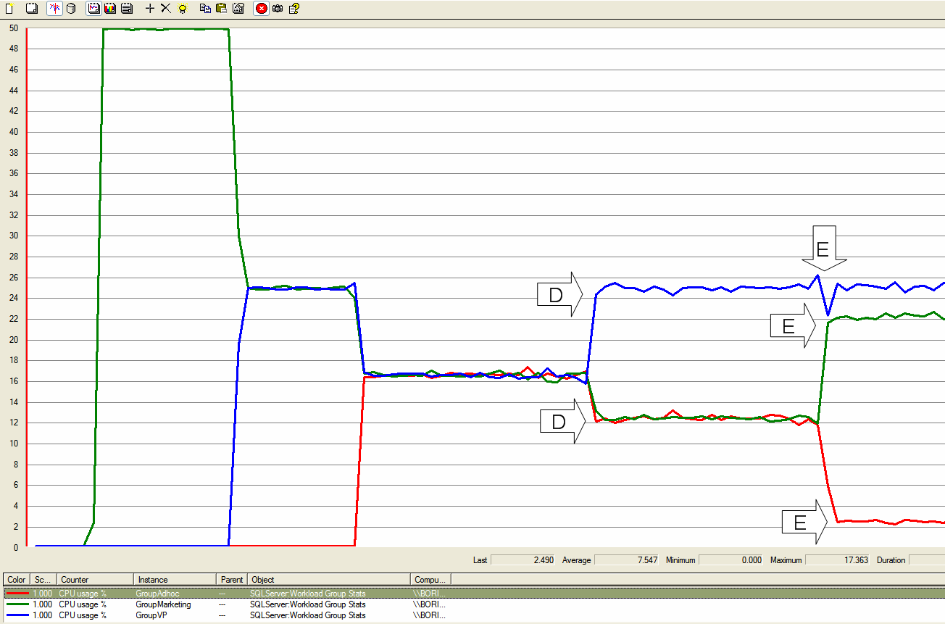
G R O U P S
G R O U P S
Aaron Shilo, Database Consultant Oracle & MS Sql Server Certified

Slide 36
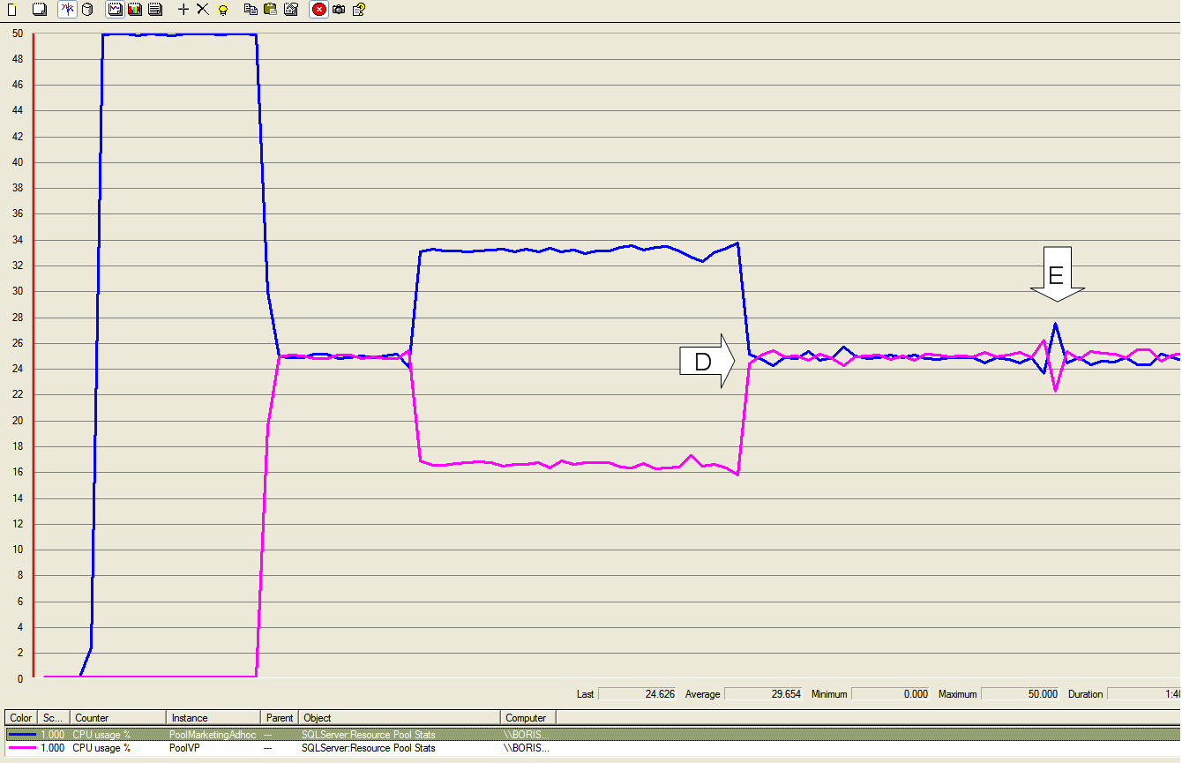
P O O L S
Aaron Shilo, Database Consultant Oracle & MS Sql Server Certified

Slide 37
WHAT ARE THE LIMITATIONS?
CPU / Memory only (no I/O yet)
2008 Database Engine only (no SSAS, SSRS, SSIS)
Single instance only
Short OLTP operations are immune to constraints
Lack of contention can also prevent enforcement
Cannot constrain “internal” processes
Must disable classification to modify classifier function(you can’t apply these changes to
existing sessions)
Pool / group names are case sensitive
Enterprise Edition only!
Aaron Shilo, Database Consultant Oracle & MS Sql Server Certified

Slide 38
COMMON MISTAKES
Expecting importance to mean priority; importance applies weights to resources, does
not form a “queue”
Expecting classifier function to be case insensitive;
  MiS-CAsEdgroup names will end up in default group
Creating classifier function in wrong database;
  function must be in master
Cluster / multi-instance failover scenarios;
  need to be prepared to have instances share resources
Aaron Shilo, Database Consultant Oracle & MS Sql Server Certified

Slide 39
Conclusion
The Resource Governor Feature of SQL Server 2008 helps DBA’s to monitor and control the CPU and memory utilization with respect to different workload groups.
Aaron Shilo, Database Consultant Oracle & MS Sql Server Certified

Slide 40
THANK YOU!
Aaron Shilo, Database Consultant Oracle & MS Sql Server Certified
aaron.shilo@gmail.com 050-4477117

