Slide 1
Hidden Power : Service Broker
BY :- ANKIT BARIA & KOURTNEY APEL

Slide 2
Agenda
What is Service Broker ?
Why hidden power ?
When to use Service Broker ?
Service Broker Architecture
Certificate
Demo

Slide 3
What is Service Broker ?
SQL server application that allows messaging and queuing between instances.
It can send and receive guaranteed, asynchronous messages from source to destination, develops a “conversation.”
Each conversation is a channel of communication.
Each Service Broker conversation is a dialog, having two participants involved.

Slide 4
Why Hidden Power ?
Messaging application exists from a long time but-
Awareness
Less documentation
No graphical application builder
Error/ Solution interpretation is tough
Challenging to work on
Solves some of the most difficult messaging application issues-
Message ordering
Coordination
Multithreading
Receiver management
Less work for developer

Slide 5
When to use Service Broker ?
Asynchronous triggers
Reliable query processing
Reliable data collection
Distributed server-side processing for client applications
Data consolidation for client applications
Large-scale batch processing

Slide 6
Basic Service Broker Architecture
Message type
Defines the name of the message and the type of data the message contains
Queue
Holds the incoming message for a service
Contract
Defines the name of a contract/task and the message type used in that contract
Service
Represents a business process as a distinct set of contracts/tasks.

Slide 7
External Service Broker Architecture
Certificates
Contains public and private key
Service Broker Endpoints
Allows outside connection
Remote Service Binding
Defines the database user, certificate for user, and the remote service
Route
Defines the remote service name, IP Address, and the port

Slide 8
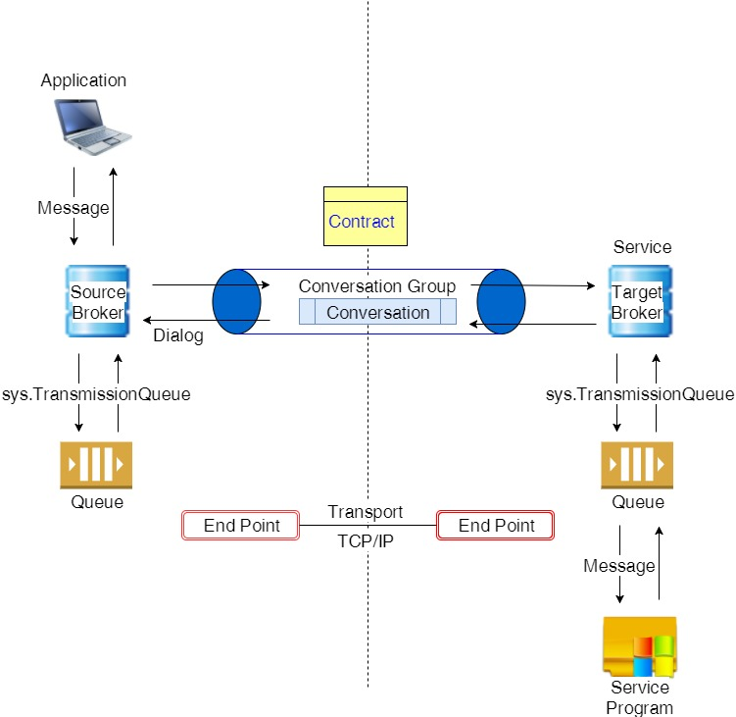
Service Broker Architecture

Slide 9
Certificate Architecture
Master Certificates & Authentication-
Database master key - master db
Login
User
Certificates
Endpoints
Database Certificates & Authentication-
Database master key - user db
User
Certificates

Slide 10
Demo

Slide 11
References
Service Broker Introduction
Service Broker Foundation with Scripts
Usage of Service Broker
Certificates
Conversation Architecture
Closing Conversations

Slide 12
Contact Us
Ankit Baria
Twitter: @ank_baria
Kourtney Apel
Twitter: @kourtney_apel

