Slide 1
Inside the Black Box
Making Sense of Service Broker

Slide 2

About Me
Colleen Morrow
MCSE – Data Platform
Principal Consultant at UpSearch
http://colleenmorrow.com
@ClevelandDBA
Contributor to Tribal SQL

Slide 3
Agenda
Intro to Service Broker (What? Why? Where?)
Service Broker Architecture
Implementing a basic Service Broker environment
Implementing a distributed environment
Troubleshooting

Slide 4
What is Service Broker?
Messaging service introduced in SQL Server 2005
Integrated into the database
Managed via DDL
Available in all editions
Express Edition only supported in conjunction with a different edition

Slide 5
Why use Service Broker? (1)
Asynchronous - long-duration processing is decoupled from client process
Guaranteed message delivery – even if network is down
Guaranteed message sequencing - internal locking and sequencing mechanisms guarantee messages are processed in order
Performance - Service broker implementations can be scaled out to handle large workloads

Slide 6
Why use Service Broker? (2)
Durability - Service broker messages and conversations are persistent across server restarts
Transactional - message management is part of data processing transactions
Flexibility - messages can be sent inside the same database or to a server halfway around the world
Easier application development - you don't need to worry about any of the above!

Slide 7
Where can I use Service Broker?
Auditing - event notifications
Triggers – make them asynchronous!
ETL – Change Data Capture (CDC)
Distributed server-side processing for client applications - Order entry system
Asynchronous batch processing
DIY replication

Slide 8
Service Broker Architecture

Slide 9
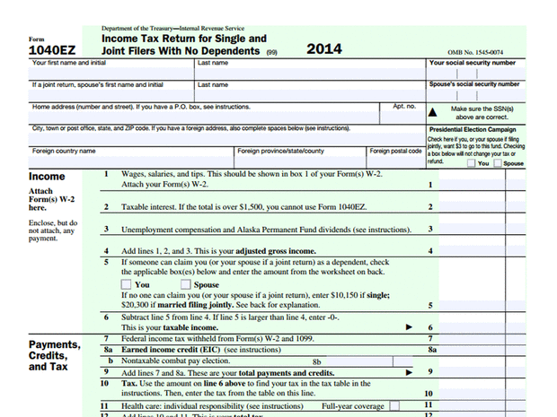



Service Broker Architecture: Taxes

Slide 10
Service Broker Architecture: Message Type
Defines name and format of messages exchanged between services
Optional validation, well-formed XML, XML of a specific schema, empty, or no validation

Slide 11
Service Broker Architecture: Contract
Specifies message types allowed in a conversation
Which participant can send which message type
Taxpayer:
IRS:

Slide 12
Service Broker Architecture: Queue
Stores the messages for a particular service
Each message is a row in the queue
Hidden table – SELECT only (no insert/update/delete)
Included in transactions, logging, backups, mirroring, etc. (just like a "real" table)

Slide 13
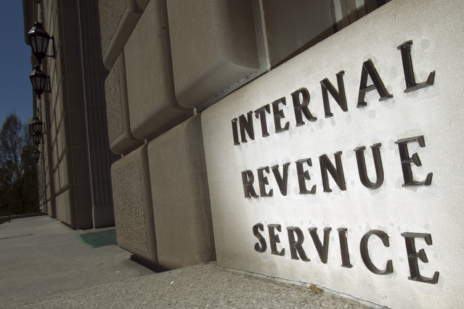
Service Broker Architecture: Service
Addressable endpoint for conversations
Bundles up the message types, contract, and queue

Slide 14
Demo
Creating the Service Broker architecture

Slide 15
Sending Service Broker Messages

Slide 16
Sending messages: Conversation/Dialog
Reliable, persistent bidirectional stream of messages between two services.
Messages in a conversation are delivered in order, only once
Can be short-lived, or span days, weeks, years
Persistent across restarts
Stays open until explicitly ended (unless a timer is placed on it)

Slide 17
Sending messages: Dialog Participants
Initiator - participant that begins a dialog
Target - participant that accepts the dialog begun by the initiator
Roles may be reversed between servers, depending on situation

Slide 18
Sending messages: Service Program
Stored procedure or external program that processes messages in a queue
Internal activation - stored procedure is attached to the queue to process messages automatically as they arrive
External activation – process/application outside of the SQL Server engine processes messages

Slide 19
Putting it all together: How it works
Contract
RequestMessage Message Type (Initiator)
ReplyMessage Message Type (Target)
Initiator Service
Target Service
sys.transmission_queue
sys.transmission_queue
Ack
Message
InitiatorQueue
TargetQueue
SEND msg
Message
Message
Service Program
Service Program

Slide 20
Demo
Sending and receiving messages

Slide 21
Distributed Service Broker Systems

Slide 22
Distributed Systems: Endpoint
Defines port on which SQL Server listens for Service Broker communication over network
Required when sending/receiving messages between multiple instances
One Service Broker endpoint per instance

Slide 23
Distributed Systems: Route
Used to determine where to deliver messages
Specifies the address for remote service
Incoming messages also need route defined for local services
Required when sending messages to a different instance

Slide 24
Distributed Systems: Security
Transport Security
Establishes authenticated network connection between SQL Server instances/Service Broker endpoints
Required for distributed deployment
Dialog Security
Establishes secure, authenticated connection between Service Broker Services/Dialog endpoints

Slide 25
Demo
Configuring a Distributed Solution

Slide 26
Troubleshooting
Sys.transmission_queue – transmission status
SQL Server Error log – initiator and target
SQL Server Profiler – Service Broker events
Sending queue – sometimes

Slide 27
Review
Intro to Service Broker (What? Why? Where?)
Service Broker Architecture
Message types, contracts, queues, services
Implementing a basic Service Broker environment
Dialogs, sending/receiving messages
Implementing a distributed environment
Endpoints, routes, security
Troubleshooting

Slide 28
Questions?

Slide 29


Thank you!
Session Evaluation:
Event Evaluation:

