Slide 1
Fun with SQL Server Spatial Data
Mindy Curnutt
TMW Systems / Trimble Navigation

Slide 2


Microsoft Data Amp
WHERE DATA GETS TO WORK
Put data, analytics and artificial intelligence into the heart of your solutions. Get the latest on big data and machine learning innovations.
Join us online April 19, 2017 at 8AM PT
microsoft.com/data-amp

Slide 3


About Me
VP, Information Management, TMW
3X SQL Server/Data Platform MVP
Idera Ace 2016-2017
SQL Server since 6.5 / 1995 (20+ Years)
PASS Summit Speaker, 2005, 2012-2015
PASS Program Manager 2015-2017
Twitter: @sqlgirl
Email: mindycurnutt@hotmail.com

Slide 4


Thank You Idera!
My speaking to you today
was made possible through
the Idera ACE program.

Slide 5
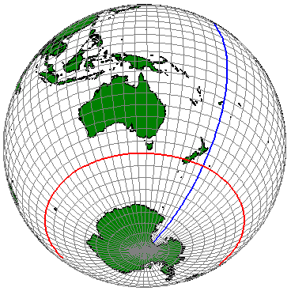
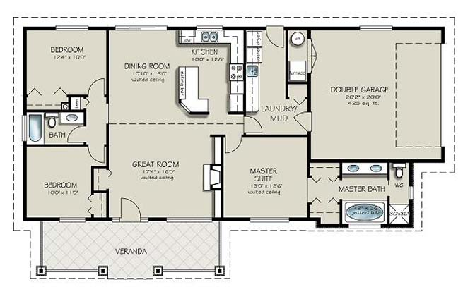
Spatial Data Types
Geography
Ellipsoidal (Lat, Long, Z, M)
Define points, lines & areas with latitude & longitude
Geometry
Flat Map (X, Y, Z, M)
Define points, lines & areas with coordinates
Use for localized & interior spaces

Slide 6






What Can I Represent?
POINT |  | MULTIPOINT
LINESTRING |  | MULTI-LINESTRING
POLYGON |  | MULTI-POLYGON
There’s more too! Complex Polygons & Multi-Polygons, Collection, Curves, Combinations…

Slide 7
What Can I Represent?
Points
A GPS Position:
Declare @location geography = geography::Point(@lat, @long, 4326);
A Region of 20 meters around a Point (Buffer):
Declare @region geography = geography::Point(@lat, @long, 4326).STBuffer(20);
Notes:
Show Demo 1

Slide 8
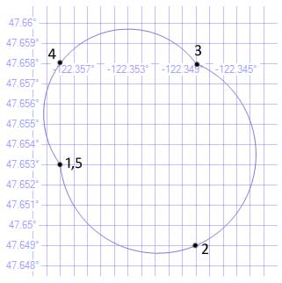
What Can I Represent?
Circular Arcs
Circular Strings (3 point+)
Compound Curves
Curved Polygons
DECLARE @g geography =
'CIRCULARSTRING(
-122.358 47.653,
-122.348 47.649,
-122.348 47.658,
-122.358 47.658,
-122.358 47.653)';
Notes:
Demo 2 – Circular String

Slide 9
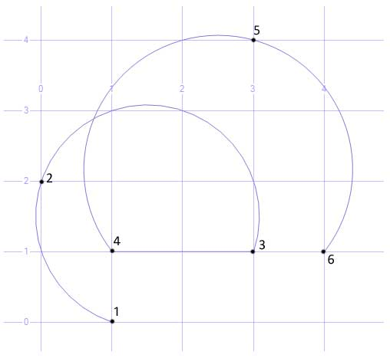
What Can I Represent?
Circular Arcs
Circular Strings
Compound Curves
Curve Polygons
DECLARE @g geometry = 'COMPOUNDCURVE
(
CIRCULARSTRING(1 0, 0 2, 3 1),
(3 1, 1 1),
CIRCULARSTRING(1 1, 3 4, 4 1)
)';

Slide 10
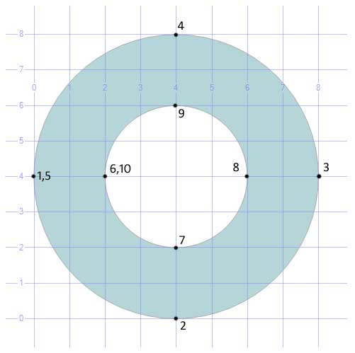
What Can I Represent?
Circular Arcs
Circular Strings
Compound Curves
Curved Polygons
DECLARE @g geometry =
'CURVEPOLYGON
(
CIRCULARSTRING(0 4, 4 0, 8 4, 4 8, 0 4),
CIRCULARSTRING(2 4, 4 2, 6 4, 4 6, 2 4)
)';
SELECT @g.STArea() AS Area;
Notes:
Demo 4 – Circular Arcs

Slide 11
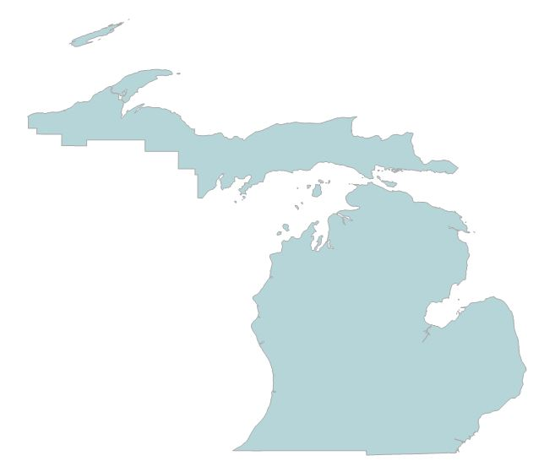
What Can I Represent?
Complex Polygons
select * from timezone_world where ID = 86
select * from timezone_world where ID in (
27,17,7,273,41,204,86,81,149,74,126,296,312,44,82,389,124,400,251,206,104,67,102,41)
Notes:
Demo 5 – Complex Polygons

Slide 12
Common Spatial Methods in T-SQL
STBuffer (return type: Geography)
Draws a buffer of the specified distance around the geography shape. If the shape is a point, the buffer will draw a circle.
ShortestLineTo (return type: Geography)
Returns an object that represent the shortest distance between two objects
STIntersection (return type: Geography)
Returns an object that represents the points where a geography instance intersects another geography instance.
STUnion (return type: Geography)
Returns an object that represents the points where a geography instance intersects another geography instance.
Notes:
Demo 6 – Shortest Line To & STLength / Demo 7 – STIntersection and STUnion

Slide 13
Common Spatial Methods in T-SQL
STContains (return type: Boolean)
Specifies whether the calling geography instance spatially contains the geography instance passed to the method.
STIntersects (return type: Boolean)
Returns 1 if a geography instance spatially overlaps another geography instance, or 0 if it does not.
STDistance (return type: Float)
Returns the shortest distance between a point in a geography instance and a point in another geography instance. (Float)
STLength (return type: Float)
Returns in Meters the length of a Line or Curve object
STArea (return type: Float)
Returns Square Meters of the Area of the resulting
Notes:
Demo 8 – STContains and STIntersects

Slide 14
Examples
Get all Customers within a distance of X
Select * from Customers c where s.geo.STDistance(@me) < @x
Get all Customers within a particular City’s Boundary
Select * from Customers c where
c.geo.STIntersects(@ACityBoundary) = 1
How many miles is a walk in my neighborhood with my dog?
declare @g geography;
SET @g= geography::STGeomFromText('LINESTRING
(-96.777639 32.951932, -96.777639 32.951932, -96.777620 32.952159,
-96.778624 32.952167, -96.779098 32.952243, -96.778716 32.978184)',4326);
select @g;
select @g.STLength() * .000621371 * 2;

Slide 15
Convert Objects to Spatial Data
Geocoder Services
GPS Visualizer – Batch Address Locator
Give a list of addresses, returns Lat/Long
http://www.gpsvisualizer.com/geocoder/
ArcGIS
https://developers.arcgis.com/features/geocoding/
Google Maps
https://google-developers.appspot.com/maps/documentation/utils/geocoder/
Texas A & M
http://geoservices.tamu.edu/Services/Geocode/
Notes:
Demo 9 - GeogCoding

Slide 16
Sources of Free Data
Shapefiles
United States Census - https://www.census.gov/
State and Local Governments – http://geo.data.gov
http://www.mapcruzin.com/download-free-arcgis-shapefiles.htm
http://www.naturalearthdata.com/
http://freegisdata.rtwilson.com/ (huge list of links)
http://download.geofabrik.de/
http://nationalmap.gov/small_scale/
http://tnmap.tn.gov/
ArcGIS - http://opendata.arcgis.com/

Slide 17
Loading Spatial Data
Shape2SQL
http://www.sharpgis.net/page/SQL-Server-2008-Spatial-Tools
Notes:
Demo – Shape2SQL

Slide 18
SQL Server Art using Spatial Data
http://www.purplefrogsystems.com/blog/2011/05/sql-server-art-using-spatial-data/
Convert image to a bitmap
Convert bitmap to a vector (vectormagic.com)
Use Excel workbook for formatting
Paste in SQL
http://michaeljswart.com/2010/02/more-images-from-the-spatial-results-tab/

Slide 19
Credits
Michael Rys, Milan Stojic – TechEd Europe 2012 DBI324
Michael J Swart Blog
Alex Whittles – Purple Frog Consultancy Blog

Slide 20
Questions?
Mindy Curnutt Twitter: @sqlgirl Email: mindycurnutt@hotmail.com

