Slide 1
SQL SERVER TRANSACTION LOG INSIDE
Tsvetozar Iv. Ivanov
Senior DBA
CSC

Slide 2
Introduction - Triple W
What we are going to talk about?
Why we have to know that?
Who have to listen?
Notes:
How presentation will benefit audience: Adult learners are more interested in a subject if they know how or why it is important to them.
Presenter’s level of expertise in the subject: Briefly state your credentials in this area, or explain why participants should listen to you.

Slide 3
Agenda
Database files structure
Transaction Log Architecture
Logical Architecture
Physical Architecture
Write Ahead Logging
Check point process
Phases of Recovery
Recovery Models
Notes:
Lesson descriptions should be brief.

Slide 4
Database files structure
Data Files
Transaction Log Files
Notes:
Example objectives
At the end of this lesson, you will be able to:
Save files to the team Web server.
Move files to different locations on the team Web server.
Share files on the team Web server.

Slide 5
Transaction Log Architecture
Logical Architecture
Physical Architecture
Write Ahead Logging
Check point process

Slide 6
Transaction Log Logical Architecture
Log Records
LSN
Transaction ID
Data modification records
Logical operation logged
Before and after image logged

Slide 7
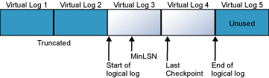
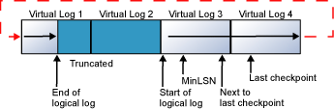
Transaction Log Physical structure
Physical files
Virtual Log Files

Slide 8
Transaction Log Physical structure
Number of VLFs created depending on the amount of space added to the transaction log.
Number of VLFs | Growth Size
4 | <64MB
8 | >=64MB and < 1GB
16 | >=1GB

Slide 9
Write Ahead Logging
ACID
Atomicity
Consistency
Integrity
Durability
How modified data is written to disk?
Buffer cache
Log cache

Slide 10

Checkpoint process
Check point operation
Active portion of the transaction log

Slide 11
..... Checkpoint process
Check point operation
What cause checkpoint
Checkpoint statement
Minimally logged operation
Shutdown of a database or instance
.....
Automatic checkpoints

Slide 12
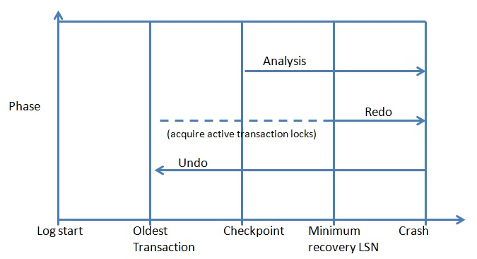
Phases of Recovery
Analysis
Redo
Undo

Slide 13
Recovery Models
Summarize important points.
Allow time for questions.

Slide 14
Assessment and Evaluation
Prepare a quiz or challenge to assess how much information participants learned.
Survey participants to see if they found the training beneficial.

