Slide 1
Inside transaction logging

Slide 2









Sponsors

Slide 3
About me
Taras Bobrovytskyi
Senior Database Developer @ Wincor Nixdorf
MCITP: SQL Dev/Admin 2008
MCT: 2007-2014

Slide 4
Transaction Basics
Core properties
Atomicity
Consistency
Isolation
Durability

Slide 5
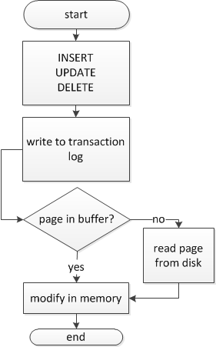
Data Modification Process
Buffer pool
INSERT
UPDATE
DELETE
Transaction
Log
Disk file

Slide 6
Transaction Logging
Demarcation on transactions
BEGIN
COMMIT
ROLLBACK
SAVE
Data changes
operation performed
before/after data
ROLLBACK writes compensation log records

Slide 7
Recovery
Server restart
Database restore operations
Phases
Analysis
Dirty Page Table
Active Transaction Table
Redo
Reapply logged operations
Since oldest uncommitted transaction
Undo
Rollback uncommitted transactions

Slide 8
Page LSN
Data page
Log Record
Page 1:36
LSN:
2:200:7
Op: UPD
Page: 1:36
Row:5
LSN:
2:210:6
Prev LSN:
2:200:7
Redo
Page 1:36
LSN:
2:300:10
Op: UPD
Page: 1:36
Row:5
LSN:
2:210:6
Prev LSN:
2:200:7
Do nothing

Slide 9
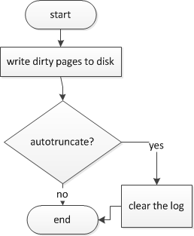
Checkpoints
Automatic – recovery interval
Indirect – database target recovery time
Manual – CHECKPOINT command
Internal
DB files manipulations
Backups
Snapshots
DB Shutdown (i.e. AUTO_CLOSE)
Instance stopped
Failover cluster instance offline

Slide 10
Automatic Checkpoints
Recovery interval – default to 1 minute
Relies on number of transactions
Simple recovery model – Transaction Log 70% full
EXEC sp_configure 'recovery interval','seconds'

Slide 11
Indirect Checkpoints
Recovery interval override at database level
Relies on number of dirty pages
More reliable recovery time constraint
May cause IO performance overhead
ALTER DATABASE … SET TARGET_RECOVERY_TIME =target_recovery_time{ SECONDS | MINUTES }

Slide 12
Manual Checkpoint
CHECKPOINT [ checkpoint_duration ]

Slide 13
Virtual Log Files (VLF)
Unit of log space management
Initially – between 2 an 16 VLFs
No fixed Size
<1 Mb - ??
1-64 Mb – 4 VLF
64Mb-1Gb – 8 VLF
>1Gb – 16 VLF
States
Active
Recoverable
Reusable
Unused

Slide 14
VLF Information
DBCC LOGINFO
RecoveryUnitId FileId FileSize StartOffset FSeqNo Status Parity CreateLSN
-------------- ----------- -------------------- -------------------- ----------- ----------- ------ ------------------
0 2 262144 8192 4377 2 128 0
0 2 262144 270336 4378 2 128 0
0 2 262144 532480 4372 0 64 0
0 2 303104 794624 4375 0 64 0
0 2 278528 1097728 4376 2 64 82000000003200001
0 2 262144 1376256 4373 0 64 91000000048800020
0 2 262144 1638400 4374 0 128 110000000037600119
(7 row(s) affected)
DBCC execution completed. If DBCC printed error messages, contact your system administrator.

Slide 15
Multiple Log Files
First file is reused until no unused or reusable VLF available
I so, additional VLF added to log sequence
file 1
file 2
file 3
file 1
file 2
file 3
file 1
file 2
file 3

Slide 16
Long-running transactions impact
t1
t1
t2
t3

Slide 17
Long-running transactions impact
t1
t1
t2
t3

Slide 18
Size Increment Considerations
Instant File Initialization not working for Log!
Bigger Increment = Less Fragmentation + Less VLF

Slide 19
Log Truncation
Simple – automatic on checkpoint
Full
on log backup
if no full backup has yet been made – automatic on checkpoint
Bulk-logged
on log backup
if no full backup has yet been made – automatic on checkpoint

Slide 20
Shrinking Log Files
Manually
DBCC SHRINKFILE
DBCC SHRINKDATABASE
Automatic
autoshrink database option
every 30 minutes
shrinkpoint at 125% of actual log space used

Slide 21
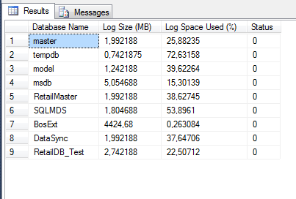
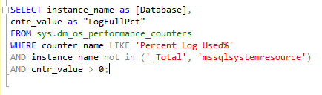
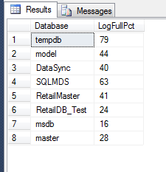
Monitoring File Size
DBCC SQLPERF(LOGSPACE)

Slide 22
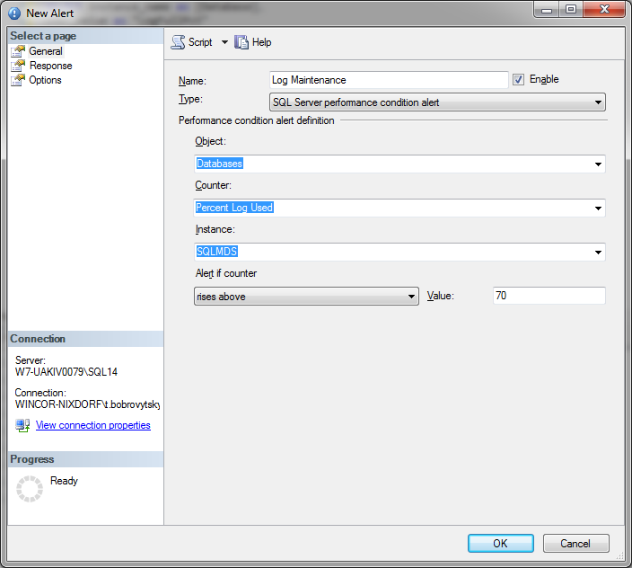
Reacting to Log File Size events

Slide 23
Minimally Logged Operations
SELECT INTO
BULK INSERT / bcp
INSERT INTO.. SELECT
OPENROWSET(BULK ..)
target table with no nonclustered indexes+TABLOCK
Partial Updates
LOB
WRITETEXT, UPDATETEXT
Index operations

Slide 24
Recovery Models
FULL
full logging
transaction log backups available
log truncated on log backup
BULK_LOGGED
logs the occurrence on minimally logged operation
minimally logged map
additional IO overhead
transaction log backups available
log truncated on log backup
Simple
logging same as BULK_LOGGED
log truncated on checkpoint
no log backups

Slide 25
Log Cache
Since SQL 2008
128 entries on 64-bit systems
32 entries on 32-bit systems
Entry contains buffer for log records
Buffer size is capped at 4MB
Log records are flushed to disk in block of typically 60KB
Log records are flushed before dirty pages
Log pool

Slide 26
Final Recommendations
Developers
Keep transactions short
Keep an eye on the log for long running transactions
Typical – housekeeping
Administrators / App support engineers
Choose the Recovery model wisely
Don’t forget the log backups
Monitor the space usage and number of VLF’s

Slide 27

Further reading
MSDN / TechNet
Paul Randal blog - http://www.sqlskills.com/blogs/paul/
SQLSkills Insider emails –
https://www.sqlskills.com/join-the-sqlskills-insider-community/
SQL Server Internals 2008/2012

Slide 28
Q&A
Thanks

