Slide 1
Refresh a 1TB+ database in under 10 seconds…
by Andrzej Pilacik

Slide 2
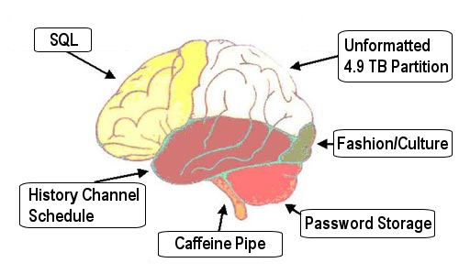

Who am I?
Senior Database Administrator / Solution Architect at Bracebridge Capital
15 years of experience in Database Platforms, SQL Server 7.0 - 2014, Oracle, PostgreSQL
Microsoft Certified Professional - SQL Server
Working with large data in Healthcare, Insurance, and Financial Sectors
Andrzej.Pilacik@outlook.com
@cypisek77

Slide 3

Bracebridge Capital is a hedge fund founded in 1994 that pursues an absolute return strategy using a broad array of investment instruments
We manage approximately $10 billion in capital for global investors including endowments & foundations, pensions, high net worth individuals, fund of funds, and ourselves
Approximately 100 employees are located at our office in Boston’s Back Bay
Our senior investment professionals have worked at the firm for an average of more than 16 years
We have a strong track record and are well respected within the industry
Emerging Markets
Data Collection & Management
Corporate Credit
Security Modeling & Analytics
TRADING
TEAM OF 24
QUANTITATIVE RESEARCH TEAM OF 18
Treasury & Agency
Structured Products
Risk Management Software
Development

Slide 4
Database Platform Challenges
Complicated Environments (multiple hardware and software layers)
Increasing need for higher RTO and RPO
Increasing data footprint
Increasing demand for instant data
Constant Change
Increasing cost of hardware and licensing
Balancing budgets
Our beloved Developers

Slide 5
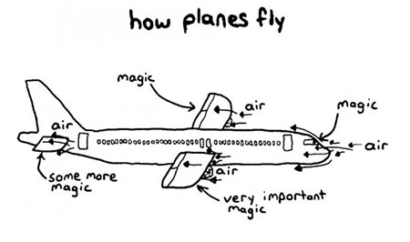
Rule # 1
NO MAGIC !!!

Slide 6
Problem at hand…
Creation of multiple read/write SQL Server Environments
1-10TB+ database size
Mixed database load (OLTP (30%), OLAP (70%))
Production environment with a limited, ever moving maintenance window
SQL Server recovery model – nothing other than SIMPLE
Daily creation of 1-10 DEV / 1-5 TEST / 1 UAT / 1 PROD (RO) environments
On-demand environment restores
Magic 24/7

Slide 7
World in SQL Server
Read/Write Environment Delivery
Time consuming restores
Backup and Recovery model dependent
Limited to Read-only (Log Shipping, Mirroring, Always-On)
Storage footprint
SQL Editions and licensing
Custom coding
Increasing need for higher RTO and RPO
Log Shipping
Mirroring
Always-On
Decreasing DBA maintenance window

Slide 8
World in SQL Server
Increasing data footprint
Unpredictable data growth
Operational data growth
Unmanageable maintenance window
Increasing demand for instant data
Data Warehousing
Data availability 24/7
Read/write demands
Instant data refreshes
Constant Change
Custom solutions – code maintenance
Legacy code support
Windows / SQL Server patching
SQL Version support

Slide 9
World in SQL Server
Increasing cost of hardware and licensing
SQL Server Licensing (Enterprise Core model)
Windows Licensing (Core model)
Cheaper / Faster hardware – reality check
Balancing budgets
Ever increasing maintenance costs
Ever increasing licensing costs
Shifting costs

Slide 10
SQL Server ways… Scalability…
Restores / Log shipping / Mirroring / Always-On
DB Size | Backup Time | Backup Size | Restore Time
1 TB | 15 min | 110GB (compressed) – 8 files | ~ 24 min
1.5 TB | 21 min | 140GB (compressed) – 8 files | ~ 33 min
Daily Restores
Log Shipping (Read Only - Sometimes) - Full
Mirror (Read Only) - Full
AlwaysOn (Read Only) - Full

Slide 11
What now?
Full SSD storage solution with an innovative, simplified future path
Evaluation of storage vendors
Pure Storage, Solid Fire, EMC
Support of current HA/DR solutions
Snapshot technology ***
Performance degradation (NO MAGIC)
Flexibility
Consistency in recoverability
Support for an API
Future development of the technology
“We” chose to go with EMC XtremIO brick

Slide 12
What now?
if (works) {
SUCCESS;
}
else {
URLT;
}

Slide 13
Semi-Magic ways… Production
Multiple Environments
PROD
UAT1
DEV1
Enterprise SP1
Enterprise SP1
Developer SP1

Slide 14
Semi-Magic ways… DR
PRODUCTION
DR
PROD
UAT1
UAT2
DR
DEV1
DEV2
Enterprise SP1
Enterprise SP1
Enterprise SP1
Enterprise SP1
Developer SP1
Developer SP1
SQL Restores
DR LUNS
SNAPSHOTS of DR LUNS

Slide 15

Semi-Magic way… Procedure
EMC XtremIO Snapshots Initial Setup
Stop SQL Server
Start SQL Server
D: System
D: System
D: System
E: Data
E: Data
E: Data
F: Tlog
F: Tlog
X: System (SNAP)
F: Tlog
T: TempDB
T: TempDB
Y: Data (SNAP)
T: TempDB
Z: Tlog (SNAP)
Q: TempDB (SNAP)

Slide 16


Semi-Magic ways… Procedure cont.
EMC XtremIO Snapshots Subsequent Runs
Stop SQL Server
Start SQL Server
D: System
D: System (SNAP)
D: SQLBin (SNAP Refresh)
E: Data
E: Data (SNAP)
E: Data (SNAP Refresh)
F: Tlog
F: Tlog (SNAP)
F: Tlog (SNAP Refresh)
T: TempDB
T: TempDB (SNAP)
T: TempDB (SNAP Refresh)

Slide 17
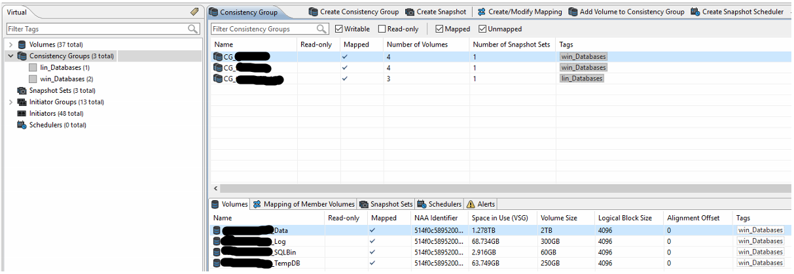
Semi-Magic ways…
EMC Control Panel - Simplification

Slide 18
Semi-Magic ways…
Post Refresh Cleanup Procedures
Use of custom SQL Framework
SQL Agent (Jobs, Alerts, Operators, Proxies)
Database settings (Recovery, Encryption)
Security (Logins, Roles, Credentials, Audits)
Server Management (Resource Governor, Policies, Extended Events and traces, Maintenance Plans, Mail, DTC)
Server Objects (Triggers, Linked Servers, Endpoints, Backup Devices)
Replication
SSIS, SSRS
Custom Rule Automation
Verification procedures
Delivery Automation
On-Demand Magic

Slide 19
Semi-Magic ways…
Framework Development
PowerShell Framework Integration
Custom PowerShell Modules
Server Control
Service Control
File Control
Windows Security Control
Security API (Password Management in Keypass)
Storage API (EMC XIO)
SQL Server Native PS API
Idera Diagnostic Manager API

Slide 20
Snapshots of existing SQL Luns
Time analysis of Snapshot LUN creation
 | 10GB Delta | 500GB Delta
Refresh Time 1 TB Database | < 1 sec | < 10 sec
Refresh Time 1.5 TB Database | < 1 sec | < 10 sec
Refresh Time 2 TB Database | < 1 sec | < 10 sec

Slide 21

Refresh a 10TB+ database in under 60 seconds…

Slide 22
Questions?
Thank you !

