Slide 1

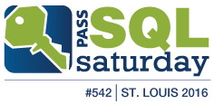
Data Security
Lighthouse Software Solutions
Rick Bielawski
2042 Wooddale Dr.
Suite 125
St. Paul, MN 55125
On the web at lssinc.com

Slide 2
Agenda
Infrastructure Security
Data security requires a comprehensive environment-pervasive plan.
Database security requires more than access controls.
SQL Server Security
The Database instance service account
Logins vs Users
Ownership Chaining
Impersonation
Certificate Signing
TRUSTWORTHY & DB_CHAINING

Slide 3
Limits to what I can cover
Data security is an enormous topic To cover the basics of every feature would take 2 days.
There are thousands of points of vulnerability http://www.teamscs.com/category/data-security/
Hundreds of tools readily available
An infinite combination of implementation strategies
What are ‘Best Practices’ & who decides?

Slide 4
Design Best Practices
Design practices that, over time, have proven to be:
Easier to troubleshoot
Easier to enhance
Easier to secure
IOW: Over time – cost less to maintain than other design choices.

Slide 5
The single most important Design best-practice
Build to interfaces not implementations
In the database world (almost) NOBODY seems to follow this rule
TABLES are IMPLEMENTATIONS!

Slide 6
Data Access Design Pattern
Create at least two types of schemas: Public and Private. Use a naming convention to denote the schema type.
Tables are ALWAYS in a private schema. NOBODY is granted access to these.
Access is only granted to interface schemas. These schemas NEVER contain tables! Views in an interface schema always specify “WITH VIEW_METADATA”
Optionally a ‘Protected’ schema type used to join data from multiple private schemas for use by multiple public schemas.

Slide 7
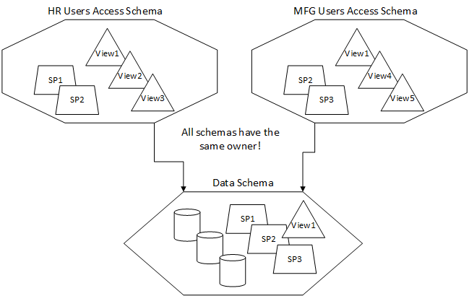

Slide 8
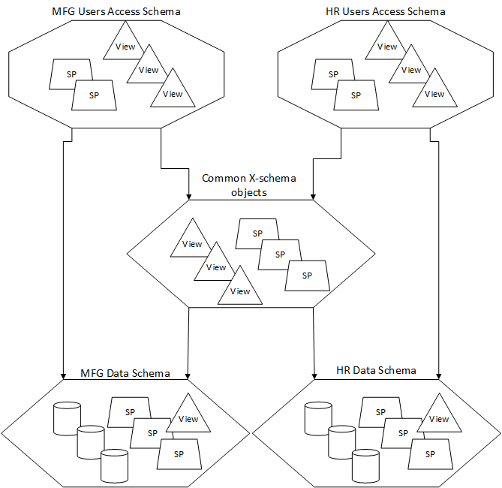

Slide 9
Top 5 Security Best Practices
Least Privileges
Least Privileges
Least Privileges
Monitor access failures
INVESTIGATE access failures!
If you don’t stop an attacker BEFORE they succeed they WILL eventually succeed!

Slide 10
What are you securing?
0010101111001110101011 Is it really just the database?
What about printed copies Only policies and procedures can protect these.
What about backups Can they be stolen? If the building is destroyed can you still recover?
What about transient locations Memory scraping, network sniffing, paging file access, EMF monitoring…

Slide 11
Barriers to access
The vast majority of important data is not deliberately accessible from the internet
Physical access
ID/Password
Encryption
The more barriers you have the harder you make it to reach your data.

Slide 12
Terms
Unsecure
Accessible and readable without much or any manipulation.
Secured
Access mechanisms refuse to present the data.
Obfuscated
Information to return to clear text is available.
Encrypted
Additional information is required to get clear text.
Hashed
Can’t be reversed. Many data blocks produce the same hash.

Slide 13
ID/Password
Obfuscating words is not effective against programs Replacing O with 0 or S with $....
Use MORE than 14 characters So the easily broken legacy LM Hash is not computed. http://en.wikipedia.org/wiki/LM_hash Phrases or sentences are easier to remember than ‘p@$sw0rds!’.
Passwords can contain ANY Unicode character Single sign-on systems reduce your options to the LCD. If forced: Use a keyboard pattern rather than words. If possible include non-ASCII characters like <alt>0176 (° degree).
Don’t use predictable patterns DPAPI must store all prior passwords to work. https://www.elie.net/go/p14a

Slide 14
Physical Access
Means Access to:
The machine holding the data
A network with access to the machine
Backups of the machine
User hardcopies
User storage media (phone, thumb drive…)

Slide 15
Nullifying the Physical Access Barrier
Key Sweeper video
https://www.youtube.com/watch?v=WqkmGG0biXc

Slide 16
Nullifying the ID/Password barrier
Network sniffing
EMF sniffing
Written or easily guessed passwords
Malware introduced by user activity
Malware introduced through lack of barriers
Malware introduced due to barrier weaknesses
EXCESSIVE ACCESS

Slide 17
Nullifying Encryption
Having strong keys and protecting them is paramount.
Microsoft SQL Server uses DPAPI which is vulnerable to certain software attacks. (See https://www.elie.net/go/p14a) It can’t protect its keys from an ‘inside job’.
Where security is truly critical a 3rd party hardware based encryption system (using the EKM interface) is almost mandatory. These have no interface to reveal their keys. Only the box can decrypt what it encrypts.

Slide 18
Microsoft SQL Server Service Account
Needs very little more than access to the directories where data, log and snapshot files are stored. Don’t give it more. Certainly not admin access!
Configure credentials for use in specific cases where additional authority is required for other tasks; be they agent jobs, replication, service broker etc.
Nothing else should ever be allowed to run under the service account. DPAPI protects the keys protecting credentials, certificates and data so anything using the same account can compromise those keys.

Slide 19
Understanding LOGINs
At the ‘Server Instance’ level the Instance:
Deals only with LOGINs (Stored in Master)
Performs all authentication
A Login only needs connect authority to be authenticated (given a session) in the instance (unless they specify an initial catalog which is contained)
Once a session is granted
Server level permissions control what server level operations can be performed. None are required.
Database permissions control database level activity

Slide 20
Understanding USERs
At the Database level a database
Deals only with USERs
Delegates any authentication back to the instance (Contained databases are only a technical exception)
Any unknown login is mapped to the GUEST user if enabled (It’s not, by default)
If a login, certificate or asymmetric key isn’t mapped to a user NO access is granted

Slide 21
Ownership Chaining
There are always 2 sets of permissions in effect when a procedure is running: Yours & the procedure’s.
Works for row level access & execute only.
If you have access to a view, function or procedure, that access automatically extends to any other view, function, procedure or table owned by that object’s owner. No extra authority needs to be granted.
Applies to any view, function or procedure you can use (for any reason: grant, chaining, execute-as, signing certificate).
Includes cross database access in specific cases.
This permission is NOT affected by a DENY on the user executing the statement.

Slide 22
Ownership Chaining
Read & Execute
Read & Execute
Giving Permissions through Stored Procedures
http://www.sommarskog.se/grantperm.html

Slide 23
Ownership Chaining
Doesn’t work when:
Referenced objects are owned by another user. (breaks chain)
Dynamic SQL is executed. (no owner - breaks chain)
In cross database situations where:
The SERVER LEVEL setting of ‘cross db ownership chaining’ is off (off by default).
The request isn’t made by a Login mapped to a user in the referenced database (not a user)
EXECUTE AS <User> is specified. Only Logins can make cross database calls.

Slide 25
Impersonation
CREATE … WITH EXECUTE AS {owner|caller|self}
CREATE … WITH EXECUTE AS [user = ] 'dbUser'
CREATE … WITH EXECUTE AS LOGIN = 'Domain\User'
Works on Multi-statement functions, stored procedures, triggers and queues.
Operates as if that ID executed the function or procedure.
DO NOT impersonate authoritative users such as dbo, OWNER or SELF (violates least privilege).
Ownership chaining continues to work

Slide 26
Certificate Signing
CREATE CERTIFICATE CertForUser …
CREATE USER CertUser FROM CERTIFICATE CertForUser
ADD SIGNATURE TO SensitiveProc BY CERTIFICATE CertForUser …
Permissions are assigned by granting them to the user (or login) associated with the certificate.
Works on Multi-statement functions, stored procedures, triggers and queues.
An object can be signed by multiple certificates.
The permissions the signature imparts are not inherited by referenced objects.
Ownership chaining continues to work

Slide 27
Differences between certificate user and a user without login
You can assign a procedure permissions from multiple certificates but you can only execute AS a single user or login
Execute AS persists as nested calls are made (unless another EXECUTE AS intervenes)
Execute AS changes CURRENT_USER() thus auditing should refer to ORIGINAL_LOGIN()
Certificate permissions don’t persist (although ownership chaining does)

Slide 28
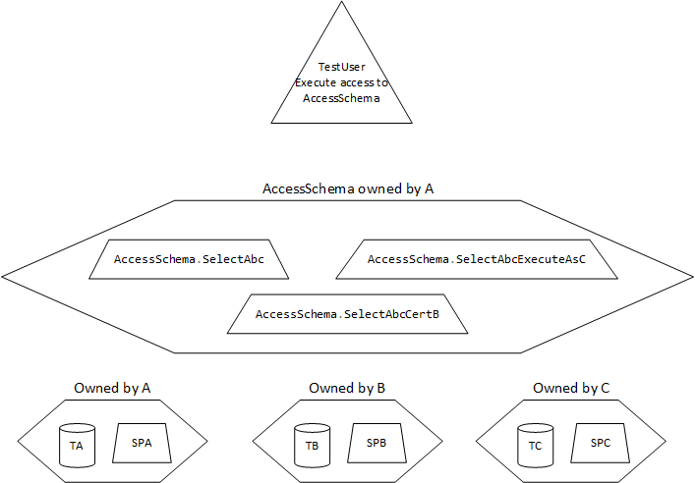
Test Script

Slide 29
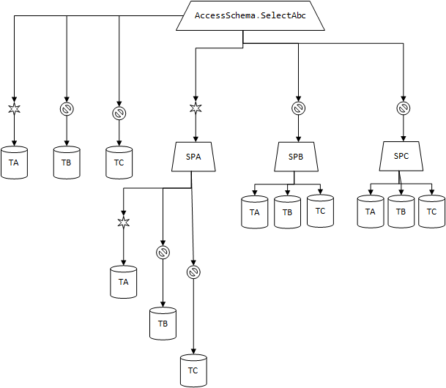
Chaining

Slide 30
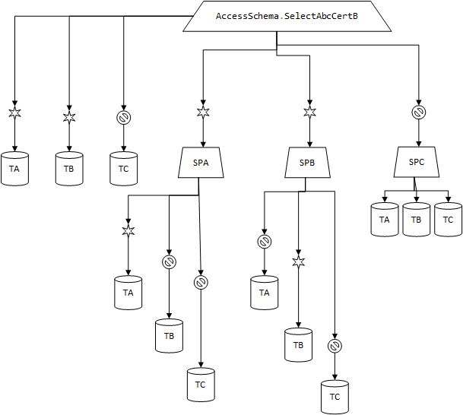
Certificate

Slide 31
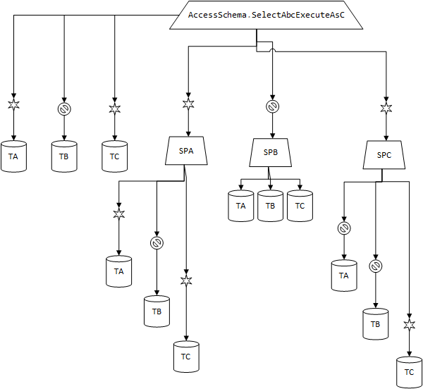
Execute AS

Slide 32
Trustworthy
Pros:
This server level permission is granted to a specific database, not all databases.
A database used only by the SA has the potential to be a ‘trustworthy’ database.
Cons:
Once granted, the database can impersonate any login – including logins with SA access!

Slide 33
Database Chaining
Pros:
No system level permissions can be compromised because only EXEC and row-level operations are affected
Cons:
The setting isn’t database specific. All databases are affected.
As a DBO I can add any ID that exists in another database then use chaining to read/update/delete rows in any table.

Slide 34
Concepts I didn’t have time to cover
Implications to allowing contained databases
SSL – Requiring encrypted connections
Dedicated Admin Connection considerations
Impersonating non-database users
Auditing
Using the Login trigger & CONTEXT_INFO()
Allowing non-SA users to perform bulk insert.
Implementing row level security
Encryption (backups, TDE, Columns)

