Slide 1
Taming the Beast
How a SQL DBA
can keep Kerberos under control
David Postlethwaite
Notes:
Abstract
Taming the Beast – How can a SQL DBA keep Kerberos under control
The word Kerberos can strike fear into a SQL DBA as well as many Windows Server Administrators.
What should be a straight forward and simple process can lead to all sorts of issues and trying to resolve them can turn into a nightmare.
This talk looks at the principle of Kerberos, how it applies to SQL Server and what we need to do ensure it works
About the Author
David Postlethwaite has been a SQL Server and Oracle DBA for Liverpool Victoria in Bournemouth, England for the last 6 years. He manages over 200 SQL and Oracle Servers from 2000 to 2012, DBMS, SSIS, SSAS and Reporting Services. Before that he was a .NET developer and way back in history a Windows and Netware administrator.
He is an occasional blogger on www.gethynellis.com
Good Morning.
Welcome to this morning’s presentation. This presentation is entitled “Kerberos for the SQL Server DBA” so if you are expecting to hear something else you are in the wrong room.

Slide 2











Sponsors

Slide 3


About Me
David Postlethwaite
Liverpool Victoria LV=
SQL and Oracle DBA
MCSE 2012 Data Platform
MCITP 2008, 2005
Oracle OCA
25 years IT Experience
6 years as DBA
david@clunyweb.co.uk
Blog: gethynellis.com
3 |
Notes:
About Me
Good Afternoon.
Welcome to this presentation which is entitled “How can a SQL DBA keep Kerberos under control
so if you are expecting to hear something else you are in the wrong room.
My name is David Postlethwaite, I am a senior SQL Server DBA for Liverpool Victoria,
one of the largest insurance companies in the UK with over five million customers
I have been working as a DBA for the last 6 years
I currently manage SQL and Oracle instances including database, analysis services, Integration services and Reporting Services.
Previous to that I was a developer using .NET, SQL, Access, FoxPro and Oracle
And before that I was a Windows and Netware administrator.
I contribute to the blog on gethynellis.com

Slide 4
Introduction
Kerberos
What is it?
When do we need it?
How do we configure it?
Who can configure it?
Why does it cause so many issues?
How do we fix it?
4 |
Notes:
Introduction
As a matter of interest how many people have had experience of configuring Kerberos in Windows?
And who has had problems?
Kerberos. It’s something that causes lots of problems for many SQL DBAs as well as many Windows Server Administrators.
But configuring Kerberos isn’t that difficult.
What should be a straight forward and simple process can lead to all sorts of issues and trying to resolve them can sometimes be hard work
In this talk we are going to look at Kerberos, how it applies to SQL Server and what we need to do ensure it works
We are going to look at
* What is the purpose of Kerberos in relation to SQL Server?
* When do we need to use it? Do we need to worry about it at all?
* How do we configure it? What tools can we use?
* Who can configure it? Is it the DBA job to manage and configure Kerberos?
* Why does it cause so many issues?
Because on the face of it setting up Kerberos for a SQL Server is actually straightforward but it is very easy to get wrong and then sometimes very difficult to see what is wrong
And finally
* How do we fix it?
When it doesn't work what can we do to try and get it working

Slide 5



My Windows Domain
Active Directory Domain CW1
Cluny10
Domain Controller
clw-sw-s007
SQL Server
clw-sw-s008
SQL Server
clw-sw-s006\CW2012
Cw1\sqlservice2
Notes:
Active Directory Domain CW1
Before I look at what Kerberos is I want to give a scenario where Kerberos authentication is required for SQL Server
Here is a diagram of my Windows setup
I have an Active Directory domain called CW1
A domain controller s007
Two SQL Servers s006 and s008
Both instances of SQL are using domain accounts to run the SQL Server service
My laptop is Cluny10
I am logged in as a domain admin and I have sysadmin permissions on all SQL instances

Slide 6
When do we need it?
The Double Hop Problem
Using desktop SSMS to insert data into a SQL instance from another server
BULK INSERT dbo.table1
FROM '\\RemoteServer\data$\test1.csv'
WITH (
FIELDTERMINATOR = ','
,ROWTERMINATOR = '\n'
)
OR
select * from openrowset('SQLNCLI', 'Server=RemoteServer Trusted_Connection=yes;', 'select * from sys.databases')
Login failed for user ‘NT AUTHORITY\ANONYMOUS LOGON’
Notes:
When do we need it?
RDP to SQL Server (clw-sw-s008)
I want to insert some data from a text file using bulk insert. On the server I can run
BULK INSERT dbo.table1 FROM ‘c:\data\test1.csv‘
WITH (FIELDTERMINATOR =,',ROWTERMINATOR = '\n')
And it works fine. There are no permissions issues because the data file is local
I can also use a data file on another windows server (clw-sw-s006)
BULK INSERT dbo.table1
FROM '\\clw-sw-s006\data$\test1.csv'
WITH (FIELDTERMINATOR = ',',ROWTERMINATOR = '\n')
And it works fine. There are no permissions issues.
Let’s create a Linked Server to the other SQL Server (clw-sw-s006) and use the security option “Be Made using the login’s current security context”
I can run queries to select data from the linked server without error
I can also use the “openrowset” command to do add-hoc queries from the remote server
Now lets move to SSMS on my desktop connected to SQL server clw-sw-s008
BULK INSERT dbo.table1 FROM ‘c:\data\test1.csv'
WITH (FIELDTERMINATOR = ',‘ ,ROWTERMINATOR = '\n')
Will work fine, the files are on my desktop.
Interesting question. Who needs permissions to the data file? Me or the SQL Server service?
Now lets try inserting data from clw-sw-s006 data file to SQL Server clw-sw-s008
BULK INSERT dbo.table1
FROM '\\clw-sw-s006\data$\test1.csv'
WITH (FIELDTERMINATOR = ',',ROWTERMINATOR = '\n')
And it will fail with this error (assuming file permissions are correct)
Login failed for user ‘NT AUTHORITY\ANONYMOUS LOGON’
Let’s run the query that uses the linked server .
This also fails with the same error
In all cases I can connect directly to server clw-sw-s006 but I can’t connect to clw-sw-s006 via server clw-sw-s008
You may also experience similar errors in these scenarios
Viewing a report in Reporting Services that connects to SQL Server
Using a web application or other front-end applications such as SharePoint that accesses data from a SQL Server
The only way to fix this is to use Kerberos Delegation

Slide 7

NTLM
Authentication Process
1 “user1”
password
2 “user1”
3 challenge
hash
1
4 response
1
SQL Server
5
User1
challenge
response
7
“user1”
hash
6 compare
.
Domain Controller
Notes:
NTLM Authentication Process
So why does our query fail?
NTLM uses a challenge/response protocol to authenticate a user.
To avoid sending your password over the network the system requesting authentication must perform a calculation that proves it has access to your login credentials.
To keep it simple I’ve missed a few steps
Interactive Authentication
1. * A user logs on at a client computer and provides a domain name, user name, and password.
The client pc computes a cryptographic * hash of the password and then discards the actual password.
* It uses this to login to the Windows domain.
2. * The client now wants to connect to the SQL Server. It sends the user name to the server in plaintext.
3. * The server generates a 16-byte random number, called a challenge and sends it to the client.
4. * The client encrypts this challenge with the hash of the user's password and returns the result to the server. This is called the response.
5. * The SQL server sends to the domain controller:
The User name
The Challenge
The Response
6. * The domain controller looks up the user in Active Directory
and then computes its own version the Response from the password hash in Active Directory
and the challenge it received from the SQL Server.
7. *The domain controller compares the Response it computed (in step 6) to the response computed by the client (in step 4).
If they are identical, authentication is successful.

Slide 8
NTLM
Why It Fails
2 “user1”
1 “user1”
3 challenge
1
X
1
SQL Server
SQL Server 2
.
Domain Controller
Notes:
NTLM Why it Fails
So what happens when the SQL server tries to authenticate to the 2nd Server?
As we’ve just seen when a client wants access to use a resource it must go through the challenge
So the SQL server wants to connect to the File server using the client’s credentials
1. * The user has authenticated to the first SQL Server
2. * The 1st SQL server sends the client’s user name to the 2nd server
3. * The 2nd server generates the 16-byte random number challenge and sends it back to the SQL server.
4. * The 1st SQL server now needs to encrypt this challenge with the hash of the user's password to return to the file server.
But it can’t because it doesn't know what that hash is. That is only held on the client pc and the client pc will not to pass it to anything else
* So the connection fails
This is why NTLM fails.
The server cannot authenticate to the next hop without the user’s original password, something which it can’t get.
As a result, the process can only authenticate to the next tier as itself or NULL (anonymous).
Kerberos and its ability to delegate is the solution to this problem

Slide 9


What is Kerberos?
http://web.mit.edu/kerberos/
Created by Massachusetts Institute of Technology, USA
Name is based on the three- headed dog figure from Greek mythology known as Cerberus.
harrypotter.wikia.com
Or possibly Harry Potter
Uses Cryptographic Tickets
More secure and faster than NTLM
Can join Windows to other systems
Notes:
What is Kerberos?
Kerberos is a network authentication protocol developed at the Massachusetts Institute of Technology in the USA in the 1980s.
The name Kerberos is based on the three-headed dog figure from Greek mythology known as Cerberus because there are three parts to the protocol.
* Or possible from Harry Potter (Hagrid owned a Kerberos called Fluffy that guarded the Philosopher's Stone)
Instead of using a challenge, each time a client needs to access a server, Kerberos uses a concept known as * cryptographic tickets.
Kerberos is * faster and much more secure than NTLM and with the threat of hacking and data theft we should be looking to use Kerberos authentication throughout our Windows domain.
With the latest Windows 2012 R2 domains it is now possible to turn off NTLM authentication and I would expect one day that NTLM will be dropped from Windows altogether.
One major advantage of Kerberos authentication is that you can join Windows domains to other networks such as Unix allowing you to have one password domain covering all your systems.
Interestingly prior to changes in US federal law in 2000, Kerberos was classified by the U.S. government as a munition (i.e. a military weapon) and could not be exported outside the USA.
(Kerberos has been built into Windows 2000 and all versions since)

Slide 10
How Kerberos Works
Key Distribution Centre (KDC)
TGT Ticket Granting Ticket
Domain Controller
Authentication Server
ST Service Ticket
Ticket Granting Service
8 ST
3
7
TGT
1
2
TGT
4
ST
TGT + ST
5
9 TGT + ST
6 data
SQL Server
10 data
10 data
“user1”
.
SQL Server 2
Client
Notes:
How Kerberos Works:
There are three components to Kerberos:
1. * A Key Distribution Center (KDC), which has two parts: an * Authentication Server and a * Ticket Granting Service. In Windows this is a * domain controller
2. * A client or user
3. * A server that the client wants to access
Step 0 – * User enters his login name, password and domain
Step 1 – * The client passes this to the Authentication Server (AS) for verification
Step 2 – * It then grants the client a TGT - A Ticket Granting Ticket.
Think of the TGT as a general admission ticket to the domain. It allows the user permission to get onto the domain but not necessarily access to a specific service
Step 3 – * When the client wants to connect to the SQL Server ,
the client uses its TGT to request a * Service Ticket from the KDC.
Step 4 – The KDC looks up the SQL Server in Active Directory.
If the SQL Server is configured for Kerberos Authentication the Ticket Granting Service * provides a Service Ticket for that SQL Server to the client
Think of this Service Ticket as an admission ticket for a specific service within the domain
Step 5 – * The client can now offer the SQL Server its TGT and this Service Ticket
The SQL server doesn’t need to contact a Domain Controller for verification. The fact that the client has a TGT and the Service Ticket for this SQL service means that it has already proven its identity to the Domain Controller
And that’s all the server needs to know.
It does not need to know the user’s password
Step 6 – * The SQL Server can now return the data to the client. Assuming it has SQL permissions
One way to think of the TGT and ST is to compare it to a visit to a Theme park. The TGT gives you general access to the theme park for that day. To go on a specific ride you would present your TGT to the pay desk who would then issue you with a ticket specifically for that ride, your ST. You would then go to the ride and present both tickets to prove that you were allowed in the park today and that you have paid to go on the ride.
Step 7 – When the SQL Server sees that it needs to connect to the * 2nd Server it can use the * client’s TGT
Step 8 – * To request a service ticket for that server from the KDC
Step 9 – * With this service ticket the SQL Server can now connect to the 2nd Server using the client’s credentials.
Step 10 – The SQL Server can return the data to the client * *
Why (and how) Kerberos succeeds
As you can see Kerberos doesn’t depend on the original user password for authentication.
The only time the original password is used is when the user first logs on and authenticates to the Authentication Server
After that point, authentication to other services is based on the user possessing a Service Ticket for that service
For the SQL server to authenticate to the 2nd Server all it needs is the client’s TGT an ST
Why doesn’t SQL always use Kerberos
Kerberos is now the default protocol used by Active Directory.
In a Windows domain you will have logged into your pc using Kerberos authentication.
However many services and applications don’t yet support Kerberos authentication or require extra configuration before they can use it
Every time you login or connect to a server it will always first attempt to use Kerberos and if it can’t it will then revert to NTLM authentication.
In many cases SQL Server requires manual configuration to use Kerberos so in these cases you will use NTLM authentication when connecting to a SQL instance.

Slide 11
Configuring SQL for Kerberos
Done by the Windows Admin not the DBA
or someone with Write servicePrincipalName AD rights
Server Principle Name (SPN)
SETSPN.exe
Setspn.exe -s serviceclass/hostname:portnumber serviceAccountName
Setspn.exe -s MSSQLSvc/MySqlServer:1433 mydomain\sqlservice
SPN required for all aliases
Restart SQL
Notes:
Configuring Kerberos
So how do we configure Kerberos in Windows?
As I’ve already mentioned Kerberos is the default protocol used by Active Directory.
And your SQL Server may already be using Kerberos authentication without you having to do anything.
If not then you will have to configure it manually.
To configure a service such as SQL to use Kerberos you need to be a domain administrator or as a minimum have the Write servicePrincipalName permission in active Directory.
So the good news is that Kerberos configuration is probably not done by you, the DBA, but by a Windows Admin.
In my experience a lot of Windows admins don’t understand Kerberos either so, although you won’t be doing the work, its worth understanding what’s required and, even better, be able to tell your Windows admin what you need.
To enable Kerberos authentication on our SQL instance we must register a Server Principle Name or SPN for our SQL Server service.
An SPN is a unique name by which a client can identify a service on a particular host.
These SPNs are registered into Active Directory.
Like most complicated things that people struggle to understand, Microsoft has only produced a simple command line tool to configure it ☹
This tool is setspn.exe.
It should be already installed on your Windows servers. If its not installed on your desktop you can download it.
To create an SPN we need four things:
• Service Class: This identifies the general class of service. For SQL Server it is always MSSQLSvc
• Host Name: This is the fully qualified domain name in DNS of the computer that is running SQL Server. • Port: This is the port number that the service is listening on.
• Service Name The account that is running the service
The syntax to create an SPN for SQL Server service is
Setspn.exe –s serviceclass/host:portnumber servicename
So for SQL Server it will look like
SetSPN -s MSSQLSvc/clw-sw-s008:1433 CW1\sqlservice2
If you have aliases for your server, each of those must be registered as well.
Restart the SQL instance and you will now communicating with your SQL server using Kerberos
And that’s it
FYI
Every pc and server automatically has several SPNs running on them. For example whenever a computer is joined to a domain, it is assigned two SPN's called HOST (HOST/netbiosName, and HOST/FQDN.com) These SPNS are used to login to a domain using Kerberos.
(Quick note. Use the latest version of setspn.exe. This is much improved. With this version we can use –s to add a new SPN. NOT –a)
Remote Server Administration Tools for Windows 8.1
http://www.microsoft.com/en-gb/download/details.aspx?id=39296
Setspn Full syntax
https://technet.microsoft.com/en-us/library/cc731241.aspx

Slide 12
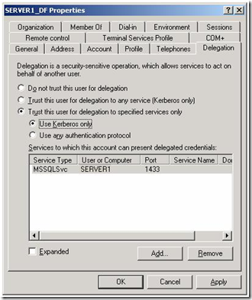
Configuring Kerberos in Windows
Delegation for Double Hop
Active Directory Users and Computers (ADUC)
View/Advanced Features
Delegation Tab
Remote Server Administration Tools
Notes:
Double Hop
To complete the configuration and enable the ability to double hop then you must make one more change.
This is to enable delegation
You can configure this using Active Directory Users and Computers
If you’ve never heard of ADUC, this is the tool that is used to manage user and computer accounts in Active Directory.
Find the service account that is running your SQL Service
Then select the Delegation Tab (This only appears if the account has an SPN and you’ve enabled Advanced features under the View menu)
Select Trust this user for delegation to any service (Kerberos Only)
Or if you want to be more restrictive on what this account can delegate then use
Trust this user for delegation to specified services only
And then enter the spn details for the service you wish your SQL server to connect to
You don’t need to Restart SQL
Even if you aren’t a windows admin or involved in managing user accounts ADUC can be invaluable for checking a user’s permissions in your domain.
It has helped me many times when someone has claimed they can’t get access to a SQL instance and it turns out they aren’t in the required AD group.
ADUC can be downloaded from Microsoft as part of the Remote Server Administration Tools. It’s part of the Windows 8 installation

Slide 13
Check to see if SQL is using Kerberos
sys.dm_exec_connections
SELECT
s.session_id, s.original_login_name, c.net_transport, c.auth_scheme, c.local_net_address, c.local_tcp_port, s.program_name
FROM sys.dm_exec_sessions s
LEFT OUTER JOIN
sys.dm_exec_connections c
ON (s.session_id = c.session_id)
where s.is_user_process = 1
Notes:
SQL Script to Check Kerberos
How do we check if SQL is using Kerberos authentication?
It wouldn’t be SQL if there wasn’t a DMV to help you
To see what authentication is being used use:
sys.dm_exec_connections
SELECT s.session_id,s.original_login_name, c.net_transport, c.auth_scheme,c.local_net_address,c.local_tcp_port,s.program_name
FROM sys.dm_exec_sessions s
LEFT OUTER JOIN
sys.dm_exec_connections c ON (s.session_id = c.session_id)
where s.is_user_process = 1

Slide 14
DEMO
Create the SPN
Use ADUC to enable delegation
Restart SQL
Rerun SQL script
Notes:
Create the spn using setspn
Set up the delegation using Active Directory users and Computers
Restart SQL
And demonstrate the three hops working

Slide 15
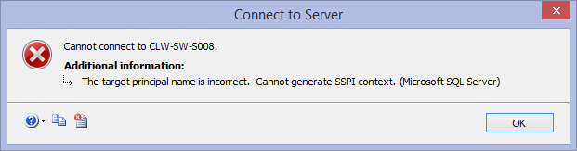
Problems
Duplicate SPN
Use –s instead of –a when creating SPNs. Or use the 2012 version
setspn – X to look for duplicates
setspn – D to delete an SPN
Setspn – L to list SPNs for particular account
Incorrect SPN
Spelling mistakes
Wrong Server Name – NetBIOS or FQDN
Registering the Alias
Wrong Service Account
Changing the service account invalidates SPN
Forgetting to Enable Delegation
Notes:
Problems
So if its so simple why do so many people struggle with Kerberos?
The error messages you receive won’t always tell you that Kerberos is the issue
The most common mistake used to be creating Duplicate SPNs
It used to be very easy to create more than one SPN for your SQL Server. If there are two SPNs, which one are you going to authenticate against?
Unfortunately the error you receive isn’t very helpful and doesn’t point to the fact you have a duplicate SPN
Microsoft has helped here.
In setspn.exe
Originally you used the –a option to create an SPN. This didn’t check for duplicates
Now, there is the option “–s”. This will check for a duplicate before it creates the SPN
The version of setspn that comes with Windows 2012 and Windows 8 has changed to make the –a option also checks for duplicates so now it is very difficult to create a duplicate SPN.
http://blogs.msdn.com/b/psssql/archive/2012/08/17/setspn-a-with-windows-2012-does-a-duplicate-check-upfront.aspx
Use the –X option to look for duplicates across the whole domain
You can delete the offending SPN with the –D option
Use –L to list all SPNs for a particular account. You can use it to list SPNs for a server but it will only list those registered to the local server account, it will not list those using a domain account on that server
(-s option was released with Windows 2003 SP 2 so chances are you are using the latest version. I can only find v6.1 and above on our systems and that has –s option)
Incorrect SPN
Easy to type it wrong, it won’t complain about spelling mistakes
Wrong Server Name
Use the FQDN when you register rather than just the server name
If you are connecting using an alias you must register that alias name as well as the server name
You must register the correct port number
Wrong Service Account
The SPN only works for the service account it was configured for. If you change SQL to use a different service account you will not be able to connect.
If you are going to change service account delete old SPN first then create the new one
Forgetting to turn on delegation
Delegation won’t work if its not turned on

Slide 16
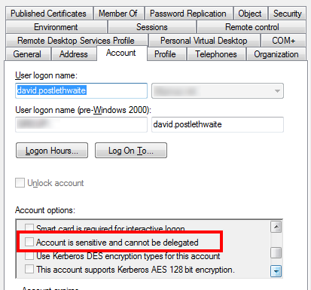
Problems
Forgetting to restart SQL
AD Replication
Stale Kerberos Tickets klist.exe
Sensitive Clients
Time Synchronisation
Dynamic Port or IP Address
Kerberos not configured on the End Server
Hosts File
BE PATIENT !
Notes:
Problems 2
Remember to restart the SQL Service after changing an SPN
Replication
Active Directory can take quite a while to replicate changes to all domain controllers so you may have to be wait a while before it works.
Stale Kerberos Tickets
Even when everything looks correct it can still not work.
The ticket on your pc may not recognise the new SPN
Klist.exe (part of the Remote Server Administration Tools) allows you to list cached tickets on your desktop and purge them forcing your pc to obtain a new Kerberos ticket
Sensitive Clients
In ADUC there is a setting called “Account is Sensitive and cannot be Delegated”
If this is set then your account won’t be able to do the two hops
Time Synchronisation
Kerberos is time sensitive. If the time is not correct across all servers in the domain then Kerberos may fail
Dynamic Ports or IP addresses
If the TCP port or IP address changes each time the server is restarted then the SPN will have to be deleted and recreated each time
The End Server
Make sure that the server at the end of the hop is also configured for Kerberos
Hosts File
If you use a hosts file ensure that the server name use the FQDN. Better not to use a hosts file
Sometimes you just have to be patient and wait for the changes to take effect.

Slide 17
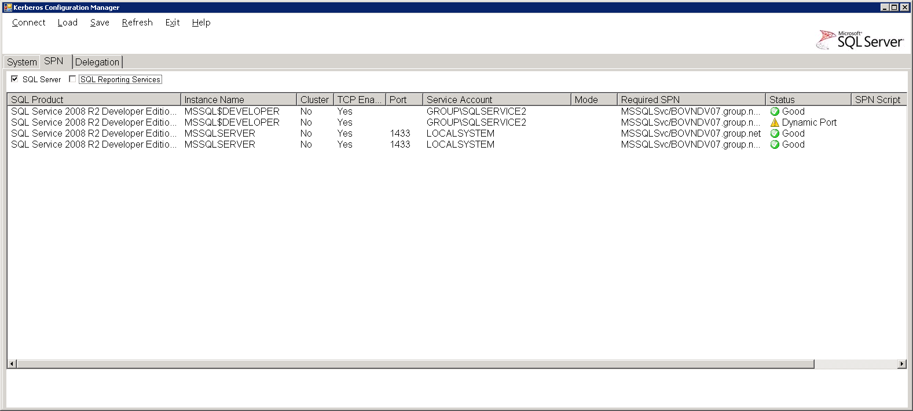
Microsoft Kerberos Configuration Manager for SQL Server
http://www.microsoft.com/en-gb/download/details.aspx?id=39046
\Program Files\Microsoft\Kerberos Configuration Manager for SQL Server
Notes:
Making the Job Easier
You may remember I said that there was only a command line tool for managing your SPNs
Well Microsoft have developed a graphical tool especially for SQL Server
called
Microsoft Kerberos Configuration Manager for SQL Server
And it’s really, really good.
You can download and install it, but it doesn’t create a shortcut so you’ll need to go and create one yourself
C:\Program Files\Microsoft\Kerberos Configuration Manager for SQL Server
This will tell you what SPNs are missing or duplicated for your SQL instance.
it will even write the setspn scripts for you to give to your Windows admins
This is a must have for any SQL DBA dealing with Kerberos
Latest version is v3. This supports SQL 2014 and below, DBMS, SSRS and SSAS instances.
Note – I found a bug in v3. if you only have SQL 2012 or below installed it won’t find them. It uses WMI to find the SQL servers. V3 looks in the location where SQL 2014 would be so can't find any previous versions
V2 supports 2012 and below DBMS and SSRS. It doesn’t recognise SQL 2014 instances.

Slide 18
Final Thoughts
Automatic SPN Creation
SQL Server is attempting to register a Service Principal Name (SPN) for the SQL Server service. Kerberos authentication will not be possible until a SPN is registered for the SQL Server service. This is an informational message. No user action is required.
Permission Write servicePrincipalName
Local and Virtual Accounts
NT Service/MSSQLServer will register spn automatically
Register the machine
Setspn -s MSSQLSvc/MySqlServer:1433 MyDomain\MySqlServer$“
http://blogs.msdn.com/b/saponsqlserver/archive/2013/05/03/faqs-around-kerberos-and-sql-server.aspx
SSRS
http://sqlmag.com/sql-server-reporting-services/implement-kerberos-delegation-ssrs
Notes:
Final Thoughts
You may be wondering why you have to go through the pain of creating SPNs manually
Why can’t SQL server just create them automatically?
Well SQL Server can and does.
By default, when the SQL service starts, it will attempt to register the SPN. If your service account is a domain admin or a built-in account such as Local System (And I hope it isn’t) it will automatically create an SPN when SQL starts and then automatically delete it when it shuts down.
If the SQL Service account doesn’t have permission to register an SPN in Active Directory Domain Services, this call will fail and a warning message will be logged in the SQL Server error log.
SQL Server is attempting to register a Service Principal Name (SPN) for the SQL Server service. Kerberos authentication will not be possible until a SPN is registered for the SQL Server service. This is an informational message. No user action is required.
This is why we have to create the SPNs manually if you are using a domain account to run the SQL Server service
It is possible to automate the process by giving the domain accounts Write servicePrincipalName permissions
That is way beyond the scope of this talk but I have included an article at the end of this PowerPoint slide deck if anyone is interested
Microsoft doesn’t recommend automating the SPN creation for SQL clusters.
Local and Virtual Accounts
If you are using SQL 2012 or 2014 then its quite likely you are using a virtual account or a managed service account (MSA) as your service account. (such as NT Service/MSSQLServer)
Both virtual accounts and MSA’s can register an SPN.
SQL Server must be running on the Windows 7 or above or Windows Server 2008 R2 and above
Otherwise you can register a local account manually
When you use local and virtual accounts the SPN is registered against the server name instead of the domain account
I would recommend using the Configuration Tool to ensure you get the syntax correct
Useful Article
http://blogs.msdn.com/b/saponsqlserver/archive/2013/05/03/faqs-around-kerberos-and-sql-server.aspx
SSRS
We haven’t mentioned Reporting Services but this is often where the double hop is required. You can be hopping from Web Browser to Web Server to SQL database .
This link http://sqlmag.com/sql-server-reporting-services/implement-kerberos-delegation-ssrs
provides a very good explanation of Kerberos and SSRS.
Also Kerberos Configuration Manager also supports SPNs for the SSRS service.

Slide 19
Any Questions
Conclusion
Hopefully you now have a better understanding of Kerberos
And will be able to use it safely in your environment
Q & A
https://www.youtube.com/watch?v=uO9NqxizT_8
david@clunyweb.co.uk
Blog: gethynellis.com
Notes:
Any Questions
Hopefully you now have a better understanding of Kerberos
And will be able to use it safely in your environment

Slide 20
Sponsors

Slide 21
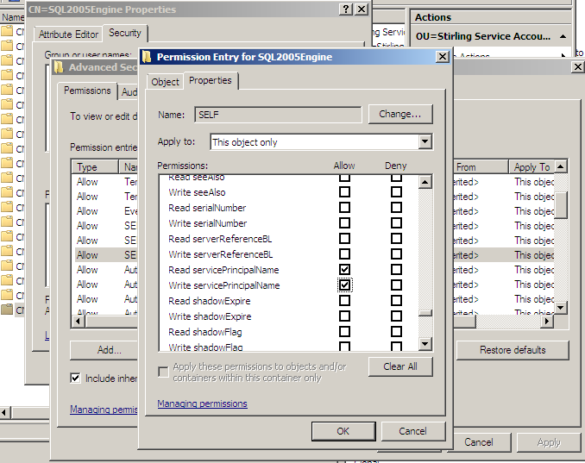
Dynamically Set SPN's for SQL Service Accounts
http://clintboessen.blogspot.co.uk/2010/02/dynamically-set-spns-for-sql-service.html
Notes:
Dynamically Set SPN's for SQL Service Accounts
From an article by Clint Boessen
http://clintboessen.blogspot.co.uk/2010/02/dynamically-set-spns-for-sql-service.html
For SQL Services Accounts they must have a SPN (service principal name) set. If the service account is also a Domain Admin this will be done automatically. If your SQL service account is not a Domain Admin it will not be able to set the SPN automatically. Usually a way to get around this is to use a program called setspn.exe and set the SPN on behalf of the user account as an Administrator. setspn.exe is part of the windows resource kit. I am going to show you another way how to do this - to allow a non-Domain Admin SQL service account to dynamically register its own SPN without having to use setspn.exe. 1. Click Start, click Run, type Adsiedit.msc, and then click OK. 2. In the ADSI Edit snap-in, expand Domain [DomainName], expand DC= RootDomainName, expand CN=Users, right-click CN= AccountName, and then click Properties. 3. In the CN= AccountName Properties dialog box, click the Security tab. 4. On the Security tab, click Advanced. 5. In the Advanced Security Settings dialog box, make sure that SELF is listed under Permission entries. If SELF is not listed, click Add, and then add SELF. 6. Under Permission entries, click SELF, and then click Edit. 7. In the Permission Entry dialog box, click the Properties tab 8. On the Properties tab, click This object only in the Apply onto list, and then make sure that the check boxes for the following permissions are selected under Permissions: - Read servicePrincipalName - Write servicePrincipalName 9. Click OK three times, and then exit the ADSI Edit snap-in.

