Slide 1
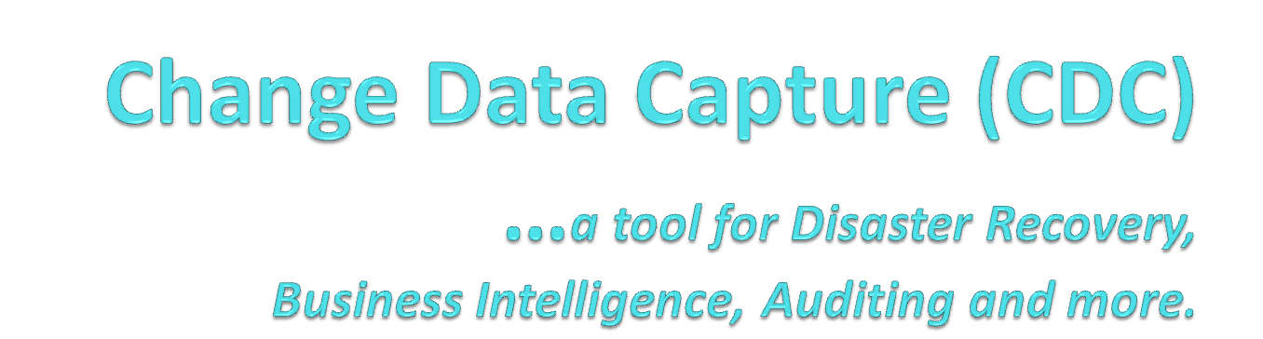

By: Jose Chinchilla
July 31, 2010

Slide 2
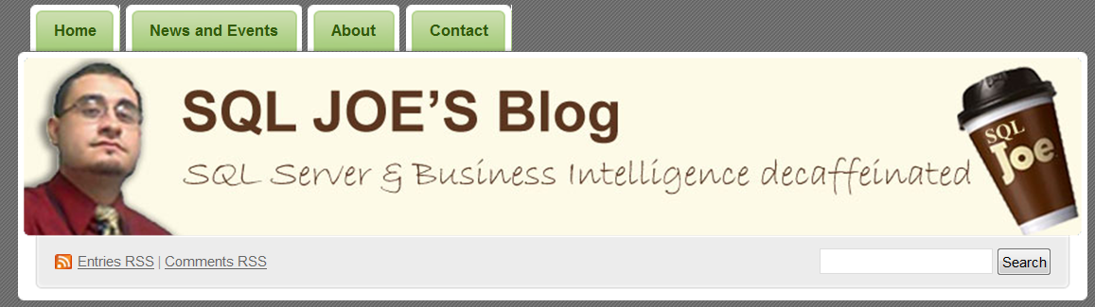
Jose Chinchilla
MCITP: SQL Server 2008 , Database Administrator
MCTS: SQL Server 2005/2008, Business Intelligence
“DBA by accident, BI Developer by chance, Geek by Choice”
Blog: http://www.sqljoe.com
Twitter: http://www.twitter.com/sqljoe
Linked-in: http://www.linkedin.com/in/josechinchilla
Email: jchinchilla@sqljoe.com

Slide 3
Session Agenda
Terms and Acronyms
CDC overview
Difference between CDC & CT
What can I use CDC for?
Demo: Configuring CDC
Demo: Querying changes in a CDC enabled table
Q&A

Slide 4
Terms and Acronyms
CDC: Change Data Capture
CT: Change Tracking
LSN: Log Sequence Number
Metadata: Data about data
SP: Stored Procedure
DDL: Data Definition Language
DML: Data Manipulation Language
BI: Business Intelligence
DW: Data Warehouse
SCD: Slowly Changing Dimensions

Slide 5
What is CDC?
New feature for SQL Server 2008
Enterprise and Developer Editions (included in Evaluation version)
Records all Inserts, Deletes and Updates on tracked tables (DML changes)
Before & After time stamped values recorded
Changes read from Transaction Log through SQL Agent Job
Changes can be queried through T-SQL statements
Does not use triggers -> Little or no performance overhead
Writes a record for each DML change -> Storage overhead

Slide 6
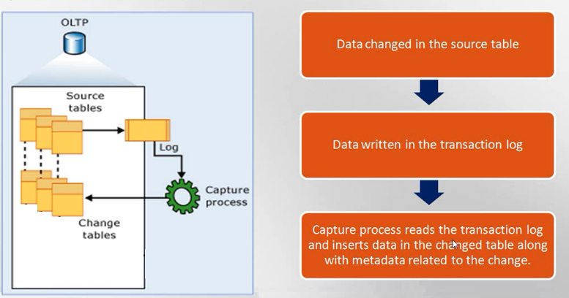

How does it work?

Slide 7
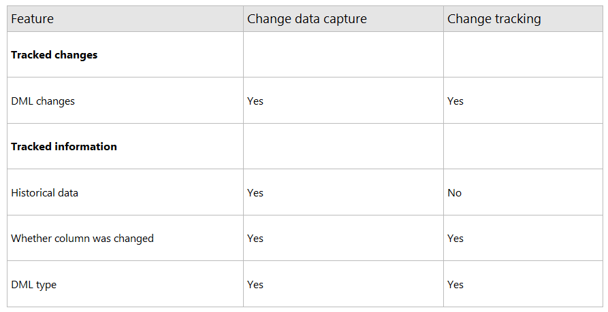
Change Data Capture (CDC) vs. Change Tracking (CT)
Source: MSDN BOL http://msdn.microsoft.com/en-us/library/cc280519.aspx

Slide 8
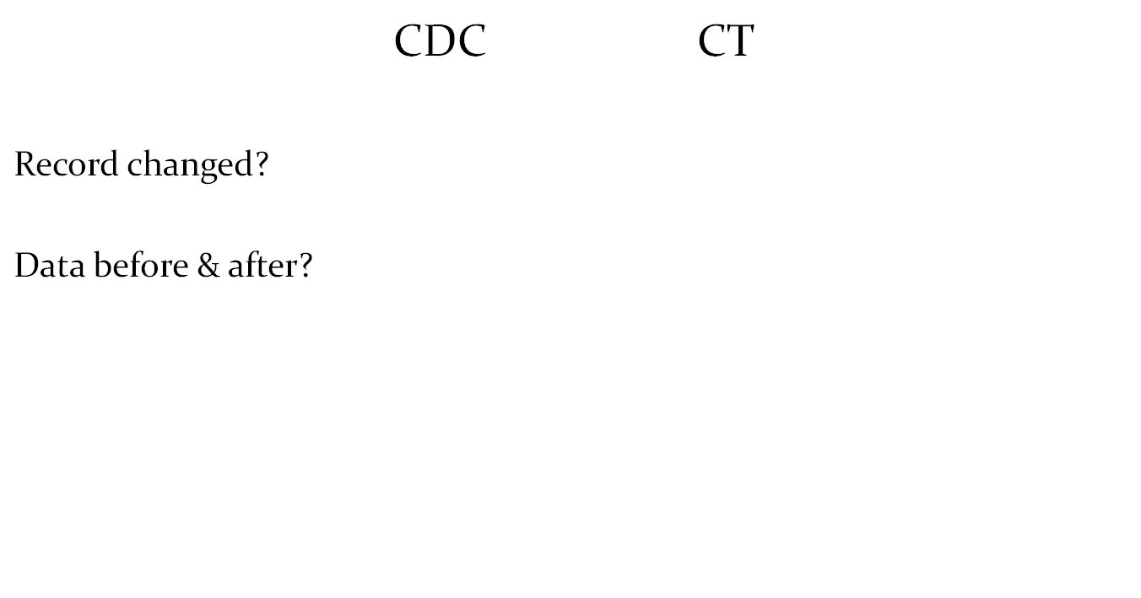


Change Data Capture (CDC) vs. Change Tracking (CT)

Slide 9
What can I use CDC for?
Auditing
Disaster Recovery (Human Errors)
Data Warehouse / BI Incremental Loads / SCDs
Debugging and QA
Database usage patterns and growth trends
Performance Tuning
Much more…

Slide 10

What can I use CDC for?
Auditing & Change Control
  What?
  Who?
  When?

Slide 11

What can I use CDC for?
Disaster Recovery
  Human errors
  Unintentional results
I didn’t mean to delete last 10 mins worth of transactions!
5,000 in total!
Perfect Storm
No backups for the last 15 mins
Not using transactions (no rollback)
Log Shipping not enabled
Deletions already replicated
Don’t have restore permissions
Production database cannot be offline at any time
Note: If you had restore permissions, you may have been able to recover the data by backing up tail of the log, restoring last full backup with NORECOVERY and restoring tail-log backup using STOPAT and Recovery option

Slide 12
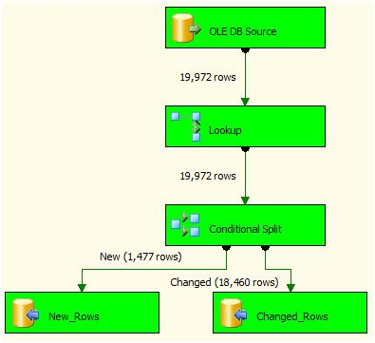
What can I use CDC for?
Data Warehouse / BI Incremental Loads
  No need for:
    Triggers
    Custom scripts
    Time Stamp
    Action Stamp
    Delete and Reload
  New process:
    Query CDC tables for new and
    changed data (updates/deletions)
  Perfect for Slowly Changing Dimensions (SCDs)

Slide 13

What can I use CDC for?
Debugging and QA
Before & After data results after code change
Documenting results after code change
Identifying “data anomalies” reported by users

Slide 14
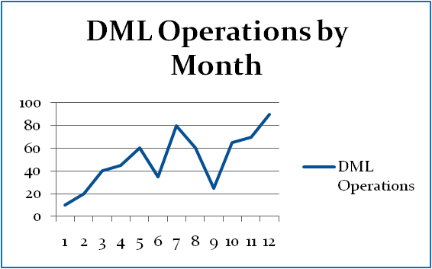
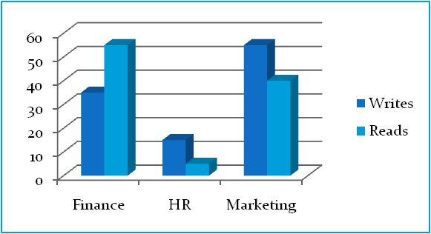
What can I use CDC for?
Database usage patterns and growth trends
  More Writes than Reads ?
  Operational Reports
    New Records per day: 5,000
    Updated Records in a week: 3,000
    Deletion of Records in a month: 500
Performance Tuning
    Identify most used tables and columns
    Identify indexing & partitioning needs

Slide 15
Configuring
Change Data Capture

Slide 16
How do I configure CDC?
System SPs
SSMS Template Explorer : pre-built scripts
Free CDCHelper at CodePlex

Slide 17
How do I configure CDC?
Enable CDC for the database
  EXEC sys.sp_cdc_enable_db
Enable CDC for a table
  EXEC sys.sp_cdc_enable_table
Enable CDC for specific columns in a table
  EXEC sys.sp_cdc_enable_table
  @source_schema = N‘MyDatabaseName',
  @source_name = N‘Customers',
  @role_name = NULL,
  @captured_column_list = '[CusomterID],[CustomerName]‘
* Role_name can be defined to limit view by SQL server roles. NULL defines view by everyone

Slide 18
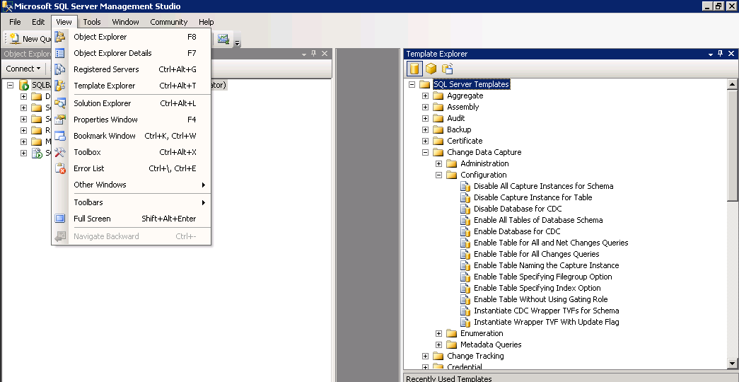
How do I configure CDC?
Template Explorer in SSMS

Slide 19
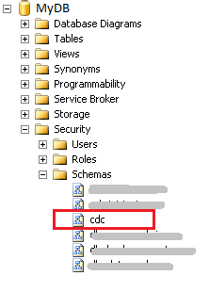
What changes does CDC do in my SQL Server?
Adds a new schema called “cdc”

Slide 20
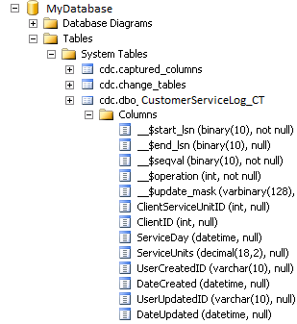
What changes does CDC do in my SQL Server?
Two SQL Server Agent jobs
  cdc.MyDatabase_capture
  cdc.MyDatabase_cleanup
Tracking system table
  _$ Metadata Columns

Slide 21
Demo:
Configuring CDC
Querying changes in a CDC enabled table

Slide 22
Word of Caution
DO NOT enable Change Data Tracking on ALL tables of your production database
Performance</>Storage
DO test and estimate performance and storage impact
DO establish CDC archiving policy (cleanup jobs)

Slide 23
Summary
Auditing
  Who, What, When
Disaster Recovery
  Human Errors
Data Warehouse / BI Incremental Loads
  SCDs
Debugging and QA
  Documentation, CYA
Database usage patterns and growth trends
  Usage reports, department chargebacks
Performance Tuning
  Reads vs. Writes down to the Table and Column
Much more…

Slide 24
Additional Resources
SQLPASS Summit Nov.,Seattle 2010
www.sqlpass.com
24 hours of PASS (Live Meetings)
SQL Saturday
www.sqlsaturday.com
SQL / BI local user groups
Twitter
#sqlhelp #sql #sqlr2
Blogs
SQL MCM, MVPs, Rockstars, Book Authors

Slide 25
CDC Links
MSDN
http://msdn.microsoft.com/en-us/library/bb522489.aspx
Channel 9 - MSDN
http://channel9.msdn.com/posts/ashishjaiman/CDC-Change-Data-Capture-SQL-Server-2008/
Pinal Dave
http://blog.sqlauthority.com/2009/08/15/sql-server-introduction-to-change-data-capture-cdc-in-sql-server-2008/

Slide 26
Thank you for attending!
Blog: http://www.sqljoe.com
Twitter: @sqljoe
Linked-in: http://www.linkedin.com/in/josechinchilla
Email: jchinchilla@sqljoe.com

