Slide 1
Introduction to columnstore indexes
Taras Bobrovytskyi

Slide 2








Sponsors

Slide 3
About me
Senior Database Developer/Data architect @ Wincor Nixdorf
MCITP 2008
DB Administrator
DB Developer
MCT (2007-2013)

Slide 4
Introduction to columnstore indexes
General overview
Creating columnstore indexes
Storage
Usage scenarios

Slide 5
General overview
Part of MS in-memory processing strategy
xVelocity in SSAS tabular mode
Vertipaq compression
Large data

Slide 6
Creating columnstore index
Syntax
Restrictions
Memory usage

Slide 7
Syntax
CREATE NONCLUSTERED COLUMNSTORE INDEX [csindx_FactResellerSales] ON [FactResellerSales] (
[OrderQuantity],
[UnitPrice],
[ExtendedAmount],
[UnitPriceDiscountPct],
[DiscountAmount],
[ProductStandardCost],
[TotalProductCost],
[SalesAmount],
[TaxAmt],
[Freight],
[CarrierTrackingNumber],
[CustomerPONumber],
[OrderDate],
[DueDate],
[ShipDate]
);

Slide 8
Restrictions – data types
binary and varbinary
ntext , text, and image
varchar(max) and nvarchar(max)
uniqueidentifier
rowversion (and timestamp)
sql_variant
decimal (and numeric) with precision greater than 18 digits
datetimeoffset with scale greater than 2
CLR types (hierarchyid and spatial types)
xml

Slide 9
Restrictions
Cannot have more than 1024 columns.
Cannot be clustered. Only nonclustered columnstore indexes are available. (2012 version only)
Cannot be a unique index.
Cannot be created on a view or indexed view.
Cannot include a sparse column.
Cannot act as a primary key or a foreign key.
Cannot be changed using the ALTER INDEX statement (since 2014 – REBUILD,REORGANIZE).
Cannot be created with the INCLUDE keyword.
Cannot include the ASC or DESC
Cannot contain a column with a FILESTREAM attribute.

Slide 10
Memory usage
MG= ((4.2*CN)+68)*PN+CCN*34
MG – memory grant (in MB)
CN – number of columns in columnstore index
PN – number of processors
CCN – number of character columns

Slide 11
Memory usage
Alter default workload group to increase the request memory grant
ALTER WORKLOAD GROUP [DEFAULT] WITH
(REQUEST_MAX_MEMORY_GRANT_PERCENT=75)
ALTER RESOURCE GOVERNOR RECONFIGURE

Slide 12

Storage
Rowgroups ($2^{20}=1,048,576$ rows per row group)
Column Segments
Vertipaq compression

Slide 13
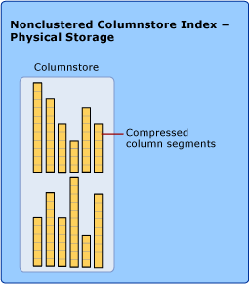
Nonclustered columnstore

Slide 14
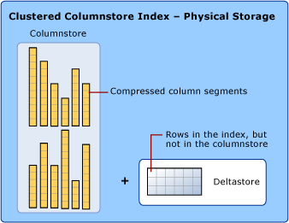
Clustered columnstore

Slide 15
Usage scenarios
Selecting data
Updating data
Rebuild index

Slide 16


Selecting data from columnstore
SELECT
SalesTerritoryKey,
SUM(ExtendedAmount) AS SalesByTerritory
FROM FactResellerSalesPtnd
GROUP BY SalesTerritoryKey;
columnstore index scan
bitmap operator

Slide 17
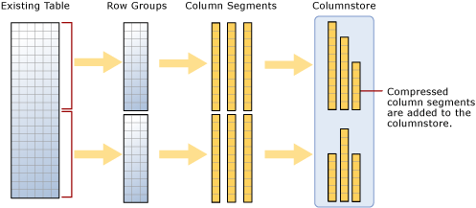
Updating data
Nonclustered indexes

Slide 18
Updating data
Nonclustered Index
ALTER INDEX mycolumnstoreindex ON mytable DISABLE;
-- update mytable –
ALTER INDEX mycolumnstoreindex on mytable REBUILD

Slide 19
Updating data
Partitioned table scenario
Staging table for data updating
ALTER TABLE FactInternetSales_Partitioned
SWITCH PARTITION 1 TO
FactInternetSales_Stage

Slide 20
Updating data
Clustered indexes
CREATE TABLE T1(
ProductKey [int] NOT NULL, OrderDateKey [int] NOT NULL,
DueDateKey [int] NOT NULL,
ShipDateKey [int] NOT NULL);
GO
CREATE CLUSTERED COLUMNSTORE INDEX cci_T1 ON T1; GO

Slide 21
Updating data
Clustered indexes
Normal DML/Bulk operations

Slide 22
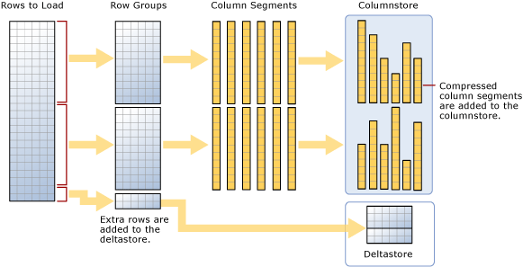
Updating data
Clustered indexes

Slide 23

Updating data
Deltastore usage
Rowgroup bottom threshold – 102,400 rows
Bulk operation
Split by $2^{20}=1,048,576$ rows

Slide 24
Updating data
DML operations on clustered columnstore
INSERT
adds row to deltastore
Tuple mover moves filled deltastore rowgroup to columnstore
DELETE
Marks row as deleted in columnstore
Removed on index rebuild
UPDATE
DELETE
INSERT

Slide 25
Rebuilding index
Nonclustered indexes
Clustered indexes
Delete bitmaps applied
Defragmentation of columnstore
Merge with deltastore

Slide 26
Columnstore in 2016
Table as columnstore
Ability to mix columnstore and rowstore indexes on a table
Updateable nonclustered columnstore indexes
in-Memory features
one columnstore allowed
in-Memory limitation
defined at creation
must include all columns
must include all rows

Slide 27
Updateable nonclustered columnstore
Act as clustered
Concept of operational analytics

Slide 28
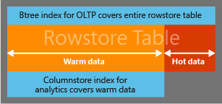
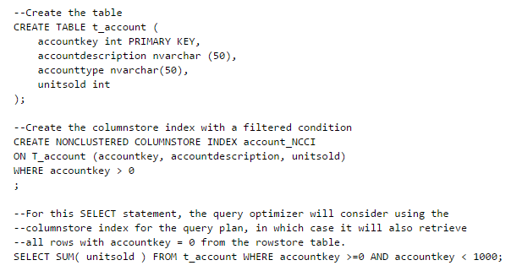
Concepts of operational analytics
Example 1

Slide 29
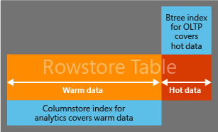
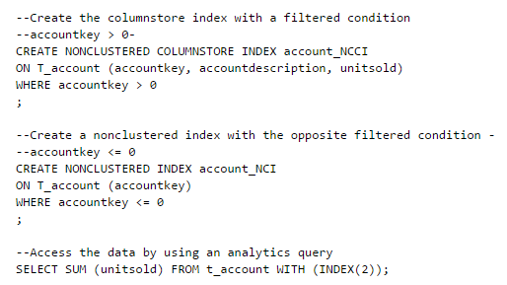
Concepts of operational analytics
Example 2

Slide 30
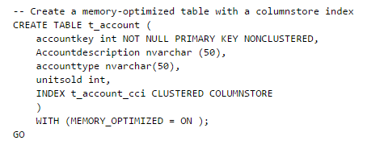
In-memory columnstore

Slide 31
Data warehousing
Rowstore primary key indexes on columnstore tables
Increase performance of table seeks
Row locking + Row group level locking
DBCC traceon (10204, -1);
Snapshot and read-commited snapshot isolation levels

Slide 32
Introduction to Vertipaq
Dictionary-based encoding
Value-based encoding

Slide 33
Vertipaq Dictionary based encoding
Primary dictionary (shared)
Secondary dictionary (for each segment) – only for string columns
segment
dictionary
segment
AAA
AAA
BBB
BBB
CCC
CCC
CCC
AAA
BBB
CCC
1
1
2
2
3
3
3

Slide 34
Vertipaq Value-based encoding
Exact numerics (integer, decimal)
Many distinct values
segment
1-7
segment
1
4
2
5
3
7
6

Slide 35
Vertipaq Value-based encoding
Decimals
0.8
11.22
3.141
minimal exponent of 3
800
11220
3141
substract the minimal of 800
0
10420
2341
900
1100
2345000
minimal exponent of -2
9
11
23450
substract the minimal of 9
0
2
23441

Slide 36
Questions?

Slide 37
Thanks

