Slide 1
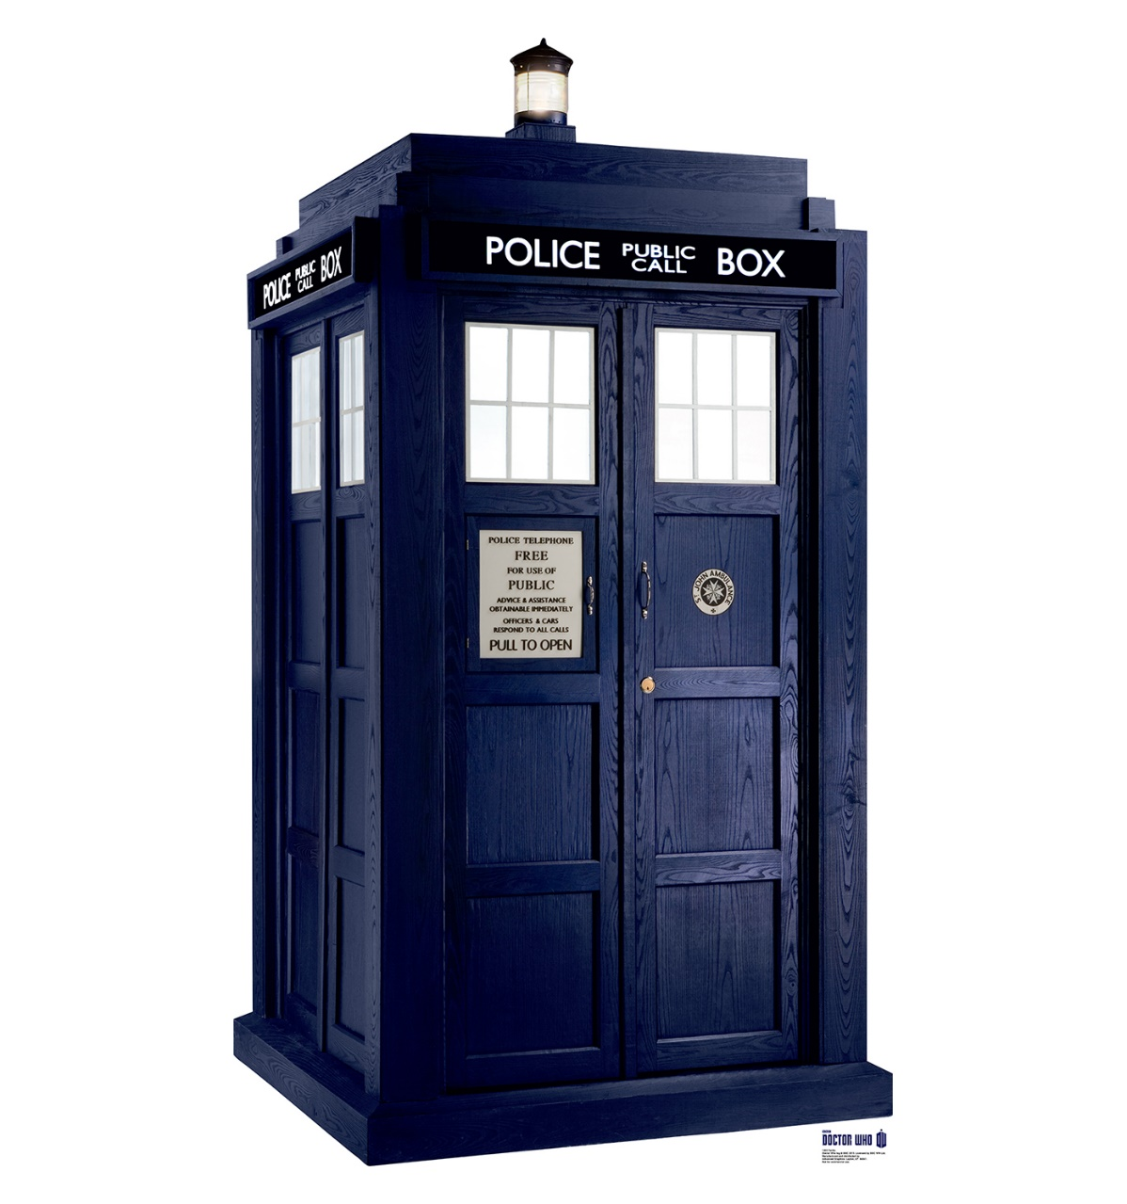
Time And Relative Dimensions in SQL

Slide 2


Our Bread and Butter
Business Intelligence
Data Visualization
Planning & Architecture
Deployment & Delivery
Data Management
Custom Development
Data Integration
Database Administration
IT Infrastructure
Backup
Cloud
Networking
Servers
Storage

Slide 3
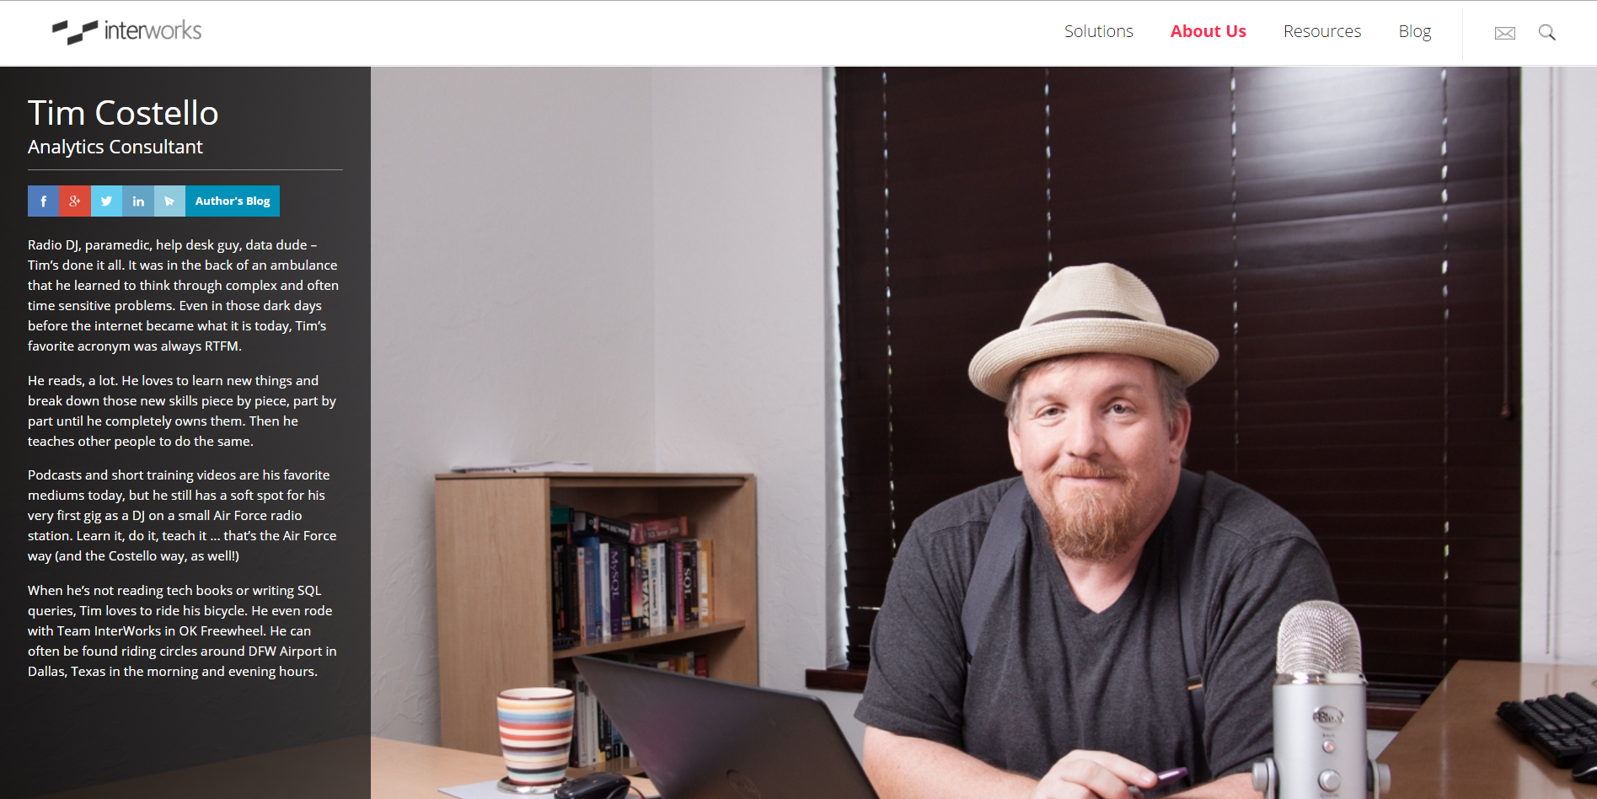
Tim.Costello@InterWorks.com

Slide 4
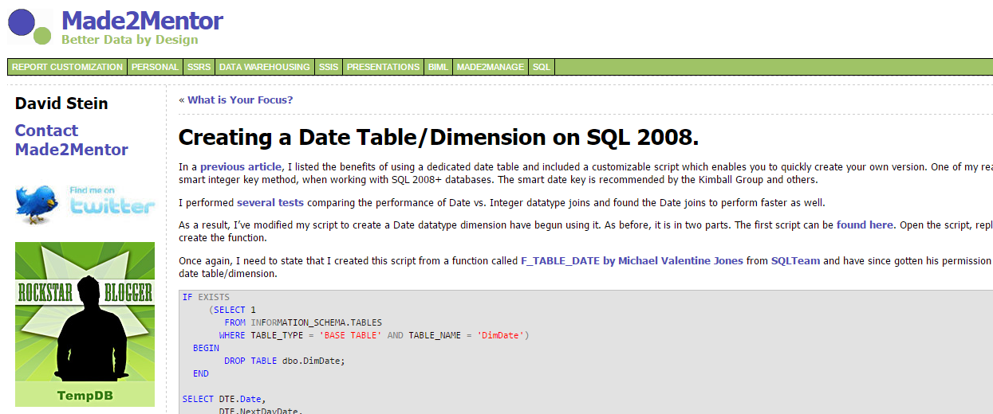
http://www.made2mentor.com/2011/06/creating-a-date-tabledimension-for-sql-server-2008/

Slide 5
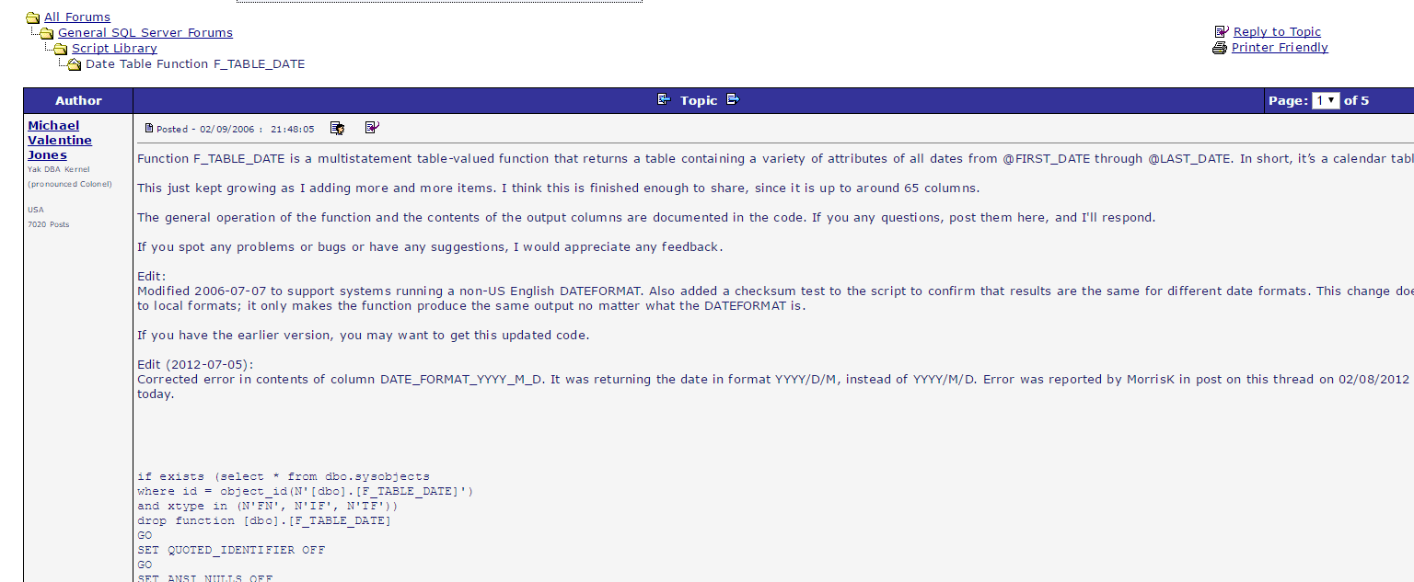
http://www.sqlteam.com/forums/topic.asp?TOPIC_ID=61519

Slide 6
Twitter: @TimCost
Email: Tim.Costello@InterWorks.com

