Slide 1
Time Functions, Logical Functions, and User Defined Functions
Presented by Steve Stedman
and Aaron Buma

Slide 2
Welcome
Welcome to all those joining us remotely.
For any questions via Google On Air Broadcasts, we will address most of these at the end of the training.
Training provided by Emergency Reporting
http://EmergencyReporting.com
Slides and sample code are available at:
http://SteveStedman.com

Slide 3
Welcome Viewers From
Bellingham, WA
Salt Lake City, UT
Glacier, WA
St Louis, MO
Gainesville, FL
Honolulu, HI
Portugal
Chennai, India
Belarus
Bucharest

Slide 4
Live Broadcast
Using Google On Air Broadcasts
There is about a 40 to 50 second delay from live to what you see.
We are still learning how to properly use Google On Air Broadcasts. Please be patient.
Session will be available on my YouTube Channel about an hour after the presentation ends.
http://SteveStedman.com/YouTube

Slide 5
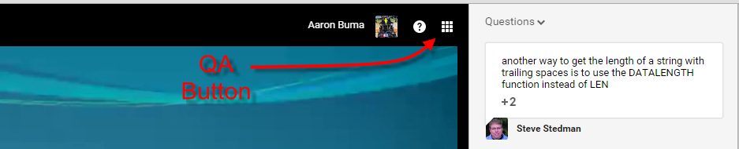
Questions
We will have time for questions at the end of the session.
Q&A available via Google On Air Hangout panel. Click the 3x3 grid icon near the top right, then select Q&A to see what people are asking, or to ask your own question.
When you ask a question, it shows up for us about 40 to 50 seconds delayed.

Slide 6
Agenda
Date and Time Functions
Logical Functions
User Defined Functions

Slide 7
Date and Time Functions
Presented by Steve Stedman

Slide 8
Date/Time Functions
GETDATE()
DATEPART()
DATEADD()
DATEDIFF()
_____FROMPARTS (2012)
EOMONTH (2012)

Slide 9
GETDATE
Returns the current database system timestamp as a datetime value without the database time zone offset.
SELECT GETDATE();

Slide 10
DATEPART()
Returns an integer that represents the specified datepart of the specified date.
SELECT DATEPART(year, GETDATE());
Date can be time, date, smalldatetime, datetime, datetime2, or datetimeoffset.

Slide 11
DATEADD()
Returns a specified date with the specified number interval (signed integer) added to a specified datepart of that date.
SELECT DATEADD(month, 1, GETDATE());

Slide 12
DATEDIFF()
Returns the count (signed integer) of the specified datepart boundaries crossed between the specified startdate and enddate.
SELECT DATEDIFF(year, '1/1/2015', GETDATE());
SELECT DATEDIFF(quarter, '1/1/2015', GETDATE());
SELECT DATEDIFF(month, '1/1/2015', GETDATE());

Slide 13
DATEFROMPARTS (2012)
DATEFROMPARTS ( year, month, day )
Arguments
Year Integer expression specifying a year.
Month Integer expression specifying a month, from 1 to 12.
Day Integer expression specifying a day.
Always Year – Month – Day order independent of language or location

Slide 14
TIMEFROMPARTS (2012)
TIMEFROMPARTS ( hour, minute, seconds, fractions, precision )
Arguments
Hour Integer expression specifying hours.
Minute Integer expression specifying minutes.
Seconds Integer expression specifying seconds.
Fractions Integer expression specifying fractions.
Precision Integer literal specifying the precision of the time value to be returned.

Slide 15
DATETIMEFROMPARTS (2012)
DATETIMEFROMPARTS ( year, month, day, hour, minute, seconds, milliseconds )
Arguments
Year Integer expression specifying a year.
Month Integer expression specifying a month.
Day Integer expression specifying a day.
Hour Integer expression specifying hours.
Minute Integer expression specifying minutes.
Seconds Integer expression specifying seconds.
Milliseconds Integer expression specifying milliseconds.

Slide 16
DATETIME2FROMPARTS (2012)
DATETIME2FROMPARTS (year, month, day, hour, minute, seconds, fractions, precision)
Arguments
Year Integer expression specifying a year.
Month Integer expression specifying a month.
Day Integer expression specifying a day.
Hour Integer expression specifying hours.
Minute Integer expression specifying minutes.
Seconds Integer expression specifying seconds.
Fractions Integer expression specifying fractions.
Precision Integer literal specifying the precision of the datetime2 value to be returned.

Slide 17
SMALLDATETIMEFROMPARTS (2012)
SMALLDATETIMEFROMPARTS(year,month,day,hour,minute)
Same idea as the others….

Slide 18
DATETIMEOFFSETFROMPARTS (2012)
DATETIMEOFFSETFROMPARTS ( year, month, day, hour, minute, seconds, fractions, hour_offset, minute_offset, precision )
hour_offset - Integer expression specifying the hour portion of the time zone offset.
minute_offset - Integer expression specifying the minute portion of the time zone offset.
Precision - Integer literal specifying the precision of the value to be returned.
Precision can be a value of 0 to 7 which specifies the precision of the fractional part of the seconds.

Slide 19
EOMONTH (2012)
EOMONTH ( start_date [, month_to_add ] )
Returns the last day of the month that contains the specified date, with an optional offset.
Arguments
start_date Date expression specifying the date for which to return the last day of the month.
month_to_add Optional integer expression specifying the number of months to add to start_date.

Slide 20
Date and Time Functions
Demo

Slide 21
Please Connect on LinkedIn
Steve Stedman
http://linkedin.com/in/stevestedman
Aaron Buma
https://www.linkedin.com/in/aaronbuma

Slide 22
Logical Functions
Presented by Steve Stedman

Slide 23
Logical Functions
CASE
IIF (2012)
CHOOSE (2012)
COALESCE

Slide 24
CASE
Evaluates a list of conditions and returns one of multiple possible result expressions.
CASE WHEN Revenue > AverageRevenue
THEN 'Better Than Average'
ELSE 'Not Better'
END AS Ranking

Slide 25
CASE with multiple WHEN
SELECT CASE @corners
WHEN 1 THEN 'point'
WHEN 2 THEN 'line'
WHEN 3 THEN 'triangle'
WHEN 4 THEN 'square'
WHEN 5 THEN 'pentagon'
WHEN 6 THEN 'hexagon'
WHEN 7 THEN 'heptagon'
WHEN 8 THEN 'octagon'
ELSE NULL
END;

Slide 26
IIF (2012)
Returns one of two values, depending on whether the Boolean expression evaluates to true or false in SQL Server.
This is similar to Excel or VB versions of IIF.
IIF(Revenue > AverageRevenue,
'Better Than Average',
'Not Better' ) AS Ranking
What does IIF stand for? Immediate IF? Inline IF?

Slide 27
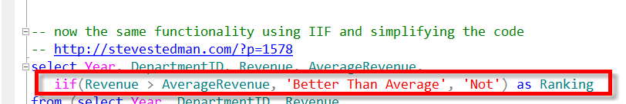
IIF Details
Performance very similar between IIF and CASE
IIF simplifies the code over using a CASE statement
Can be nested up to 10 levels
The true value and false value cannot both be NULL.

Slide 28
CHOOSE (2012)
Function that returns the item at a specific index.
CHOOSE(index, val_1, val_2, val_3, ...)
If the index is greater than the number of values or less than 1 it returns NULL
Easier than CASE in some examples

Slide 29
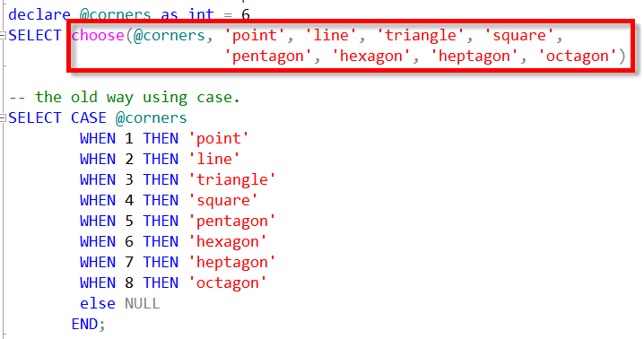
CHOOSE – Example

Slide 30
COALESCE
Similar to CASE, or CHOOSE, but returns the first NON NULL value.
Similar to ISNULL when using 2 parameters
COALESCE([Parent], 0)
Will accommodate more than 2 fields.
COALESCE([Parent], [AnotherField], 0)

Slide 31
Logical Functions
Demo

Slide 32
Please Follow us on Twitter
Steve Stedman
@SqlEmt
Aaron Buma
@AaronDBuma

Slide 33
User Defined Functions
Presented by Aaron Buma

Slide 34
User Defined Functions
Scalar
Multiple inputs, one value output
Table Valued
Multiple inputs, row(s) as output
Views
Referencing a query as a table

Slide 35
Scalar Functions - Overview
What it does:
Uses one (or many inputs)
To run one or more queries
And Return a single value
What is doesn’t:
Call non-deterministic functions (ie: GetDate())
Insert, Update, Deletes to tables or views
Error handling
Get included in an execution plan (!Important)

Slide 36
Functions in Views
Deterministic Functions ex: LEFT()
You can index the view
Non-Deterministic Functions ex: GETDATE()
You cannot index the view, because the data is always changing
For UDF’s you need SCHEMABINDING at the function and view objects

Slide 37
Table Value Function- Overview
What it does:
IN: Zero or Many inputs, OUT: a result set
Single-Statement or Multi-Statement formatting
What is doesn’t:
Call non-deterministic functions (ie: GetDate())
Insert, Update, Deletes to tables or views
Error handling
Multi-statement are not included in the execution plan

Slide 38
User Defined Functions
Demo

Slide 39
Any Questions?
Date and Time Functions
Logical Functions
User Defined Functions

Slide 40
Tune in next week
Thursday 3/26 at 9:00am pacific time
Back to Basics – JOINs INNER, LEFT OUTER, RIGHT OUTER, SEMI JOIN, ANTI SEMI JOIN, LEFT OUTER with exclusion, RIGHT OUTER with exclusion, FULL OUTER, CROSS JOIN, FULL OUTER JOIN with exclusion, LATERAL JOINS, CROSS APPLY, combinations.

Slide 41
For More Information
Visit http://EmergencyReporting.com to find out more about Emergency Reporting.
Aaron on the web
http://AaronBuma.com
Twitter: @AaronDBuma
Steve on the web
http://SteveStedman.com
twitter: @SqlEmt

