Slide 1

Join Operation in Database
Prepared by: Naimul Arif Software Engineer Progoti Systems Ltd.

Slide 2
Simple Review
What is database???
A database is a collection of information that is organized so that it can easily be accessed, managed, and updated.

Slide 3
Why database ???
To store data
To retrieve data
To update data
To merge data
Where we need database ???
- Every sector where data is handled.

Slide 4
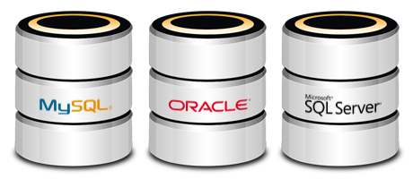
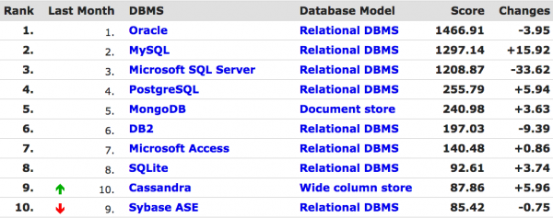
Mostly used databases:
Usage of top 10 databases in August 2014

Slide 5
Types of SQL join operations
INNER JOIN
LEFT JOIN
RIGHT JOIN
OUTER JOIN
LEFT JOIN EXCLUDING INNER JOIN
RIGHT JOIN EXCLUDING INNER JOIN
OUTER JOIN EXCLUDING INNER JOIN

Slide 6
Before knowing about SQL join we should know about Cartesian Product. Also known as cross join

Slide 7
Cartesian product of tow or more table:
Consider two tables:
Product
Sale
PID | Pname
1 | Shirt
2 | Pajabi
3 | Lungi
SID | ProductID | Price
101 | 1 | 1000
102 | 2 | 800
103 | 5 | 400
104 | 2 | 600

Slide 8
Cartesian product of tow or more table:
QUERY: Select * from Product, Sale;
PID | Pname | SID | ProductID | Price
1 | Shirt | 101 | 1 | 1000
1 | Shirt | 102 | 2 | 800
1 | Shirt | 103 | 5 | 400
1 | Shirt | 104 | 2 | 600
2 | Pajabi | 101 | 1 | 1000
2 | Pajabi | 102 | 2 | 800
2 | Pajabi | 103 | 5 | 400
2 | Pajabi | 104 | 2 | 600
3 | Lungi | 101 | 1 | 1000
3 | Lungi | 102 | 2 | 800
3 | Lungi | 103 | 5 | 400
3 | Lungi | 104 | 2 | 600

Slide 9
Cartesian Product is the all possible combinations between applied table rows.
Suppose two tables T₁ & T₁
T₁ has r₁ rows and c₁ columns
T₂ has r₂ rows and c₂ columns
Cartesian product of T₁ & T₁ will have:
r₁ * r₂ rows and
c₁ + c₂ columns.
[for more that two tables r₁ * r₂ * r₃ ...
and c₁ + c₂ + c₃ ...]

Slide 10
For ease of learning these two tables will be used for all examples
Product
Sale
PID | Pname
1 | Shirt
2 | Pajabi
3 | Lungi
SID | ProductID | Price
101 | 1 | 1000
102 | 2 | 800
103 | 5 | 400
104 | 2 | 600

Slide 11
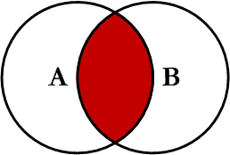
Inner join
Query: Select * from Product p Inner join Sale s on p.PID = s.ProductID
Inner join only takes that rows from Cartesian Product Table where the join elements (Product.PID and Sale.ProductID in the above query) matches fully.

Slide 12
Inner join
Query: Select * from Product p Inner join Sale s on p.PID = s.ProductID
PID | Pname | SID | ProductID | Price
1 | Shirt | 101 | 1 | 1000
1 | Shirt | 102 | 2 | 800
1 | Shirt | 103 | 5 | 400
1 | Shirt | 104 | 2 | 600
2 | Pajabi | 101 | 1 | 1000
2 | Pajabi | 102 | 2 | 800
2 | Pajabi | 103 | 5 | 400
2 | Pajabi | 104 | 2 | 600
3 | Lungi | 101 | 1 | 1000
3 | Lungi | 102 | 2 | 800
3 | Lungi | 103 | 5 | 400
3 | Lungi | 104 | 2 | 600

Slide 13
Inner join
Query: Select * from Product p Inner join Sale s on p.PID = s.ProductID
So the output of the join table is shown below.
It is to mention that, if there exists more than one matching element having same value then all possible combination will be taken.
PID | Pname | SID | ProductID | Price
1 | Shirt | 101 | 1 | 1000
2 | Panjabi | 102 | 2 | 800
2 | Panjabi | 104 | 2 | 600

Slide 14
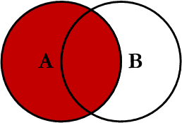
Left join
Query: Select * from Product p Left join Sale s on p.PID = s.ProductID
Left join takes that rows which are in inner join output.
And it also looks for the rows in left table which are not in inner join output. The rows are added to OUTPUT with null in right columns.

Slide 15
Left join
Query: Select * from Product p Left join Sale s on p.PID = s.ProductID
PID | Pname | SID | ProductID | Price
1 | Shirt | 101 | 1 | 1000
1 | Shirt | 102 | 2 | 800
1 | Shirt | 103 | 5 | 400
1 | Shirt | 104 | 2 | 600
2 | Pajabi | 101 | 1 | 1000
2 | Pajabi | 102 | 2 | 800
2 | Pajabi | 103 | 5 | 400
2 | Pajabi | 104 | 2 | 600
3 | Lungi | 101 | 1 | 1000
3 | Lungi | 102 | 2 | 800
3 | Lungi | 103 | 5 | 400
3 | Lungi | 104 | 2 | 600

Slide 16
Left join
Query: Select * from Product p Left join Sale s on p.PID = s.ProductID
So the output of the join table is shown below.
In the left table Product |PID = 3 | Pname = Lungi| row could not be joined with any row of Sale table. So it is added with null value in right columns.
PID | Pname | SID | ProductID | Price
1 | Shirt | 101 | 1 | 1000
2 | Panjabi | 102 | 2 | 800
2 | Panjabi | 104 | 2 | 600
3 | Lungi | null | null | null

Slide 17
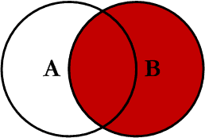
Right join
Query: Select * from Product p Right join Sale s on p.PID = s.ProductID
Right join takes that rows which are in inner join output.
Also looks for the rows in right table which are not in inner join output. The rows are added to OUTPUT with null in left columns.

Slide 18
Right join
Query: Select * from Product p Right join Sale s on p.PID = s.ProductID
PID | Pname | SID | ProductID | Price
1 | Shirt | 101 | 1 | 1000
1 | Shirt | 102 | 2 | 800
1 | Shirt | 103 | 5 | 400
1 | Shirt | 104 | 2 | 600
2 | Pajabi | 101 | 1 | 1000
2 | Pajabi | 102 | 2 | 800
2 | Pajabi | 103 | 5 | 400
2 | Pajabi | 104 | 2 | 600
3 | Lungi | 101 | 1 | 1000
3 | Lungi | 102 | 2 | 800
3 | Lungi | 103 | 5 | 400
3 | Lungi | 104 | 2 | 600

Slide 19
Right join
Query: Select * from Product p Right join Sale s on p.PID = p.ProductID
So the output of the join table is shown below.
In the right table Sale |SID = 103|ProductID = 5|Price = 400|row could not be joined with any row of Product table. So it is added with null value in left columns.
PID | Pname | SID | ProductID | Price
1 | Shirt | 101 | 1 | 1000
2 | Panjabi | 102 | 2 | 800
2 | Panjabi | 104 | 2 | 600
null | null | 103 | 5 | 400

Slide 20
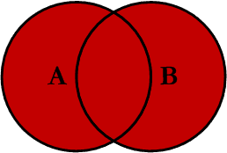
Outer join
Query: Select * from Product p Outer join Sale s on p.PID = s.ProductID
Aside of inner join output Outer join looks for the rows in left table which are not in inner join output. The rows are added to OUTPUT with null in right columns. Similarly the rows from right table not in inner join output are added to OUTPUT with null values in left columns.

Slide 21
Outer join
Query: Select * from Product p Outer join Sale s on p.PID = s.ProductID
PID | Pname | SID | ProductID | Price
1 | Shirt | 101 | 1 | 1000
1 | Shirt | 102 | 2 | 800
1 | Shirt | 103 | 5 | 400
1 | Shirt | 104 | 2 | 600
2 | Pajabi | 101 | 1 | 1000
2 | Pajabi | 102 | 2 | 800
2 | Pajabi | 103 | 5 | 400
2 | Pajabi | 104 | 2 | 600
3 | Lungi | 101 | 1 | 1000
3 | Lungi | 102 | 2 | 800
3 | Lungi | 103 | 5 | 400
3 | Lungi | 104 | 2 | 600

Slide 22
Outer join
Query: Select * from Product p Outer join Sale s on p.PID = s.ProductID
In the 4th row there is not joinable row in right. So right values are null. Similarly in 5th row there is no joinable row in left. So left values are null.
PID | Pname | SID | ProductID | Price
1 | Shirt | 101 | 1 | 1000
2 | Panjabi | 102 | 2 | 800
2 | Panjabi | 104 | 2 | 600
3 | Lungi | null | null | null
null | null | 103 | 5 | 400

Slide 23
Keep in mind
In case of Cartesian Product there is no matching, only taking all combination.
In case of Join operation:
Either matching of two column values are equal.
Or one of them is null.
In inner join no null is taken.
In left join right side null is taken.
In right join left side null is taken.
In outer join null can be taken in any side but not in both side at a time.
In left join all rows of left table are in output table.
In right join all rows of right table is taken.
Number of output rows for join is less or equal to the number of rows in Cartesian Product.

Slide 24
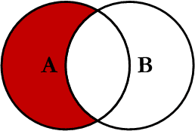
Left excluding join
Excluding join operations (Left excluding join, right excluding join and outer excluding join) only takes rows which could not be joined. So strictly one side of the output table remains null.
Left excluding join operation is nothing but a Left join operation with a fixed condition.
The condition is: right key should be null.
So eventually all right columns turn null.
Left excluding join = Left join - Inner join

Slide 25
Left excluding join
Query: Select * from Product p Left join Sale s on p.PID = s.ProductID
where s.ProductID is null
Product
Sale
PID | Pname
1 | Shirt
2 | Pajabi
3 | Lungi
SID | ProductID | Price
101 | 1 | 1000
102 | 2 | 800
103 | 5 | 400
104 | 2 | 600
Here 3rd row of left table has no joinable row in right table.
So output is:
PID | Pname | SID | ProductID | Price
3 | Lungi | null | null | null

Slide 26
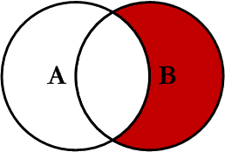
Right excluding join
This operation gives the rows from right table who have no joinable row in left table. So left columns of this join output table remains null.
Right excluding join operation is nothing but a Right join operation with a fixed condition.
The condition is: left key should be null.
So eventually all left columns turn null.
Right excluding join = Right join - Inner join

Slide 27
Right excluding join
Query: Select * from Product p Right join Sale s on p.PID = s.ProductID where
p.PID is null
Product
Sale
PID | Pname
1 | Shirt
2 | Pajabi
3 | Lungi
SID | ProductID | Price
101 | 1 | 1000
102 | 2 | 800
103 | 5 | 400
104 | 2 | 600
Here 3rd row of right table has no joinable row in left table.
So output is:
PID | Pname | SID | ProductID | Price
null | null | 103 | 5 | 400

Slide 28
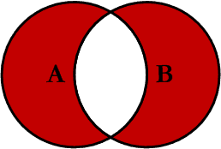
Outer excluding join
- This operation outputs the rows from left table with no joinable row in right table. So right columns are given null.
- Also outputs rows from right table having no joinable row in left. Left columns are given null.
- Outer excluding join
= Left outer join + Right outer join
= Outer join - Inner join

Slide 29
Outer excluding join
Query: Select * from Product p Outer join Sale s on p.PID = s.ProductID
where Product.PID is null or Sale.ProductID is null
Product
Sale
PID | Pname
1 | Shirt
2 | Pajabi
3 | Lungi
SID | ProductID | Price
101 | 1 | 1000
102 | 2 | 800
103 | 5 | 400
104 | 2 | 600
Lonely row from both table with null to opposite.
PID | Pname | SID | ProductID | Price
null | null | 103 | 5 | 400
3 | Lungi | null | null | null

Slide 30
Use of join
Join helps to do DB operations keeping tables small and saving memory. In short normalized database needs join operation.
Example
In facebook there may remain a lot of comments against a single post. If we keep post and comment info in same table it will look like this.
Post_ Creator | Post_Time | Post_Text | Post_ID | Comment_ Creator | Comment_ Time | Comment_ Text | Comment_ ID
Sherlock | 2014-01-23 00:00:00 | I need a case | 1001 | Moriarty | 2014-01-23 00:05:00 | Miss me!!! | 5001
Sherlock | 2014-01-23 00:00:00 | I need a case | 1001 | Joh Watson | 2014-01-23 00:06:32 | u r a psychopath! | 5002
Sherlock | 2014-01-23 00:00:00 | I need a case | 1001 | Sherlock | 2014-01-23 00:06:35 | nope, i am a high functioning sociopath | 5003
Sherlock | 2014-01-23 00:00:00 | I need a case | 1001 | Irene Adler | 2014-01-23 00:12:01 | Let's have dinner | 5004

Slide 31
Use of join
So in the table same post info are inserted a lot of time.
Waste of memory. More comments, more memory waste.
Instead we can maintain three tables, one for Posts, one for Comments and one to connect them.
The architecture is shown below.
Comment_
Creator
Comment_
Time
Post_Creator
Post_Time
PID
Post
Has
*
Comment
CID
Post_Text
Post_ID
Comment_
Text
Comment_
ID

Slide 32
Use of join
Post
Comment
Post_ Creator | Post_Time | Post_Text | Post_ID
Sherlock | 2014-01-23 00:00:00 | I need a case | 1001
Comment_ Creator | Comment_ Time | Comment_ Text | Comment_ ID
Moriarty | 2014-01-23 00:05:00 | Miss me!!! | 5001
Joh Watson | 2014-01-23 00:06:32 | u r a psychopath! | 5002
Sherlock | 2014-01-23 00:06:35 | nope, i am a high functioning sociopath | 5003
Irene Adler | 2014-01-23 00:12:01 | Let's have dinner | 5004
Has
Post_ID | Comment_ ID
1001 | 5001
1001 | 5002
1001 | 5003
1001 | 5004
So memory is optimized.
But what should I do if someone try to view the post?

Slide 33
Use of join
To fetch all comment against a post we need do the query:
SELECT
p.Post_Creator, p.Post_Time,
p.Post_ID, p.Post_Text,
c.Comment_Creator, c.Comment_Time,
c.Comment_ID, c.Comment_Text
FROM
Post p
INNER JOIN
Has h ON p.Post_ID = h.Post_ID
INNER JOIN
Comment c ON c.Comment_ID = h.Comment_ID
ORDER BY c.Comment_Time

Slide 34
References:
http://www.codeproject.com/Articles/33052/Visual-Representation-of-SQL-Joins
http://www.tutorialspoint.com/sql/sql-cartesian-joins.htm

