Slide 2
Disclaimer: This presentation is prepared by trainees of baabtra as a part of mentoring program. This is not official document of baabtra –Mentoring Partner
Baabtra-Mentoring Partner is the mentoring division of baabte System Technologies Pvt . Ltd

Slide 3


Sql server joins
ASNA C.A
kunjulaloos@gmail.com
www.facebook.com/username
twitter.com/username
in.linkedin.com/in/profilename
Phonenumber

Slide 4
Sql joins
The JOIN keyword is used in an SQL statement to query
data from two or more tables, based on a relationship
between certain columns in these tables.
Tables in a database are often related to each other with
keys.
A primary key is a column (or a combination of columns)
with a unique value for each row. Each primary key value
must be unique within the table. The purpose is to bind
data together, across tables, without repeating all of the
data in every table.

Slide 5
Different SQL JOINs
INNER JOIN: Return rows when there is at least one match in both tables
LEFT JOIN: Return all rows from the left table, even if there are no matches in the right table
RIGHT JOIN: Return all rows from the right table, even if there are no matches in the left table
FULL JOIN: Return rows when there is a match in one of the tables

Slide 6
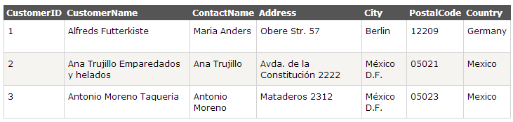
Inner join
SELECT column_name(s)
FROM table_name1
INNER JOIN table_name2
ON
table_name1.column_name=table_name2.column_name;
Example: Below is a selection from the "Customers" table:

Slide 7
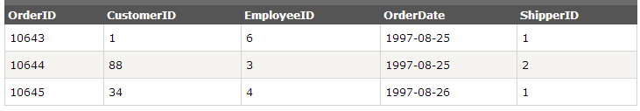
And a selection from the "Orders" table:
SELECT Customers.CustomerName, Orders.OrderID
FROM Customers
INNER JOIN Orders
ON Customers.CustomerID= Orders.CustomerID
ORDER BY Customers.CustomerName;

Slide 8
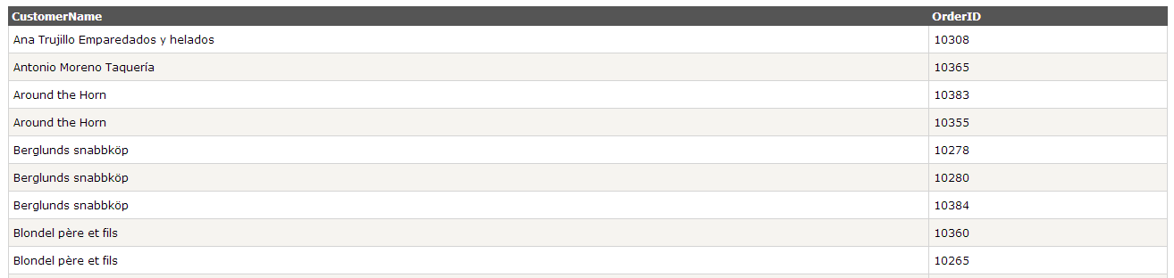

Slide 9
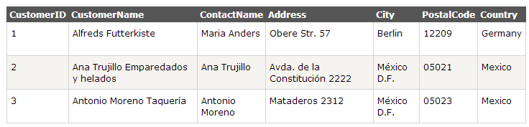
Left join
SELECT column_name(s)
FROM table_name1
LEFT JOIN table_name2
ON
table_name1.column_name=table_name2.col
mn_name
Example: Below is a selection from the "Customers" table:

Slide 10
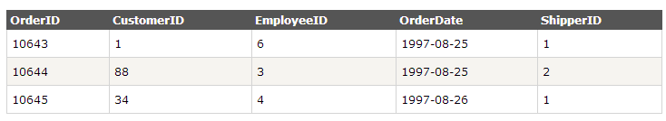
And a selection from the "Orders" table:
SELECT Customers.CustomerName, Orders.OrderID
FROM Customers
LEFT JOIN Orders
ON Customers.CustomerID=Orders.CustomerID
ORDER BY Customers.CustomerName;

Slide 11
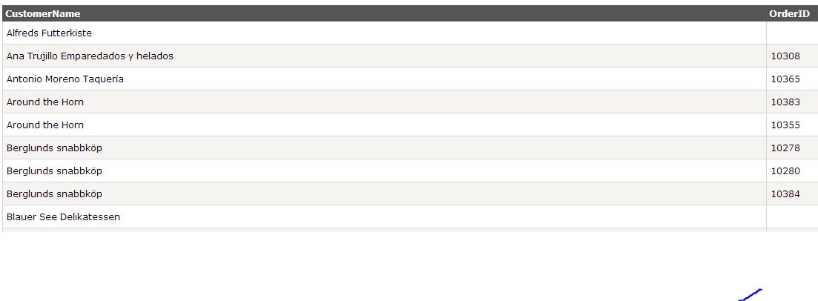

Slide 12
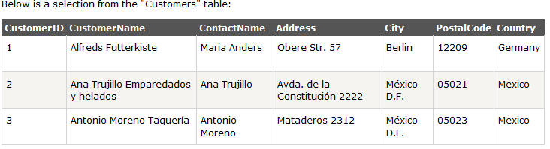
RIGHT JOIN
SELECT column_name(s) FROM table_name1 RIGHT JOIN table_name2 ON table_name1.column_name=table_name2.column_name

Slide 13
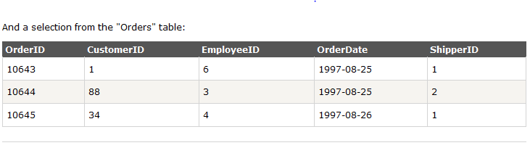
Example
SELECT Customers.CustomerName, Orders.OrderID FROM Customers RIGHT JOIN Orders ON Customers.CustomerID= Orders.CustomerID ORDER BY Customers.CustomerName;

Slide 14
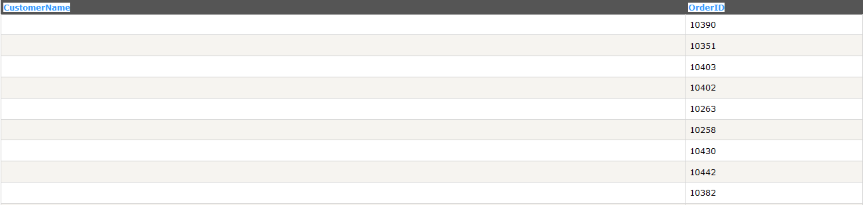

Slide 15
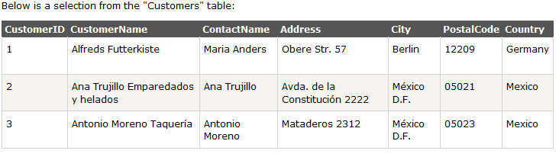
FULL JOIN
SELECT column_name(s) FROM table_name1 FULL JOIN table_name2 ON table_name1.column_name=table
_name2.column_name;

Slide 16
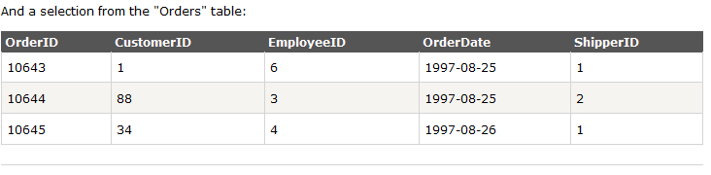
SELECT Customers.CustomerName, Orders.OrderID FROM Customers FULL JOIN Orders ON Customers.CustomerID=Orders.CustomerID ORDER BY Customers.CustomerName;

Slide 17
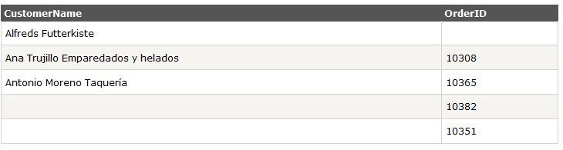

Slide 18
If this presentation helped you, please visit our page facebook.com/baabtra and like it.
Thanks in advance.
www.baabtra.com | www.massbaab.com |www.baabte.com

Slide 19

Contact Us
Emarald Mall (Big Bazar Building) Mavoor Road, Kozhikode, Kerala, India. Ph: + 91 – 495 40 25 550 |  | NC Complex, Near Bus Stand Mukkam, Kozhikode, Kerala, India. Ph: + 91 – 495 40 25 550
Start up Village Eranakulam, Kerala, India.
Email: info@baabtra.com

Slide 20
THANK YOU

