Slide 1

SQL -JOINS
Displaying Data From Multiple Tables
BY : Gaurav Dhanwant

Slide 2
Table1
Table2
Table1.coulmn
Data1
Data2
Data3
Table2.coulmn
Data1
Data2
Data3

Slide 3
INTRODUCTION

Slide 4
A mean to include columns from two or more tables
and creating a virtual table.
An SQL JOIN clause is used to combine rows from two or more tables,
based on a common field between them.
Most join queries contain WHERE clause conditions that compare two
columns, each from a different table. Such a condition is called a
join condition.
To execute a join, Oracle combines pairs of rows,
each containing one row from each table, for which the join condition
evaluates to TRUE.
The columns in the join conditions need not also appear in the select list.

Slide 5
TABLES USED

Slide 6
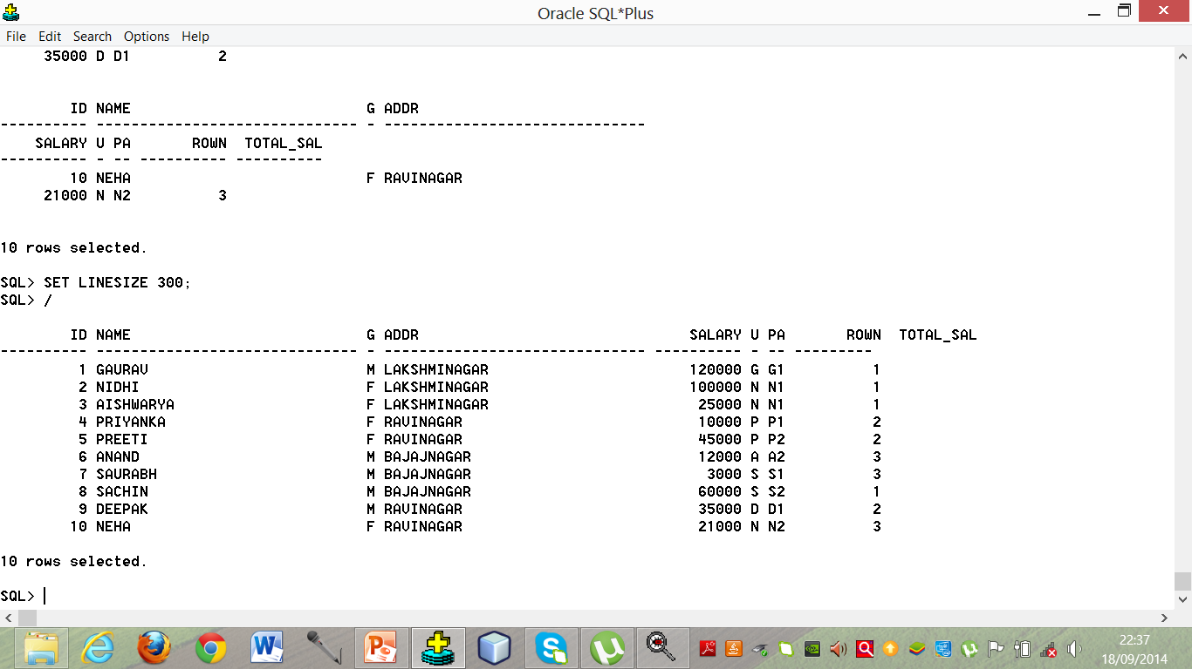
CUSTOMER_MAST
Name : CUSTOMER_MAST
Synonym: cm

Slide 7
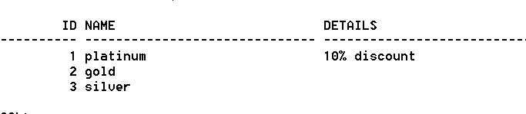
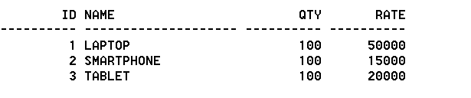
MEM_TYPE_MAST (mtm)
PRODUCT_MAST (pm)

Slide 8

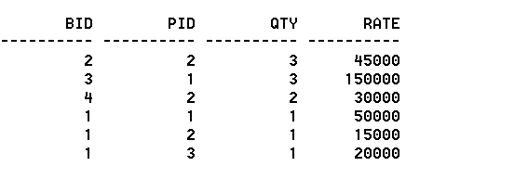
Bill_mast (bm)
Bill_Details (bd)

Slide 9
TYPES OF JOINS

Slide 10
TYPES OF JOINS:
THERE ARE 5 TYPES OF JOINS
EQUI JOIN
NON EQUI JOIN
INNER JOIN- Returns all rows when there is at least one match in BOTH tables.
4. SELF JOIN
5. OUTER JOIN
LEFT OUTER JOIN -Return all rows from the left table, and the matched rows from the right table.
RIGHT OUTER JOIN- Return all rows from the right table, and the matched rows from the left table.
FULL OUTER JOIN -Return all rows when there is a match in ONE of the tables.

Slide 11
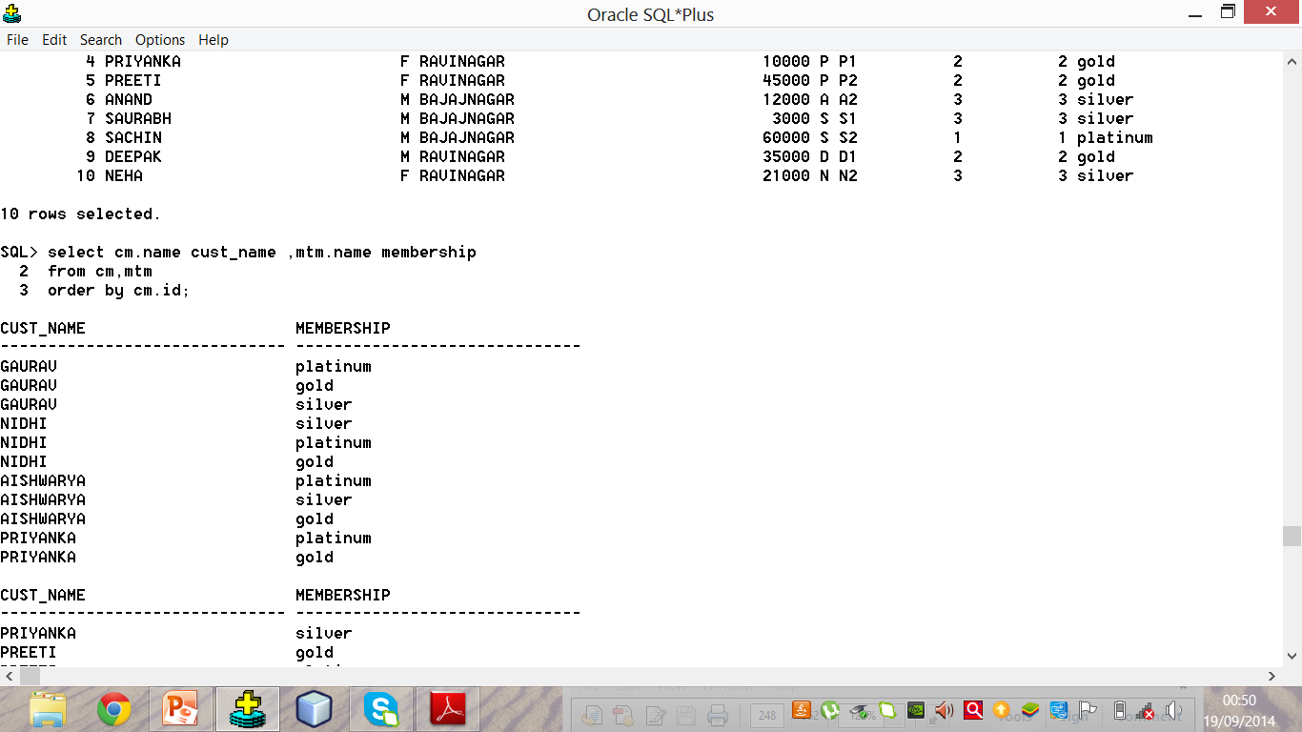
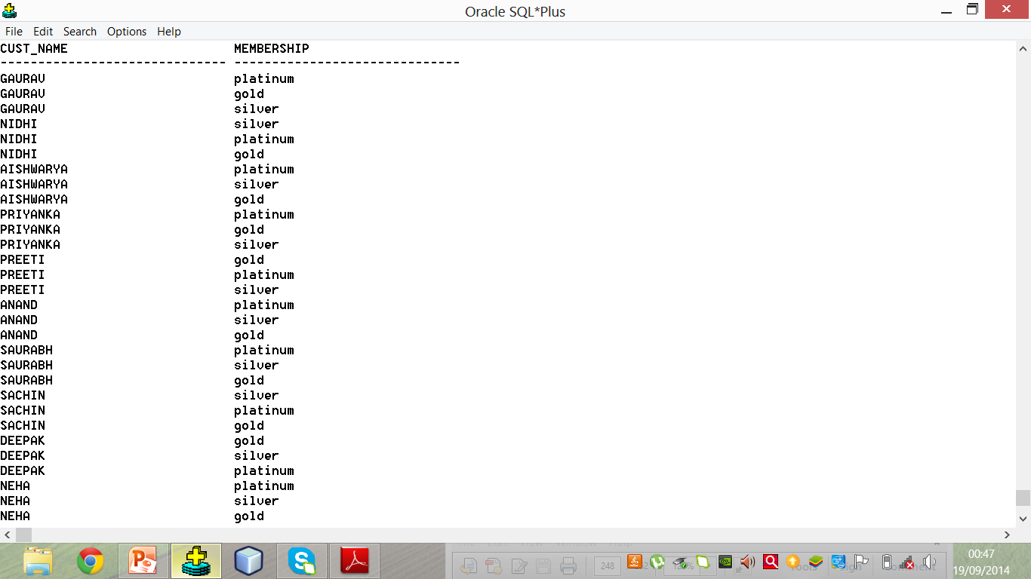
Cartesian Product with inconsistent data
Column
Aliasing

Slide 12
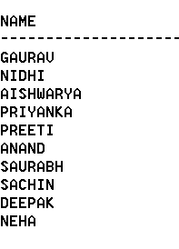
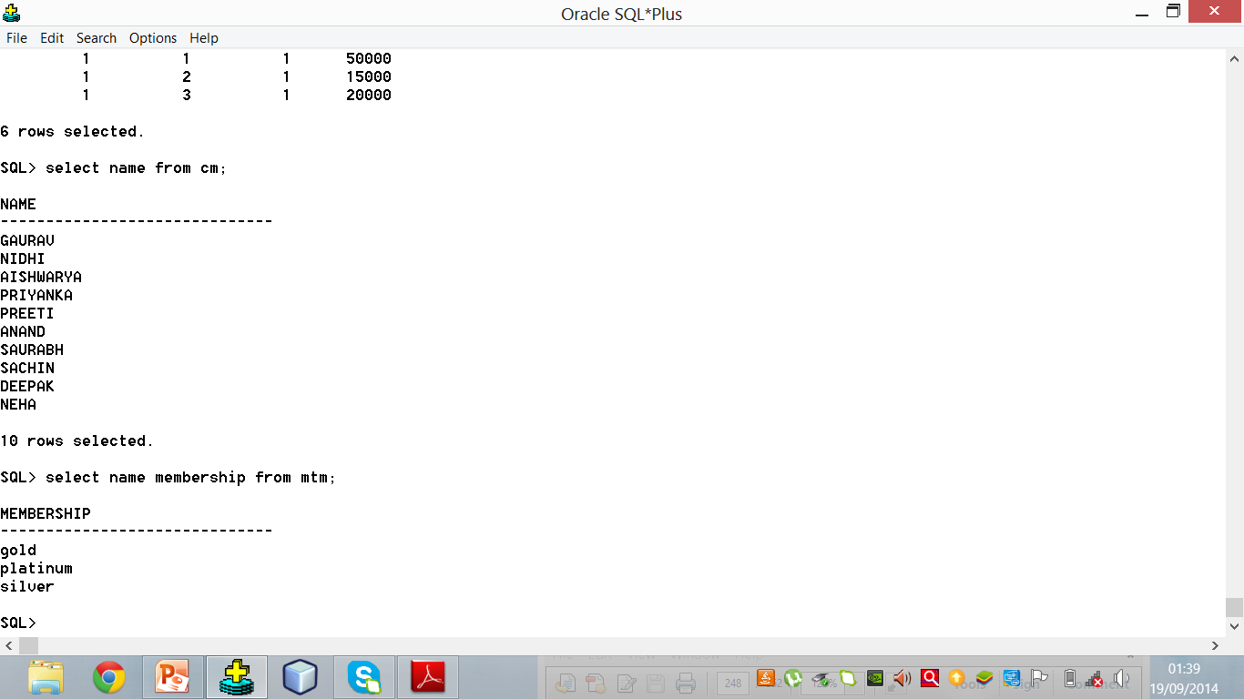
What is inconsistent data?
Cartesian
Product

Slide 13
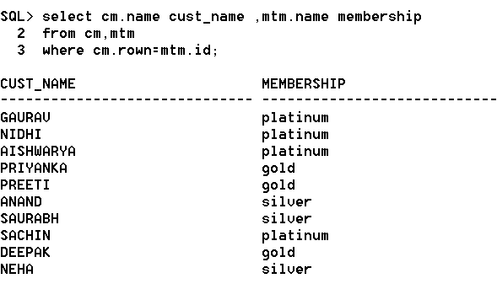
Cartesian Product with consistent data

Slide 14
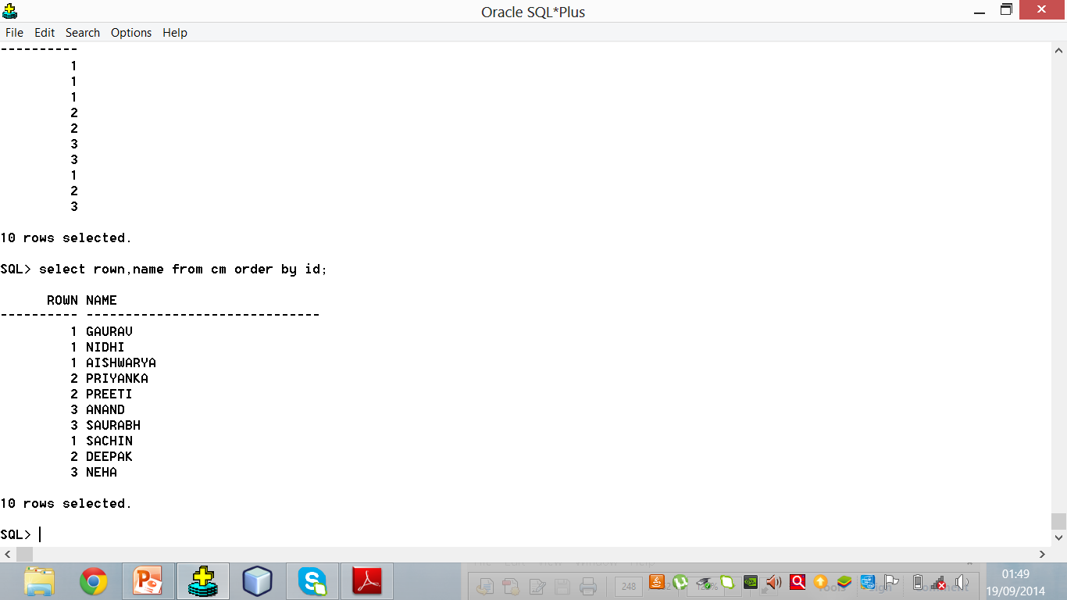
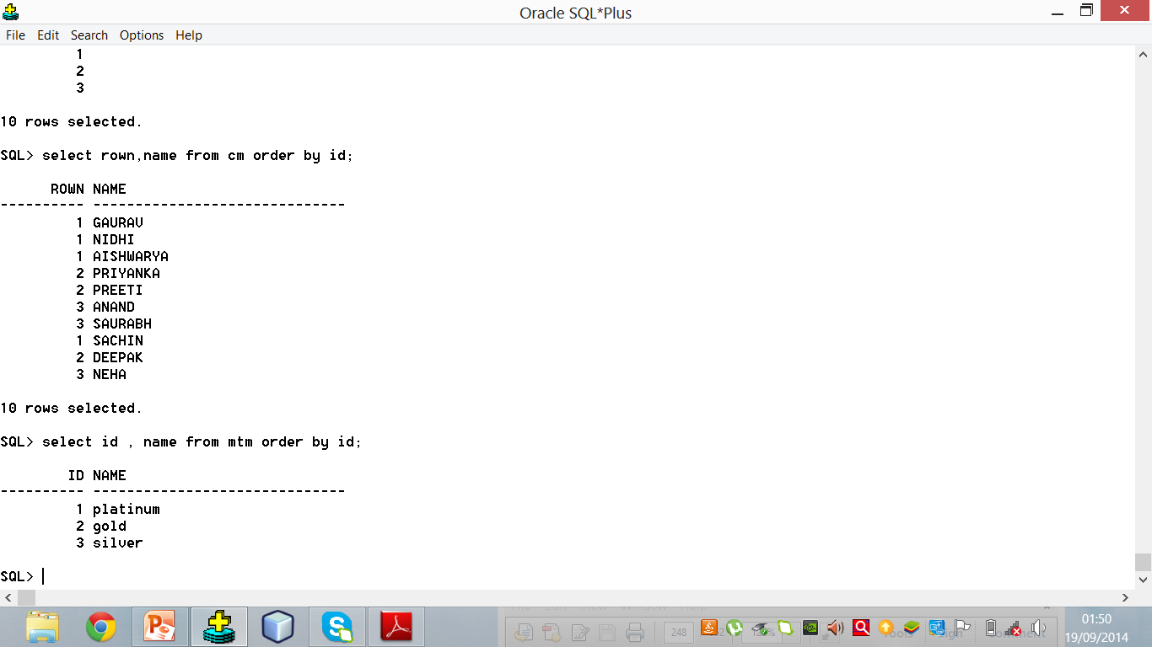
What is consistent data?
Cartesian
Product

Slide 15
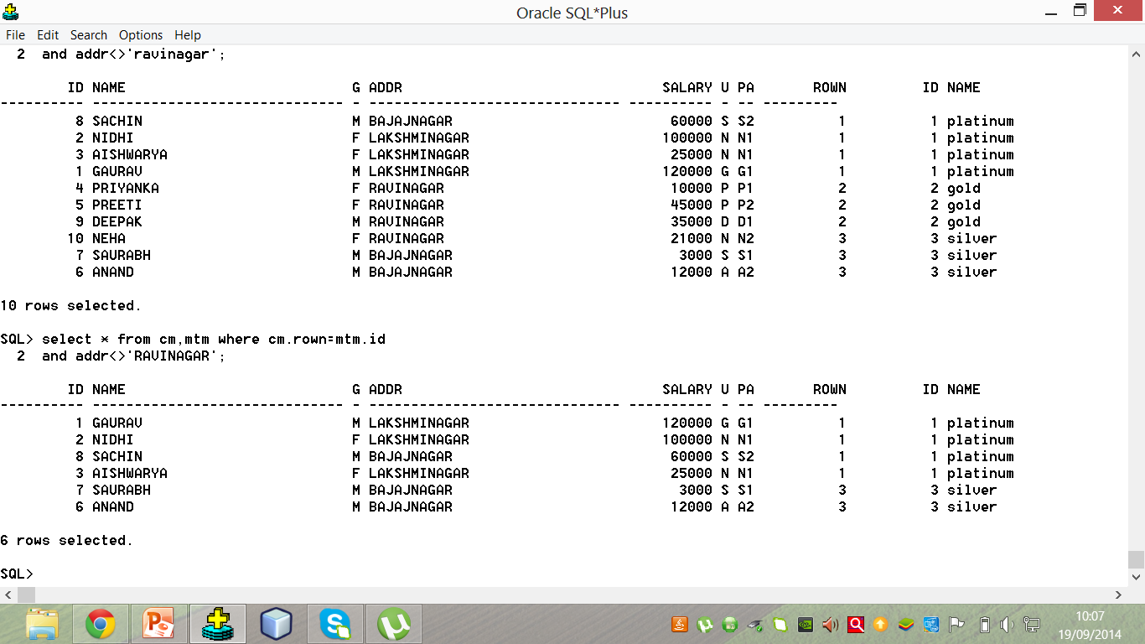
Non Equi Join
Non equi join

Slide 16
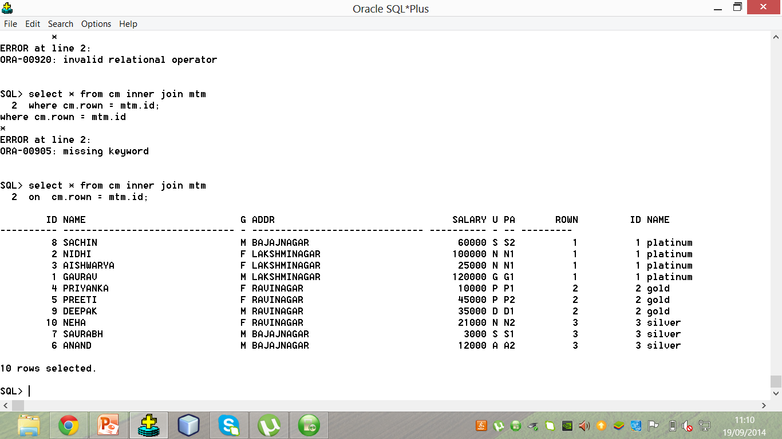
Inner Join

Slide 17
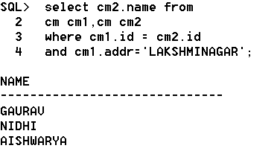
Self Join

Slide 18
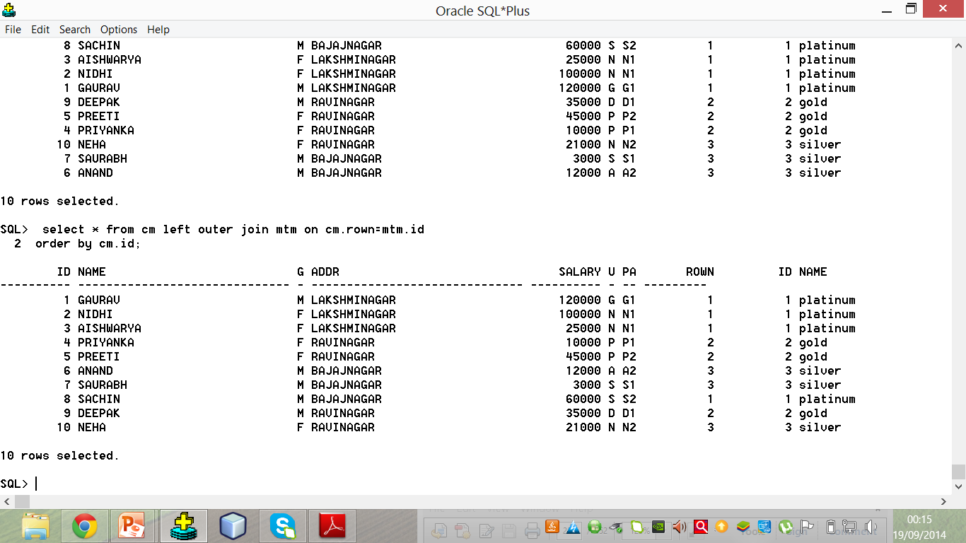
Left Outer join:
Foreign
key
Primary
key

Slide 19
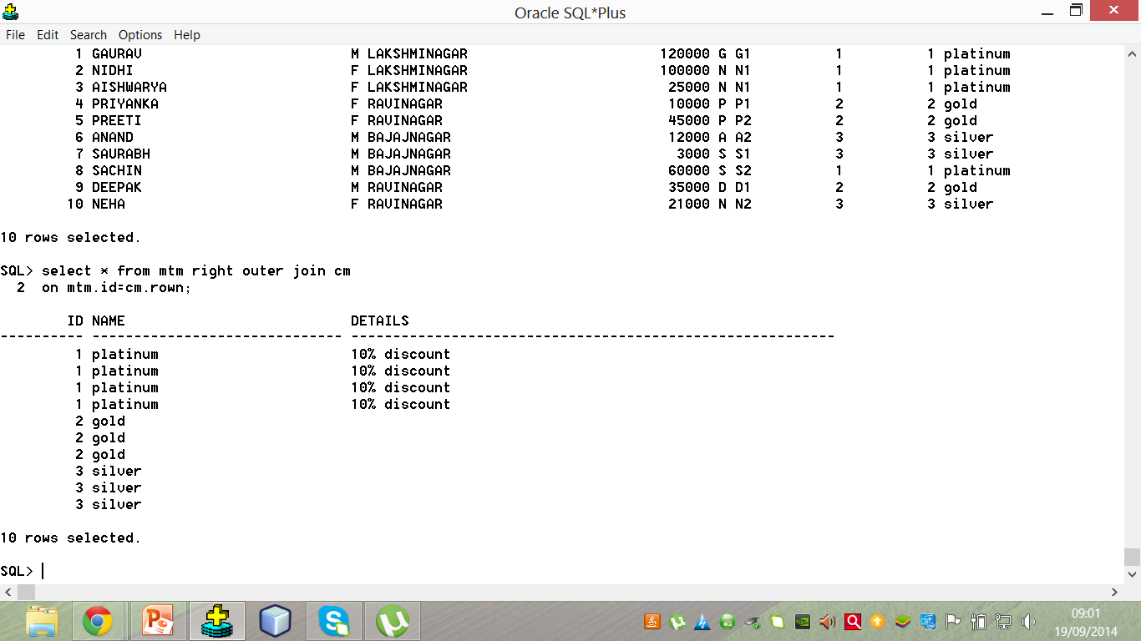
Right outer join

Slide 20
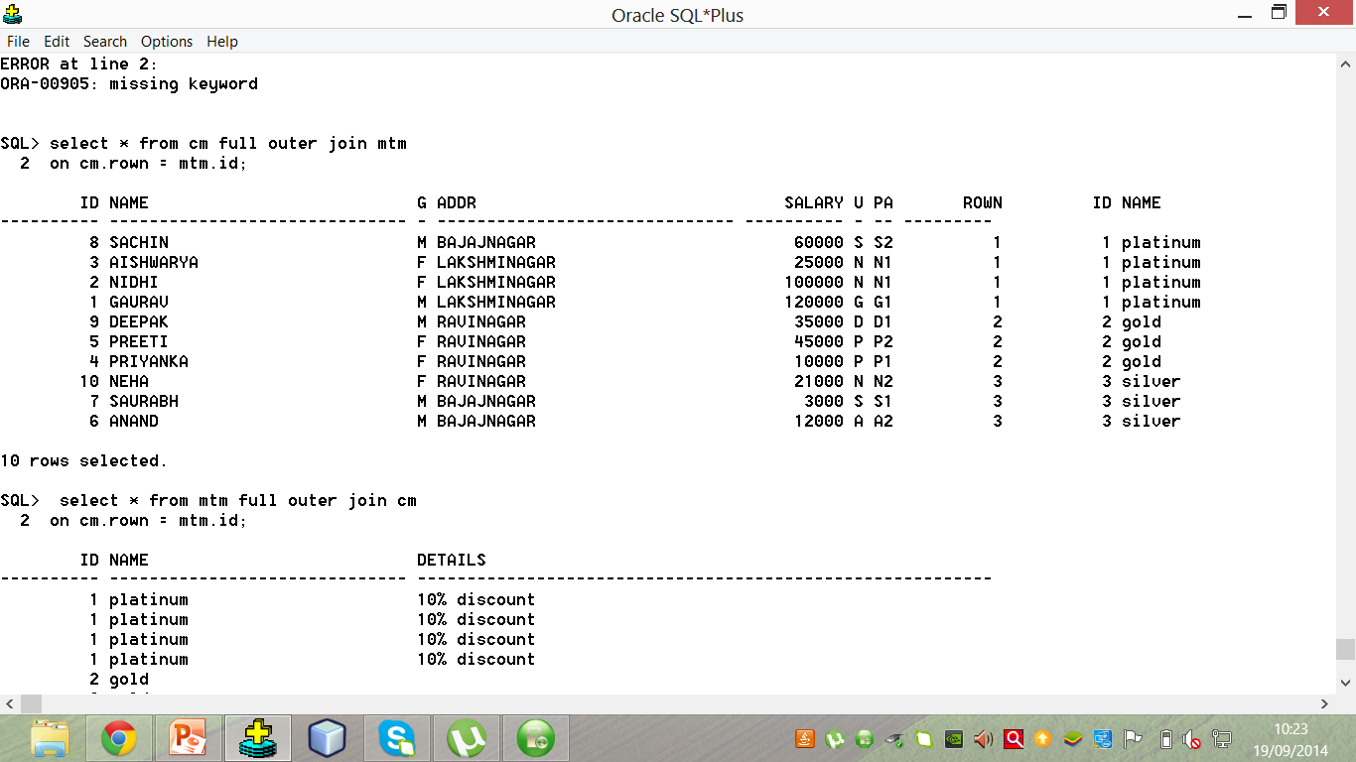
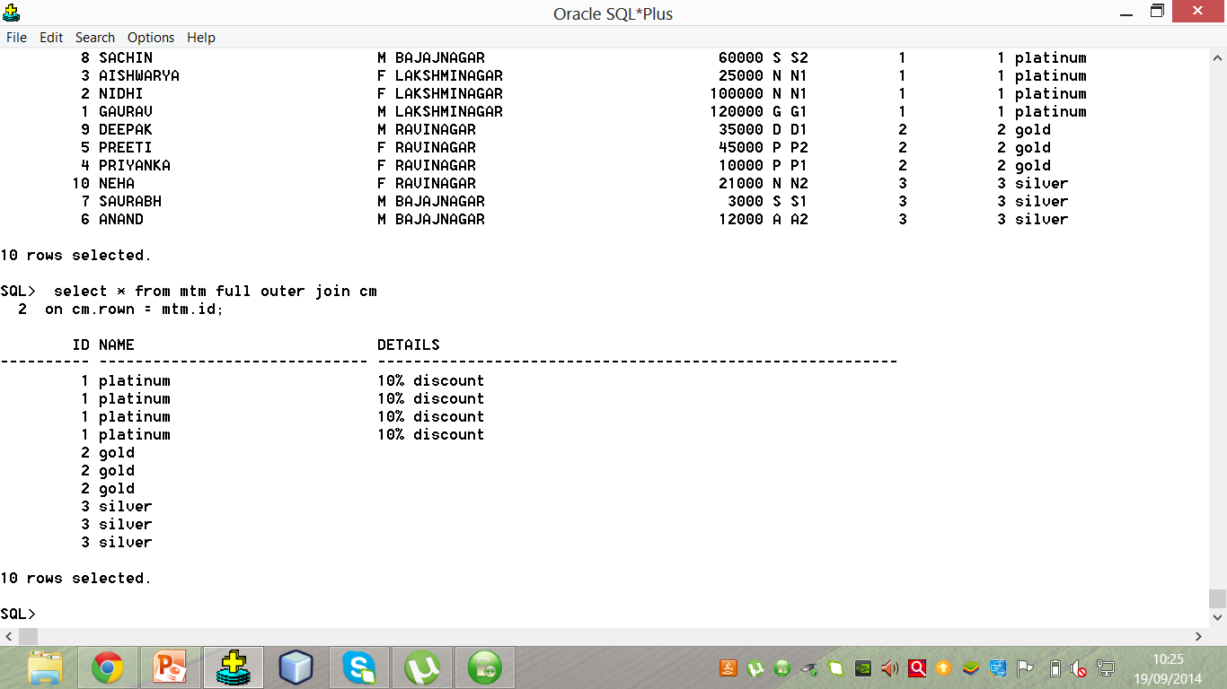
Full Outer Join

Slide 21
Joins using Venn Diagram

Slide 22
Equi join
Customer
mast
Mem type
mast

Slide 23
Non Equi join
Customer
mast
Mem type
mast

Slide 24
Left Outer join
Mem type
mast
Customer
mast

Slide 25
Right Outer join
Mem type
mast
Customer
mast

Slide 26
Full Outer join
Mem type
mast
Customer
mast

Slide 27
Union
Intersect
Minus

Slide 28
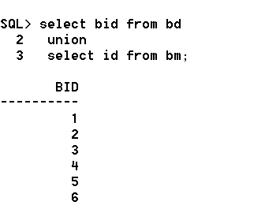
Union
Union act as logical OR operator

Slide 29

Intersect
Intersect act as logical AND operator

Slide 30
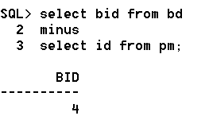
Minus
Subtracts values present in pm.id
From values in bd.bid

Slide 31


