Slide 1

http://www.programmingsguru.com/article/types-of-joins-in-sql-15

Slide 2
Introduction
A JOIN is a means for merging fields from two tables by using values common to each. SQL Joins condition is a part of the sql query that fetch/retrieve rows(data) from two or more tables. The records from the tables are fetched based on some values that are common to each."How many types of joins in sql" this question ask so many times in interviews,

Slide 3
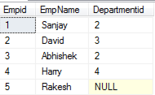
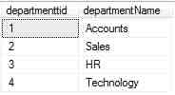
We have two tables
tbl_employee
tbl_department

Slide 4
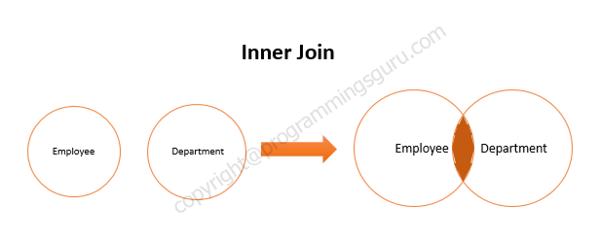
The Different Types of Joins in SQL Server
1 - INNER JOIN : A Inner Join is a type of sql join which returns all the rows from both tables where there is a match. Means return matching records for both tables.

Slide 5
2 - SELF JOIN : A Self Join is a type of sql join which is used to join a table to itself. In this join both the columns belong to the same table.
SELECT Emp1.Empid, Emp1.EmpName,Emp2.Departmentid FROM tbl_employee Emp1 INNER JOIN tbl_employee Emp2 ON Emp1.Empid=Emp2.Empid

Slide 6
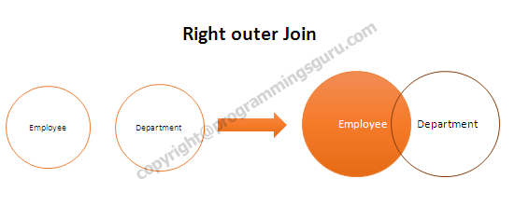
3 - OUTER JOIN : In this join includes rows even if they don't have related rows in the joined table. There are three different Outer Join methods..
Right outer Join : In This join returns all the rows from the right table in conjunction with the matching rows from the left table.

Slide 7
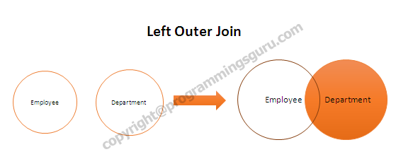
Left outer Join : In This join returns all the rows from the left table in conjunction with the matching rows from the right table.

Slide 8
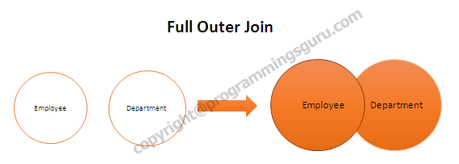
Full Outer Join : This join combines left outer join and right outer join. It returns row from both tables wether it's match or not.

Slide 9
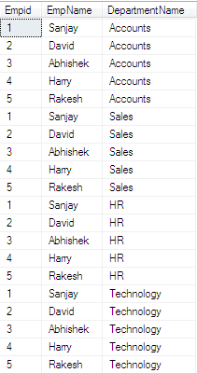
4 - CROSS JOIN : This join combines all the rows from the left table with every row from the right table. This type of join is required when we want to select all the possible combinations of rows and columns from both the tables.

Slide 10

http://www.programmingsguru.com

Slide 11



https://twitter.com/programingsguru
https://www.facebook.com/programmings4you
https://plus.google.com/u/0/106132290230951995384/posts

