Slide 1
Data Architecture 101
Pat Phelan
A quick introduction for the DBA or developer whose boss just promised a fabulous database to a new client

Slide 2
Confessions
I am a geek, I love technology
I am still a programmer at heart. I prefer scripting tools like PowerShell and Transact-SQL over GUI tools like SSMS.
I am Data-centric, because…
Data usually outlives the technology that recorded it, often by multiple generations.

Slide 3
More Confessions
Wikipedia has a lot of flaws, but…
Multiple human language support
Collaborative effort
Nearly always the first to document new terms/concepts
The “How To” ideas at the end are opinions
There are often other ways to solve a problem
Speak up if you know a better way!

Slide 4
Data Types
Data Types define how data is stored in programming and databases. https://en.wikipedia.org/wiki/Data_type
https://msdn.microsoft.com/en-us/library/ms187752.aspx
Misusing datatypes causes programming errors that don’t trigger error messages.

Slide 5
Counting Numeric Data Types
These data types are used for things you count like money, page visits, packages delivered.
INT – Signed Integer, TINYINT is unsigned
DECIMAL – Declared width and precision
NUMERIC – Synonym for DECIMAL
MONEY –Exactly four decimal places

Slide 6
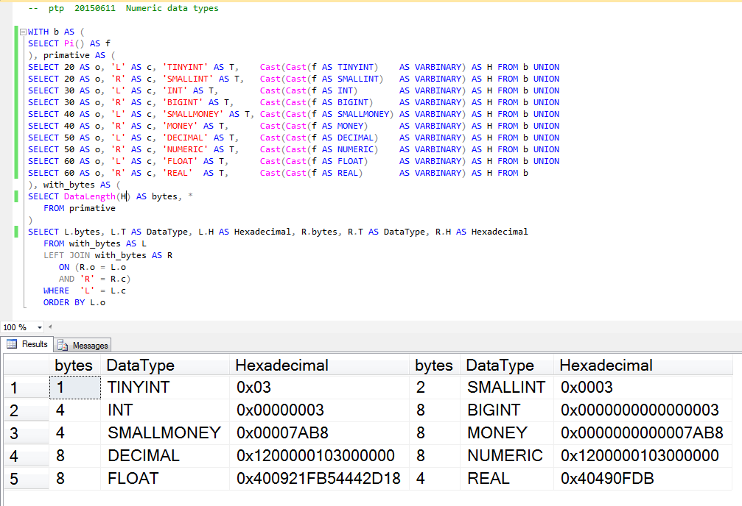
Counting Numeric Data Types

Slide 7
Measuring Numeric Data Types
These data types are used for things that you measure like meters, kilograms, seconds
FLOAT(n) – Floating point number where n is the number of bits. Note: MSSQL only uses 24 or 53.
REAL – Equivalent to FLOAT(24)

Slide 8
Measuring Numeric Data Types

Slide 9
Character Data Types
CHAR – Fixed length
VARCHAR – Variable length
Unicode variants
CHAR2/NCHAR/NVARCHAR/VARCHAR2

Slide 10
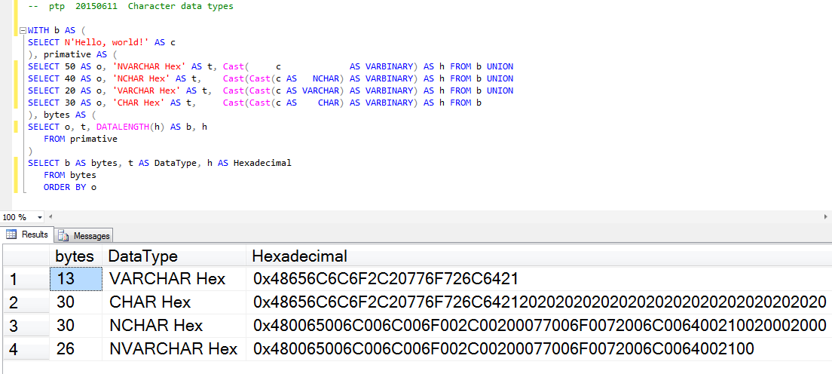
Character Data Types

Slide 11
Temporal Data Types
DATE – Date only
DATETIME – Date and time combined
INTERVAL (not in SQL Server)
TIME – Time only

Slide 12
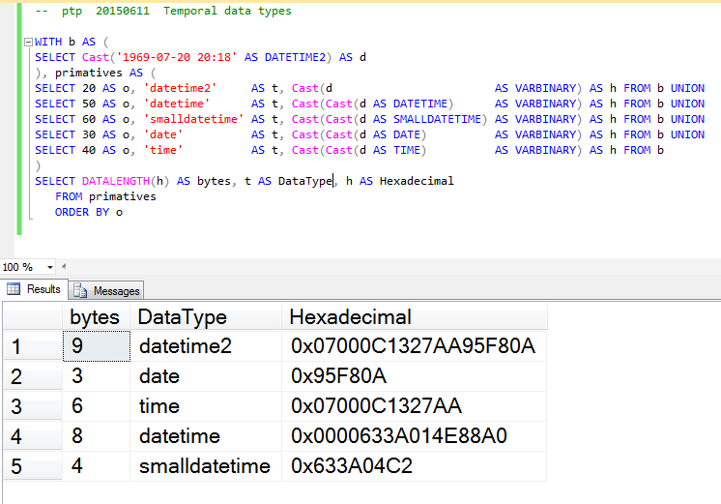
Temporal Data Types

Slide 13
Blob Data Types
IMAGE
CLOB/NTEXT/TEXT
VARCHAR(MAX)
VARBINARY(MAX)
XML

Slide 14
Other Data Types
Spatial
Uniqueidentifier
Variant

Slide 15
Relational Algebra (RA)
RA is not directly used in this presentation
RA definitions are used, because they are the authoritative source for SQL behaviors
Some SQL and relational database concepts require understanding the RA concepts to make sense without a lot of explanation.
RA is a Fundamental building block of all SQL engines and databases.
https://en.wikipedia.org/wiki/Relational_algebra

Slide 16
Relational Algebra (RA)
E.F. Codd published the first paper on RA in 1970
RA is based on mathematics
Postulate, theorem, proof
http://en.wikipedia.org/wiki/Codd%27s_12_rules
http://www.seas.upenn.edu/~zives/03f/cis550/codd.pdf

Slide 17
Relational Algebra (RA)
Element
RA definition: an integer
Practical definition: a single discrete unit of data
SQL column

Slide 18
Relational Algebra (RA)
Tuple
RA Definition: a finite ordered list of elements
Practical definition: A group of related pieces of information about a single thing
SQL row

Slide 19
Relational Algebra (RA)
Relation
RA Definition: a set of tuples
Practical definition: a spreadsheet
SQL table

Slide 20
Key Types
Natural Key (NK)
A Natural Key is formed of attributes that exist in the real world
Advantages
NKs tie to real world, so they are easy to see, follow, and prove
NKs propagate user data into child tables making some queries easier

Slide 21
Key Types
Surrogate Key (SK)
A Surrogate Key is not derived from any attributes that exist in the real world
Advantages
SKs aren’t subject to legislation or user whims
Because users don’t change SKs, the SKs don’t have FK propagation problems.

Slide 22
Key Types
Alternate Key (AK)
An Alternate Key is a group of one or more columns which uniquely identify a row in a table
Primary Key (PK)
Definition: One AK chosen to be the way to explicitly designate specific rows in a table

Slide 23
Key Types
Notes on NKs used as PKs
NKs change
ICD-9 to ICD-10
Identity theft
NKs can be duplicated
Duplicated VINs
Proprietor SSNs
Identical siblings

Slide 24
Key Types
Foreign Key (FK)
The PK from another table, used to denote a relationship
Super Key (+K)
Any key that includes unnecessary columns

Slide 25
Relational (SQL) Normalization
Why normalize?
Fewer bugs
Faster/smaller databases
Update Anomalies
Marc Rettig Puppy poster

Slide 26
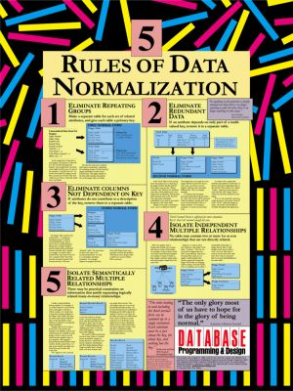
Marc Rettig Relational Database Normalization Poster
This poster was created in 1989 by Marc Rettig and was offered as a premium for subscribers to Database Programming and Design magazine from Miller Freeman Publications.
Database Programming and Design and Miller Freeman have since gone out of business, and Marc Rettig has generously allowed this poster to be freely distributed.

Slide 27
Relational (SQL) Normalization
First normal form 1NF
RA definition: A relation is in first normal form if the domain of each attribute contains only atomic values, and the value of each attribute contains only a single value from that domain.
Practical definition: No delimited (I.E. XML or CSV) columns, and no repeated columns like home_phone/work_phone/cell_phone.

Slide 28
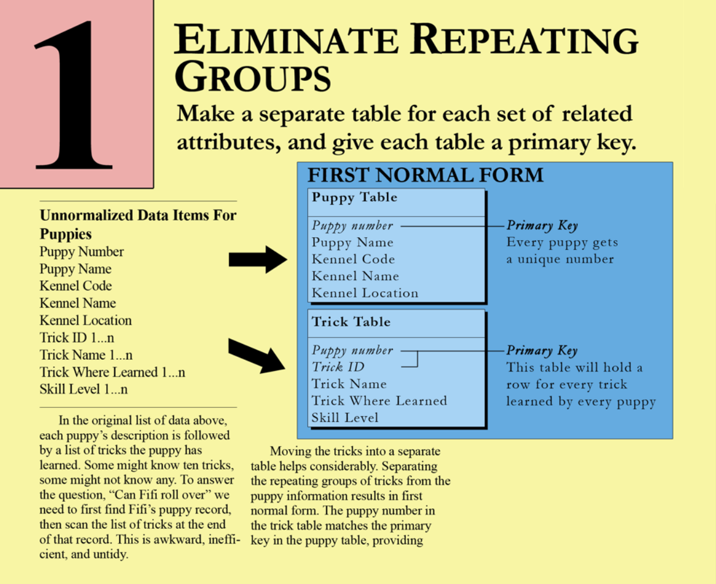
Relational (SQL) Normalization

Slide 29
Relational (SQL) Normalization
Second normal form 2NF
RA definition: a table is in 2NF if and only if it is in 1NF and every non-prime attribute of the table is dependent on the whole of every candidate key.
Practical definition: a table is in 2NF if it is in 1NF and all of the non-key columns depend on the whole PK.

Slide 30
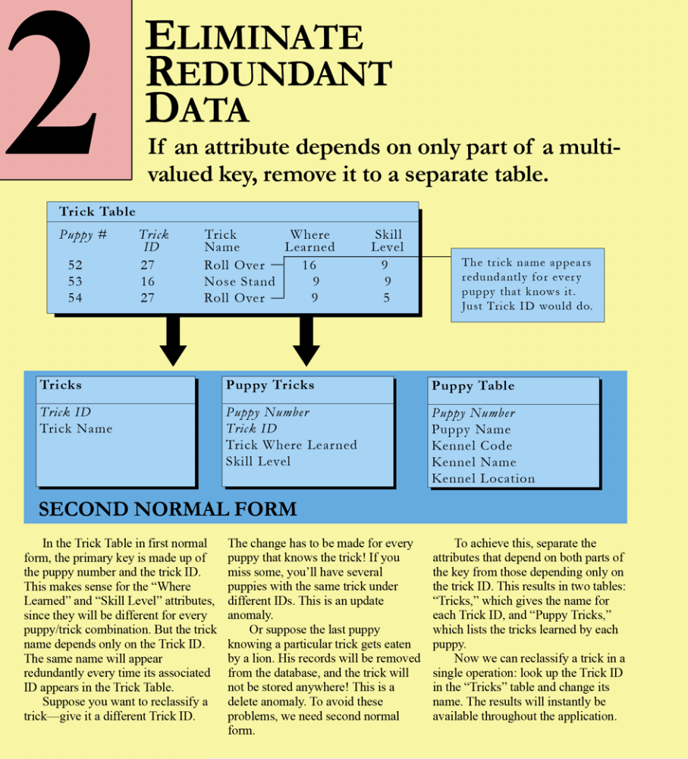
Relational (SQL) Normalization

Slide 31
Relational (SQL) Normalization
Third normal form 3NF
RA definition: The relation R (table) is in second normal form (2NF), and every non-prime attribute of R is non-transitively dependent on every superkey of R.
Bill Kent/Chris Date Quote: "Each attribute must represent a fact about the key, the whole key, and nothing but the key."
3NF is the minimum standard expected by most organizations

Slide 32
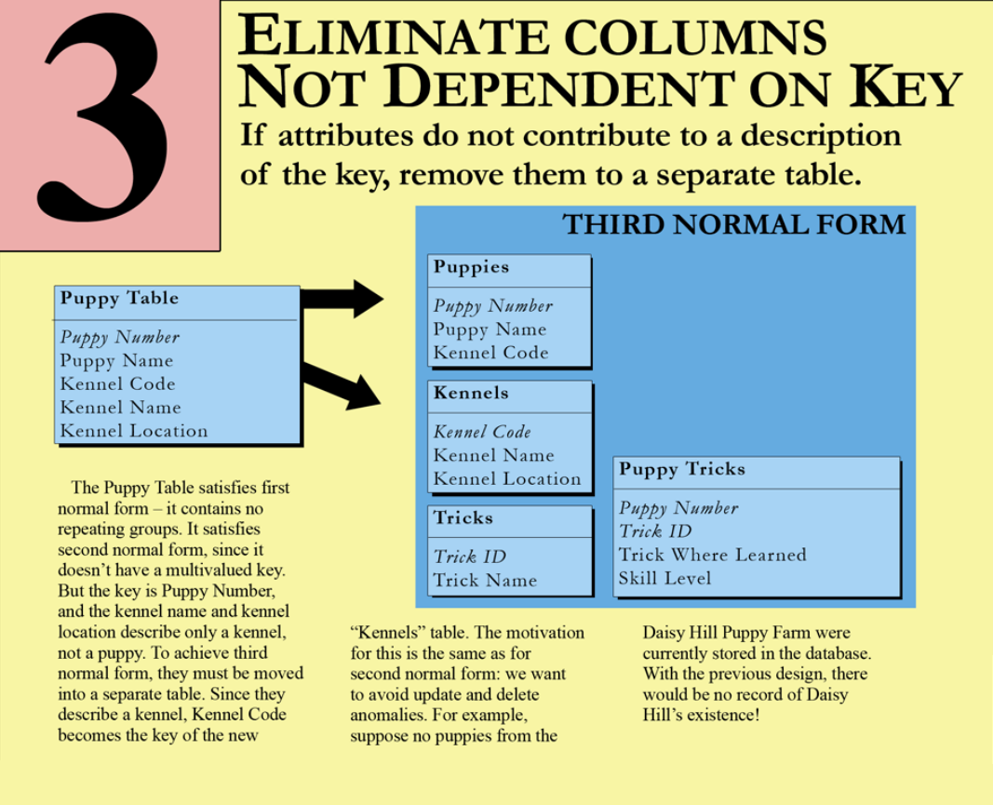
Relational (SQL) Normalization

Slide 33
Relational (SQL) Normalization
Fourth normal form 4NF
RA definition: a table is in 4NF if and only if, it is in 3NF and for every one of its non-trivial multivalued dependencies X Y, X is a superkey. That is, X is either a candidate key or a superset thereof
Practical definition: If attributes or relationships depend on the primary key, but not on each other, then they should be represented separately.
In a 1992 study, Margaret Wu found that 20% of systems studied have tables that should be in 4NF

Slide 34
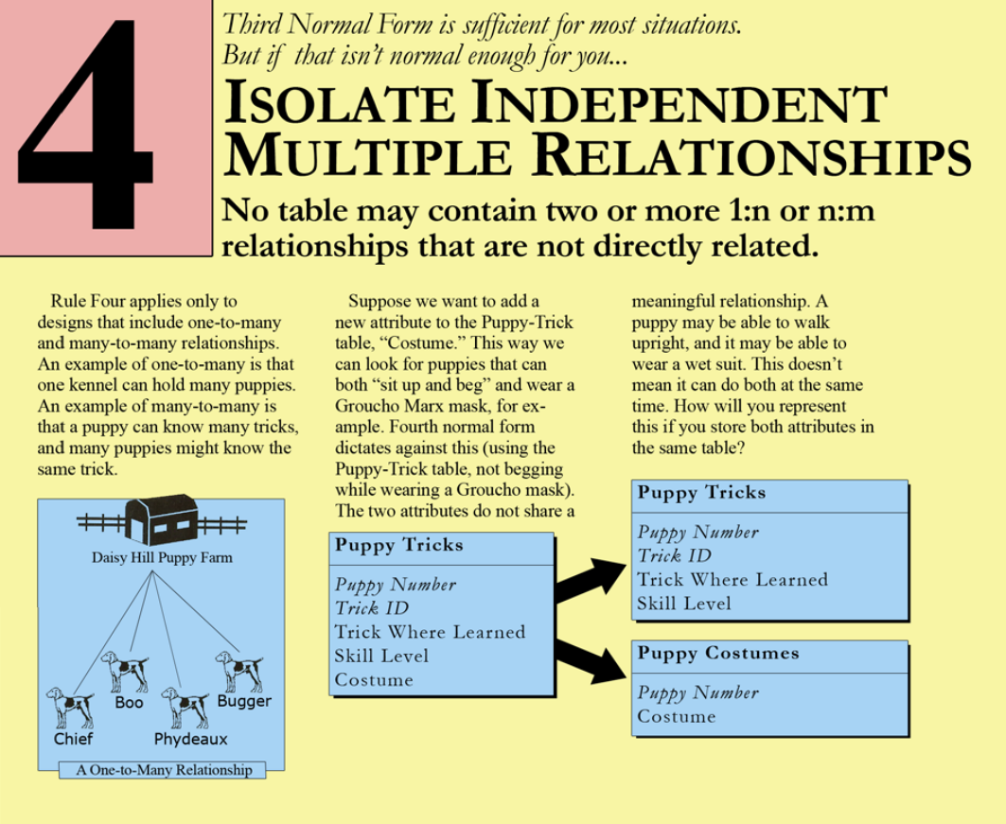
Relational (SQL) Normalization

Slide 35
Relational (SQL) Normalization
Fifth normal form 5NF
RA definition: A table is in fifth normal form (5NF) or Project-Join Normal Form (PJNF) if it is in 4NF and it cannot have a lossless decomposition into any number of smaller tables.
Practical definition: data maintenance can be made simpler and faster in a few cases by splitting logically related many-to-many operations.
I’ve only seen two cases as of 2015-04-15

Slide 36
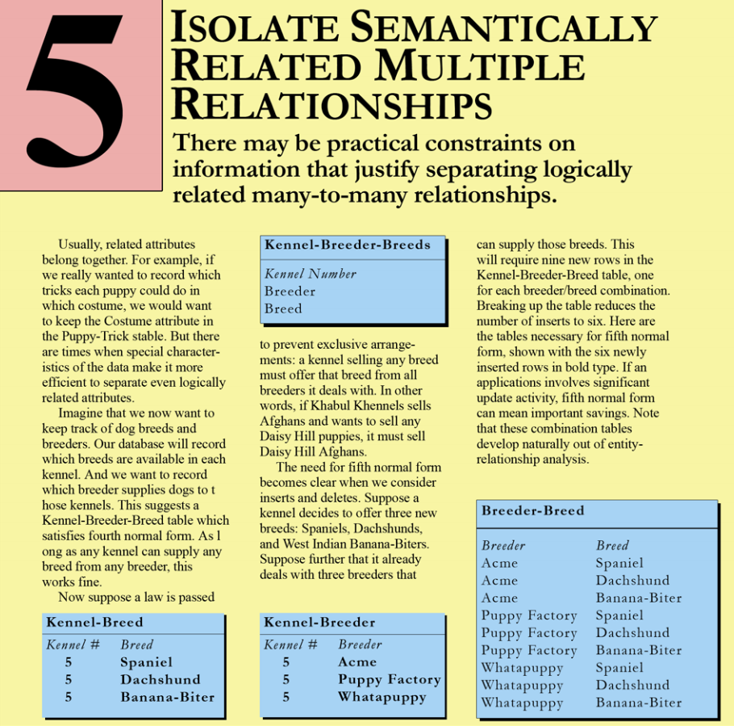
Relational (SQL) Normalization

Slide 37
Relational (SQL) Normalization
UNIQUE CONSTRAINT
Used to enforce AK Keys
I use to enforce at least one NK
MSSQL uses a UNIQUE INDEX, but the optimizer can better use the constraint

Slide 38
Relational (SQL) Normalization
PRIMARY KEY CONSTRAINT
Used to enforce PK keys
MSSQL uses a UNIQUE INDEX.
I use SKs whenever possible

Slide 39
Relational (SQL) Normalization
FOREIGN KEY CONSTRAINT
Used to enforce FK relationships
Provides faster join operations based from parent (optimizer will favor index use if FK is defined)
MSSQL allows using either AK or PK

Slide 40
Relational (SQL) Normalization
CHECK CONSTRAINT
Adds logic at the row level
Logical (true/false) expression must be true, such as these examples:
BeginDate <= EndDate
(PostalCode LIKE ‘[0-9] [0-9] [0-9] [0-9] [0-9]’ OR PostalCode LIKE ‘[A-Z][0-9][A-Z] [0-9][A-Z][0-9]’ OR PostalCode IS NULL)

Slide 41
How To
SK and NK play well together
Surrogate Keys and Natural Keys can be used together, and I STRONGLY recommend doing that.
PK should be an SK
At least one NK should be an AK

Slide 42
How To
Many-to-many Relationships
Many-to-many relationships require a relationship table which has FKs to the other tables.
A classic example is that an employee can work on many teams, many machines, and have many skills.
The helper table frequently needs attributes such as descriptions, EffectiveDate/InvalidDate, etc.

Slide 43
How To
One-to-one Relationships
1-1 relationships do not make sense in a relational database, unless security or outside factors are in play.
To implement 1-1 relationship in SQL:
Define two tables with the same PK
Implement an FK from each table to the other table
INSERT operations only work inside of transactions with deferred consistency checks!

Slide 44
How To
Useful URLs
http://karenlopez.brandyourself.com/
http://thomaslarock.com/
http://sqlblog.com/blogs/aaron_bertrand/archive/2009/10/12/bad-habits-to-kick-using-the-wrong-data-type.aspx

Slide 45
How To
Internet “places” to find Data Architecture help
http://http://dataarch.sqlpass.org/ - The PASS Virtual Chapter for Data Architecture
http://Twitter.com – Check the #SQLHelp hashtag, or find me @YetAnotherSQL
http://SQLServerCentral.com – Many people, notably SQLInTheWild

Slide 46
Even More Confessions
The first PASS User Group presentation for this session was June 2015. First SQL Saturday will be August 2015. This presentation was built from a database design workshop, so:
I NEED feedback!
Please comment on everything: good, bad, or noteworthy! I want to improve.

Slide 47

Pat Phelan Database Architecture 101
Pat is a Database Architect at Involta, LLC.
Email:
Pat@YetAnotherSQL.com
Twitter:
@YetAnotherSQL

