Slide 1
SQL Server TVP Performance Gotcha
Dan Guzman
Microsoft Data Platform MVP
http://www.dbdelta.com

Slide 2
TVP Development
Create database table type for TVP (CREATE TYPE…AS TABLE…)
.NET code defines parameter type as SqlDbType.Structured for TVP
.NET code may stream TVP data using a DataTable, array of DataRows, or IEnumerable<SqlDataRecord> object
These object all include meta-data that specify the column name (client), data type and (importantly) length of each column
Notes:
TVP data is streamed to SQL Server, and bulk-inserted into tempdb
TVPs are read-only and may be used in queries similarly to table variables
TVPs supported by modern APIs, including SqlClient, SQL Native Client, later ODBC drivers, and latest JDBC driver

Slide 3
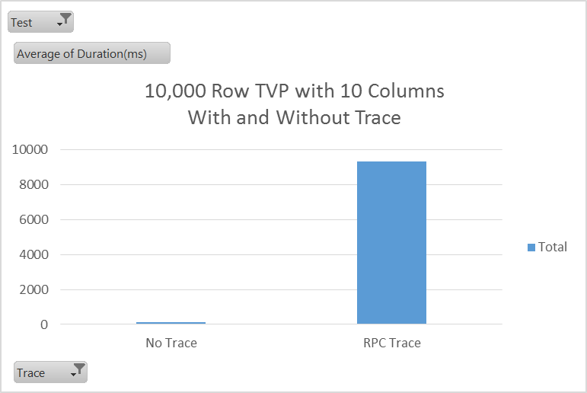
Trace Can Significantly Impact TVP Performance
Notes:
Performance issue exists with both legacy SQL Trace and Extended Event Trace of RPC events that include a TVP parameter
Root cause of performance impact is tracing’s use of OBJECTSTORE_LBSS when LOB columns are traced:
SELECT SUM(pages_kb) AS OBJECTSTORE_LBSS_KB
FROM sys.dm_os_memory_clerks
WHERE type = N'OBJECTSTORE_LBSS';
Each LOB cell of a TVP requires about 8K from the OBJECTSTORE_LBSS memory pool during tracing regardless of actual value length
Over 800MB per TVP request required in this example (10,000 x 10 x 8K)

Slide 4
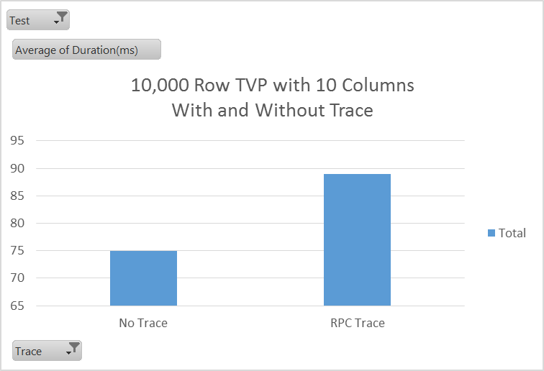
A TVP Column MaxLength <= 4000 can Greatly Mitigate Trace Performance Impact
Notes:
Applies to application string columns regardless of target TVP type (varchar or nvarchar)
Strings in .NET are Unicode with 2GB max length
SQL Server considers a client column MaxLength of over 4000 characters as a LOB and will impact performance with tracing

Slide 5
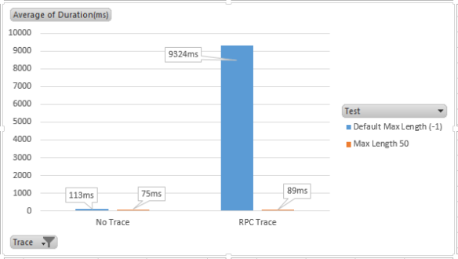
TVP and Tracing Performance Summary
Notes:
The default string MaxLength of a DataTable column is -1 (2GB)
It is important to specify actual target column MaxLength for varchar(n) and nvarchar(n) to avoid excessive memory utilization during tracing
If TVPs include varchar(MAX) or nvarchar(MAX) columns, avoid tracing of TVP requests with many events or many rows in production – can result in server instability to the point of crashing

Slide 6
TVP Tracing Blog Article
http://www.dbdelta.com/sql-server-tvp-performance-gotchas/

