Slide 1
SQLSaturday 2017
Sioux Falls, SD | Hosted by (605) SQL

Slide 2
Isolation Levels Understanding Transaction Temper Tantrums
Adam Koehler

Slide 3
Please be sure to visit the sponsors during breaks and enter their end-of-day raffles!
Remember to complete session surveys! You will be emailed a link after the event or you visit http://www.sqlsaturday.com/662/Sessions/SessionEvaluation.aspx
Event After Party
At Will’s Training Table (Formally Beef O’Bradys) near the Pentagon starting at 5:45 PM
Want More Networking and Training?
(605) SQL meets the 2nd Tuesday of every month. https://605sqlusergroup.sqlpass.org

Slide 4
















THANK YOU SPONSORS

Slide 5
Title
Adam Koehler, Senior Database Administrator at ScriptPro LLC
15 years of progressive experience with SQL Server from 7.0 to 2014
E-mail: ajkoehl@gmail.com
Twitter: @sql_geek
LinkedIn: https://www.linkedin.com/in/adam-j-koehler
Blog: https://sqlgeekery.wordpress.com

Slide 6
What are We Going to Cover?
What are the ACID properties?
What are Isolation Levels?
Examine each Isolation Level and how they work in SQL Server
How to implement Isolation Levels
Troubleshooting
Demos
Q&A

Slide 7
What are the ACID Properties?
The properties of a database transaction
Atomicity
Each transaction is all or nothing, including during power failures.
Consistency
Any transaction will transition the database from one state to another.
Isolation
Ensures that concurrent execution of transactions result in a database state that would happen if each transaction was executed in serial
Durability
Ensures that once a transaction is committed, it stays that way

Slide 8
What are Isolation Levels?
The degree at which a given transaction is isolated from others in the system
Is part of the ACID mechanisms of database management systems
Atomicity, Consistency, Isolation, Durability
Defined by the ISO/ANSI SQL Standards
Read Uncommitted, Read Committed, Repeatable Read, Serializable

Slide 9
Dirty, Phantom & Non-Repeatable Reads
Dirty Reads:
One transaction executing a query may not see results that happen from another transaction
Non-Repeatable Reads:
Data read twice in the same transaction that gives different results on each read
Phantom Reads:
Occurs when two identical queries are executed and the results of one query is different than the first

Slide 10
Read Uncommitted
Pros:
Least restrictive isolation level
Same as adding NOLOCK to a SQL query
Quick way to ease blocking
Only takes a schema stability lock and shared Database lock to prevent table definition changes while the query executes

Slide 11
Read Uncommitted
Cons:
Data can be inconsistent throughout query execution
Can corrupt indexes if used on DML (Insert/Update/Delete) statements
Allows for dirty, phantom, & non-repeatable reads in the database

Slide 12
Read Uncommitted
DEMO

Slide 13
Read Committed
Pros:
Next step up from Read Uncommitted
Default for SQL Server
Does not allow for dirty reads
Takes shared locks to prevent updating of data while the data is being accessed
only when RCSI is turned off
Locks are only taken while the data is accessed, and not until the end of the transaction

Slide 14
Read Committed
Cons:
Is not a point in time snapshot of the entire data set that is being queried
Can end up reading the same data twice or not reading data at all since only row-level locks are taken during the query
Data being queried may not be up to date.
Just because it’s committed data doesn’t mean that someone isn’t about to manipulate it after your query is done

Slide 15
Read Committed
DEMO

Slide 16
Repeatable Read
Pros:
Next step up from Read Committed
A Query statement can not read data that has been modified, but not committed
Shared locks are taken on all the data in the query until the transaction completes
These guarantee that the data will not change during the transaction once it has been initially read

Slide 17
Repeatable Read
Cons:
Can cause consistency related issues when new rows are inserted during the same transaction after the data is first accessed (phantom reads)
Can cause excessive locks if the queries are long-running or poorly written until the query is committed

Slide 18
Repeatable Read
DEMO

Slide 19
Serializable
Pros:
Highest isolation level
(ANSI standard default)
Queries cannot read data that has not been committed
Other transactions cannot modify data that is currently being queried under this isolation level
Other transactions cannot insert data in the range of data currently being queried
Same as HOLDLOCK table hint
Makes a transaction fully ACID compliant

Slide 20
Serializable
Cons:
Highest isolation level
Can cause massive blocking & deadlocking
Uses range locks on the data being accessed in order to satisfy the query
Doesn’t allow phantom or dirty reads
Will cause other queries trying to access the data to fail because they are already locked

Slide 21
Serializable
DEMO

Slide 22
Read Committed Snapshot
Pros:
Implements row-versioning with Read Committed
Does not use shared locks to read data
Can improve blocking/deadlocking conditions (optimistic locking)
Allows for improved access between queries that use different isolation levels
Readers do not block writers, and writers do not block readers

Slide 23
Read Committed Snapshot
Cons:
Tempdb is affected by the version store
RCSI provides a snapshot view of the committed data when the statement started
This can be a problem in long running queries when comparisons need to be made on the data set, and an update to the data set occurs in another query
Adds 14 bytes to each database row
Update performance can slow because of creating the row-versioning information
Writers still block writers, this does not change

Slide 24
Read Committed Snapshot
DEMO

Slide 25
Snapshot
Pros:
Guarantees a point in time version of the data in the query when used
The query sees the data at the beginning of the transaction as it existed when initiated without taking locks on the data itself
Requires ALLOW_SNAPSHOT_ISOLATION to be enabled on the database in question
Always uses optimistic concurrency with locks only taken to prevent updates on the underlying data

Slide 26
Snapshot
Cons:
Cannot be enabled while transactions are executing
Have to modify code to use this isolation level
tempdb can fill up if size is not monitored
14 bytes per row are added to each table
Versions in the version store hold the previous update/delete values for all the records in each table that it is used in a query
Conflict detection can cause unexpected update termination

Slide 27
Snapshot
DEMO

Slide 28
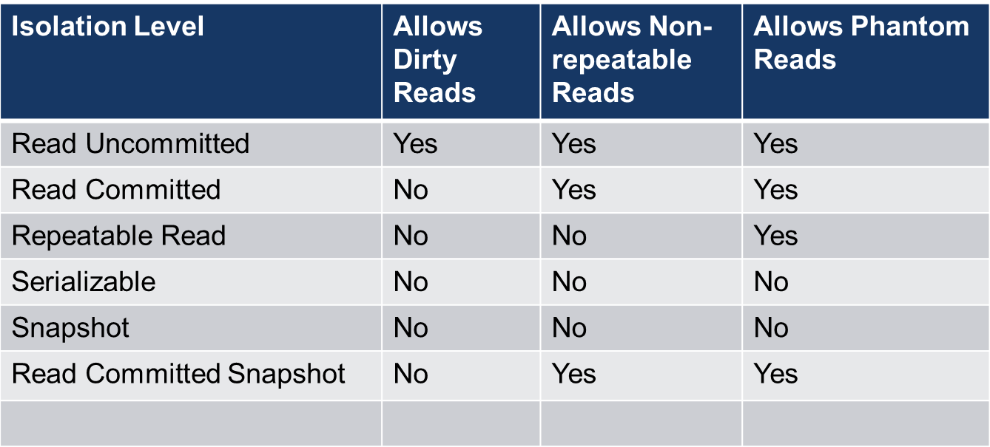
Isolation Level Properties

Slide 29
Ways to Set Isolation Levels
At a query level (SET TRANSACTION ISOLATION LEVEL)
At the connection level via code
At the transaction level via code

Slide 30
Setting Isolation Levels in code
C#:
TransactionScope()
Default IsolationLevel when setting up an TransactionScope() class is Serializable and timeout is 60 seconds
This can lead to deadlocks in applications
SQLConnection.BeginTransaction
Must set isolation level as part of the begin transaction
This offers safety as it forces the developers to decide what isolation level the transaction will run at

Slide 31
How do these affect performance?
You may not be able to query the data at the same time, causing queries to increase execution time
You could run out of tempdb space because of the increased overhead of SNAPSHOT/RCSI isolation level use
I/O could be affected by SNAPSHOT/RCSI isolation use

Slide 32
Troubleshooting Isolation Level Issues
Check waits
Profiler
Extended Events
DMV’s
Deadlocks
TF 1222 will show isolation level of the query in a deadlock graph
Blocked Process report
XE & Profiler

Slide 33
Troubleshooting Isolation Level Issues
DEMO

Slide 34

What to do when there are problems?
Gather statistics necessary to make changes
Talk to your developers!
Adjust the isolation level to get the optimal execution necessary for your application in test
Monitor changes in test
Deploy to production as necessary, monitor and adjust again as necessary

Slide 35
Resources
http://bit.ly/2cTPVCH - Isolation Levels in the Database Engine
http://bit.ly/2ddIDMC - SET TRANSACTION ISOLATION LEVEL (Transact-SQL)
http://bit.ly/2cJGe9k - using new TransactionScope() Considered Harmful
http://bit.ly/2dmpiaz - Series on Isolation Levels - Paul White
http://bit.ly/2d3XJAH - How to enable Blocked Process Report
http://bit.ly/2dgW7Hv - Enlarge AdventureWorks - Jonathan Kehayias
http://bit.ly/2d7ELtg -- AdventureWorks download for SQL 2014
E-mail: ajkoehl@gmail.com
Twitter: @sql_geek
LinkedIn: http://www.linkedin.com/in/adam-j-koehler

