Slide 1
The PROCESS of Queries
John Deardurff
Website: http://john.deardurff.com
Twitter: @John_Deardurff
Email: John@Deardurff.com

Slide 2

Presentation Topics
Batches vs Transactions
How Queries are Processed
Working with Batches
ACID Transactions
Error Handling
Table Structures
Execution Plans

Slide 3

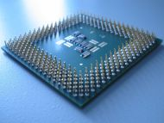
Batches vs. Transactions
Batches
Transactions
VS
TSQL2012.mdf
Sends Code to the Processor
Modifies Data in the Database

Slide 4
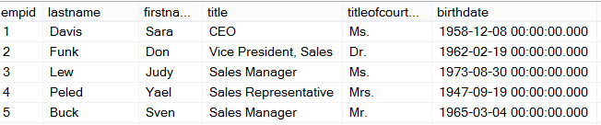
Ad Hoc Query
Stored Procedure
Syntax
Parse
Execution Context
Resolve
Compile
Optimize
Execution Plan
Procedure Cache
Compile
Compile
Run Time
Execute
Execute
Execute
Execute
SQL
SQL
Sets
Sets

Slide 5
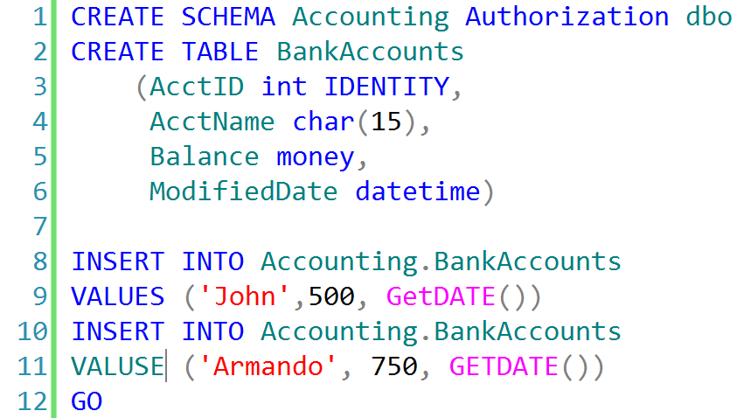
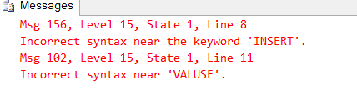
Working with Batches

Slide 6
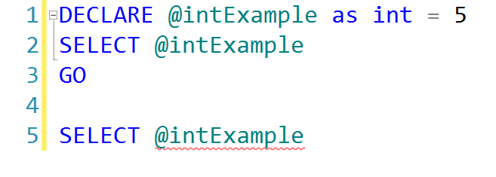
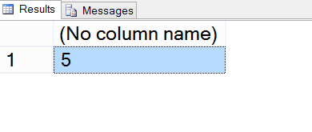
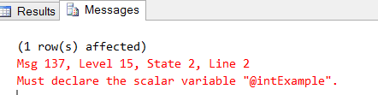
Batches And Variables
First Batch Successful
Second Batch Fails

Slide 7
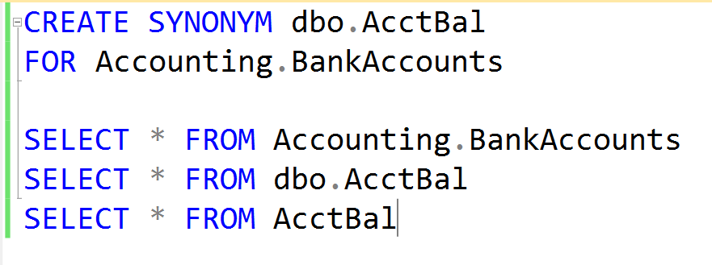
Creating Synonyms

Slide 8
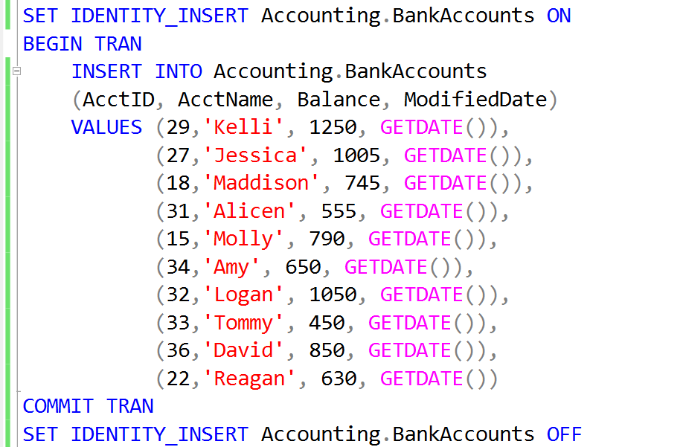
Inserting Records into an IDENTITY field

Slide 9
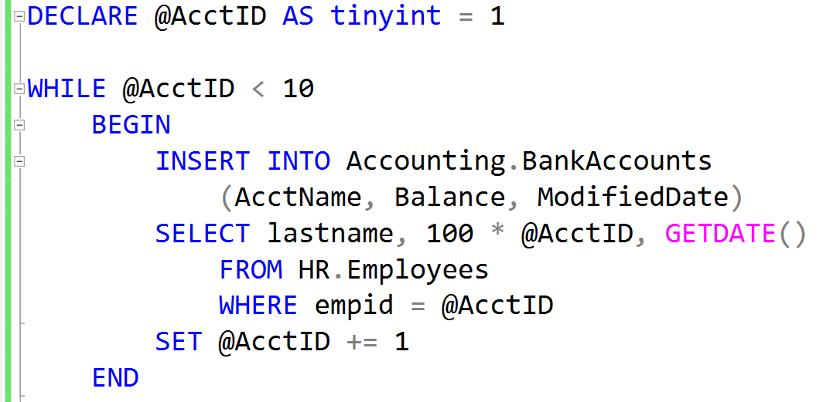
Add Records using a While Loop

Slide 10
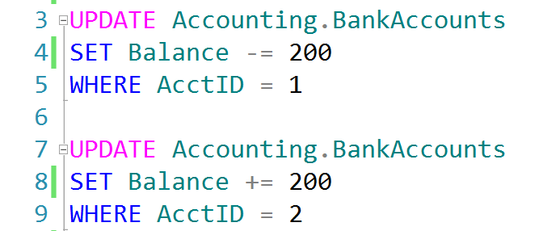
Auto Commit Transactions without Error Handling
TSQL2012.ldf
Checkpoint
TSQL2012.mdf

Slide 11
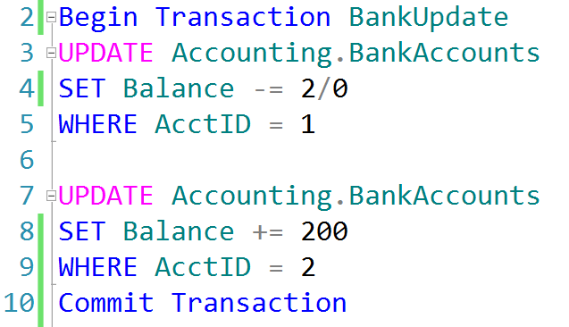
Explicit Transactions without Error Handling
TSQL2012.ldf
Checkpoint
TSQL2012.mdf

Slide 12
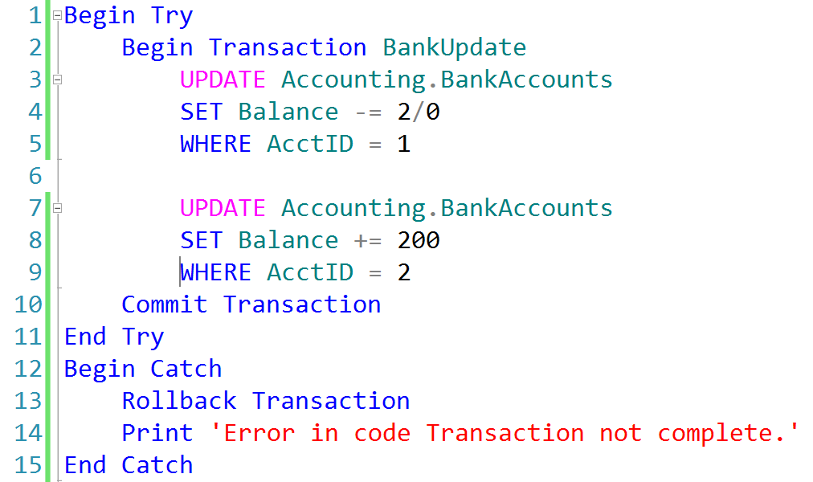
Explicit Transactions with Error Handling
TSQL2012.ldf
TSQL2012.mdf
Checkpoint

Slide 13
Transactions must pass the ACID test
Atomicity – All or Nothing
Consistent – Only valid data
Isolated – No interference
Durable – Data is recoverable

Slide 14
Transaction Recovery
Transaction Recovery
Action Required
1
None
2
Roll forward
3
Roll back
4
Roll forward
5
Roll back
Checkpoint
System Failure

Slide 15
How Data is Stored
Heap
Data stored in a Heap is not stored in any order and normally does not have a Primary Key.
Data Row 8
Data Row 2
Data Row 7
Data Row 6
Data Row 5
Data Row 4
Data Row 1
Data Row 3
Data Row 9
Clustered Index
Clustered Index data is stored in sorted order by the Clustering key. In many cases, this is the same value as the Primary Key.
Data Row 1
Data Row 4
Data Row 7
Data Row 2
Data Row 5
Data Row 8
Data Row 3
Data Row 6
Data Row 9

Slide 16
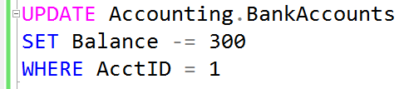


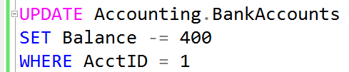
What are Locks?
Transaction 1
Transaction 2
TSQL2012.mdf

Slide 17
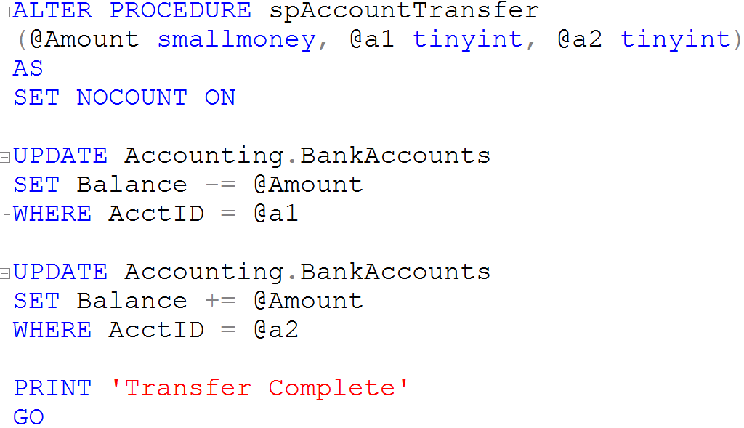
Creating Stored Procedures

