Slide 1


Data Analysis with
SQL Window Functions
Adam McDonald
Senior Application / SQL Developer
Smith Travel Research
adam@str.com @adam_mcd1
Notes:
Good afternoon, let’s get started
This class is called “Data Analysis with SQL Window Functions”
We’re going to look at a high level overview of window functions and how to use them
First an introduction
Adam McDonald
Senior developer at STR in nashville, 12+ years
First sql Saturday event, and first time presenting
History:
started out as a .NET developer (reporting applications, windows services, windows forms)
started doing my own SQL work to increase efficiency
SSIS (integration services)
SSAS (analysis services) to preaggregate data (OLAP / MDX)
over the years I became the resident data expert
Now I build database solutions for the devs to use
Window functions is singular
Windows is an operating system, this is a window
you’re opening a window into your result set

Slide 2
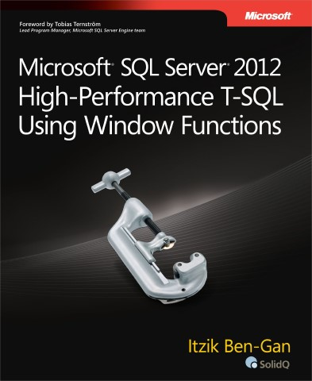
References:
High-Performance T-SQL Using Window Functions
By: Itzik Ben-Gan
Todays presentation is available on dropbox.
Slides : https://goo.gl/x7IsBk
Demo : https://goo.gl/2aGcsr

Slide 3

What are window functions?
Window functions are the sliced bread of SQL server!
"Window functions, to me, are the most profound feature supported by both standard SQL and Microsoft SQL Server's dialect -TSQL. They allow you to perform calculations against sets of rows in a flexible, clear, and efficient manner. The design of window functions is ingenious, overcoming a number of shortcomings of the traditional alternatives.”
Itzik Ben-Gan
Notes:
you've heard the saying "This is the greatest thing since sliced bread.“
Window functions are the sliced bread of sql server
When they were introduced it immediately changed the way certain problems were solved
Gave a unified approach to doing certain tasks
Read intro from book
That’s a pretty powerful statement

Slide 4
What are window functions?
Definition:
Window functions allow you to perform calculations against sets or of rows within a query.
subsets
SQL Order of Operations
FROM
WHERE
GROUP BY
HAVING
SELECT
ORDER BY
Window functions are performed after the SELECT
Notes:
official definition
Subsets is the key here
Window functions allow you to get a result set and then drill into it to perform additional calculations
order of operations
imagine that window functions fit after the select clause
what does that mean?
only usable in the select and order by, not in WHERE clause
Some of the third party players have solutions for that, like a qualify statement that works like a where clause
This seems like a limitation but…
You can usually work around that limitation by applying the window function in a CTE then referencing it in the where statement outside of the CTE

Slide 5
Why are they useful / better?
Fast
Efficient
Powerful
Easy to read syntax
Does not require GROUP BY or sub-queries
Encourages you to use set based operations
Notes:
Fast & Efficient & Powerful
But it does have a cost
Imagine you built a CTE with a window function applied
Then outside the CTE you filter based on the window function, what happens?
It has to build the entire result and apply the function to every row before it can return a filtered set
Easy to read syntax
Does not require GROUP BY or sub-queries
this can be really handy
Group by clauses summarize data into a single context
Window functions allow you to have multiple contexts in one query
For example, if I’m pulling monthly sales data for hotels
I can pull the row level monthly data, then using window functions add R3, R12, YTD
All in one query and very fast
Encourages you to use set based operations
We all know in sql server you can’t get optimum performance without using set based operations

Slide 6
Version History
SQL 2005
Ranking function
Aggregate functions (only partition clause, no frame clause)
SQL 2012
Window order clauses
Frame clauses
Offset clauses
Distribution functions
Not just SQL Server
Window functions are part of the SQL ANSI standard
PostgreSQL, Oracle, MySQL, DB2, Teradata…
Parts of the standard are not supported by Microsoft
Notes:
Originally added in sql 2005 with limited support
2012 was the first version where they were fully fleshed out
Not just SQL server, included in SQL standards
Some have slightly different implementations
For example, Teradata created a Qualify statement
Acts like a WHERE clause with a window function
If you’re not using 2012 you’re limited, but still good to know

Slide 7
Function Types
Aggregate
SUM
MIN
MAX
COUNT
AVG
Distribution / Analytic
CUME_DIST
FIRST_VALUE
LAST_VALUE
LAG
LEAD
PERCENTILE_CONT
PERCENTILE_DISC
PERCENT_RANK
Ranking
ROW_NUMBER
RANK
DENSE_RANK
NTILE
Notes:
Three general types of window functions
I have typically used the functions on the left more
but the ones on the right are good to know about
For example, if you have a complete timeline, you could use LAG to calculate percent change

Slide 8
Parts of a Window Functions
Function
Name
SUM(revenue)
OVER(
PARTITION BY hotelID
ORDER BY yearmonth
ROWS BETWEEN
2 PRECEDING
AND CURRENT ROW
)
Partition Clause
Order Clause
Window
Definition
Frame Clause
Running 3 Month Sum
Notes:
Function name
A lot of times you’ll have to provide a column to apply the function to
For example, a sum on the revenue column
Over clause
It’s not a window function without an OVER clause
You use the over clause to define your window
Remember you’re getting a result set then building a window on top of that set
The over clause has several optional clauses inside it that you can use to specify your window
Partition clause
The partition clause allows you to apply a function to multiple smaller windows
For example: imagine if you wanted a sum by year, you would partition by year
Any record in the year 2000 would have a window of all the record in the year 2000
This ones easier to see in use than to explain, we’ll look at some examples in a minute
Order clause
Lets you sort your window just like you would sort your entire result set
A good example is the RANK function
With the RANK function you have to include an ORDER clause
Otherwise the function wouldn’t know the order in which to rank them
Frame clause
The frame clause lets you navigate within the bounds of the window partition
In this example, it’s saying (within my window *partition*) give me the current row and the 2 rows (if any) preceding it
Does anyone know what the function on this slide is doing?
Running 3 month sum

Slide 9
Demo:

Slide 10
Questions?
Slides : https://goo.gl/x7IsBk
Demo : https://goo.gl/2aGcsr
Adam McDonald
Senior Application / SQL Developer
Smith Travel Research
adam@str.com @adam_mcd1

