Slide 1

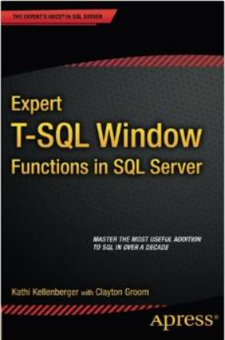

Window function performance
Kathi Kellenberger
@auntkathi
http://auntkathisql.com

Slide 3

What are window functions?
Nothing to do with Windows OS
Standard functionality added to T-SQL
Functions that operate on a set or window of rows
Always with an OVER clause (but sometimes you will see an OVER clause without a window function)
Always found in the SELECT and ORDER BY
Makes queries easier to write
Often better performance

Slide 4
What are window functions?
2005
ROW_NUMBER(), RANK(), DENSE_RANK() and NTILE()
Window aggregates
2012
Framing
Enhanced window aggregates with ORDER BY
Analytic functions

Slide 5

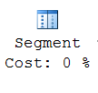
Execution Plan Operators

Slide 6


Execution Plan Operators

Slide 7

Execution Plan Operators

Slide 8
Indexes
POC Index
Filtered column(s) + Partition column(s) + Order by column(s) + Covering columns(s)

Slide 9
Framing
Default frame: RANGE BETWEEN UNBOUNDED PRECEDING AND CURRENT ROW
Better performance with ROWS BETWEEN UNBOUNDED PRECEDING AND CURRENT ROW
IMPORTANT: If ORDER BY column values are not unique, will get different results

Slide 10
Performance in Minutes

Slide 11
Performance in Minutes

Slide 12





Cultivating a Healthy Database
Office Hours
June 24 2015 at 12:00 ET
http://tiny.cc/dkb9yx
Text LINCHPIN to 33444
Linchpin People is a team of amazing experts
focused entirely on the Microsoft database ecosystem
Notes:
Linchpin People is comprised of a team of world class SQL Server Experts and MVPs who work together to create and deliver top-of-the-line Microsoft Data Ecosystem solutions.
We can help you design new projects that are on the drawing board,
Or we can rescue projects that are already being implemented but may need some expert assistance to successfully meet their intended goals.
Our expertise spans the Microsoft ecosystem -
from SQL Server based performance tuning, high availability and disaster recovery, data integration architecture, ETL and data warehouse consulting, big data, complex data, business intelligence and analytics,
to platform agnostic application development with a data-centric focus.
Have a problem in this space? We can help.

Slide 13
Summary
POC index can help all window functions
Use ROWS for framing
Use window aggregates (without ORDER BY) with caution

Slide 14
Resources
Adam Machanic’s Big Adventure Script
http://sqlblog.com/blogs/adam_machanic/archive/2011/10/17/thinking-big-adventure.aspx
My book: Expert T-SQL Window Functions in SQL Server
Itzik Ben-Gan’s book: Microsoft SQL Server 2012 High-Performance T-SQL Using Window Functions
http://auntkathisql.com
Beginning T-SQL 3rd Edition by Kathi Kellenberger and Scott Shaw

