Slide 1


WELCOME!
SQL Server Security

Slide 2
Scott Gleason
This is my 9th Jacksonville SQL Saturday
Over ten years DBA experience
Director of Database Operations
SQLScottGleason@Gmail.com

Slide 3
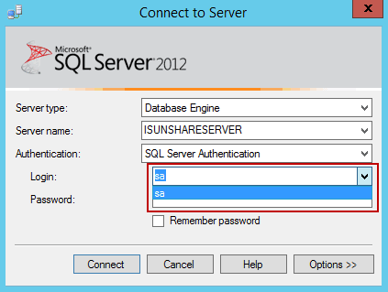
This is what were talking about

Slide 4
Please don’t use SA
SA allows the server to be crashed and recovered.
It is more difficulty to tell two things: Who did it (service account? NT Service\MSSQLSERVER)
Should *that* have really happened

Slide 5
System Administrator (sa) Login SQL Server 2000
New Information - SQL Server 2000 SP3.
System administrator (sa) is a special login provided for backward compatibility. By default, it is assigned to the sysadmin fixed server role and cannot be changed. Although sa is a built-in administrator login, do not use it routinely. Instead, make system administrators members of the sysadmin fixed server role, and have them log on using their own logins. Use sa only when there is no other way to log in to an instance of Microsoft® SQL Server™ (for example, when other system administrators are unavailable or have forgotten their passwords).

Slide 6
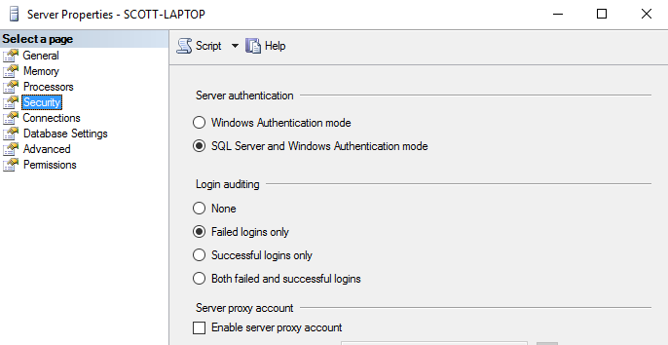
Database Connections

Slide 7
SQL Authentication
Mixed Mode (allows SQL Logins)
Used when applications can’t connect using windows authentication or connecting from non trusted domains
Windows Authentication
Domain controller ☺
Easy to change passwords here!

Slide 8
Server Logins. What are they?

Slide 9
Server Roles

Slide 10
Fixed server-level role | Description
Sysadmin (AKA SA) | Members of the sysadmin fixed server role can perform any activity in the server.
serveradmin | Members of the serveradmin fixed server role can change server-wide configuration options and shut down the server.
securityadmin | Members of the securityadmin fixed server role manage logins and their properties. They can GRANT, DENY, and REVOKE server-level permissions. They can also GRANT, DENY, and REVOKE database-level permissions if they have access to a database. Additionally, they can reset passwords for SQL Server logins.
 | Security Note
 | The ability to grant access to the Database Engine and to configure user permissions allows the security admin to assign most server permissions. The securityadmin role should be treated as equivalent to the sysadmin role.
Dbcreator | Members of the dbcreator fixed server role can create, alter, drop, and restore any database.

Slide 11
Fixed server-level role | Description
public | Every SQL Server login belongs to the public server role. When a server principal has not been granted or denied specific permissions on a securable object, the user inherits the permissions granted to public on that object. Only assign public permissions on any object when you want the object to be available to all users. You cannot change membership in public.
processadmin | Members of the processadmin fixed server role can end processes that are running in an instance of SQL Server.
setupadmin | Members of the setupadmin fixed server role can add and remove linked servers by using Transact-SQL statements. (sysadmin membership is needed when using Management Studio.)
bulkadmin | Members of the bulkadmin fixed server role can run the BULK INSERT statement.

Slide 12
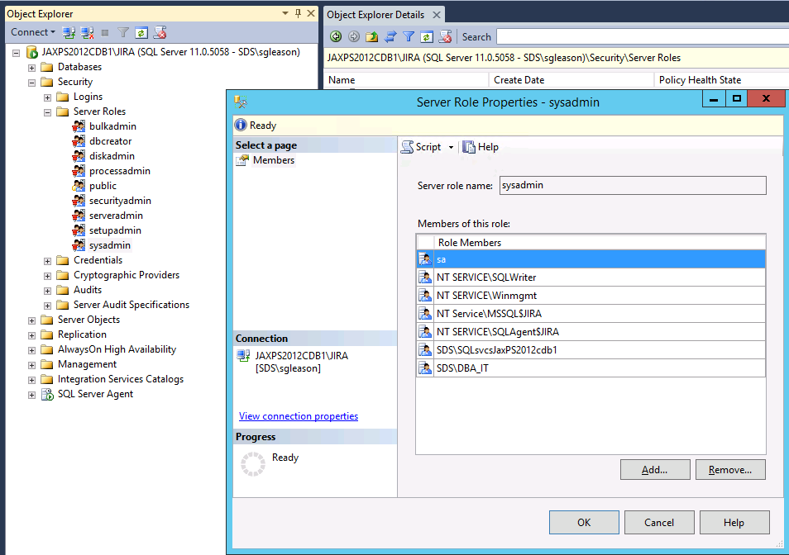
Viewing Server Role Membership

Slide 13
Multiple Databases in Server

Slide 14
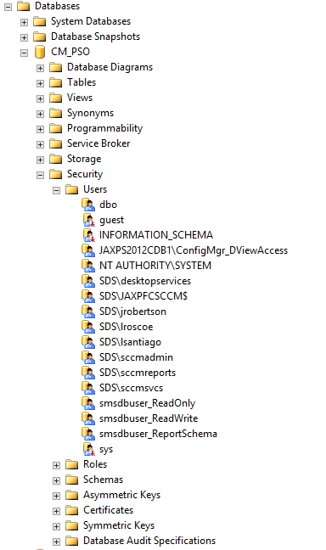
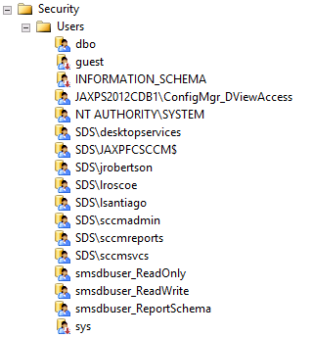
Database Users

Slide 15
Database Roles

Slide 16
Database-level role name | Description
db_owner | Members of the db_owner fixed database role can perform all configuration and maintenance activities on the database, and can also drop the database.
db_securityadmin | Members of the db_securityadmin fixed database role can modify role membership and manage permissions. Adding principals to this role could enable unintended privilege escalation.
db_accessadmin | Members of the db_accessadmin fixed database role can add or remove access to the database for Windows logins, Windows groups, and SQL Server logins.
db_backupoperator | Members of the db_backupoperator fixed database role can back up the database.
db_ddladmin | Members of the db_ddladmin fixed database role can run any Data Definition Language (DDL) command in a database. MAKE NEW STUFF (Tables/Stored Procs/Functions)

Slide 17
Database-level role name | Description
db_datawriter | Members of the db_datawriter fixed database role can add, delete, or change data in all user tables.
db_datareader | Members of the db_datareader fixed database role can read all data from all user tables.
db_denydatawriter | Members of the db_denydatawriter fixed database role cannot add, modify, or delete any data in the user tables within a database.
db_denydatareader | Members of the db_denydatareader fixed database role cannot read any data in the user tables within a database.

Slide 18
Orphaned user
Troubleshoot Orphaned Users (SQL Server)
Find out which users are orphans Exec sp_change_users_login @Action='Report';
Fix Them Exec sp_change_users_login @Action='update_one', @UserNamePattern='<user>', @LoginName='<_name>';

Slide 19

SSIS / SQL Agent / sp_send_dbmail

Slide 20
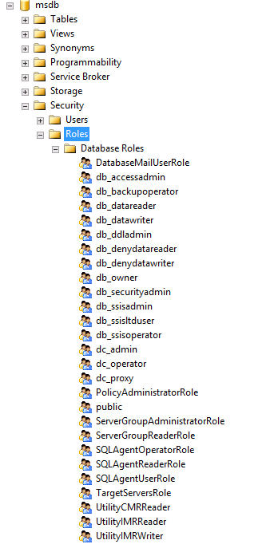
MSDB Roles (make it stop)

Slide 21
SSIS
Role | Read action | Write action
db_ssisadmin or Sysadmin (Windows administrators) <- can view running packages and stop them. | Enumerate own packages. Enumerate all packages. View own packages. View all packages. Execute own packages. Execute all packages. Export own packages. Export all packages. Execute all packages in SQL Server Agent. | Import packages. Delete own packages. Delete all packages. Change own package roles. Change all package roles.
db_ssisltduser | Enumerate own packages. Enumerate all packages. View own packages. Execute own packages. Export own packages. | Import packages. Delete own packages. Change own
db_ssisoperator | Enumerate all packages. View all packages. Execute all packages. Export all packages. Execute all packages in SQL Server Agent. | Non

Slide 22
SQL Agent
Role | action
SQLAgentUserRole | The least privileged of the SQL Server Agent fixed database roles. It has permissions on only operators, local jobs, and job schedules. Members of SQLAgentUserRole have permissions on only local jobs and job schedules that they own.
SQLAgentReaderRole | includes all the SQLAgentUserRole permissions. Members of this role can also view the list of all available jobs and job schedules and their properties, not just those jobs and job schedules that they own. SQLAgentReaderRole members cannot change job ownership to gain access to jobs that they do not already own.
SQLAgentOperatorRole | is the most privileged of the SQL Server Agent fixed database roles. It includes all the permissions ofSQLAgentUserRole and SQLAgentReaderRole. Members of this role can also view properties for operators and proxies, and enumerate available proxies and alerts on the server.

Slide 23
Send mail

Slide 24
Bigger

Slide 25
Hey.. What about execute?
Need to run stored procs? Yea.. MSFT never gave us that.. and they had a reason for doing so. So you CAN create new roles (server & database) and you can grant execute on DBO(schema) to your new role name db_data_execute
But.. Let the devs do that.

Slide 26
Auditing aka WHO DONE DID IT ?
DEMO

Slide 27
SQL Job
Demo a Jobby-Job

Slide 28
SQLScottGleason@Gmail.com
Kinda knows what he is talking about
Might really have a few years of exp
Did I leave the Iron on?
Kindly nudge the person next to you and let them know the session is over and it is time to wake up.

