Slide 1
SQL Server Security The Low Hanging Fruit

Slide 2

Lindsay Clark
Database Administrator at American Credit Acceptance
Twitter: @LindsayOClark
Email: sirwrenitey1@gmail.com

Slide 3

What are we going to cover
An outside in approach to covering a few of your SQL Server security issues
Network Level
Server Level
Database Level

Slide 4
Network Level Security

Slide 5
Network Level Make friends with your Network Admins
I. Discover the security protocols for your data centers and find out the location of all of your servers.
II. Verify that your SQL Server Service accounts DO NOT have VPN access.
III. Use Windows Authentication where possible.
IV. Create AD groups specifically for SQL Server access to prevent unauthorized inclusion into AD groups that provide database access.
V. DO NOT nest your AD groups.

Slide 6

Server Level Security
Service Accounts
I. One Master Account for all SQL Server instances
II. One Account for each SQL Server instance
III. One Account for each SQL Server service

Slide 7
What is a Service Account you say?
It is a start up account used to start and run SQL Server and can be domain user accounts, local user accounts, managed service accounts, virtual accounts, or build in system accounts.
Each of the following uses a login to start up the service:
SQL Server Agent
SQL Server Database Engine
Analysis Services
Reporting Services
Integration Services
SQL Server Distributed Replay Client
SQL Server Distributed Replay Controller
SQL Server Full-text Filter Daemon Launcher
SQL Server Browser

Slide 8
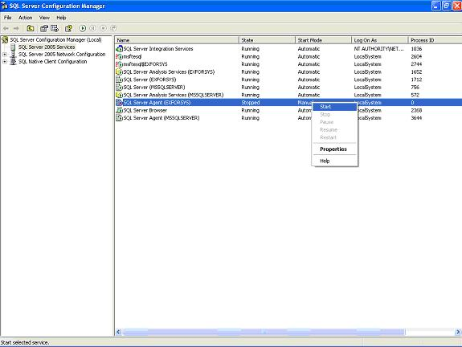
Configuration Manager and Service Accounts

Slide 9
One Account for All SQL Servers
I. Least secure method
II. Quickest for maintenance one batch rebooting for all SQL Servers
III. Ease of maintaining passwords

Slide 10
One Account for Each SQL Server Instance
I. More secure
II. Smaller batches for reboots after password changes
III. Going to require password maintenance

Slide 11
One Account for Each SQL Server Service
I. Most secure
II. Smaller batches for reboots after password changes will require a plan
III. Password maintenance is a must at this point and should require a secure password management tool

Slide 12
Operating System Rights needed by SQL
I. The service account will need to be able to log on to the server as a service
II. Adjust memory for allocation to SQL Server
III. Prior to 2008 permission to the data files necessary. Previously it had to be manually adjusted this is no longer the case.

Slide 13
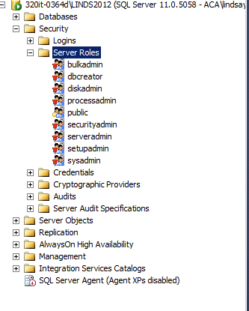
Server Level Roles
I. Fixed roles these come preconfigured and cannot be adjusted prior to 2012
II. bulkadmin: can run the BULK INSERT statement on any database
III. dbcreator: can create, alter, drop, and restore any database
IV. diskadmin: can manage disk files
V. Processadmin: can end processes that are running in an instance
VI. Public: Every login belongs to this role if permissions are granted
to this role every login has permissions to the object. **
VII. Securityadmin: manage logins and properties and can provide
server and database level permissions as well as reset passwords
VIII. Serveradmin: can shut down the server and make server wide
configuration changes.
IX. Setupadmin: can add and remove linked server servers using TSQL
X. Sysadmin: can perform any activity in the server

Slide 14

Server Level Security tidbits
I. Do not grant permissions to the public role
II. Encrypt your backups and secure the location of your backups. Why? Ask the State of South Carolina.
III. Harden the sa account
IV. Use passphrases as your passwords. Get super tricky and use Extended ASCII to baffle a lot of the password cracking scripts. These additional characters reportedly do not show up in key loggers.
V. Use windows authentication versus sql authentication.
VI. Do NOT browse web from a SQL Server instance

Slide 15
Database Level Security

Slide 16
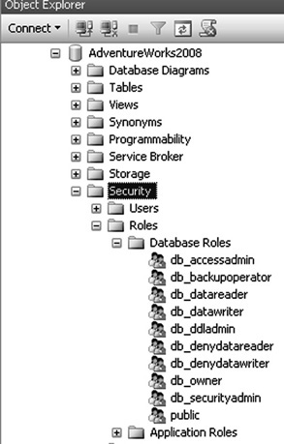
Database Level Roles
I. Fixed database roles these come preconfigured but new ones can be created
II. dbaccessadmin: can add or remove access database
III. db_backupoperator: can backup the database
IV. db_datareader: can read all data in the database
V. db_datawriter: can add, delete, or change data in all user tables
VI. db_ddladmin: can run any data definition language command in db
VII. db_denydatareader : denies read access to the database
VIII. db_denydatawriter: denies write access to the database
IX. Db_owner: perform all config and maint on the database plus drop
X. Db_securityadmin: modify role memembership and manage perms
XI. Public: every database user belongs to the public role **

Slide 17
Database Level Security
I. DB_OWNER role, know this database role allows members to give access to the database it is assigned to. This takes the management of access to your databases out of your hands as a DBA and puts it into the hands of potentially someone that doesn’t know how to administer access the SQL Server database.
II. At every possible avenue use views and stored procedures instead giving users query rights to the database. The goal with security is to provide only the permissions required to perform the necessary duties.
IV. If dynamic SQL is necessary parameterize your queries as a security measure against SQL Injections.

Slide 18
Questions?
I’d like to open the floor to discuss some of additional areas where you can harden your SQL server against would be attackers.

Slide 19
References:
Must read: Securing SQL Server: Protecting Your Databases From Attackers by Denny Cherry
Security : https://www.simple-talk.com/sql/database-administration/brads-sure-dba-checklist/#_Toc209585591
Backup encrypting: http://www.sqlservercentral.com/blogs/brian_kelley/2012/11/27/are-your-protecting-your-db-backups/

