Slide 1


SQL Server 2016
Security Features
Sam Nasr, MCSA, MVP NIS Technologies February 3, 2018

Slide 2
Introduction
Sam Nasr (@SamNasr)
Software Developer (since 1995)
Sr. Software Engineer (NIS Technologies)
Certifications: MCSA, MCAD, MCT, MCTS
President - Cleveland C#/VB.Net User Group
President - .Net Study Group
INETA Community Champ (2010, 2013)
Author for Visual Studio Magazine
Microsoft Most Valuable Professional (since 2013)

Slide 3



Cleveland C#/VB.Net User Group
Meets every month
Free of charge , open to the public
Meeting info: https://www.meetup.com
Meeting Space courtesy of
Pizza and drinks courtesy of

Slide 4
Housekeeping
Bathrooms
Forum for learning: feel free to ask questions
Cell phones on vibrate please

Slide 5
Agenda
Dynamic Data Masking (DDM)
"Always Encrypted“
Row-Level Security

Slide 6
DDM (Dynamic Data Masking)
Hide specific portions of a column
Users can be granted UNMASK rights
Can be added to existing tables or during CREATE
Does not work with encrypted values
Notes:
DDM does not work with encrypted values (encrypted in app or Always Encrypted).

Slide 7
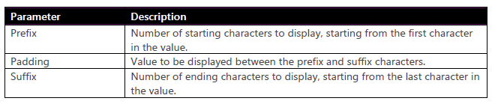
DDM Functions
Default:
  String: XXXX
  Numeric/Binary: 0000
  Date/time: 01.01.2000 00:00:00.0000000
Email: aXXX@XXXX.com
Random: mask numeric values using a random value.
Partial:

Slide 8
Demo
Demo #1

Slide 9
Always Encrypted
A client-side encryption technology
Auto encrypt when data is written/read by app
Requires client app to use an Always Encrypted–enabled driver
Client requires access to the encryption key.
Other apps can query data but cannot use it without encryption key
SQL Server instance never sees the unencrypted version of the data.

Slide 10
Always Encrypted – Setup
Create Column Master Key Definition
Create Column Encryption Key

Slide 11
Column Master Key
Stored in a Windows certificate store
3rd Party Hardware Security Module (HSM)
  Requires Enterprise Edition
Azure Key Vault
Created via SSMS or T-SQL

Slide 12
Column Master Key - Setup
Create on Trusted Machines, but not on Server
RT-Click CMK Folder -> New Column
Export CMK to all clients
  Web Server for web apps

Slide 13
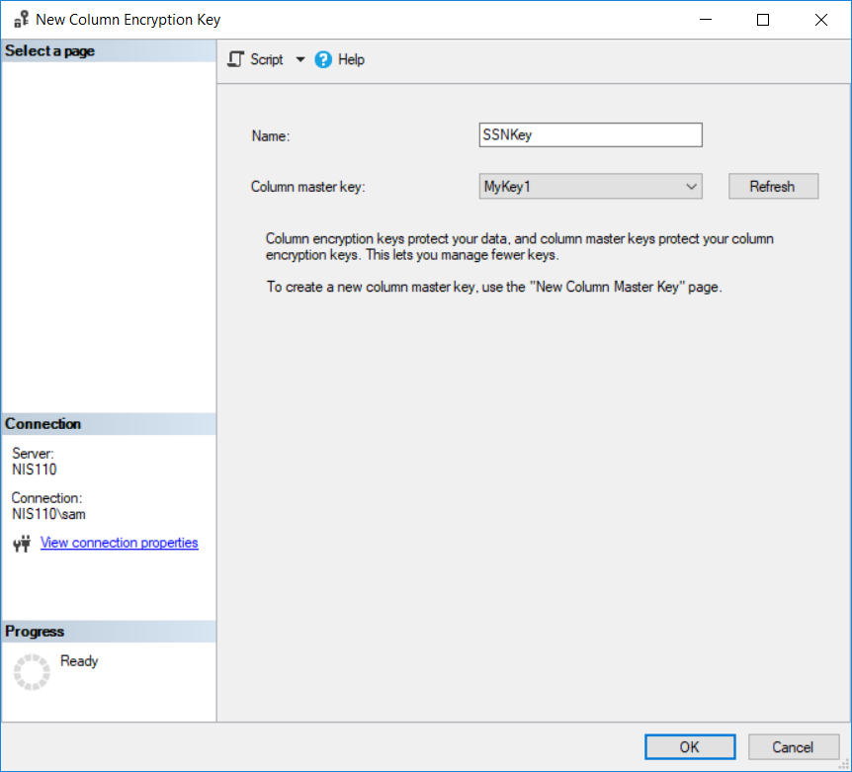
Column Encryption Keys - Setup
RT-Click CEK -> New CEK

Slide 14
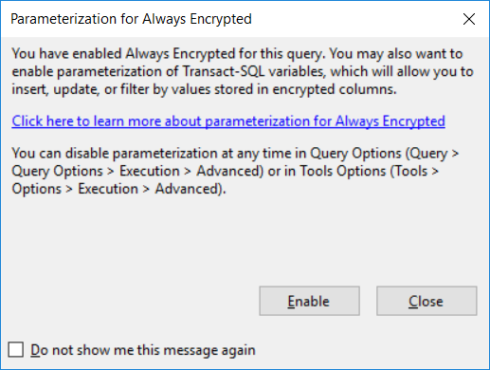
Always Encrypted
To insert/update encrypted
data
Notes:
RT-Click in Query Window (not menu) ->Options
Execution -> Advanced

Slide 15
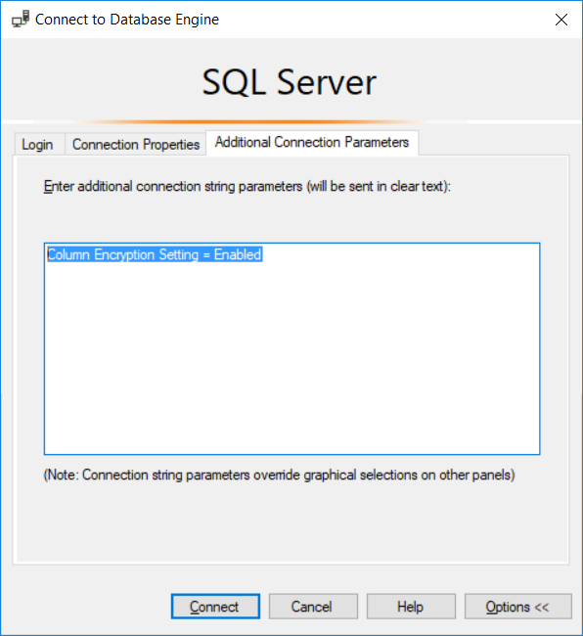
Always Encrypted
To view unencrypted
data:

Slide 16
Demo
Demo #2

Slide 17
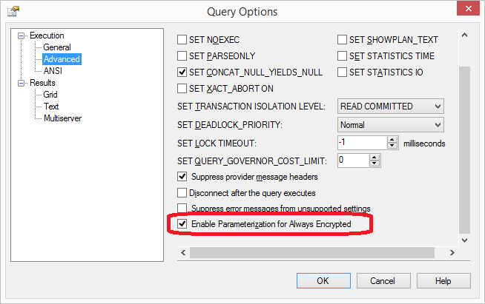
Gotchas
Random DDM may display actual value if random value matches actual value.
Use SSMS v17.4 for Row Level Security Parameterization
Always Encrypted: Other apps can query data but cannot use it without encryption key

Slide 18
Conclusion
Let’s recap…

Slide 19
References
Editions and supported features of SQL Server 2016
https://docs.microsoft.com/en-us/sql/sql-server/editions-and-components-of-sql-server-2016
Configure Always Encrypted using SQL Server Management Studio
https://docs.microsoft.com/en-us/sql/relational-databases/security/encryption/configure-always-encrypted-using-sql-server-management-studio#param
Always Encrypted (client development)
https://docs.microsoft.com/en-us/sql/relational-databases/security/encryption/always-encrypted-client-development
Notes:
Introducing SQL Server 2016 (Free e-book)
https://blogs.msdn.microsoft.com/microsoft_press/2016/02/02/free-ebook-introducing-microsoft-sql-server-2016-mission-critical-applications-deeper-insights-hyperscale-cloud-preview-2/

Slide 20

Contact Info
  snasr@nistechnologies.com
@SamNasr
http://www.linkedin.com/in/samsnasr
Thank you for attending!

