Slide 1
SQL Server Security Basics Starting with a good foundation
Kenneth Fisher Twitter: @sqlstudent144
sqlstudent144@gmail.com http://www.sqlstudies.com
Notes:
Intro
I’ve been a dev/DBA for more than 20 years.
I started in Clarion, quickly moved to Foxpro and migrated to SQL about 15 years ago.

Slide 2
Why are we here?
What security isn't
It's not high profile like HA, DR, and performance tuning.
There is no praise, only blame.
What it is
Typically very complex.
It’s very easy to make mistakes.
Notes:
Why do we want to review the basics of security?
Security isn’t exactly a fun or “sexy” subject. There is little to no praise involved, only blame if something goes wrong. Security also tends to be complex and it’s easy to make mistakes. So why would we want to study security?

Slide 3
Why are we here?
Identity theft
More than 10 million victims a year.
Not just financial identity theft but medical as well.
Data breaches
Impossible to accurately know but from one source more than half a billion individual records lost in 2014.
Notes:
Data crimes are the crime of choice these days. With more and more data theft each year we have to be more and more careful.

Slide 4
Why are we here?
Why the basics?
We all start out at the beginning.
It’s important to have a good foundation in any subject.
A large portion of our work revolves around the basics.
We tend to cause ourselves extra work if we don't understand the basics.
Notes:
So if security is that important why are we talking about the basics?

Slide 5
What are we doing?
Definitions: What are Principals, Securables and Permissions?
Where can we find everything? (using the GUI)
Some best practices.
Notes:
When we leave you should:
Understand the difference between a user, a login and a role.
Navigate the GUI to find and change different aspects of security within SQL Server.
Know not only some of the best practices but why they are best practices.

Slide 6
Definitions
Principals
Securables
Permissions

Slide 7
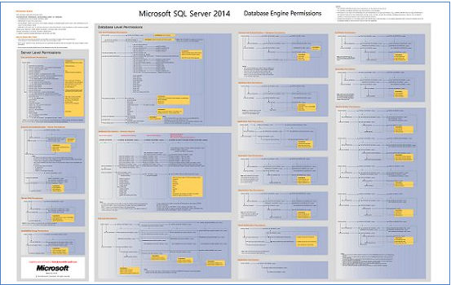
Permissions
A permission is what the principal is allowed to do to the securable.
Tables & Views
SELECT
INSERT
UPDATE
DELETE
SPs & Functions
EXECUTE
Database
CONNECT
BACKUP
CREATE PROCEDURE
VIEW DATABASE STATE
SPs, Functions & Views
VIEW DEFINITION
Notes:
A permission is what the principal is allowed to do. The most common permission is CONNECT which is required to even access a database.

Slide 8
Securables
A securable is an object that a principal wants access to.
Database
Schema
Schema
Stored Procedure
Function
View
Table
Column
Column
Notes:
Each securable is an object, and most are containers too. If a principal is granted a permission to a securable then it is granted that permission to all of the securables contained within it. Being granted the SELECT permission at the database level grants it to all schemas. Being granted the SELECT permission at the schema level grants it to all of the objects within that schema (where the SELECT permission is appropriate of course).

Slide 9
Securables
A securable is an object that a principal wants access to.
Instance
Notes:
The instance is the top level securable and obviously a container. But it doesn’t act like other containers. There are no SELECT or EXECUTE permissions that grant access to all of the databases below. Some permissions such as VIEW ANY DEFINITION do grant permissions (VIEW DEFINITION) to each database.

Slide 10
Principals
A principal is something requesting permissions to a securable.
Server
Database
SQL login
Server role
Windows login
Login mapped to a certificate
User mapped to an asymmetric key
Windows group
Application role
Login mapped to an asymmetric key
Windows user
SQL user
Windows group
User mapped to a certificate
Database role
Notes:
There are lots of different kinds of principals but they break down into Server level principals and Database level principals.

Slide 11
Principals
A principal is something requesting permissions to a securable.
Server
Database
Logins
Users
SQL login
Roles
SQL user
AD\Windows login
Server role
Database role
AD\Windows login
AD\Windows group
Application role
AD\Windows group
Login mapped to a certificate
User mapped to a certificate
Login mapped to an asymmetric key
User mapped to an asymmetric key
Notes:
Server principals are frequently called Logins and database principals Users. While I may use the terms login and user I always think of them as principals. This is because the terms login and user are overloaded and can become quite confusing. Roles can be server principals or database principals and yet are not considered logins or users.

Slide 12
Principals
A role is a special type of principal that is designed to contain other principals and transfer permissions to them.
Built in roles
User defined roles
Server and Database level roles that come with SQL Server and can’t be granted or revoked permissions.
Roles created by a user and can be granted permissions. User defined server roles are new as of SQL Server 2012.
Notes:
A role is a container for principals. A principal contained by a role is called a member of that role. Permissions can be applied to roles which are then effectively granted/denied to all members of the role. Built in roles can not be granted or denied permissions beyond what they already have or added as a member of another role. What you can do is add the user defined role as a member of the built in role then grant principals membership to the user defined role. There are special roles in MSDB for use with jobs, SSIS etc, that are built in roles but not fixed. This means they can have additional permissions granted/denied to them although this is not a best practice.

Slide 13
Tying it all together
Unsurprisingly all of this data is stored in system views.
Instance
Database
sys.server_principals
sys.server_permissions
sys.server_role_members
sys.database_principals
sys.database_permissions
sys.database_role_members
These six contain just the core data. There are quite a few more views with a variety of additional information!
Notes:
These six views contain the core of the SQL Server security data. You can see how they are broken up by instance/database and then by principal, permission and role members. Note there is no separate table for roles. This is because they are a type of principal so belong in the principals views.

Slide 14
Tying it all together
How are server principals and database principals related?
 | SID
SQL Login | 0x014EA8886B841C4CA1F7ED32489BBF62
AD Login | 0x010500000000000515000000AA70DE8DE24F4D68F572D916EB8C0100
AD Group | 0x010500000000000515000000AA70DE8DE24F4D68F572D91623FF0300
Certificate | 0x01060000000000090100000069EE6684FF55FDC676DE368D07C2C200FE155810
Principal_ID
Server
Principals
Database
Principals
Name
SID
Notes:
The SID is the link between some of the server principals and their corresponding database principal. Most other tables use the principal_id to link to the server & database principal tables. Note: The principal_id between server & database doesn’t match. The SID for a SQL login is generated by SQL. AD Logins & Groups are generated by AD. Logins associated with a certificate or asymmetric key have an SID derived from the SHA-1 hash of the public key

Slide 15
Tying it all together
Orphaned Users
 | SID
SQL Login | 0x014EA8886B841C4CA1F7ED32489BBF62
AD Login | 0x010500000000000515000000AA70DE8DE24F4D68F572D916EB8C0100
AD Group | 0x010500000000000515000000AA70DE8DE24F4D68F572D91623FF0300
Certificate | 0x01060000000000090100000069EE6684FF55FDC676DE368D07C2C200FE155810
Server
Principals
Database
Principals
Notes:
When the SID for a database principal does not have a corresponding match in the server principals then you get an orphan. Exceptions are roles and the principals of a contained database.

Slide 16
Tying it all together
Orphaned Users – Windows Authenticated
Server A
Server B
CREATE LOGIN [Domain\Dopey] FROM WINDOWS
Logins
Logins
Users
Users

Slide 17
Tying it all together
Orphaned Users – SQL Authenticated
Server A
Server B
CREATE LOGIN Dopey WITH PASSWORD = 'MyPass';
Logins
Logins
EXEC sp_change_users_login 'auto_fix','DOPEY';
or
ALTER USER Dopey WITH LOGIN = Dopey;
Users
Users

Slide 18
Tying it all together
Orphaned Users – SQL Authenticated
Server A
Server B
CREATE LOGIN Dopey WITH PASSWORD = 'MyPass';
Logins
Logins
EXEC sp_change_users_login 'auto_fix','DOPEY';
or
ALTER USER Dopey WITH LOGIN = Dopey;
Users
Users

Slide 19
Tying it all together
Orphaned Users – SQL Authenticated
Server A
Server B
CREATE LOGIN Dopey WITH PASSWORD = 'MyPass';
Logins
Logins
EXEC sp_change_users_login 'auto_fix','DOPEY';
or
ALTER USER Dopey WITH LOGIN = Dopey;
Users
Users

Slide 20
Tying it all together
Orphaned Users – SQL Authenticated
Server A
Server B
CREATE LOGIN Dopey WITH PASSWORD = 'MyPass',
SID = 0x014EA8886B841C4CA
1F7ED32489BBF62
Logins
Logins
Users
Users

Slide 21
Tying it all together
Orphaned Users – Exceptions
Roles
Contained Databases
Server and database roles have no relation to each other.
The database principals in a contained database have all of the information needed to connect to the server and database.
Server A
Server A
Server B
Login
User
Roles
<>
Roles
Login
User

Slide 22
Tying it all together
How do we apply a permission to a principal?
DENY
GRANT
A permission cannot be allowed.
Allow a permission
REVOKE
Remove a GRANT or DENY.
Notes:
DENY is the opposite of GRANT and overrides any GRANT. Revoke removes a GRANT or a DENY but does not affect a permission directly. GRANT can also be “granted” allowing a principal to GRANT that permission to another principal.

Slide 23
Administrative Principals and Permissions
There are six special principals/permissions. These are the super users and deserve special attention.
Each of these principals and permissions have complete control over their associated securable.
Single User
Role
Permission
Instance
sa
sysadmin
control server
Database
dbo
db_owner
control database
Notes:
Because these principals and permissions are so powerful you have to be particularly careful with them. Disabling sa is considered a best practice. Of the six db_owner, control server, control database can be denied the others can not. All six of these should be carefully monitored.

Slide 24
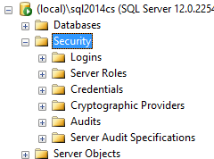
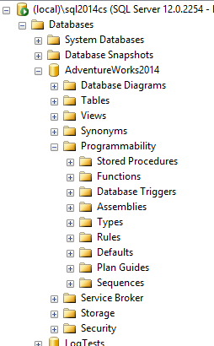
Where can we find everything?
Most people start out using the GUI to find what permissions a principal has. But where in the GUI is everything?
Principals
Securables
Notes:
Principals are found under the security drop down (at the server and database level) within object explorer. Securables are everything else. There are some securables in the security drop down as well.

Slide 25
Where can we find everything?
DEMO
Finding the security data in SSMS object explorer.

Slide 26
Best Practices!
Least Maintenance
Least Surface Area
Least Privileges

Slide 27
Best Practices!
Least Maintenance
Make your life as easy as possible.
Don’t make permissions more granular than you have to. (Don’t grant at a table level if a Schema or even better the DB level will work)
Using Roles and AD/Windows groups.
Be consistent.
Notes:
These best practices are designed to make your life as easy as possible.

Slide 28
Best Practices!
Least Surface Area
Reduce the number of places an attack can come from.
Don’t install it if you won’t be using it, or if you do then disable it. (SSIS, SSAS etc.)
Don’t create “extra” databases in production. (AdventureWorks for example)
Disable unused SQL Server Protocols. (TCP\IP, Named Pipes, VIA, shared memory)
Notes:
Give yourself as small an area as possible to monitor and as small an area to be attacked.

Slide 29
Best Practices!
Least Privilege
If they don't need to do it don't let them.
Adding a developer to the db_Owner role, even on a development database.
Grant permissions to views, SPs etc. rather than the underlying tables.
Granting permissions at lowest level possible. (Don’t grant at a DB level if a Schema or even Object level will work)
Notes:
This is the most common category of security best practices. The idea here is to grant the absolute minimum permissions needed to do the job. This will frequently conflict with least maintenance. You have to make a decision based on your situation, your business

Slide 30
Best Practices!
Security is all give and take.
Security is a balance between granting sufficient permissions to allow users to get their job done and limiting those permissions to avoid mistakes and discourage malicious activities.
To make security workable you also have to balance the risks of granting too many permissions against the maintenance cost of granting permissions at the minimum level.
Notes:
This is the most common category of security best practices. The idea here is to grant the absolute minimum permissions needed to do the job. This will frequently conflict with least maintenance. You have to make a decision based on your situation, your business

Slide 31
It's a big scary world out there.
Physical Security
Network Security
Server Security
SQL Server Security
Social Engineering
Notes:
SQL Server security is a small piece of a very big picture that makes up the security of the data. That being said it is still a very important piece.

Slide 32
Questions Kenneth Fisher sqlstudent144@gmail.com http://sqlstudies.com Twitter: @sqlstudent144
Thank You!

Slide 33
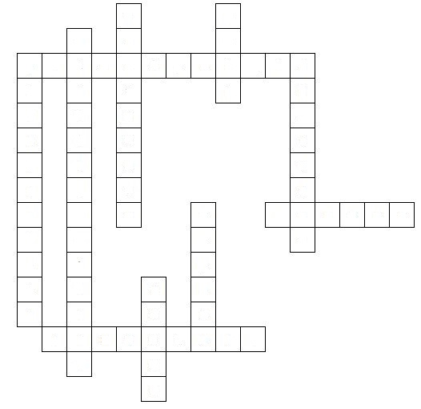
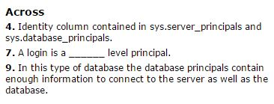
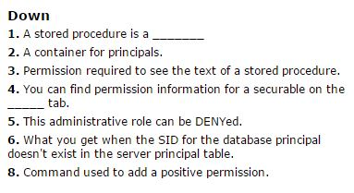
The Quiz!

