Slide 1

Always On Availability Groups
George Walters
Technical Solutions Professional, Data Platform
Microsoft
george.walters@microsoft.com
@gwalters69 on twitter

Slide 2
High Availability and disaster recovery
Before SQL 2012….
Failover Clustering
Mirroring
Log Shipping
Hardware Protection
Automatic failover
Single instance and network name
Single copy of your data
Been around since SQL 2000!
SQL Server only technology
Application failover uses both server names in connection string
Optional witness to make automatic failover
Built in compression and encryption (2008)
Auto-page repair (2008)
Been around since SQL 2005 SP1!
SQL Server only technology
Warm standby of data
Multiple secondary possible
Manual failover process
Been around since SQL 2000!

Slide 3
AlwaysOn Availability Groups
AlwaysOn Availability Groups is a new feature that enhances and combines database mirroring and log shipping capabilities
Flexible
Integrated
Efficient
Multi-database failover
Multiple secondaries
Total of 4 secondaries (8 with 2014)
2 synchronous secondaries
1 automatic failover pair
Synchronous and asynchronous data movement
Built in compression and encryption
Auto-page repair
Automatic and manual failover (new design)
Flexible failover policy
Application failover using virtual name
Configuration Wizard
AlwaysOn Management Dashboard
System Center Integration
Rich diagnostic infrastructure
File-stream replication
Replication publisher failover
Active Secondary
Readable Secondary
Backup from Secondary
Improves primary server performance by offloading work to secondary
Monitoring and Troubleshooting enhanced
Automation using PowerShell

Slide 4
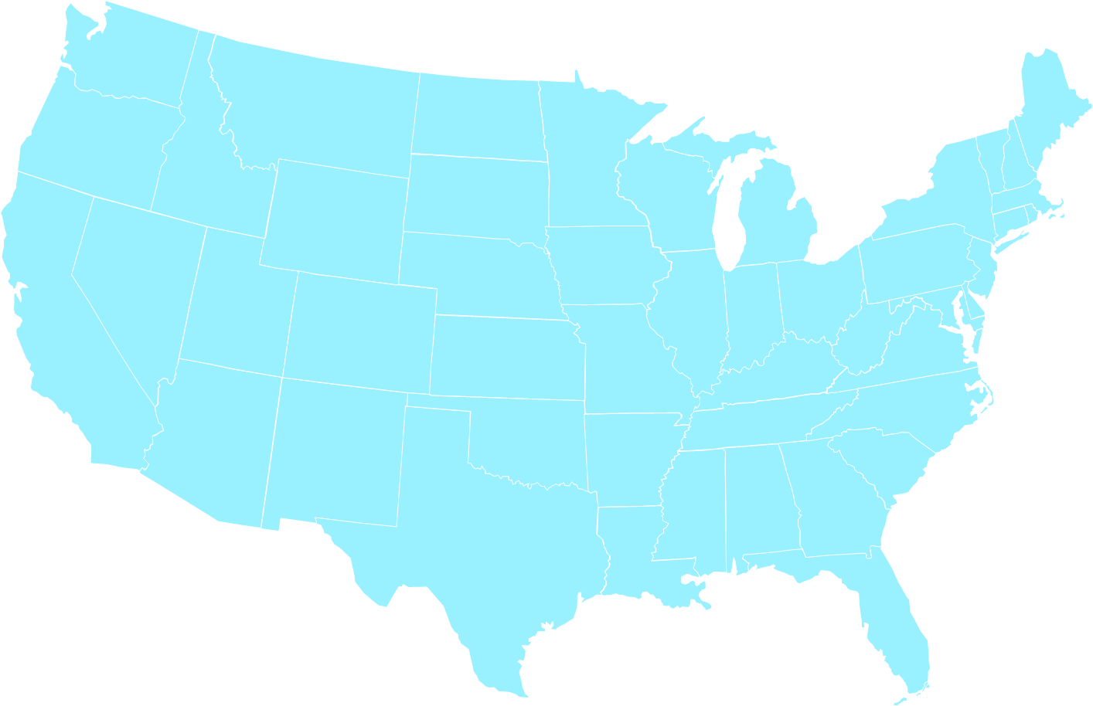

Example HA/DR Topology
DR
HA
A
DR
A
A
A
AlwaysOn-SRV4
AlwaysOn-SRV3
AlwaysOn-SRV2
AlwaysOn-SRV1
Reports
Backups
Sync Log
Synchronization
Async Log Synchronization

Slide 5
Benefits
Better Data Protection
Multiple sync (no data loss) secondaries
Automatic Page Repair
Lower Recovery Point Objective (RPO) for DR secondaries through continuous log synchronization (w/ compression)
Higher Availability
Fast app failover to any secondary through Listener
Full Hardware Usage Including Secondaries
Active Secondaries: Read Workloads & Backups*
Near real-time data through continuous log synchronization
Easier Configuration, Management, and Monitoring
Single solution
Multiple databases
Multiple replicas
Unified configuration, management, and monitoring
SCOM pack available
*Database backup is copy-only type, Log backup is regular. See http://msdn.microsoft.com/en-us/library/hh245119.aspx

Slide 6
Availability Group Concepts
Availability Group
Databases:
No limit (recommended: max 100 DBs in AGs, max 10AGs)
Availability Replicas:
5 (including primary) (9 in SQL 2014)
Failure Condition Level:
1 (simple failures) to 5 (simple & complex failures)
Listener:
Virtual Network Name
Availability Replica
Role:
Primary / Secondary
Availability Mode:
Sync / Async
Failover Mode:
Automatic / Manual / Force
Allow Connections:
Read_Write, Read_Only, No

Slide 7


Physical Architecture
Windows Server Failover Clustering (WSFC)
SQL1
SQL2
SQL3
Database
Active Log
Synchronization
Database
Active Log
Synchronization
Availability Group uses WSFC for
WSFC is a Common Microsoft Availability Platform
Inter-node health detection
Failover coordination
Primary health detection
Distributed data store for settings and state
Distributed change notifications
SQL Server AlwaysOn Failover Cluster Instances
SQL Server AlwaysOn Availability Group
Microsoft Hyper-V
Microsoft Exchange
Built-in WSFC workloads (e.g. file share, NLB, etc.) and third party workloads
Notes:
http://msdn.microsoft.com/en-us/library/hh510230(v=sql.110).aspx

Slide 8
Logical Architecture
Network subnet
Network subnet
Node
Node
Node
Node
Node
WSFC Configuration
WSFC Configuration
WSFC Configuration
WSFC Configuration
WSFC Configuration
SQL Server Instance
SQL Server Instance
SQL Server Instance
Always On SQL Server Failover Cluster Instance
Instance Network Name
Instance Network Name
Instance Network Name
Instance Network Name
Always On Availability Group
Availability Group Listener Virtual Network Name
Primary Replica
Secondary Replica
Secondary Replica
Secondary Replica
Storage
Storage
Storage
Storage
Windows Server Failover Clustering (WSFC)

Slide 9
Availability Groups use Windows Server Failover Cluster
WSFC is Microsoft’s Availability Platform
Hyper-V, Exchange, MSMQ, SQL Server Always On, 3rd party apps
What for?
How?
Inter-node health detection
Distributed store for settings
State change notifications
Failover coordination
New Cluster Resource DLL (hadrres.dll)
WSFC Resource Host Subsystem process (rhs.exe)

Slide 10
Failover Process
Apps re-connect to primary via AG2 listener
User tells SQL Server to failover AG 2 to SQL Server Instance 1
Clients disconnected from AG2
SQL Server Instance 1
SQL Server Instance 2
SQL Server Instance 3
Availability Group 1
Availability Group 2
Secondaries connect to new primary
SQL Server tells WSFC
Resource DLL
Resource DLL
Resource DLL
WSFC Service
WSFC tells
SQL Server to bring AG2 online
WSFC Service
WSFC tells
SQL Server to bring AG2 offline
WSFC Service
Notification of new primary
WSFC verifies
Failover readiness
Notification of new primary

Slide 11

Application Connectivity
Seamless connectivity to primary through Listener
Virtual Network Name
1 Virtual IP per subnet
Cluster resource
Part of AG resource group
Fails over with AG (binds to network interface)
ServerA
ServerB
ServerC
HR
DB
HR
DB
HR
DB
AG_HR
Primary
AG_Listener
Primary
Secondary
Secondary
Secondary
Connection retries
Data Source=HR_VNN;
Initial Catalog=HRDB

Slide 12

AlwaysOn Availability Group Listener
Availability Groups Listener allow applications to failover seamlessly to any secondary; reconnecting through Virtual Network Name
Server A
Server B
Server C
2 DB
2 DB
2 DB
TechAG1
TechListener1
Primary
Primary
Secondary
Secondary
Secondary
Application Retry During Failover
Parameter Sample: -server TechListener1
Connect to new primary once failover is complete and the listener is online
Notes:
http://msdn.microsoft.com/en-us/library/hh213417(v=sql.110).aspx#Aglisteners

Slide 13

Availability Group Replaces DB Mirroring
Windows Server Failover Cluster
Primary Data Center
Disaster Recovery Data Center
Or Azure VM
Availability Group
Fileshare Witness
Primary
Secondary
Secondary
Synchronous
Synchronous / Asynchronous
Note: More secondaries (total up to 4 in 2012, 8 in 2014) can be added for additional resiliency or read scale out

Slide 14
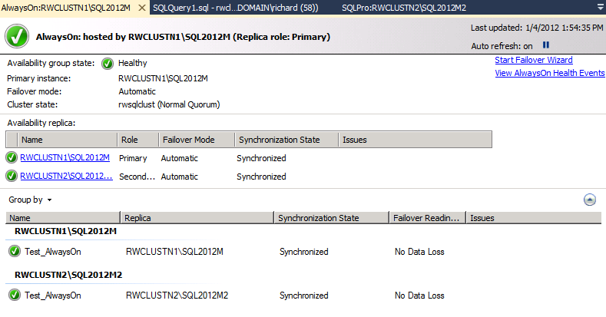
New Topology Benefits
Better SLAs
Easier Deployment & Management
Multiple no data loss secondaries
Better data loss protection for DR secondaries through continuous replication
Faster failover to DR secondaries through virtual name failover
Unified solution
Simple deployment
Unified dashboard
Rich diagnostics
Centralized management of client connection topology
Multi-DB failover
SCOM pack available
New Management Dashboard
Notes:
http://msdn.microsoft.com/en-us/library/hh403386(v=sql.110).aspx

Slide 15
Considerations for Availability Groups
All SQL servers (including the secondary in the DR site) in the same Windows domain
One Windows Server Failover Cluster spreads over the primary and DR sites
All the databases must be in FULL recovery model
The unit of failover (for local HA, as well as DR) is at the AG level, i.e., group of databases – not the instance
Consider using Contained Database for containing logins for failover
For jobs and other objects outside the database, simple customization needed
No delayed apply on the secondary like log shipping
Removing log shipping means the regular log backup job is removed
Need to re-establish periodic log backup (essential for truncating the log)
New Tools for Monitoring & Alerting
AlwaysOn Dashboard
System Center Operations Manager
Third party tools

Slide 16
Flexible Failover Policy
AG’s failure level for automatic failover (cumulative)
SQL Server
1
SQL Server process is down
Sp_server_diagnostics
System
Resources
Query Processing
IO Subsystem
Events
2
SQL Server is unresponsive (configurable threshold to receive health diagnostics exceeded - default 30s)
3
Critical SQL Server errors (e.g. Write AVs, orphaned spinlocks, etc)
Request Health Diagnostics
Health Diagnostics
4
Moderate SQL Server errors (e.g. persistent OOM conditions)
AG Resources DLL
5
Any internal SQL Server error (e.g. unsolvable deadlock)
WSFC Service

Slide 17
Cluster Considerations
Cluster Members must be in same Windows domain or trusted domains
Cluster needs quorum to avoid split brain
The number of voting members determines the cluster tolerance to failure
Configuring cluster quorum:
Select cluster members to vote
Primary
Auto failover target
Other nodes in local data center (not necessarily hosting SQL Server instances)
Select quorum type:
Odd number of votes, use “Node Majority”
Even number of votes
a) Add an additional node and use “Node Majority”
b) Add a file share and use “Node and File Share Majority”

Slide 18
Example Topology – Cluster Quorum Configuration
Witness File Share
Vote = 1
DR
HA
A
A
A
A
AlwaysOn-SRV4
Vote = 0
AlwaysOn-SRV3
Vote = 0
AlwaysOn-SRV2
Vote = 1
AlwaysOn-SRV1
Vote = 1
Reports
Backups
Sync Log
Synchronization
Async Log Synchronization

Slide 19






Always On Active Secondaries
AlwaysOn Active Secondary enables efficient utilization of high availability hardware resources to improve overall IT efficiency
It Efficiency and Cost-effectiveness are Critical for Businesses
Idle hardware is no longer an option.
Active Secondary uses
Read-only workloads
Offloading Backups

Slide 20
Active Secondary – Readable Secondary
SQL Server
SQL Server
Primary
Secondary
Secondary
Primary
CRASH
Database Log Synchronization
Instance A
Instance B
DB1
DB2
DB1
DB2
Reports
Reports
Readable secondary allow offloading read queries to secondary
Low data latency
After failover, the read applications can be automatically redirected to the new Secondary (require explicit connection request)
Not a replacement for replication scenarios
Notes:
http://msdn.microsoft.com/en-us/library/ff878253(v=sql.110).aspx
Explains purpose and “close to real-time” nature of queries

Slide 21
Offloading Read Workloads
SQL Server
SQL Server
Primary
Active Secondary
Log Synchronization
DB1
DB2
DB1
DB2
Reports
DBs in active secondaries are readable
Committed transactions visible quickly(depends on log synchronization latency)
Same data center: <1s
Different data center: 1-5s

Slide 22
Offloading Read Workloads
SQL Server
SQL Server
Active Secondary
Active Secondary
SQL Server
DB1
DB2
DB1
DB2
Log Synchronization
Primary
Log Synchronization
Reports
Reports
SQL Server
Log Synchronization
Log Synchronization
SQL Server
Active Secondary
Active Secondary
DB1
DB2
DB1
DB2
DB1
DB2
Reports
Reports
Up to 4 secondaries
Sync or async

Slide 23
Offloading Read Workloads
SQL Server
SQL Server
Manual
Failover
Active
Secondary
Primary
Active Secondary
Primary
Log Synchronization
DB1
DB2
DB1
DB2
Reports
Read workloads can be automatically routed to an active secondary

Slide 24
Configuring Secondary as Readable
ALLOW_CONNECTIONS setting
NO
Don’t allow connections
ALL
Allow all connections
READ_ONLY
Only allow connections specifying READ_ONLY intent
ALTER AVAILABILITY GROUP ag_name
MODIFY REPLICA ON 'server_name'
WITH (
SECONDARY_ROLE (
ALLOW_CONNECTIONS = { NO | ALL | READ_ONLY } ) )

Slide 25

Client Connectivity
Read / Write Workload
Connecting using AG Listener
Connection using FAILOVER_PARTNER (if connection string of existing applications can’t be changed)
Read Only Workload
Connection using VNN and ApplicationIntent=ReadOnly
Connection to the secondary instance directly
ReadOnly Routing
Multi subnet failover scenario:
New client libraries => MultiSubnetFailover=True
Old client libraries configure appropriate client connection timeout
Client
AG Listener
Primary
Secondaries
Notes:
Read/Write Workload
If you already have FAILOVER_PARTNER in the connection string, and can’t change the connection string, it will continue to work, provided:
There are only two replicas – primary and one secondary, and
The replicas have been set to NOT “Allow All Connections” in secondary role
If using new client libraries, use MultiSubnetFailover=True in the connection string
Read Only Workload
If using legacy client libraries:
Set the “Connection Mode in Secondary Role” for the AG replicas to “Allow All Connections”
Connect directly to the secondary instance
If using new client libraries:
Set the “Connection Mode in Secondary Role” for the AG replicas to “Allow ReadOnly Connections”
Define Routing List for the AG (to take advantage of ReadOnly Rerouting)
Use the AG VNN (Listener) to connect to the Availability Group, AND
Specify ApplicationIntent=ReadOnly in the connection string
If using new client libraries, use MultiSubnetFailover=True in the connection string

Slide 26
Configuring Routing of Read-Only Connections
1st - Configure Routing URL for each secondary
Endpoint for read-only connections
ALTER AVAILABILITY GROUP ag_name
MODIFY REPLICA ON 'server_name'
WITH (
SECONDARY_ROLE (
READ_ONLY_ROUTING_URL = ‘TCP://system-address:port’ ) )

Slide 27
Configuring Routing of Read-Only Connections
2nd - Create Routing List at each replica that can be primary
List of readable secondaries
Primary returns first one available
Load balancing implementable
ALTER AVAILABILITY GROUP ag_name
MODIFY REPLICA ON 'server_name'
WITH (
SECONDARY_ROLE (
READ_ONLY_ROUTING_LIST = {‘server_name’ [,..n]} ) )

Slide 28
Readable Secondary – Data Latency
Primary
Secondary
DB1
Log Capture
Network
DB1
Log Capture
Log Receive
Commit
Log Pool
Redo Thread
Log Cache
Log Cache
Log Flush
Log Hardened
Redo Pages
Acknowledge Commit
DB1 Log
DB1 Data
DB1 Log
DB1 Data
Secondary read is always behind primary during transaction activity

Slide 29
Log Synchronization to Secondary
Primary
Secondary
DB1
Log Capture
Network
DB1
Log Capture
Log Receive
Commit
Log Pool
Redo Thread
Log Cache
Log Cache
Log Flush
Log Hardening
Acknowledge Commit
DB1 Log
DB1 Data
DB1 Log
DB1 Data
Redo is async
Transactions visible after commit redo (no dirty reads)

Slide 30
Query Optimization on Active Secondary
Query optimization relies on statistics
Created by indexes and read workloads
?
Statistics created on primary are redone on secondary
But, read workloads at secondaries are different from primary workloads
Auto-create statistics on secondary
Store on TempDB
sys.stats: is_temporary=‘true’
Use most recent statistics
Remove on failover, restart, or DROP STATISTICS

Slide 31
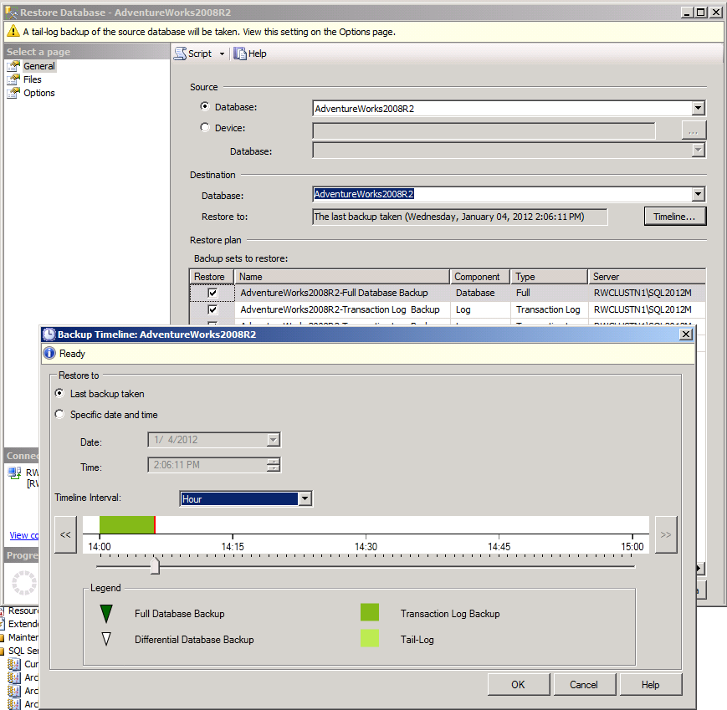
Backup* Capabilities
Recovery Advisor
Backups from any replica
Synchronous or asynchronous secondaries
Primary backups still work
Adds capacity to primary server by off-loading backups to a replica
Log backups done on all replicas form a single log chain
Recovery Advisor makes restores simple
*Database backup is copy-only type, Log backup is regular. See http://msdn.microsoft.com/en-us/library/hh245119.aspx
Notes:
http://msdn.microsoft.com/en-us/library/hh245119(v=sql.110).aspx

Slide 32
Creating Backups
R/W workload
Backups
Active
Secondary
Backups
Primary
Backups
Active
Secondary
On primary or any secondary
No need to configure secondaries as readable

Slide 33
Single Log Backup Chain
Replica 1
Replica 2
Log backup
Log backup
Log backup
Log backup

Slide 34
DEMO
SQL 2014 AG setup and failover
On existing windows two-node cluster
With file-share witness
Can I do this?
Use new Azure portal, at http://portal.azure.com to build out a new AlwaysOn Cluster!

Slide 35
SQL 2016 Changes for Availability groups
Up to 3 synchronous secondaries (up from 2)
Read-Only Routing can be round-robin
This load balances read-intent queries

Slide 36
Resources
AlwaysOn Resource Center
AlwaysOn Team Blog
SQL Server 2012 Whitepapers
http://msdn.microsoft.com/en-us/sqlserver/gg490638.aspx
http://blogs.msdn.com/b/sqlalwayson/
http://msdn.microsoft.com/en-us/library/hh403491

Slide 37
Next steps
SQL Server Case Studies:
http://www.microsoft.com/casestudies/Case_Study_Advanced_Search.aspx (Search on SQL Technologies)
SQL Server Hands On Labs:
http://www.microsoft.com/sqlserver/en/us/learning-center/virtual-labs.aspx
SQL Server Certification:
http://www.microsoft.com/learning/en/us/certification/cert-sql-server.aspx
SQL Server Best Practices:
http://technet.microsoft.com/en-us/sqlserver/bb671430
SQL 2014 Generally Available since April 1st 2014! SP1 Here… or not… but will be.

Slide 38

Thank you!
Please give feedback!
George Walters
Microsoft
Twitter: @gwalters69
Email: george.walters@microsoft.com

