Slide 1
Moving data using replication
Anthony Brown
anthony@found-it.net
http://www.sqlblogcasts.com/blogs/antxxxx

Slide 2
What can you do with it
Move data and data changes from one server to another
Filter data by columns or rows
Can be configured so data changes happen on any server and are replicated back

Slide 3
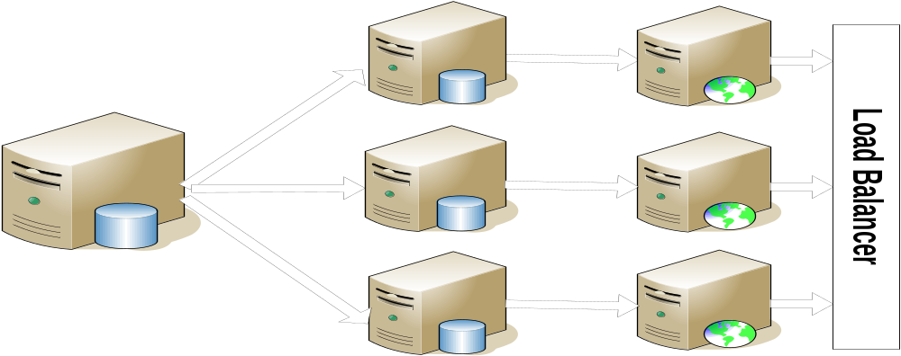
Why replicate
Get data nearer the users
Reporting
Scale out

Slide 4
Types of replication
Snapshot
Transactional
Merge
Peer to peer

Slide 5
Terminology
Publisher
  – generates data to be sent out
Subscriber(s)
  ultimate receiver of data
Distributor
  stores data to be sent to subscribers

Slide 6
Terminology
Article
  database object to be replicated
Publication
  Collection of articles in a database
Push/Pull subscriptions
  Determines whether the data is pushed or pulled from distributor

Slide 7
Snapshot replication
Reads data from publisher and stores it at distributor
Loaded into subscriber
No special setup needed for table

Slide 8
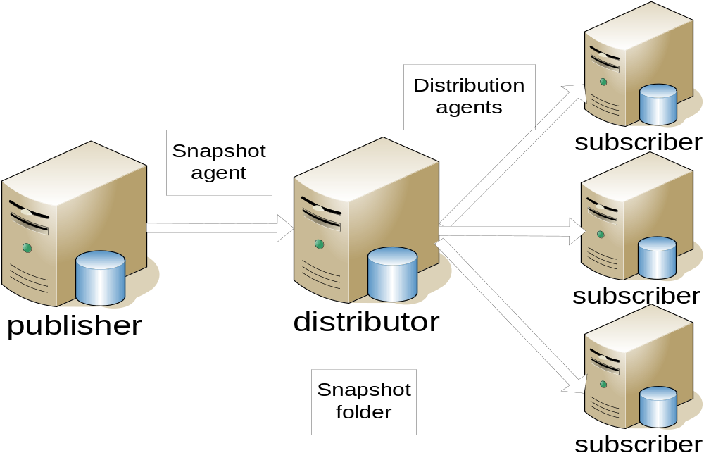

Slide 9
Transactional replication
Normally runs snapshot replication first
Any data changes are read from transaction log and stored at distributor
Changes are sent in sequence to subscribers
Tables must have primary key
With special setup can have updates on subscribers

Slide 10
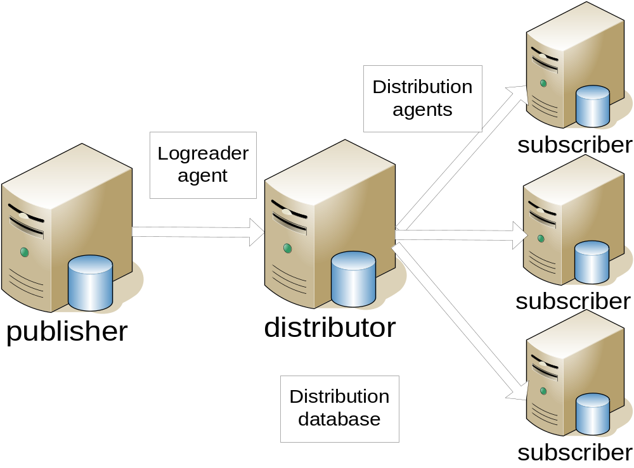

Slide 11
Merge replication
Can be used where data updated at publisher and subscriber
Table must have a guid column
Subscribers can be occasionally connected

Slide 12
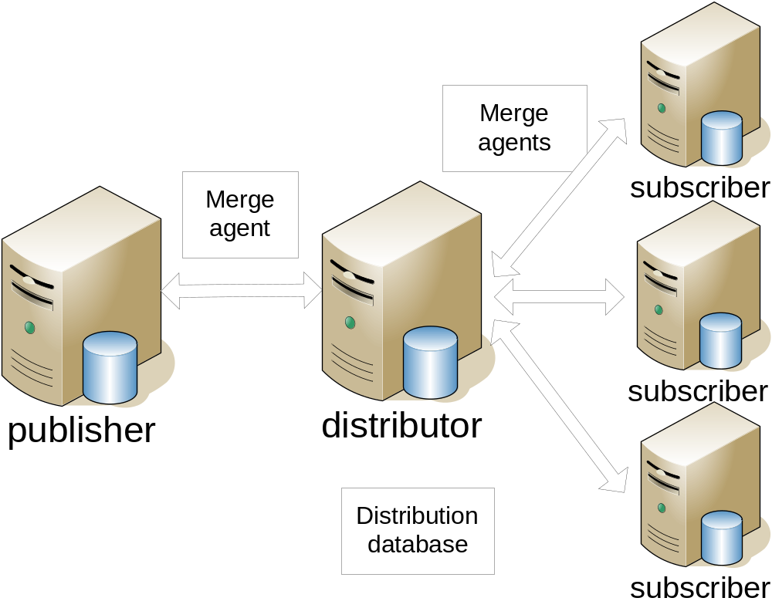

Slide 13
Peer to peer replication
Allows data to be updated on all nodes
Configured on top of transactional replication
Typically distribution server is on each node
Only in enterprise

Slide 14
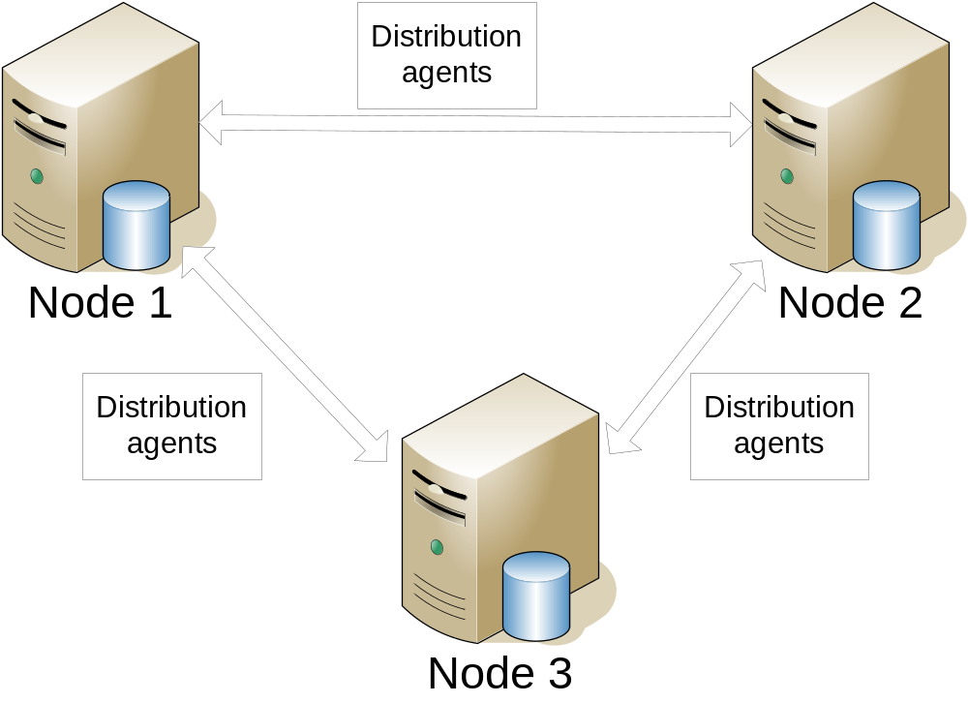

Slide 15
Setup
Can be done using wizard in management studio or T-SQL scripts
Create linked servers first
Can script creation scripts once created by wizard – either management studio or RMO (powershell)

Slide 16
Transaction log
Logreader reads the transaction log
Will not be marked as free until transactions read by logreader
But will still be backed up and can be restored

Slide 17
Database mirroring
Can be used on publisher, not distributor or subscriber
Data not replicated until it is sent to mirror (can be changed with trace flag 1448)

Slide 18
What can go wrong
Security (normally problem at setup)
Connectivity between servers – recovers automatically when they are back
Timeouts
Data becomes out of sync between publisher and subscriber – use validate subscriptions to check this
Fix by re-sync or data updates (tablediff)

Slide 19
Troubleshooting
Check replication monitor
Check event log
Tracer tokens
Sp_browsereplcmds (carefully)
profiler

