Slide 1
Electric Vehicle Dynamics
Simulation Framework
3-DOF Rigid Body Dynamics · Dugoff Tire Model · 5-Sensor Suite · CAN Bus Integration
Mario Tilocca
2026

Slide 2
Agenda
01
Model Evolution
02
3-DOF Rigid Body Dynamics
03
Dugoff Tire Model
From 1-DOF kinematic to full 3-DOF planar dynamics
Equations of motion in rotating body frame
Physics-based Fx/Fy with friction saturation
04
Steering & Kinematics
05
Load Transfer
06
CAN Architecture
Ackermann geometry · per-wheel slip
Longitudinal & lateral weight redistribution
Gear selector · subsystem execution order
07
Simulation Results
08
Sensor Suite
09
Future Developments
Cusp maneuver · 5-figure analysis
5 sensor types with validated noise models
Near / medium / long-term roadmap
Mario Tilocca | Vehicle Dynamics SIL Framework | 2026

Slide 3
Model Evolution
From Kinematic Bicycle to Full 3-DOF Planar Motion
V1 — Kinematic
V2 — Torque-Only Dynamic
V3 — Full 3-DOF (Current)
▸ Pure rolling, no slip
▸ Friction-limited forces (μFz)
▸ Full vx · vy · ψ̇ rigid body
▸ Ackermann steering geometry
▸ Dugoff Fx · Fy from slip ratios
▸ Per-wheel ω ODE (Iw·ω̇ = τ-Fx·R)
▸ No traction limits
▸ Normal load distribution
▸ Centripetal coupling in body frame
▸ Instantaneous response
▸ No wheel rotational dynamics
▸ Gear selector via CAN
▸ Hybrid kinematic/dynamic blend
Actuator → Drive → Velocity → Position/Yaw
Actuator → Drive → Tire Forces → Accel → Velocity
Actuator → Wheel Dynamics → Slip → Dugoff → Vehicle 3-DOF
Mario Tilocca | Vehicle Dynamics SIL Framework | 2026

Slide 4
3-DOF Rigid Body Dynamics
Full planar motion in the vehicle body frame (origin at CG, x-forward, y-left)
State Vector
x = [ vx vy ψ̇ x y ψ ]ᵀ
Longitudinal
m·v̇x = ΣFx − Fdrag − Froll + m·vy·ψ̇
↳ Centrifugal coupling from rotating frame → essential for stability
Lateral
m·v̇y = ΣFy − m·vx·ψ̇
↳ Centripetal acceleration → couples lateral & longitudinal
Yaw
Iz·ψ̈ = Σᵢ ( xᵢ·Fyᵢ − yᵢ·Fxᵢ )
↳ Cross product of wheel position × tire force
Position
ẋ = vx·cosψ − vy·sinψ ẏ = vx·sinψ + vy·cosψ
↳ Rotation matrix R(ψ) applied to body velocities
Mario Tilocca | Vehicle Dynamics SIL Framework | 2026

Slide 5
Dugoff Tire Model
Physics-based Fx · Fy from combined slip with friction circle saturation
Fundamental Forces
Slip Ratio Definitions
Fx = −gdir · Cx · σx · f(λ) (longitudinal)
σx = (ω·R − Vx) / max(|Vx|, |ωR|, vmin) [longitudinal]
Fy = −Cy · σy · f(λ) (lateral)
σy = Vy / |Vx| ≈ tan(α) [lateral]
gdir: +1 Forward, −1 Reverse, 0 Neutral
α = arctan( vy,w / |vx,w| ) [slip angle]
Friction Utilisation Parameter λ
λ = μ·Fz / ( 2·√( (Cx·σx)² + (Cy·σy)² ) )
Surface Friction Coefficients
Surface
μ
λ ≥ 1 → linear regime (grip available)
Use case
Dry pavement
0.85
λ < 1 → saturated / sliding regime
Urban / highway
Compact gravel
0.72
Mining haul roads
Saturation Function f(λ)
Loose gravel
0.55
f(λ) = (2−λ)·λ if λ < 1 (friction circle active)
Unpaved surfaces
Wet surfaces
0.45
f(λ) = 1 if λ ≥ 1 (linear, full grip)
Rain conditions
Mud
0.25
Guarantees √(Fx²+Fy²) ≤ μ·Fz
Extreme off-road
Load-Dependent Stiffness
Cx(Fz) = Cx,base · Fz / Fz,ref
Cy(Fz) = Cy,base · Fz / Fz,ref
Load transfer ⟹ grip redistribution per wheel
Mario Tilocca | Vehicle Dynamics SIL Framework | 2026

Slide 6
Steering Geometry & Per-Wheel Kinematics
Ackermann geometry · wheel velocity · slip angle computation
Ackermann Steering Geometry
Per-Wheel Kinematics
▸ Turn radius: R = L / tan(δ)
Wheel velocity (vehicle frame)
▸ Outer wheel: δFL = arctan( L / (R + W/2) )
vᵢ = [vx − ψ̇·yᵢ , vy + ψ̇·xᵢ]ᵀ
▸ Inner wheel: δFR = arctan( L / (R − W/2) )
Transform to wheel frame (steered wheels)
[vx,w] [cos δ sin δ] [vx − ψ̇·y]
▸ Condition: cot(δouter) − cot(δinner) = W/L
[vy,w] = [−sin δ cos δ] [vy + ψ̇·x]
▸ Ackermann %: blends between parallel & pure Ackermann
Slip angle
▸ Speed limit: δmax(v) = δmax,0 · r(v) [reduces at high speed]
α = arctan( vy,w / |vx,w| )
▸ Rate limit: δ̇ clamped (hydraulic: 30–60 °/s)
Wheel rotational ODE
Iw·ω̇ = τdrive − τbrake − Fx·R
▸ Min turn radius XCMG XDE320: Rmin = 9.0 m
Feedback term −Fx·R enables slip development,
wheel spin & wheel lock
Mario Tilocca | Vehicle Dynamics SIL Framework | 2026

Slide 7
Load Transfer & Normal Load Distribution
Weight redistribution during acceleration, braking and cornering
Static Load Distribution
Longitudinal Load Transfer
▸ Fz,front_static = m·g·Lr / L
▸ ΔFz = m · ax · hCG / L
▸ Fz,rear_static = m·g·Lf / L
▸ Acceleration (ax > 0): weight → rear → more rear traction
▸ where L = Lf + Lr (wheelbase)
▸ Braking (ax < 0): weight → front → more front braking
Lateral Load Transfer (Cornering)
Impact on Grip
▸ ΔFz,lat = m · ay · hCG / W (ay = ΣFy / m)
▸ Fz,front = Fz,front_static − ΔFz
▸ Load-dependent stiffness: Cx/Cy ∝ Fz
▸ Left turn: inside wheels unload, outside load increases
▸ Fz,rear = Fz,rear_static + ΔFz
▸ Load transfer ⟹ asymmetric grip per wheel
▸ Fz,left = Fz,static − ΔFz,lat
▸ Combined: compute per-wheel Fz every timestep
▸ Fz,right = Fz,static + ΔFz,lat
▸ Used directly in Dugoff friction utilisation λ
Mario Tilocca | Vehicle Dynamics SIL Framework | 2026

Slide 8
CAN Bus Architecture & Subsystem Execution
Real-time CAN RX/TX · priority-ordered subsystem manager · gear selector
Subsystem Execution Order (priority ascending)
CAN Frame Schedule
Priority
Subsystem
Inputs
Outputs
0x100
ACTUATOR_CMD_1
20 Hz
RX Torque, brake, steer, gear
50
Steer
δcmd
δfl, δfr
0x200
IMU_ACC
100 Hz
TX Accel X/Y/Z, temp
100
Drive
τcmd, brake%
τdrive,i, τbrake,i
0x201
IMU_GYR
100 Hz
TX Gyro X/Y/Z, status
105
Wheel
τᵢ, vx, vy, ψ̇
Fx,i, Fy,i, ωᵢ
0x210
GNSS_LL
10 Hz
TX Lat, lon
110
Vehicle
Fx,i, Fy,i
vx, vy, ψ̇, x, y, ψ
0x211
GNSS_AV
10 Hz
TX Alt, vel, fix quality
150
Battery
Pelec
SOC, V, I
0x220
WHEELS_1
100 Hz
TX FL/FR/RL/RR wheel speeds
0x230
BATT_STATE
10 Hz
TX V, I, SOC, temp, power
0x240
RADAR_1
20 Hz
TX Range, vel, angle
0x300
VEHICLE_STATE
50 Hz
TX Speed, accel, yaw rate
Mario Tilocca | Vehicle Dynamics SIL Framework | 2026

Slide 9
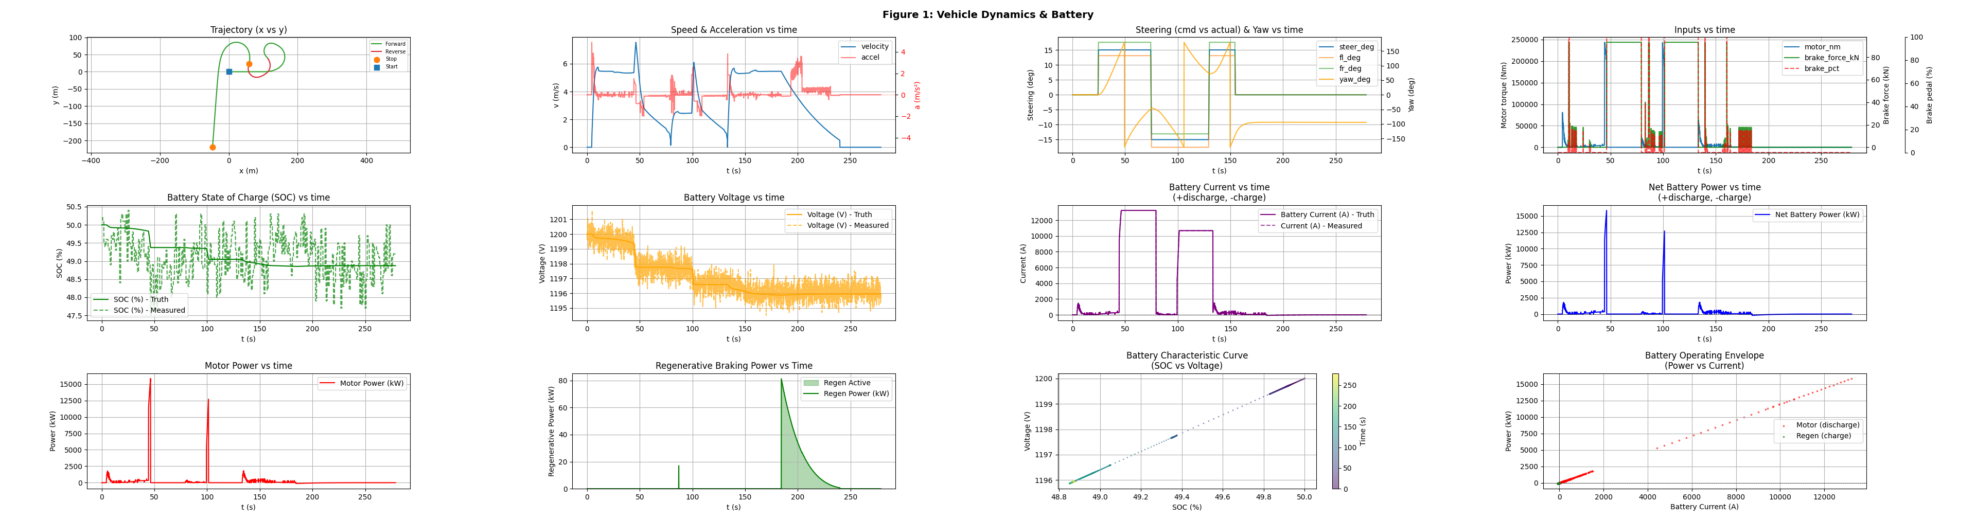
Figure 1 — Vehicle Dynamics & Battery
Cusp maneuver: forward → stop (orange dot) → reverse
▸ Trajectory: green=forward, red=reverse
▸ Stop marker at cusp point
▸ Speed & longitudinal acceleration
▸ Steering angle vs yaw rate
▸ Motor torque & brake inputs
▸ Battery SOC, voltage, current
▸ Motor & regen power flows
Mario Tilocca | Vehicle Dynamics SIL Framework | 2026

Slide 10
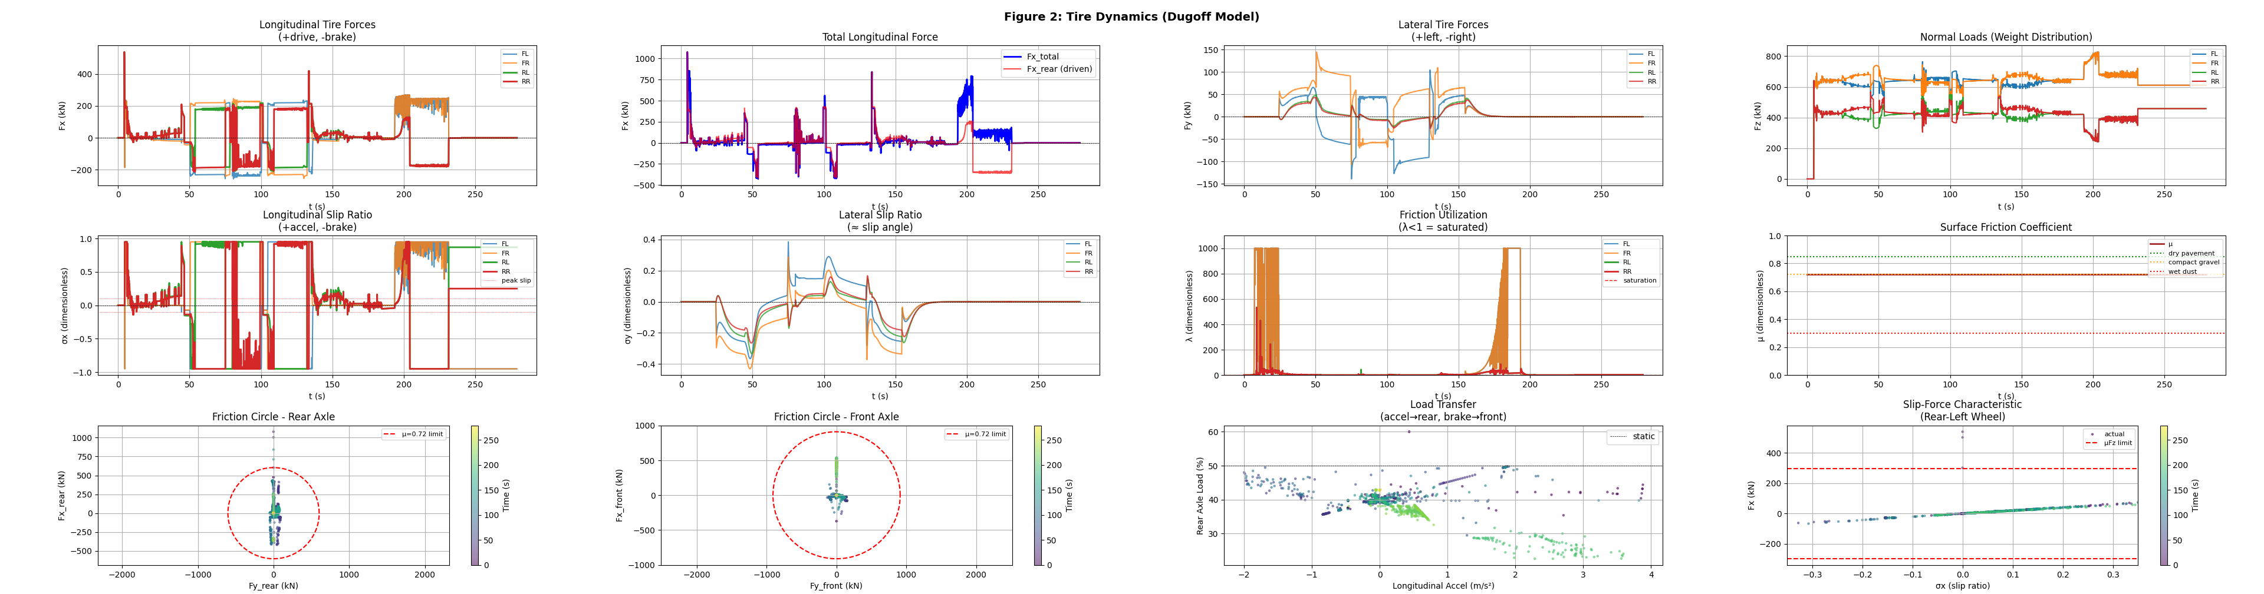
Figure 2 — Tire Dynamics (Dugoff Model)
Per-wheel forces · slip ratios · friction utilisation
▸ Fx longitudinal forces per wheel
▸ Fy lateral forces per wheel
▸ Fz normal loads with load transfer
▸ σx longitudinal slip ratios
▸ σy lateral slip ratios
▸ λ friction utilisation (λ<1 = saturated)
▸ Friction circles front & rear
Mario Tilocca | Vehicle Dynamics SIL Framework | 2026

Slide 11
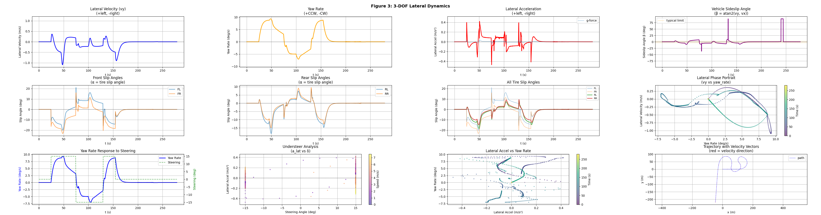
Figure 3 — 3-DOF Lateral Dynamics
Full planar motion analysis
▸ Lateral velocity vy (m/s)
▸ Yaw rate ψ̇ (rad/s and °/s)
▸ Lateral acceleration ay
▸ Vehicle sideslip angle β
▸ Per-wheel slip angles α
▸ Phase portrait (vy vs ψ̇)
▸ Trajectory with velocity vectors
Mario Tilocca | Vehicle Dynamics SIL Framework | 2026

Slide 12
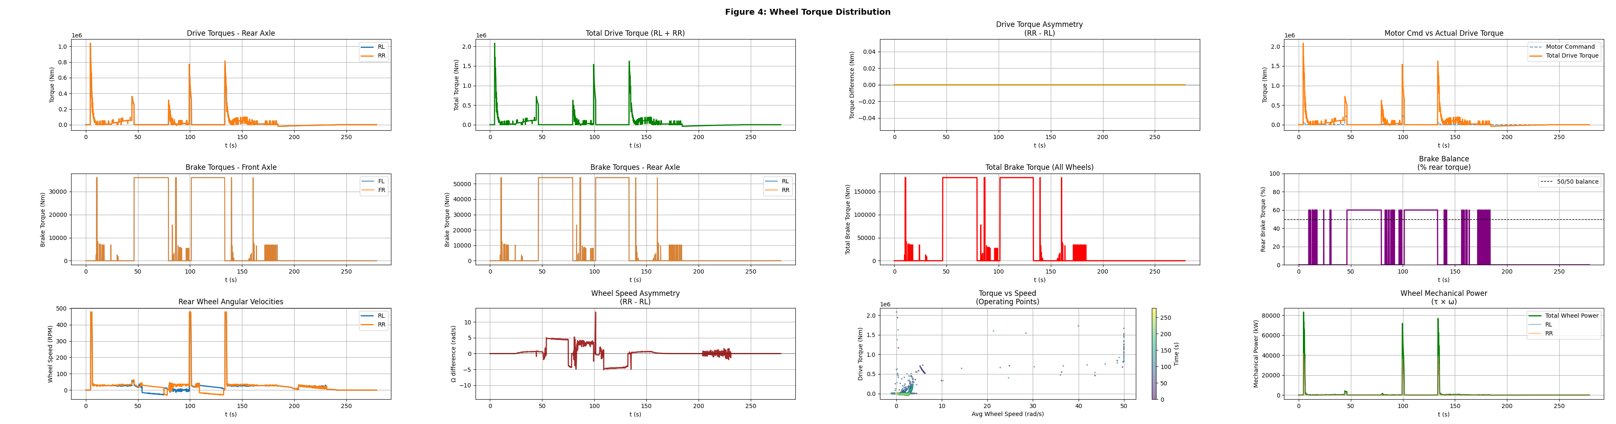
Figure 4 — Wheel Torque Distribution
Drive / brake torque per wheel · angular velocities
▸ Drive torques τ_RL · τ_RR (RWD)
▸ Torque asymmetry between wheels
▸ Brake torques all four wheels
▸ Front/rear brake balance
▸ Wheel angular velocity (RPM)
▸ Wheel speed asymmetry
▸ Mechanical power τ × ω
Mario Tilocca | Vehicle Dynamics SIL Framework | 2026

Slide 13
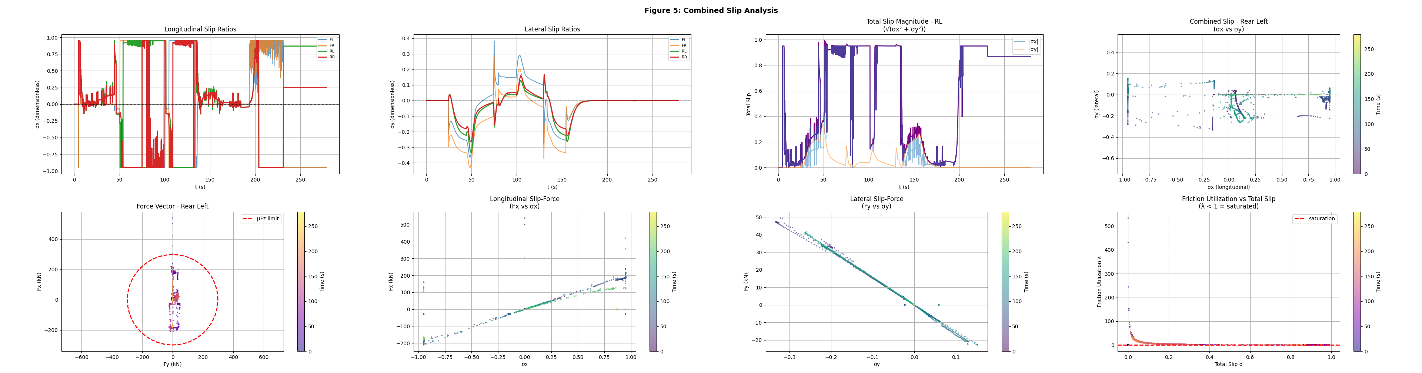
Figure 5 — Combined Slip Analysis
Longitudinal & lateral slip interaction
▸ σx longitudinal slip ratios
▸ σy lateral slip ratios
▸ Total slip √(σx² + σy²)
▸ Combined slip diagrams
▸ Force vectors Fx vs Fy
▸ Friction circles with operating points
▸ Friction utilisation vs total slip
Mario Tilocca | Vehicle Dynamics SIL Framework | 2026

Slide 14
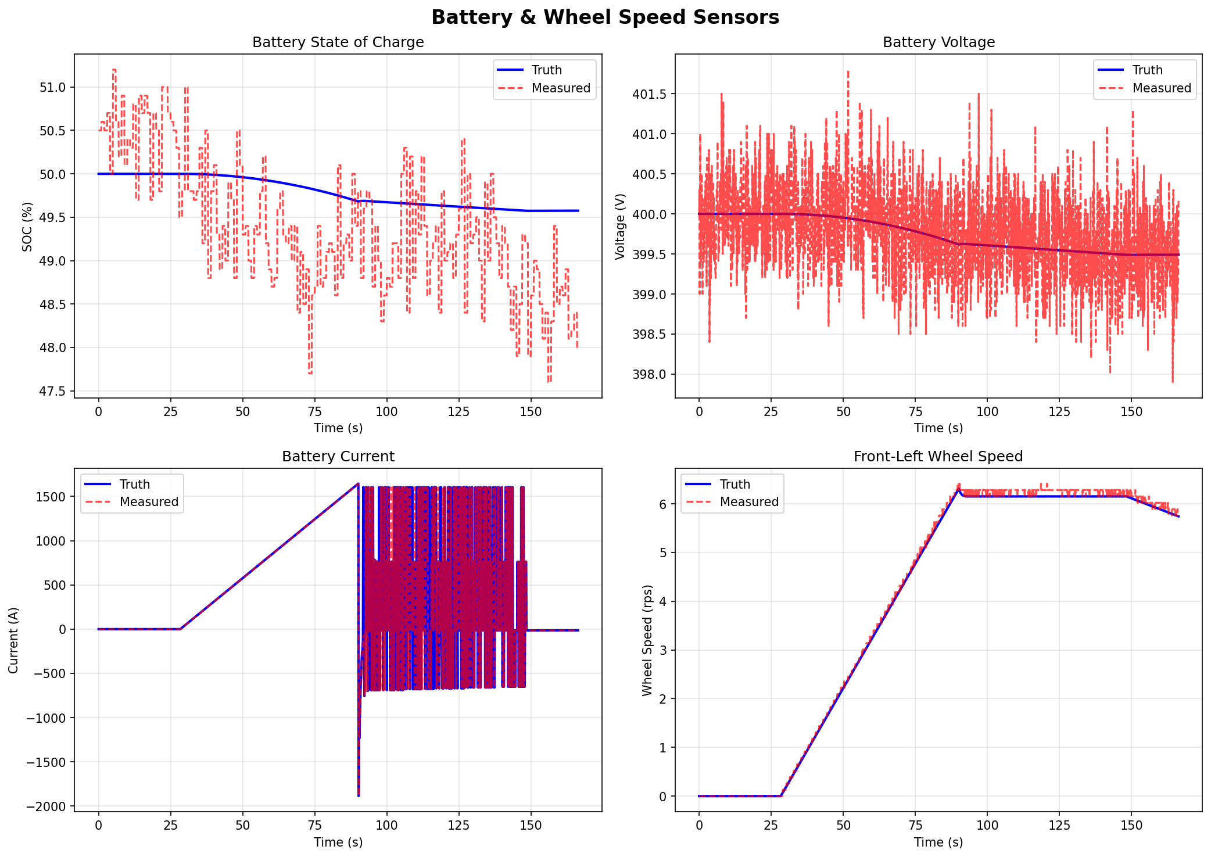
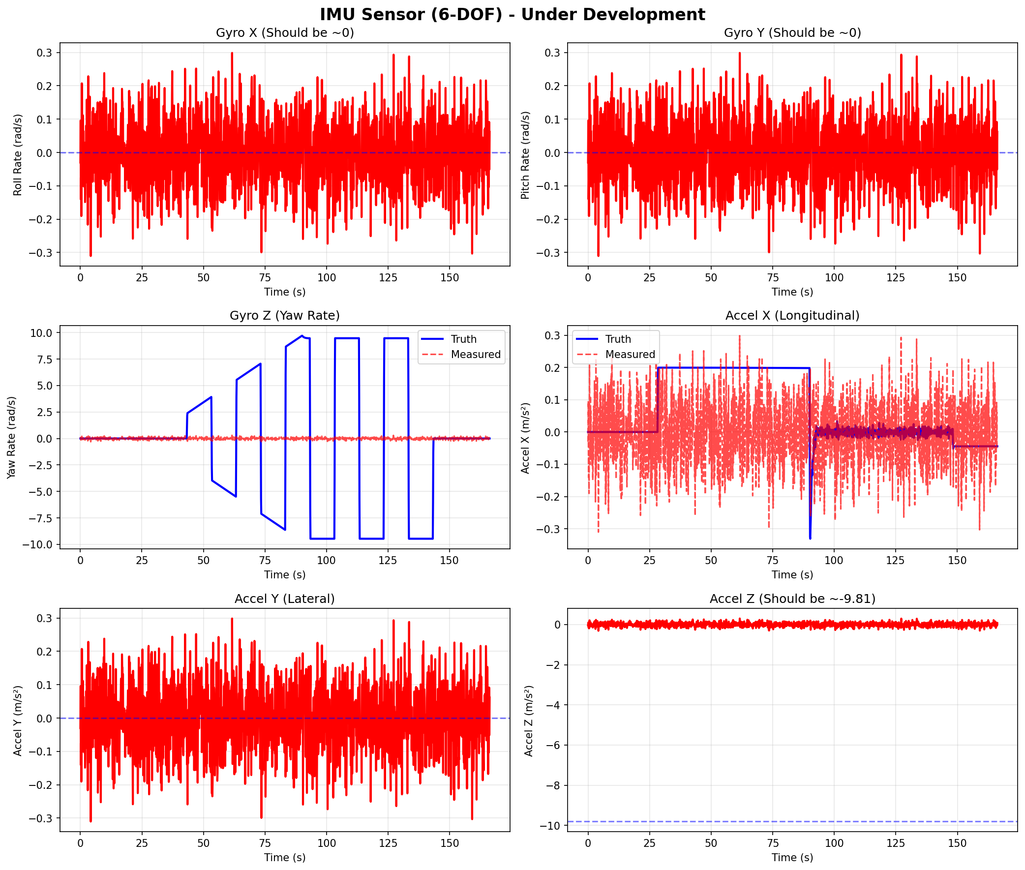
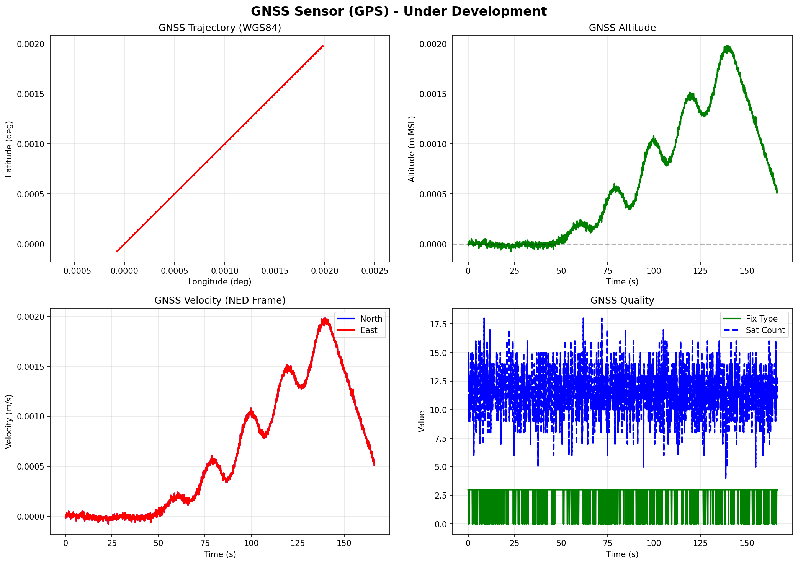
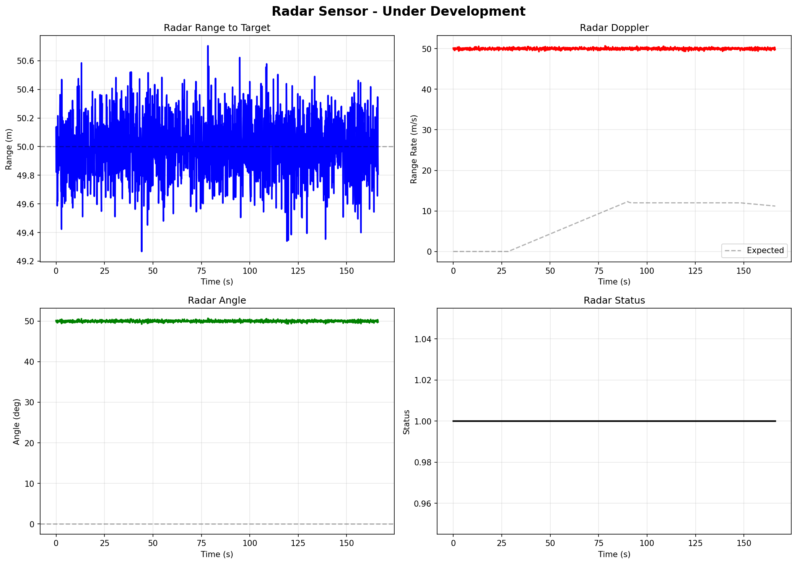
Sensor Suite — 5 Types with Validated Noise Models
Ground truth + realistic noise for ML training and EKF development
Mario Tilocca | Vehicle Dynamics SIL Framework | 2026

Slide 15
Future Developments
Near-term · Medium-term · Long-term roadmap
Near-Term
Medium-Term
Long-Term
▸ Grafana dashboard templates (live InfluxDB)
▸ Camera sensor simulation (lane detection)
▸ Hardware-in-the-Loop with real CAN hardware
▸ Multi-target radar tracking
▸ Thermal management subsystem
▸ Full 6-DOF dynamics (roll, pitch, heave)
▸ Lua scenario scripting for reverse/cusp maneuvers
▸ MQTT bridge for IoT integration
▸ ROS2 integration for sensor fusion nodes
▸ Automated test coverage for 3-DOF physics
▸ MPC / pure-pursuit controller in C++
▸ Multi-vehicle simulation (convoy operations)
▸ Trajectory replay & comparison tool
▸ Monte Carlo noise sensitivity analysis
▸ Cloud-based simulation orchestration
Mario Tilocca | Vehicle Dynamics SIL Framework | 2026

Slide 16
Summary
Physics
Architecture
Validation
▸ Full 3-DOF rigid body (vx · vy · ψ̇ · x · y · ψ)
▸ Priority-ordered subsystem execution (50→150)
▸ Cusp maneuver: forward → stop → reverse
▸ Centripetal coupling — essential for cornering stability
▸ CAN RX/TX at 10–100 Hz — HIL-ready
▸ 5-figure analysis: dynamics · tire · lateral · torque · slip
▸ Dugoff tire model with friction circle saturation
▸ Gear selector via CAN (Forward/Neutral/Reverse)
▸ 5 sensor types validated against industry specs
▸ Per-wheel rotational dynamics (wheel spin / lock)
▸ Hybrid kinematic/dynamic blend (0→4 m/s transition)
▸ 7 test suites · 91 unit tests passing
▸ Longitudinal + lateral load transfer
▸ 93-column CSV with full ground truth + sensor data
▸ Real-time at 100 Hz on single CPU core
"A production-grade SIL framework demonstrating expertise in vehicle dynamics, tire modeling, real-time systems, sensor simulation, and CAN integration."
Mario Tilocca | Vehicle Dynamics SIL Framework | 2026

