Slide 1
Relating Obesity Prevalence to Median Income Level
Max Tjen

Slide 2
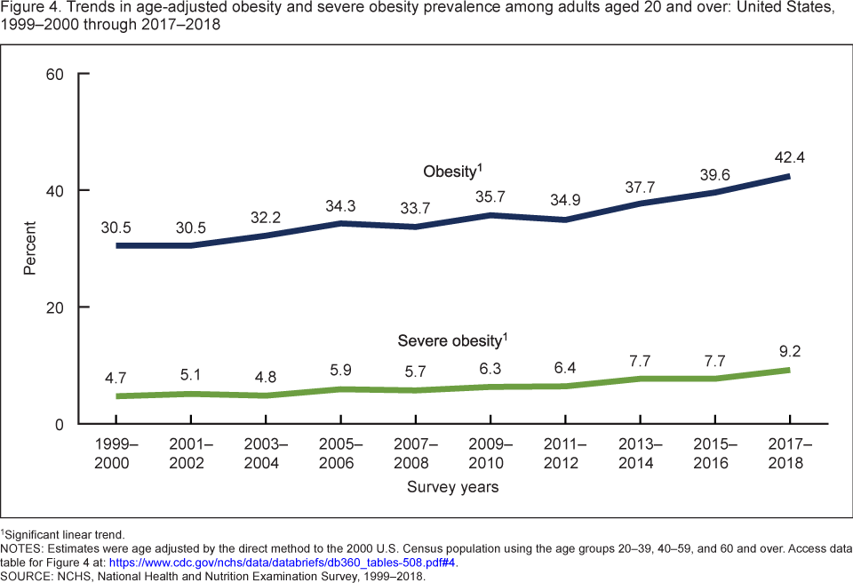
Introduction
Continuously rising obesity rates
Potential Factors
More aggressive marketing
Increased meal portions
Poor diet
Physical inactivity
Residual Effects
High blood pressure
Diabetes
Heart disease

Slide 3
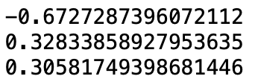
Topic Flow
Food deserts
How the distance to the nearest supermarket influences obesity
Too much variable specificity
Urban v non urban
By race
Access to vehicle
Inverse Relation of Obesity Prevalence to Median Family Income
Correlation of average obesity prevalence to
Median family income
% of people within 0.5 miles of supermarket
% of people within 1 mile of supermarket

Slide 4
Related Work
CDC - Obesity and Socioeconomic Status in Adults: United States, 2005 - 2008
Male ⇒ obesity prevalence is generally similar at all income levels
Female ⇒ higher income are less likely to be obese
Most obese women not low income
https://www.cdc.gov/nchs/products/databriefs/db50.htm
Science Daily - A Correlation Between Obesity and Income has Only Developed the Past 30 Years
Development of negative correlation
Rise of obesity and diabetes fastest among poorest regions of the US
Timing coincides with increased exposure to high fructose corn syrup
https://www.sciencedaily.com/releases/2018/12/181211103139.htm

Slide 5
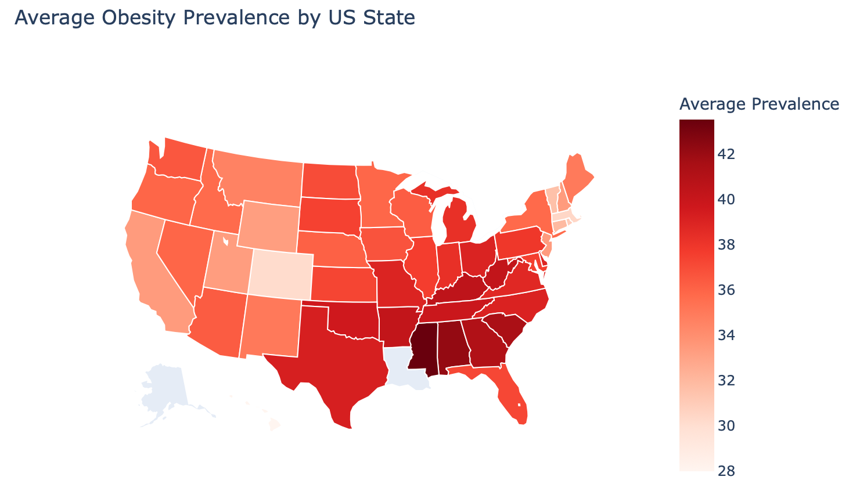
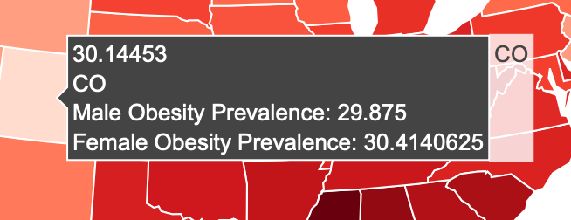
Nationwide Average Obesity Prevalence

Slide 6
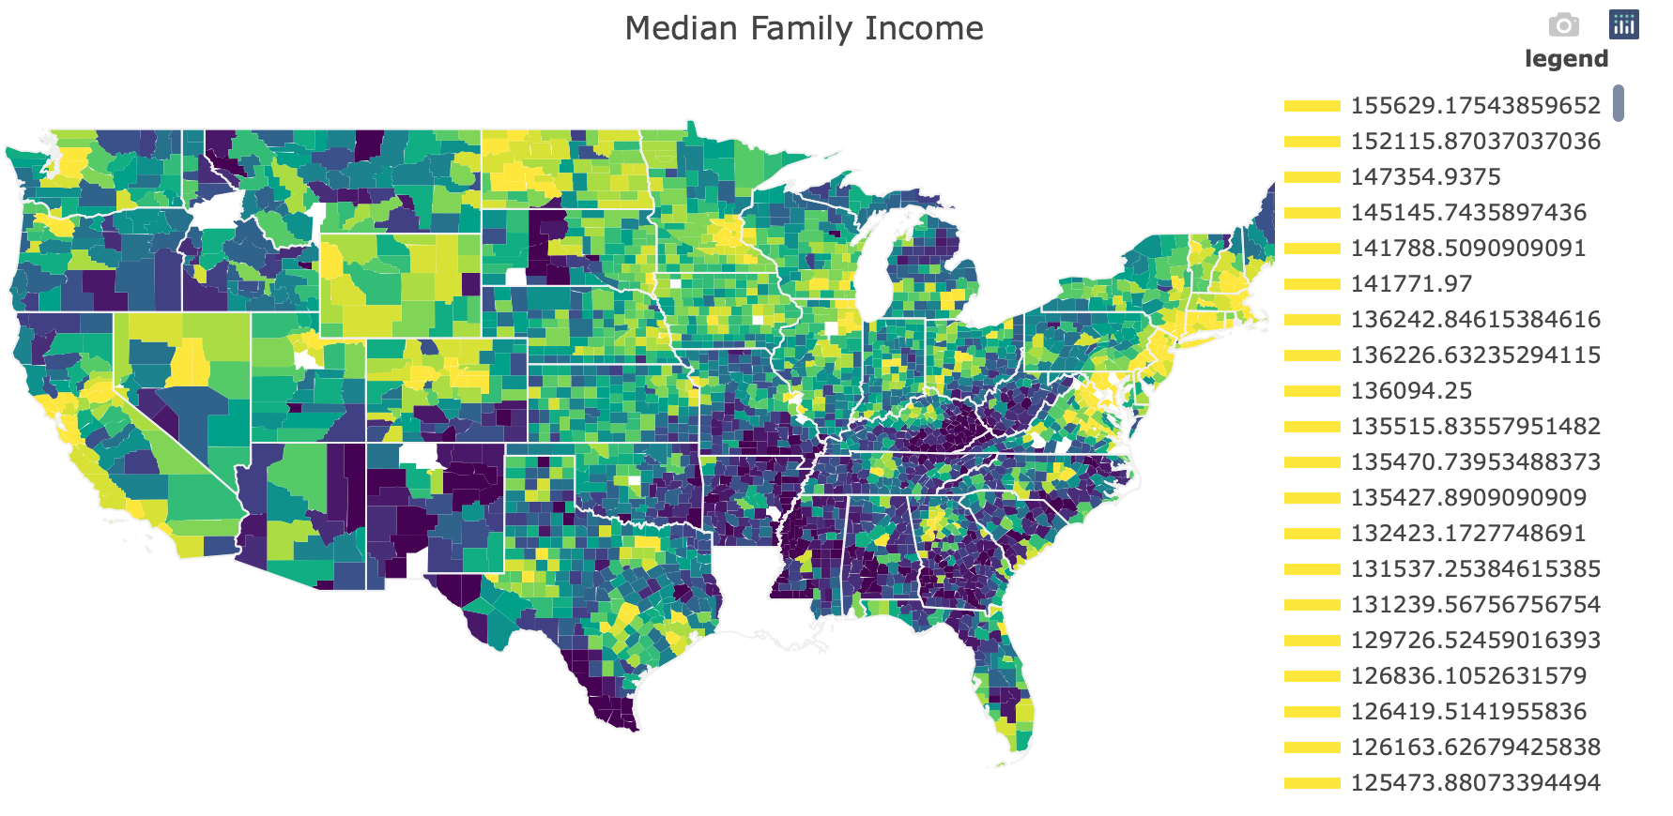
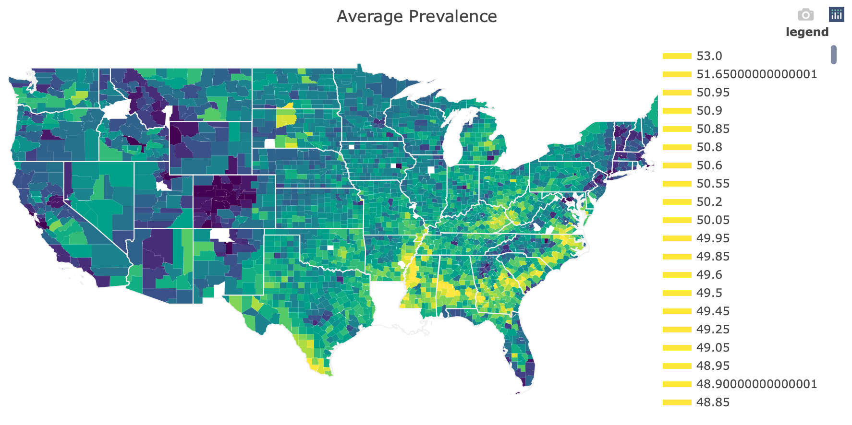
County Obesity Prevalence and Income

Slide 7
Method
Difficult to investigate the inverse relationship of median family income and average obesity prevalence
Create new percentile features of each
Get absolute value of the difference
Makes it easier to visualize
Larger percentile difference ⇒ higher correlation

Slide 8
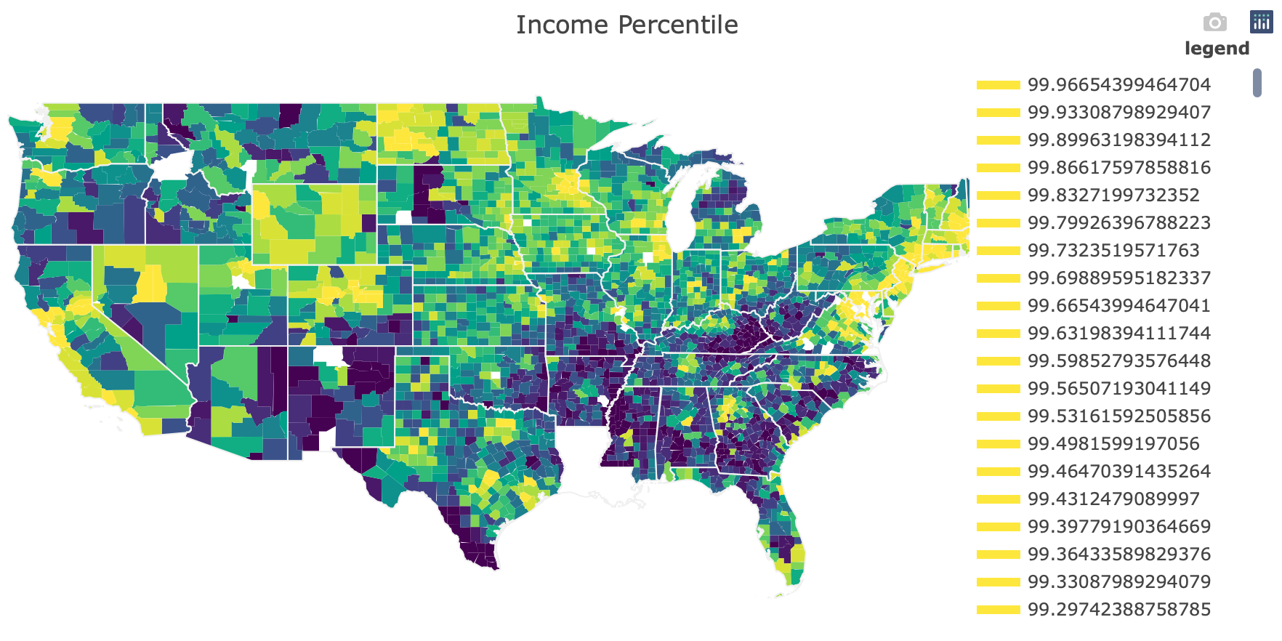
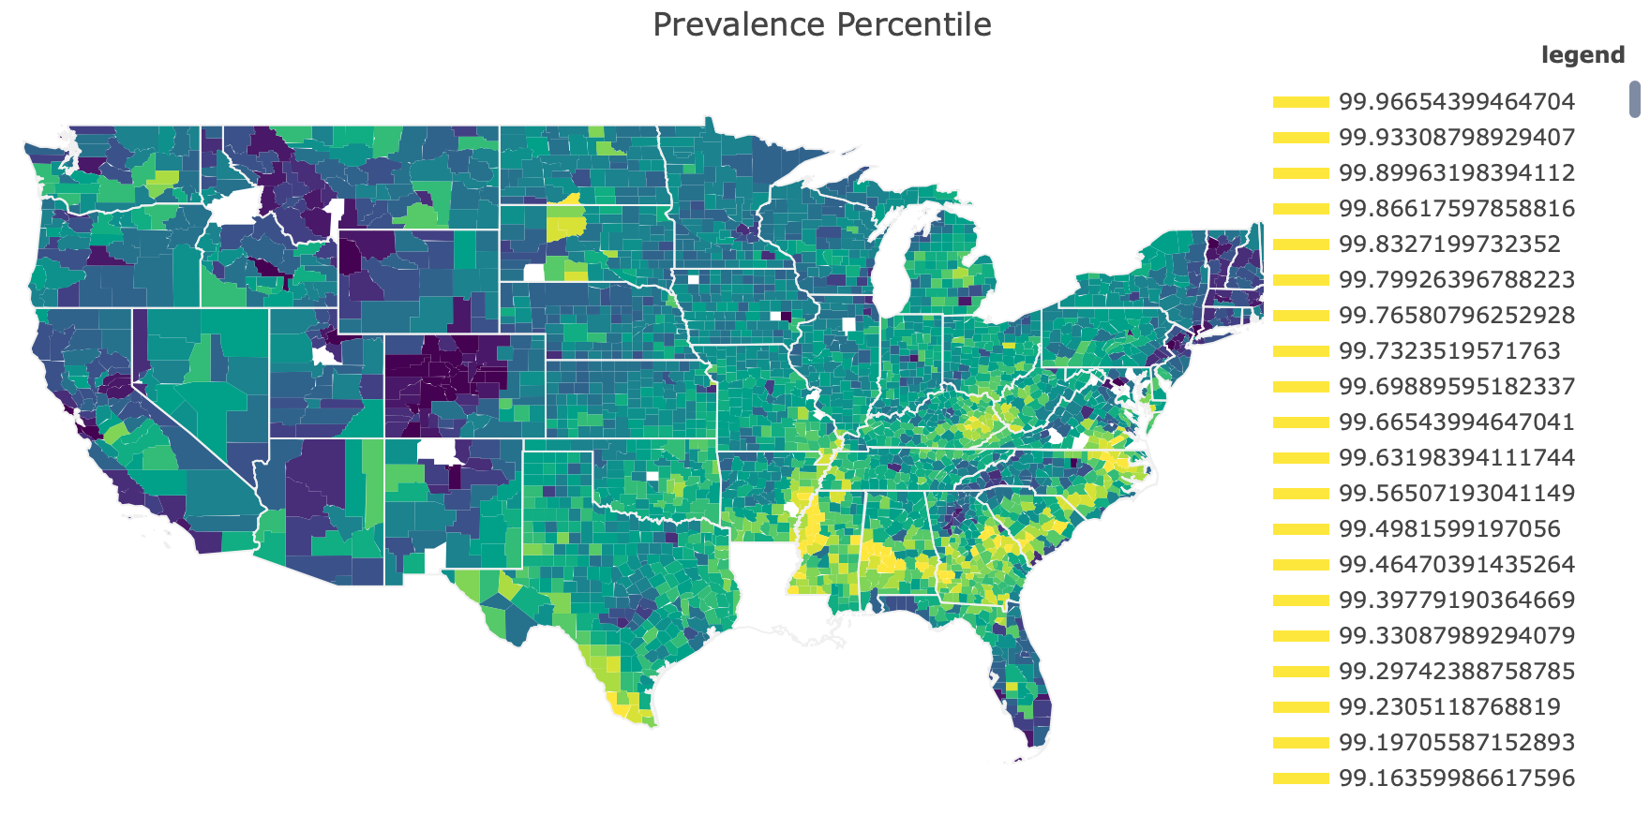
Percentile Map of Average Prevalence and Income

Slide 9
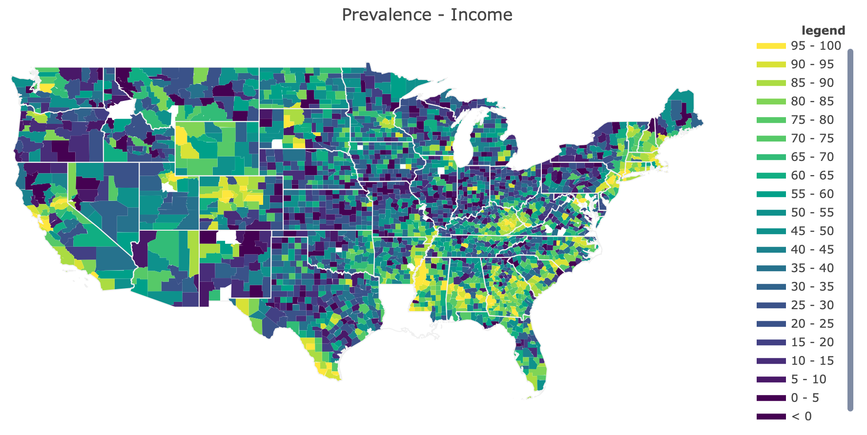
Overall Prevalence Percentile - Income Percentile

Slide 10
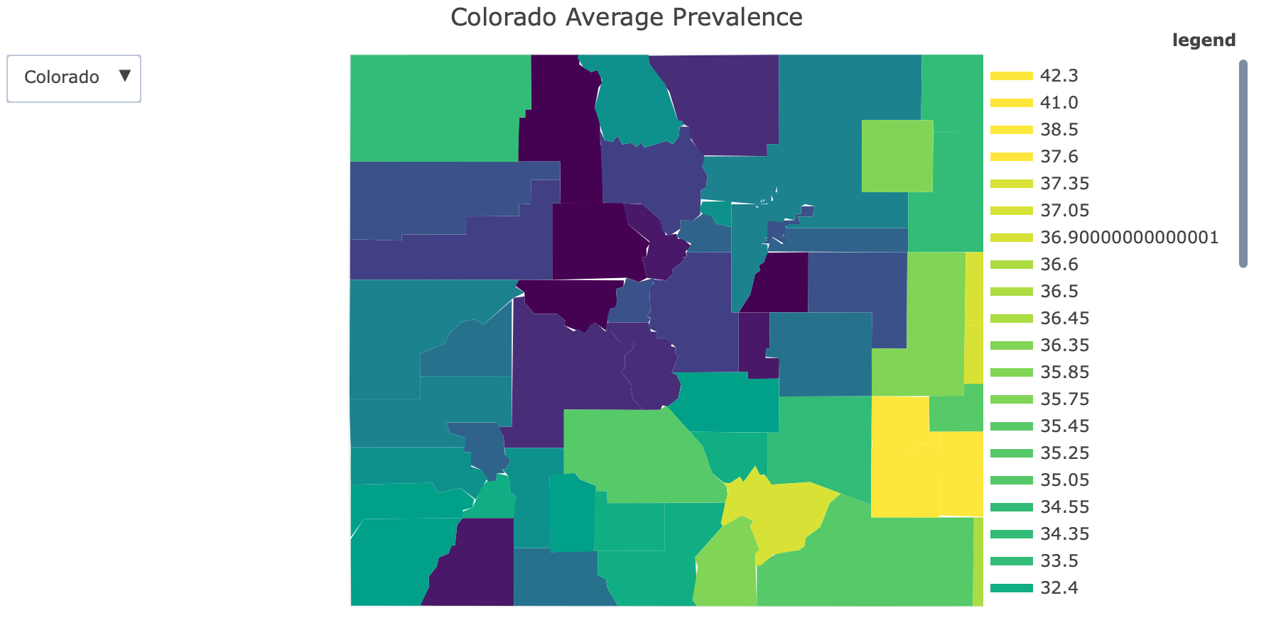
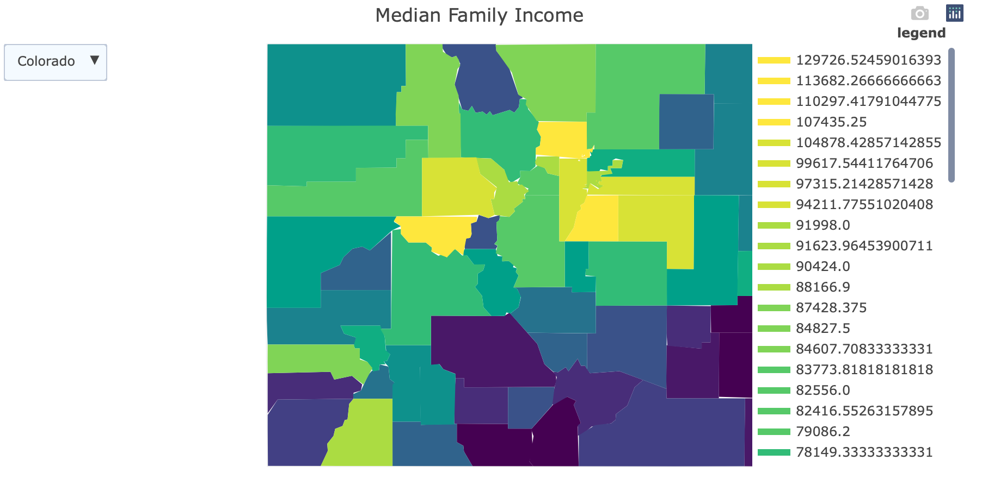
Colorado Prevalence and Income Percentiles

Slide 11
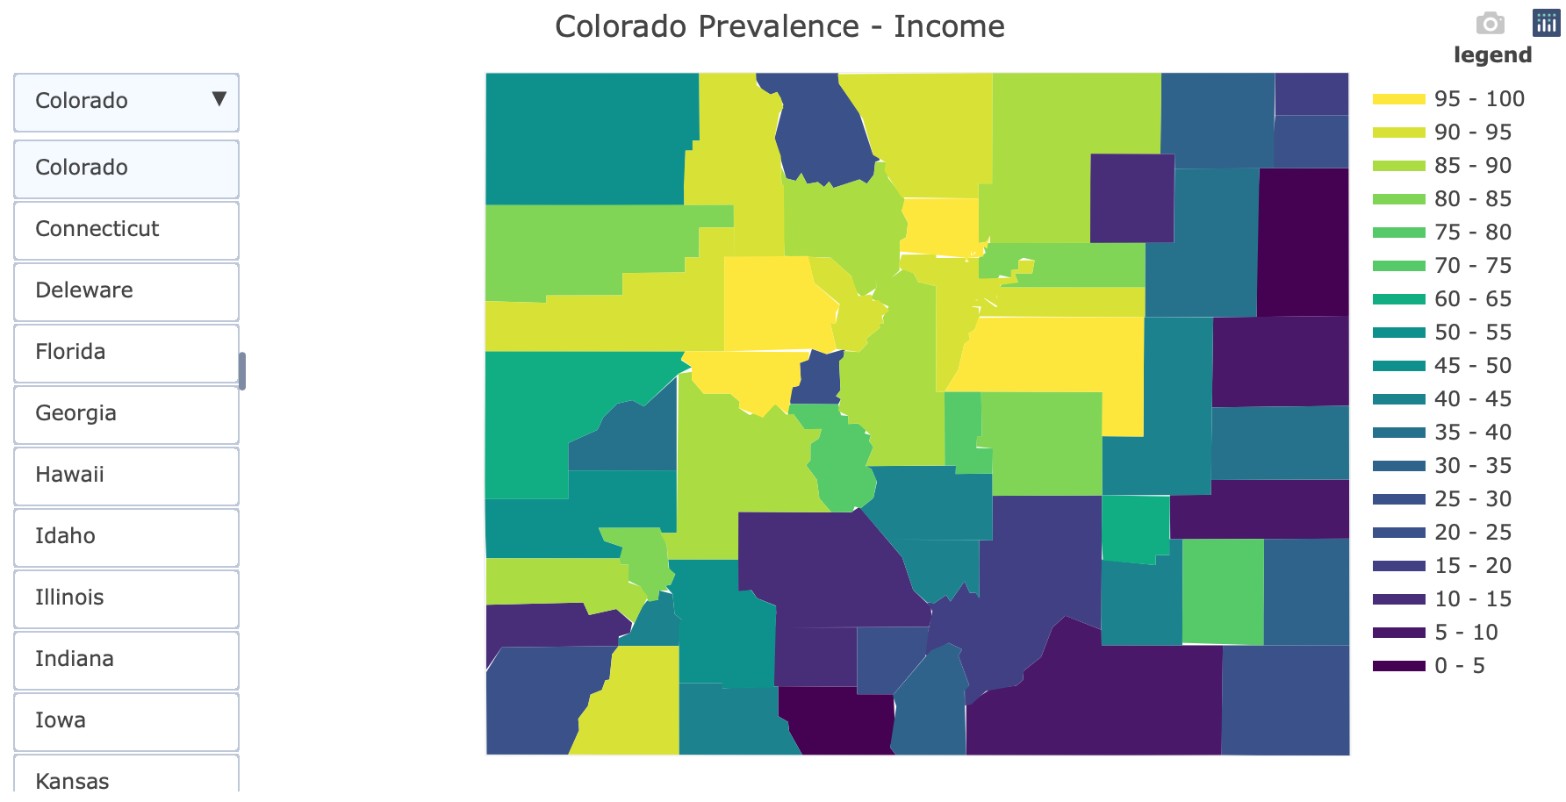
Colorado Prevalence Percentile - Income Percentile

Slide 12
Further Work
Create more accurate measures of the inverse relation between average obesity prevalence and median family income
Find/gather data with less null values
Effectively transform the data so everything is on the same scale
Rather than individual parts
More specific investigation

