Slide 1
Statin Recommendation Project

Slide 2
Background
Based around Pooled Cohort Equations
  Risk assessment tool for calculating 10-year risk of atherosclerotic cardiovascular disease
  Incorporated into clinical guidelines on cholesterol, hypertension, and aspirin therapy
  Widely used in clinical practice by primary care providers and cardiologists
Guidelines recommend the tool as part of the statin therapy recommendation decision making process
  >= 7.5% for above 40
  >= 10% for above 40 and stage 1 hypertension

Slide 3
Background
Want to look at model robustness across range of values
Goal to determine if there are certain combinations of non-modifiable factors (age, race, and sex) where the risk calculator always returns intermediate/high risk, regardless of other modifiable clinical or behavioral values

Slide 4
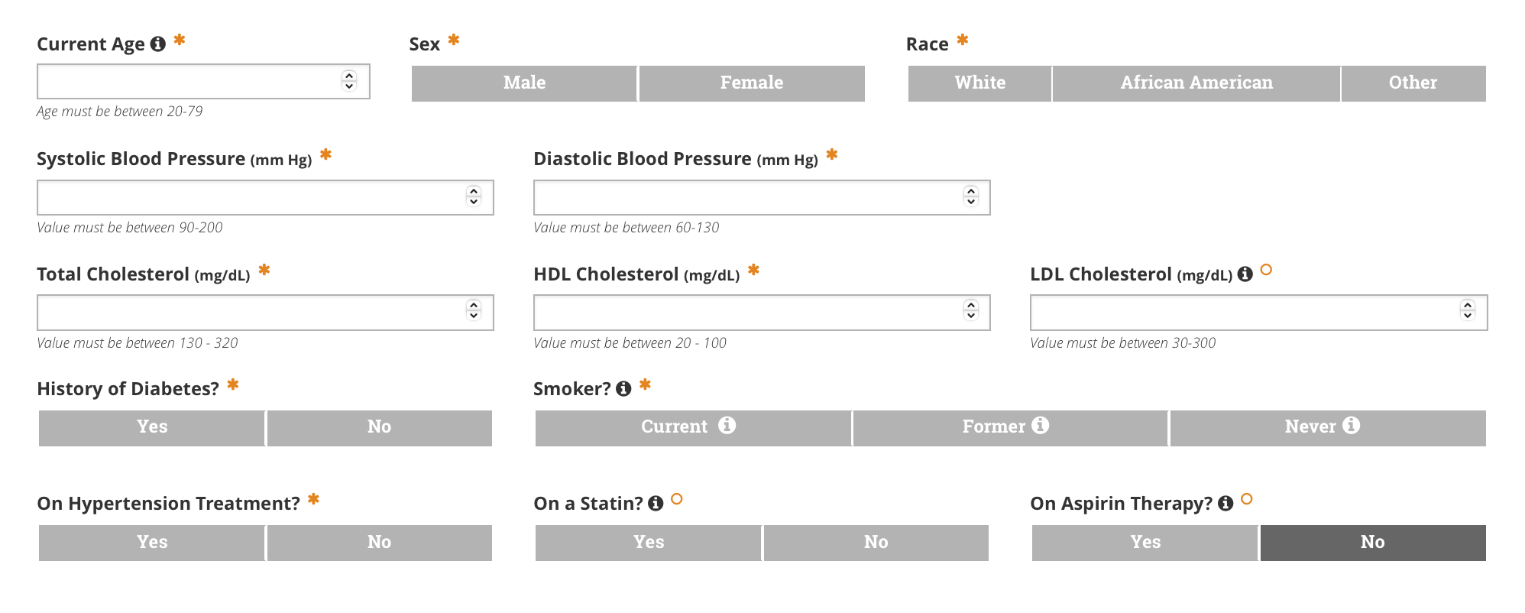
Background

Slide 5
Data Source
National Health and Nutrition Examination Survey (NHANES)
  Run by National Center for Health Statistics, part of the CDC
  Combines data from interviews and physical examinations
    Interviews ⇒ demographic, socioeconomic, dietary, and health related questions
    Physical exams ⇒ lab tests, medical/dental/physiological measurements
  Collects nationally representative sample data from 5,000 people per year
    Dataset published every other year
  Used datasets from 2011-2012, 2013-2014, 2015-2016, and 2017-2018 surveys

Slide 6
Data Definitions
Diabetes Status
  Told by doctor that they have diabetes
Smoking Status
  Do they currently smoke cigarettes
SBP
  Mean reading (mmHg)
DBP
  Mean reading (mmHg)
High Blood Pressure Status
  Told by doctor that they have high blood pressure
Age
  Age at screening
High Cholesterol
  Direct HDL cholesterol (mg/dL)
Total Cholesterol
  Total cholesterol (mg/dL)
Has Hypertension Medication
  Taking prescription medication for cholesterol
Sex
  Male/Female
Ethnicity
  Race and hispanic origin

Slide 7
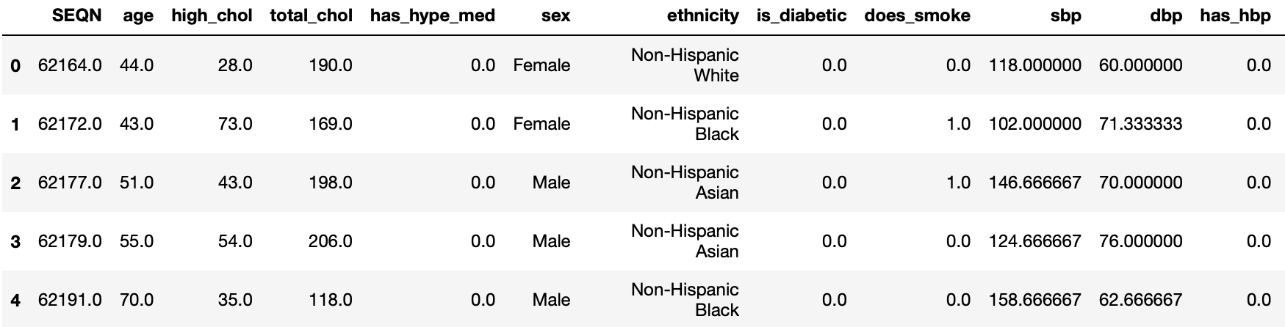
Data Definitions

Slide 8
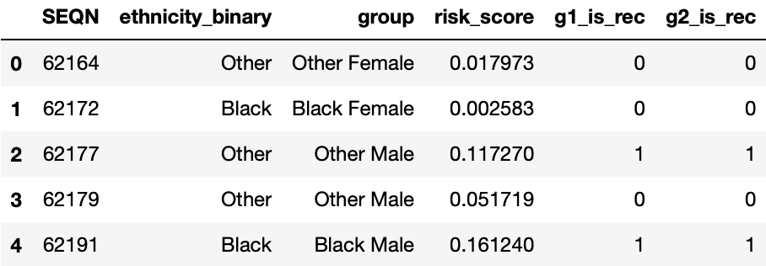
Data Definitions - Additional Variables
All Flag (g1_is_rec)
  All people
  Risk score is/isn’t >= 7.5%
HBP Flag (g2_is_rec)
  People with high blood pressure
  Risk score is/isn’t >= 10%
Ethnicity Binary
  Black or Other
Risk Score
  Calculated using ASCVD risk calculator equations
Group
  Other/Black Male/Female
⇒ percentages defined by ASCVD, indicates recommendation of high-intensity statin therapy

Slide 9
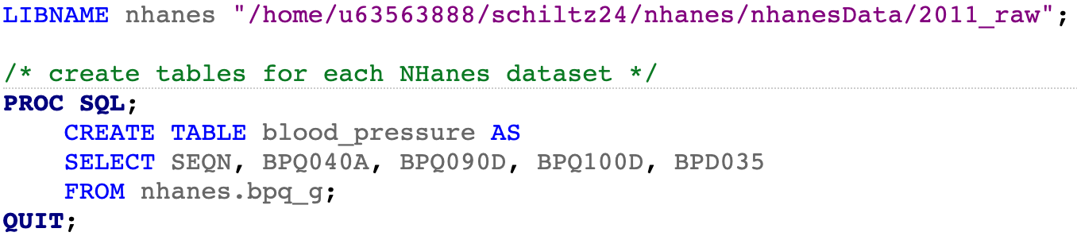
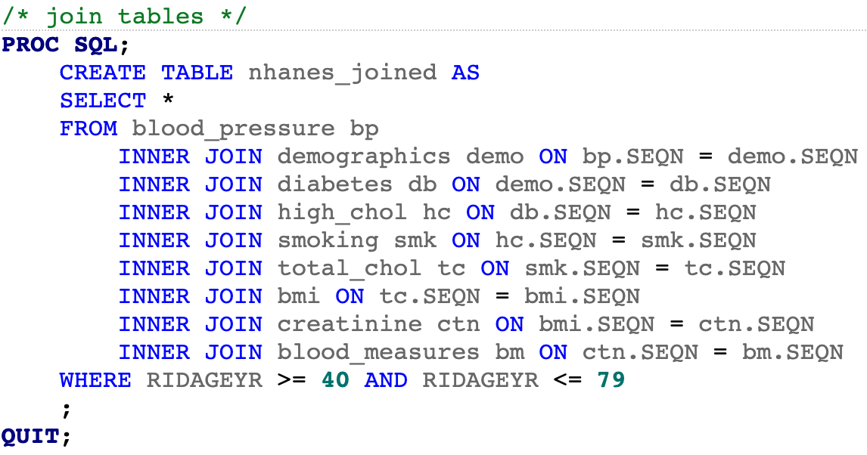
Dataset Generation

Slide 10
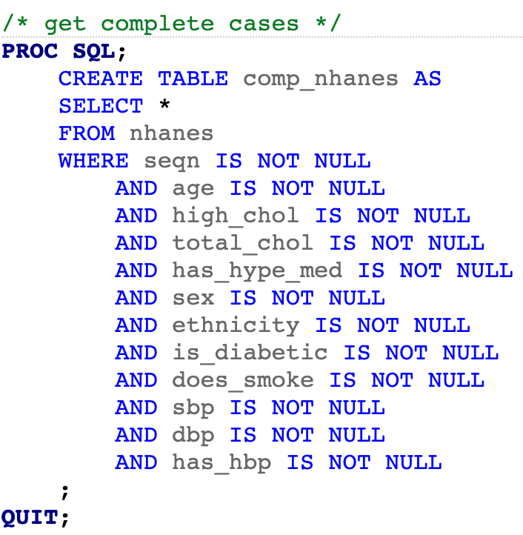
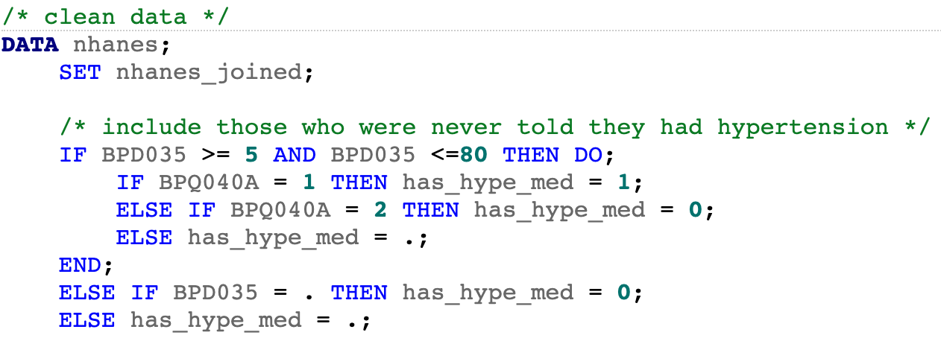
Dataset Generation

Slide 11
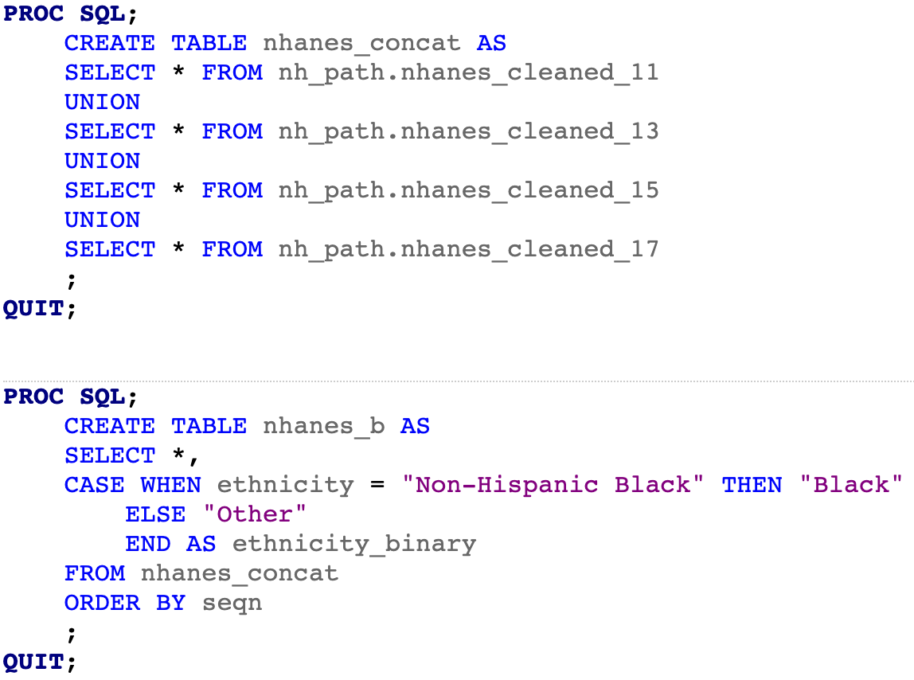
Dataset Generation

Slide 12
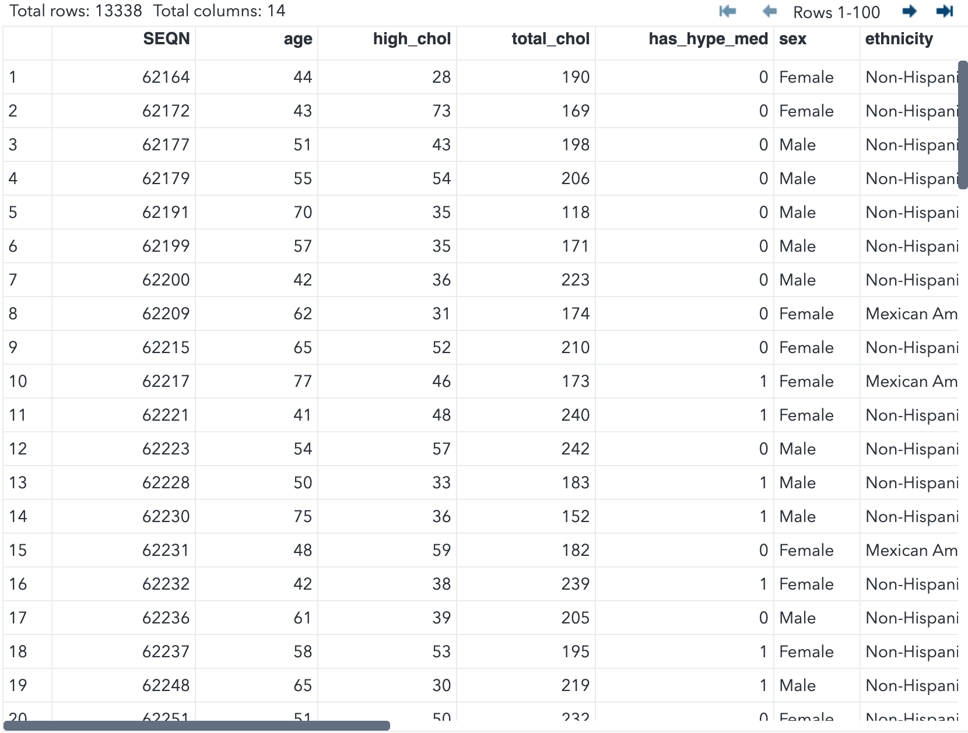
Dataset Generation

Slide 13
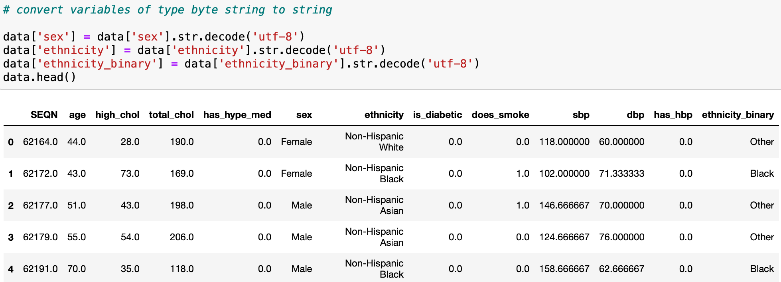
Dataset Import

Slide 14
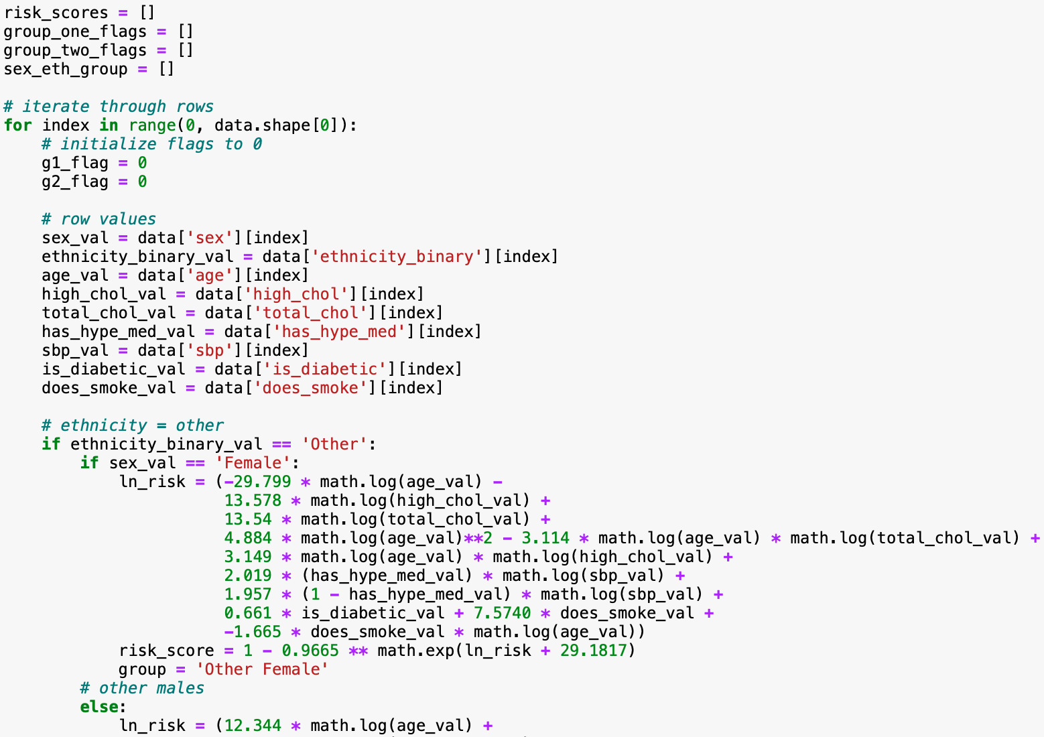
Risk Score Calculation

Slide 15
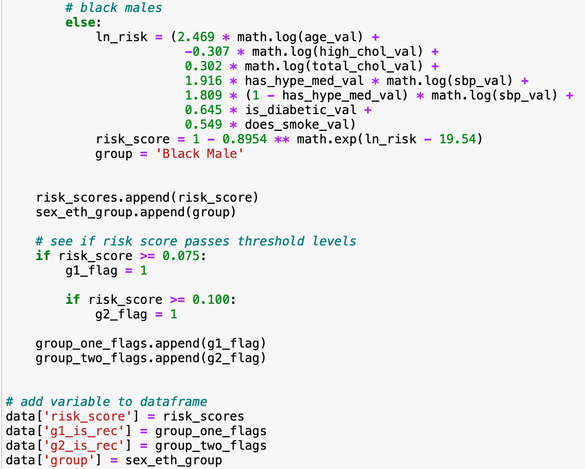
Risk Score Calculation

Slide 16
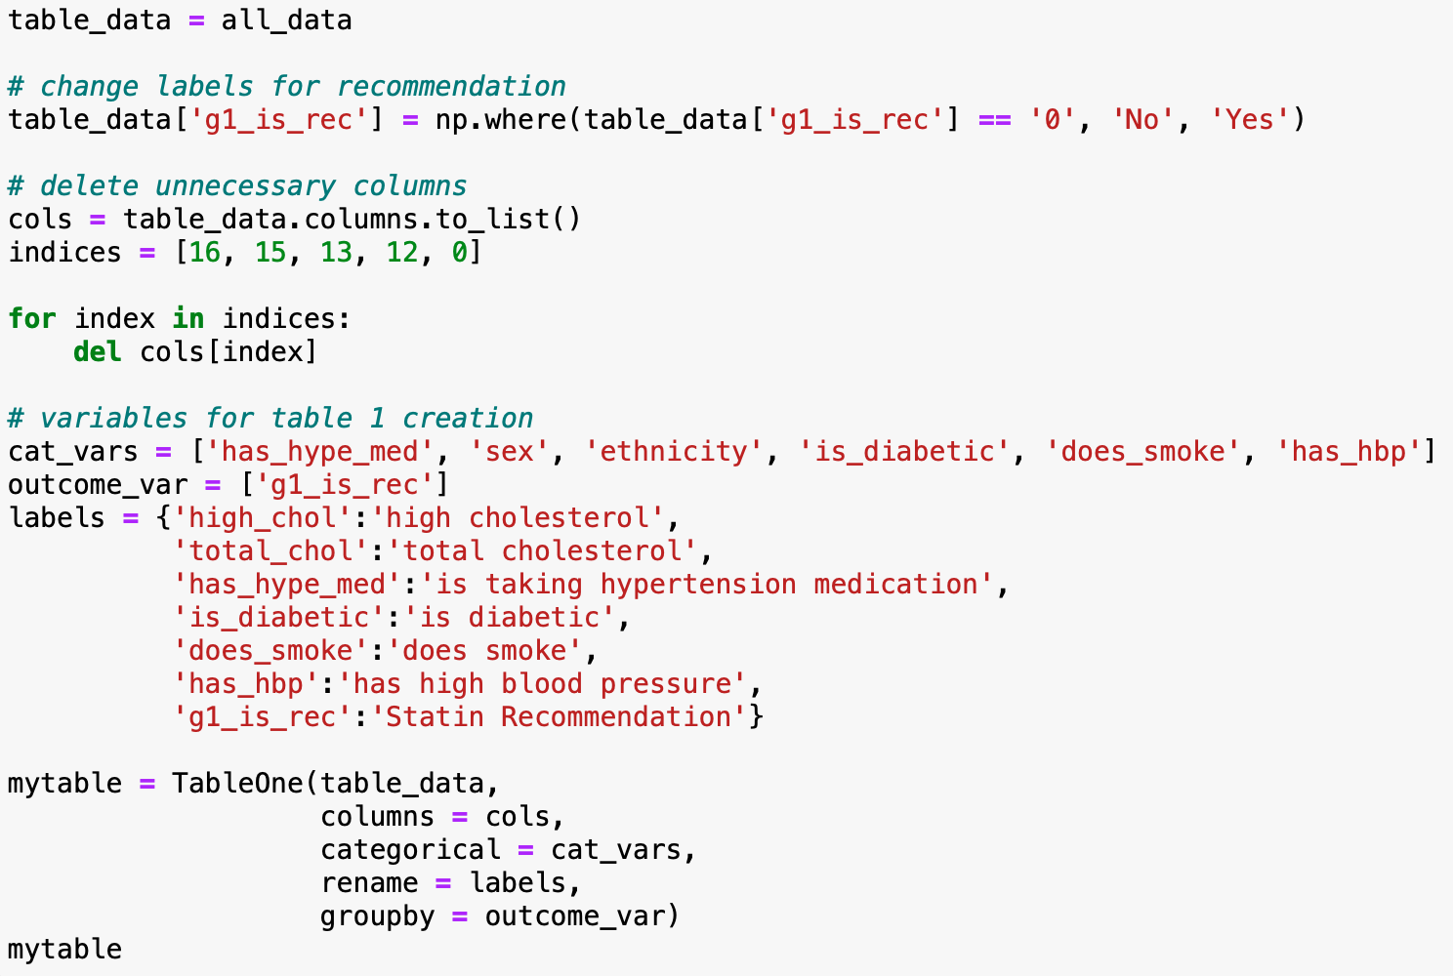
EDA

Slide 17
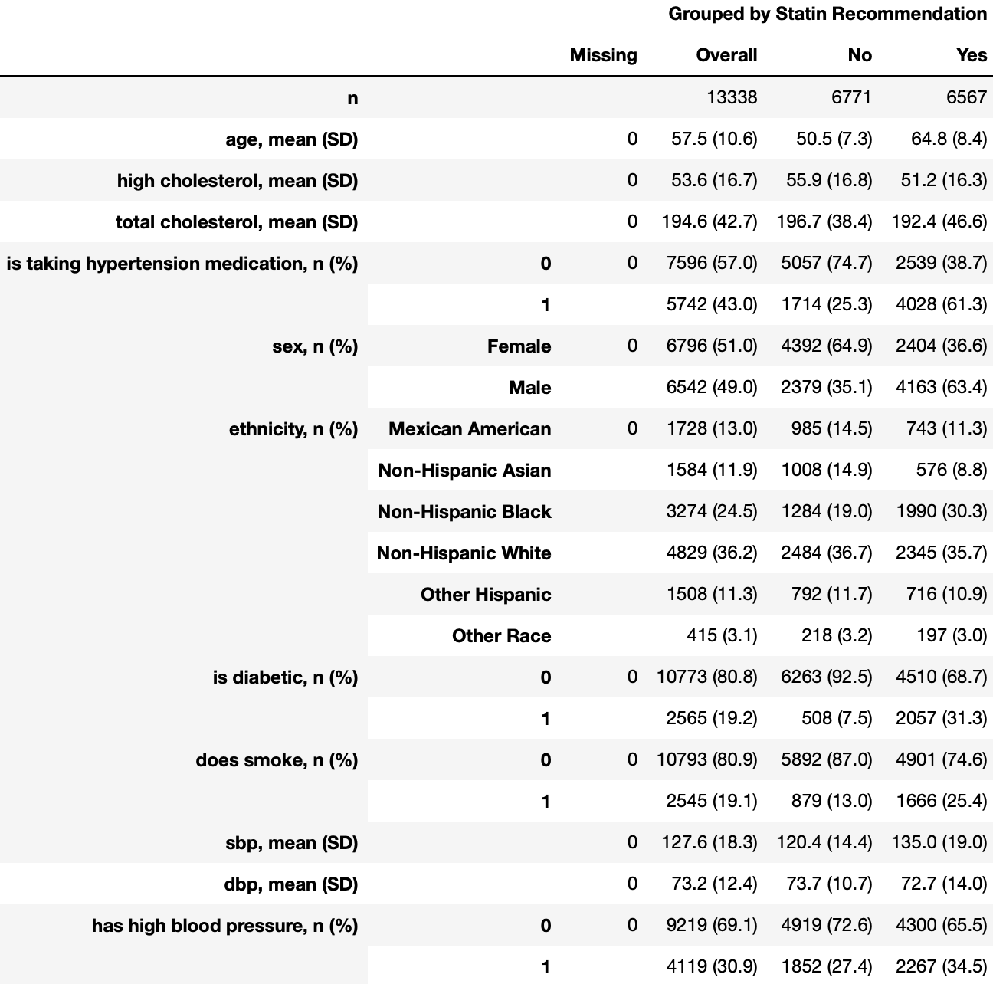
EDA

Slide 18
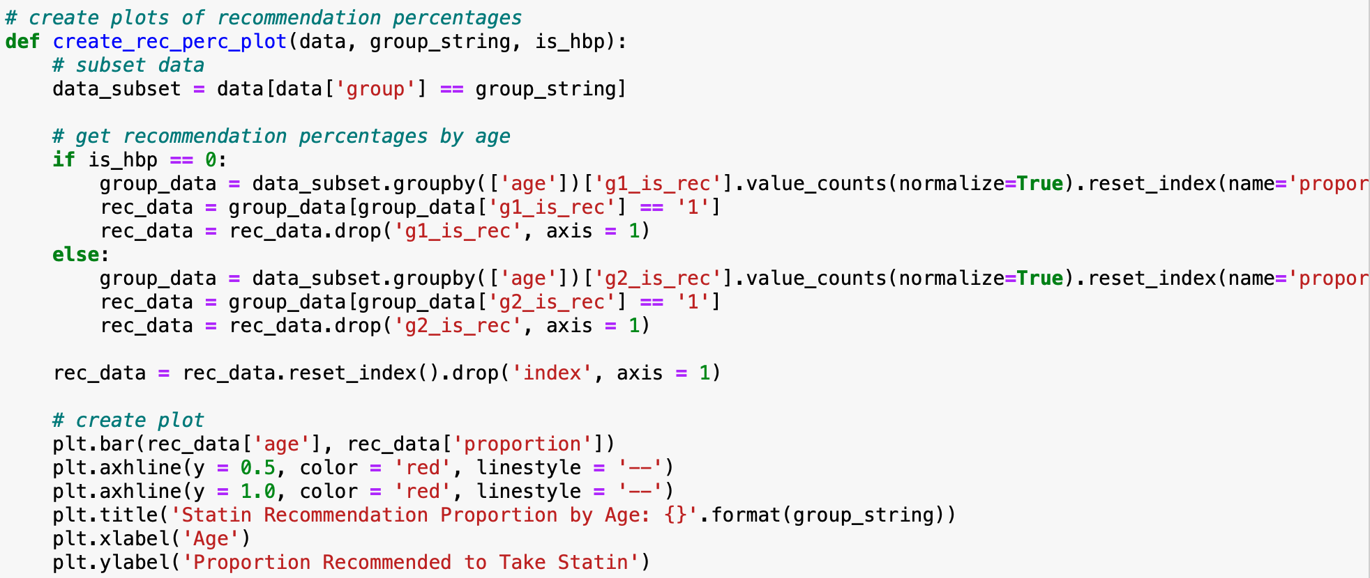
Analysis

Slide 19
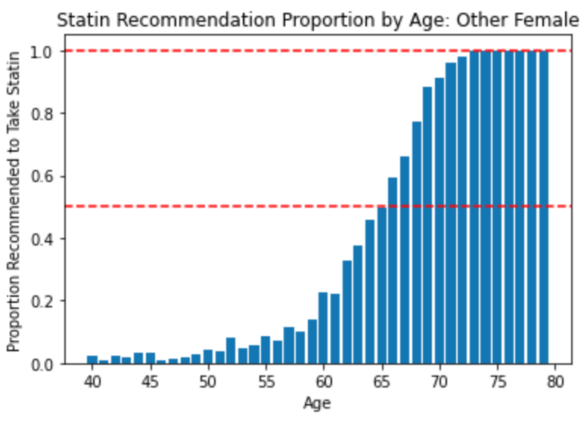
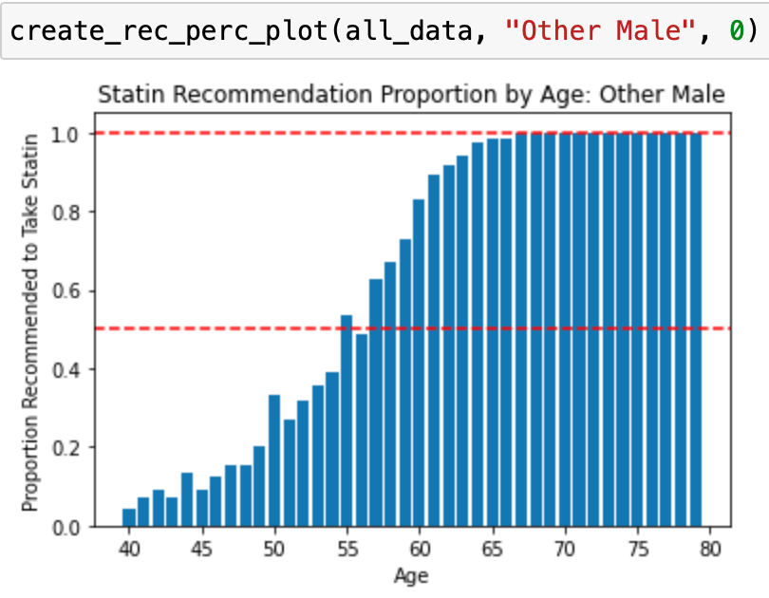
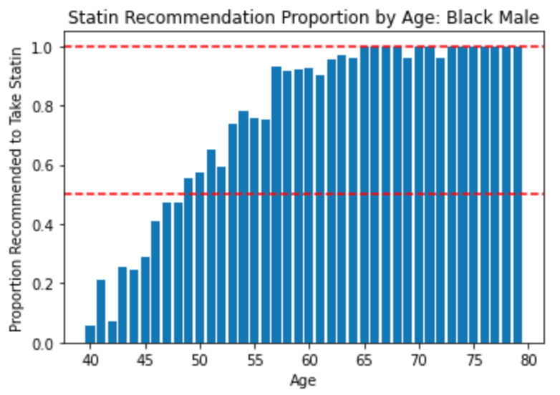
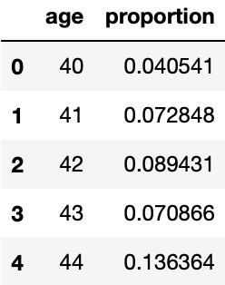
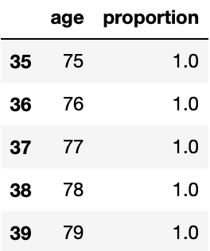
Analysis

Slide 20
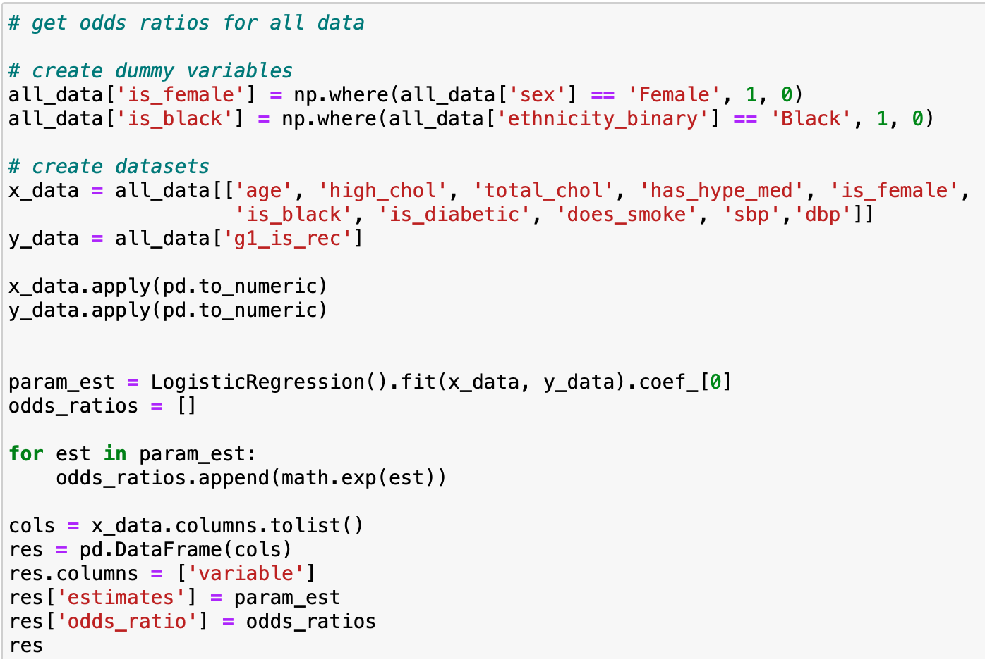
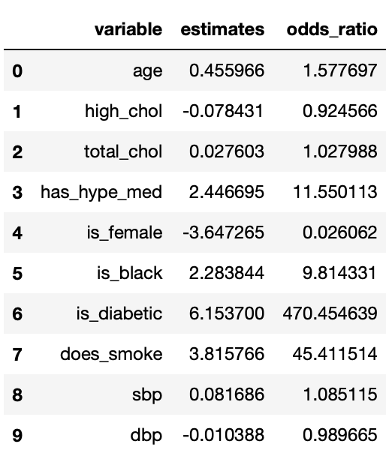
Analysis

Slide 21
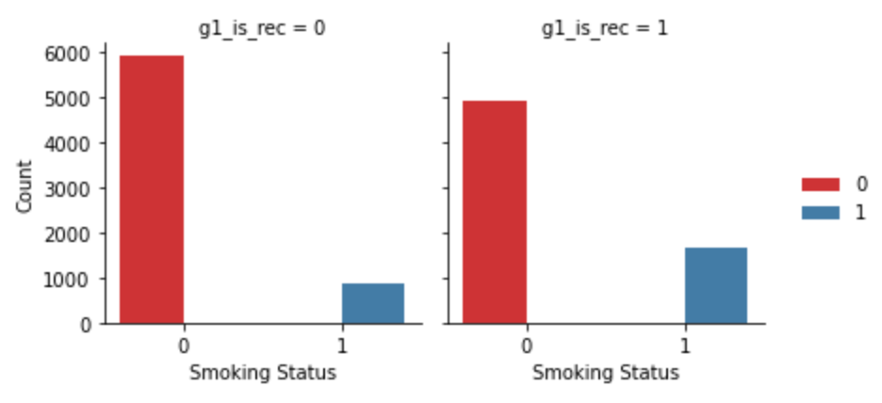
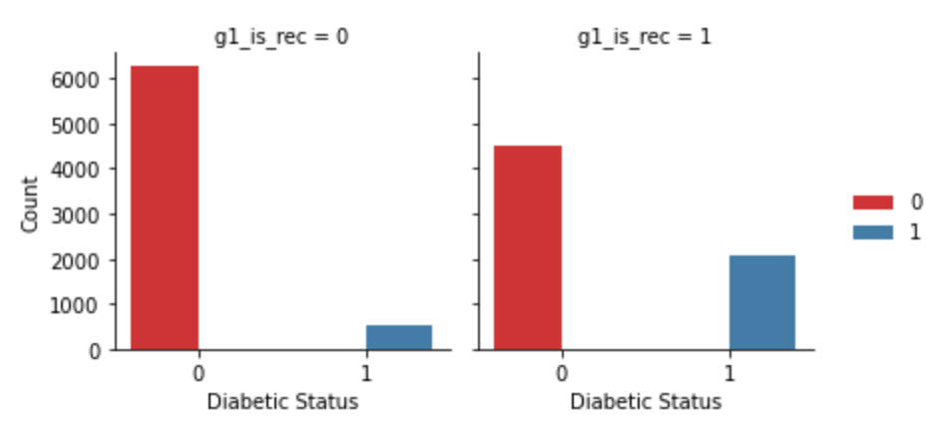
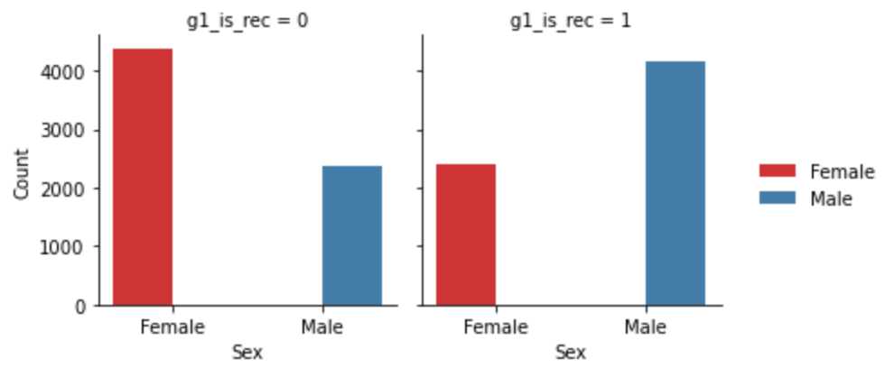
Analysis
Notes:
4.4, 2

Slide 22
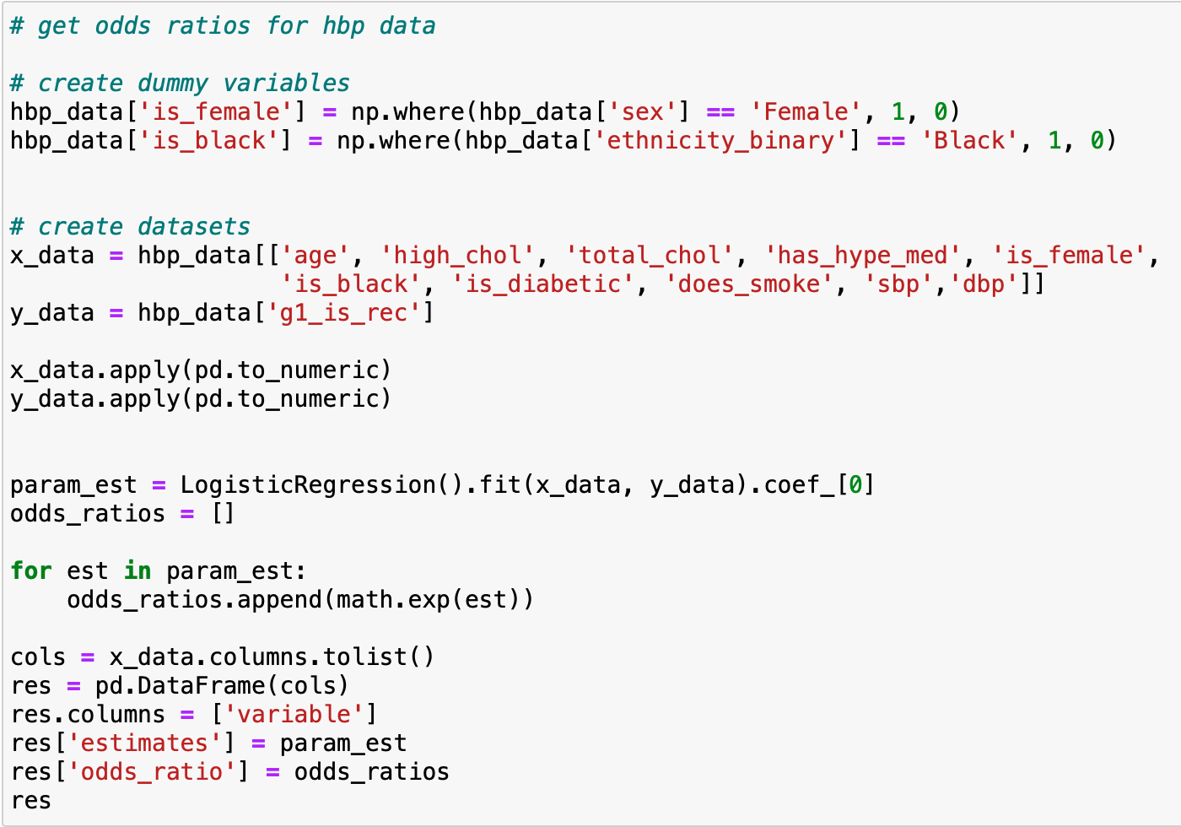
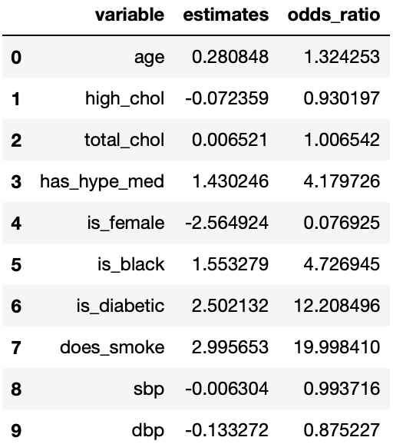
Analysis

Slide 23
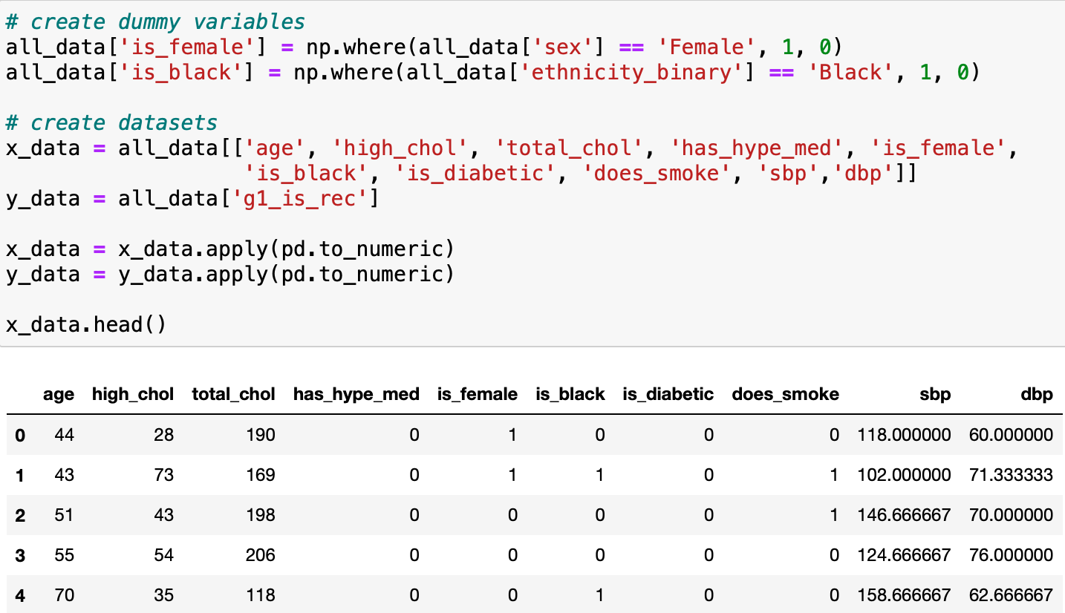
Analysis - Shapley Values
Contribution of feature values to the difference between the actual and mean predicted value
Identify variable influence in patients’ 10-year risk prediction

Slide 24
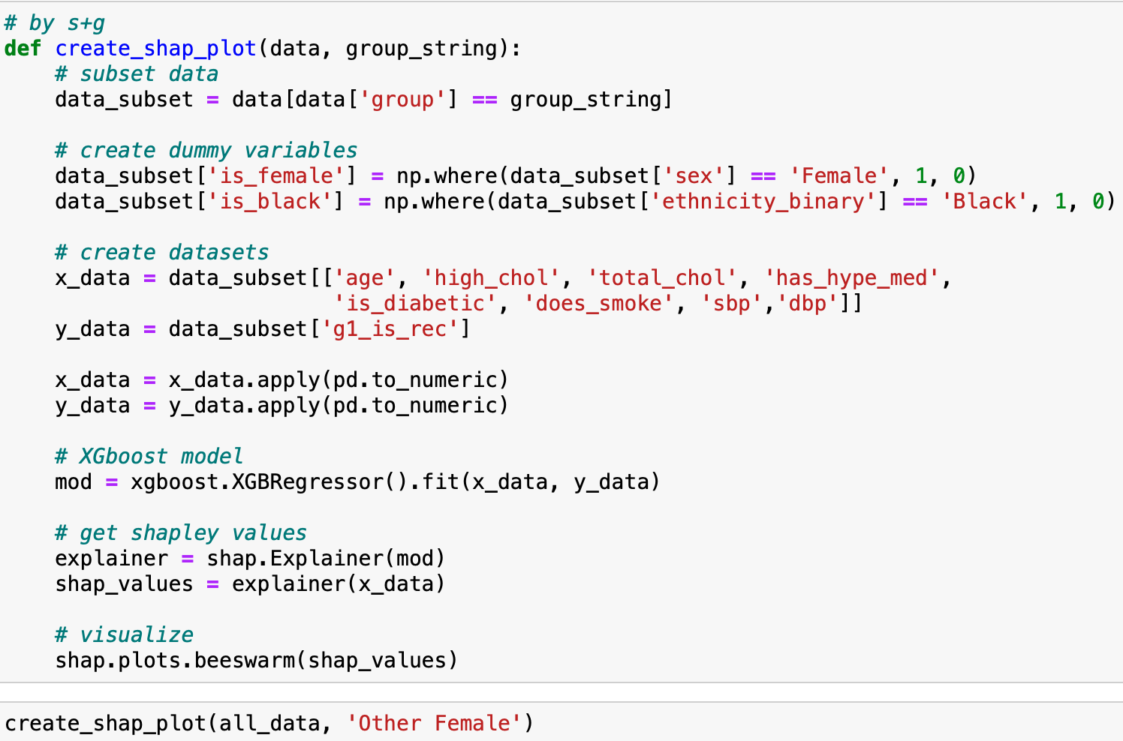
Shapley - Subgroup

Slide 25
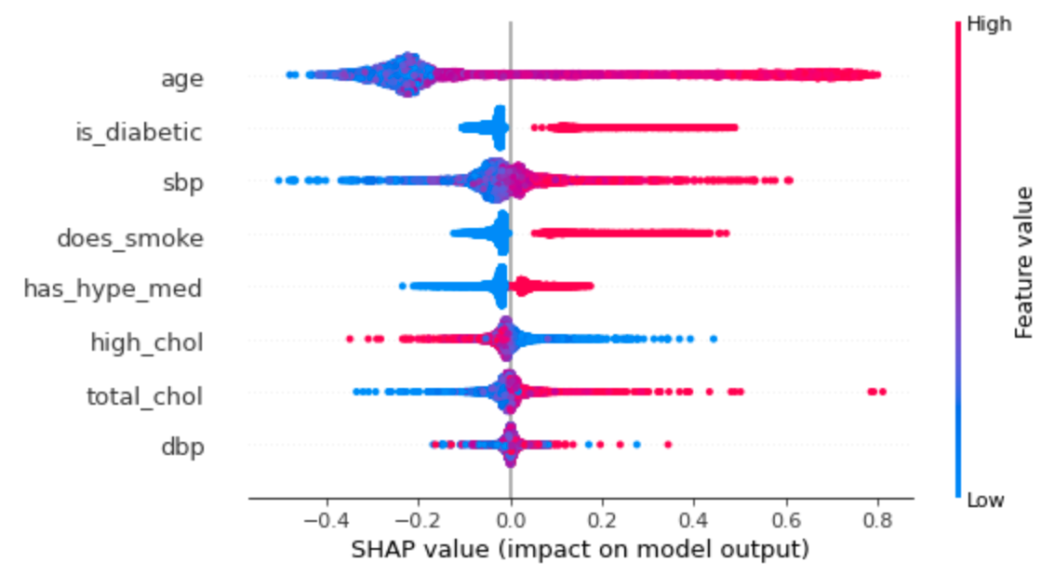
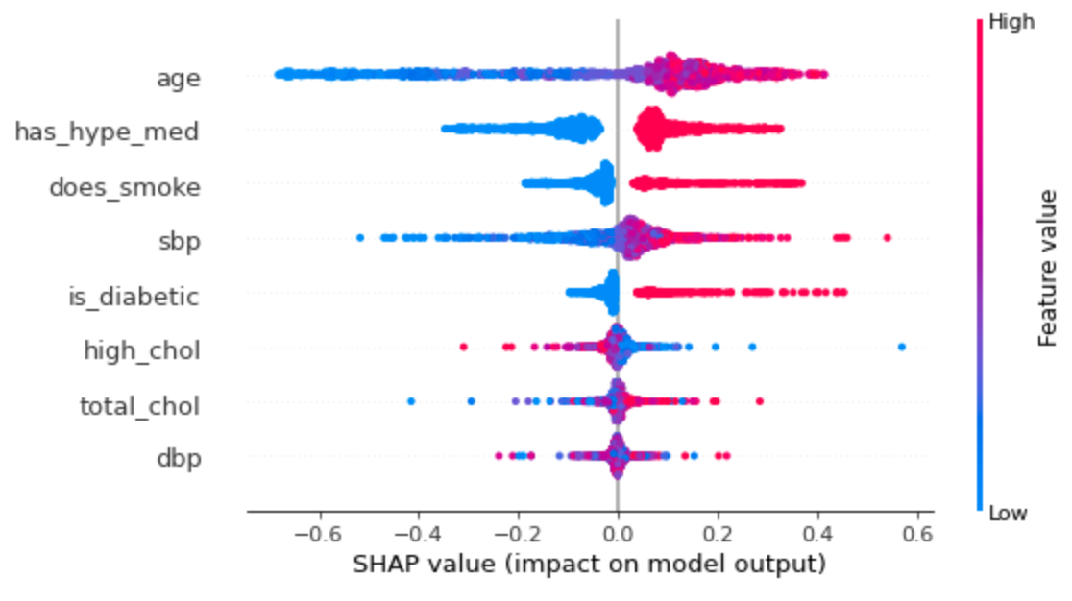
Shapley - Subgroup

Slide 26
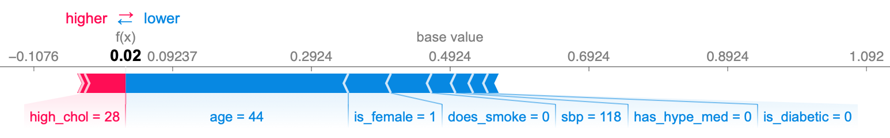
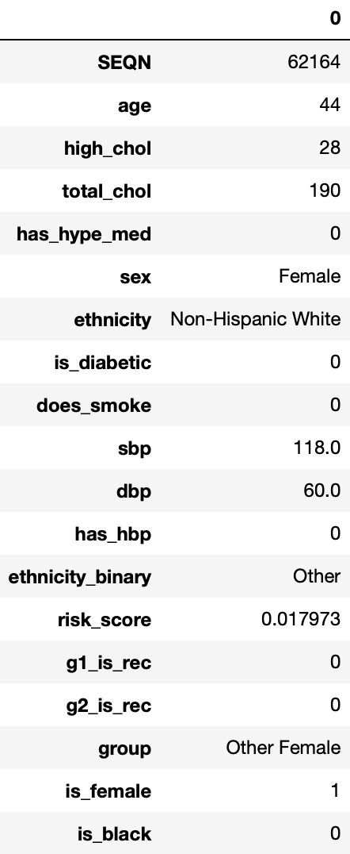
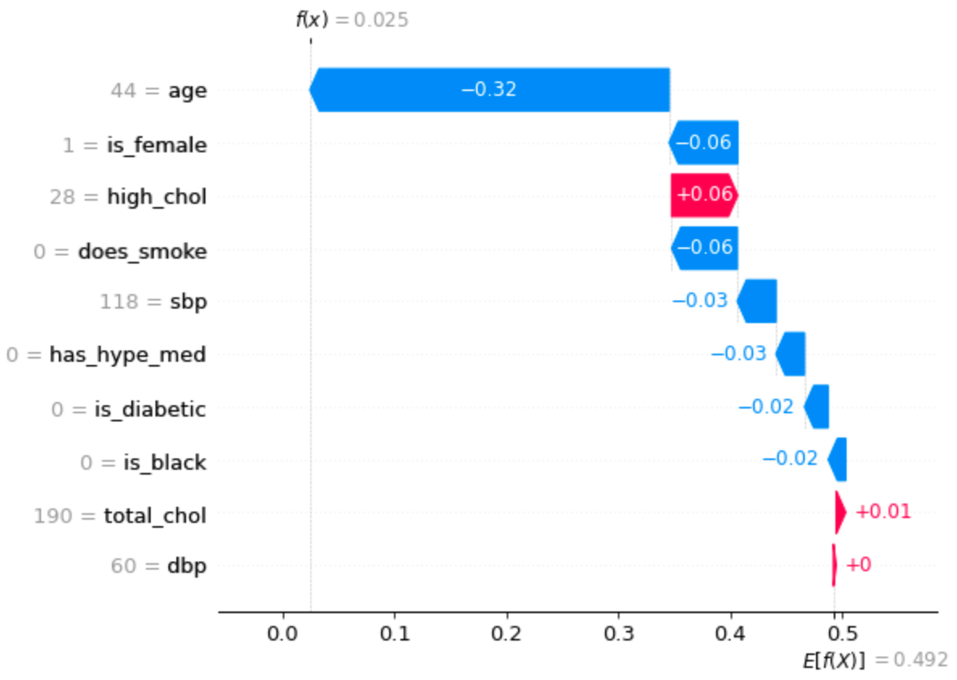
Shapley - Individual

Slide 27
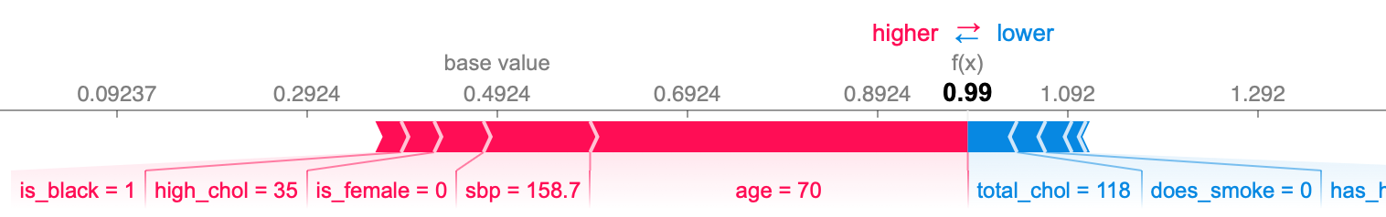
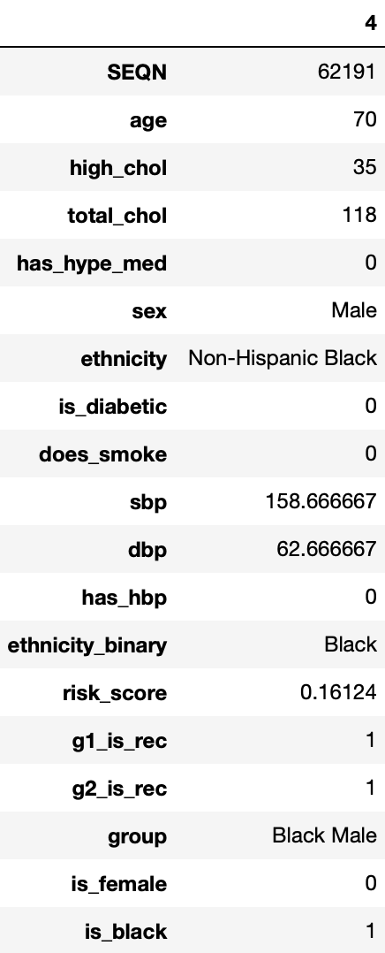
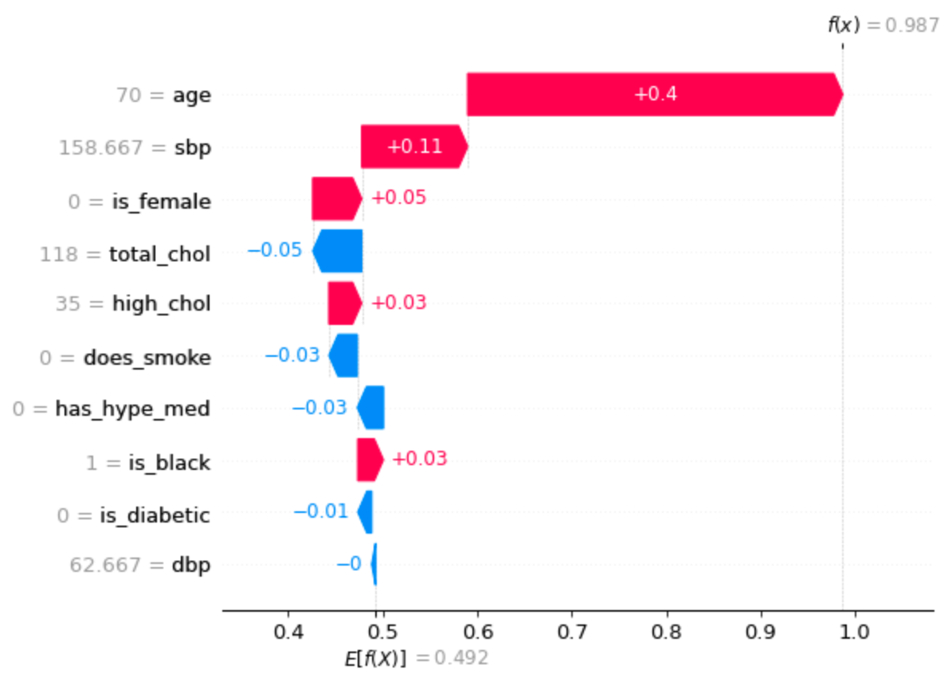
Shapley - Individual

Slide 28
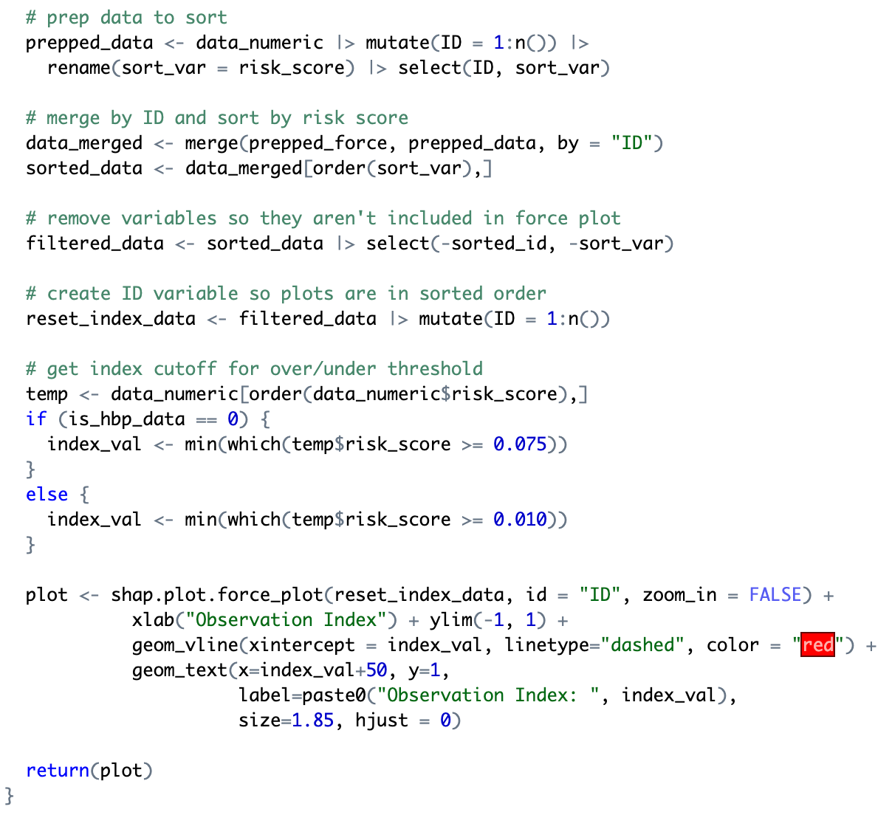
Shapley - R Stuff
Can’t implement within Python due to package limitations
Begins as before - get Shapley values
Sort data by risk score
Find index where recommendation flips

Slide 29
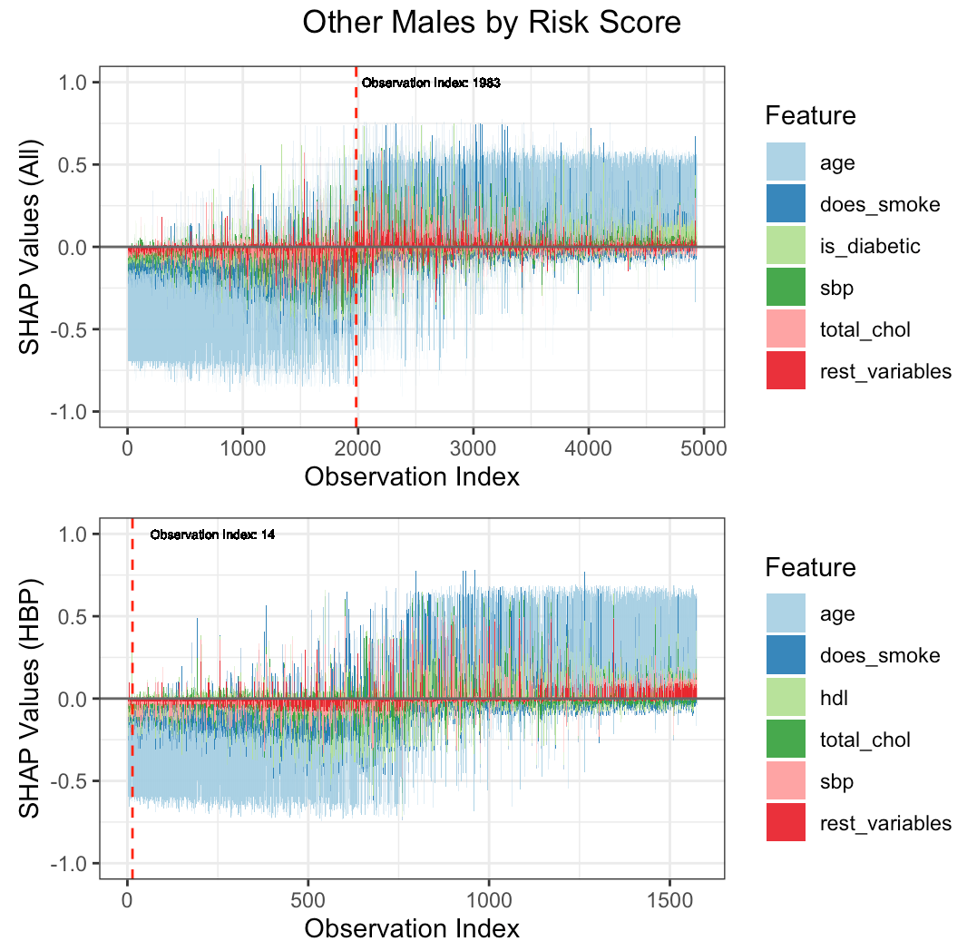
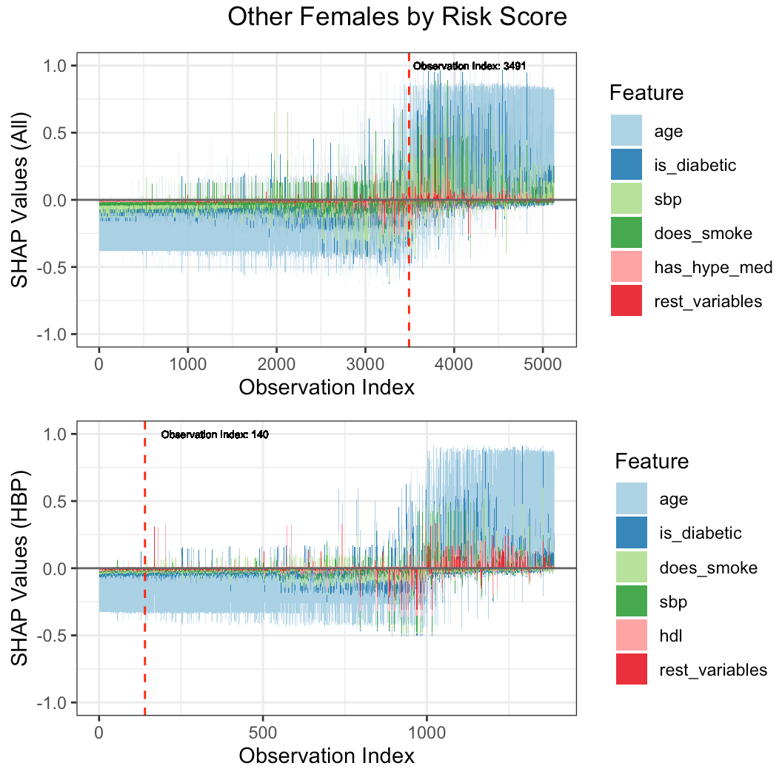
Shapley - R Stuff

Slide 30
Key Conclusions
The most influential variables in predicting statin therapy recommendation are diabetes status, smoking status, hypertension medication status, and sex
Recommendation rates from oldest to youngest:
  Other Females → Black Females → Other Males → Black Males
Black males’ recommendation rates are much higher overall

Slide 31
Key Conclusions
Ages when statin recommendation percentages initially pass 50% by subgroup
  Black Females: 58
  Black Males: 49
  Other Females: 66
  Other Males: 55
Ages when statin recommendation percentages initially equal 100% by subgroup
  Black Females: 68
  Black Males: 65
  Other Females: 73
  Other Males: 67

Slide 32
Thank You!

