Slide 1
🕹️ Interactive Game Rating Recorder
SI 579 Final Project
Zichen Jiang
SI 579
Notes:
Hi everyone! I’m Zichen Jiang, and this is my final project: the Interactive Game Rating Recorder. It’s a simple web app that lets users log, sort, and manage their game experiences.

Slide 2
Why This Project
🧠 Why I built it:
I wanted a clean, lightweight way to log games I’ve played
Existing tools felt too complex for casual use
Good practice for DOM manipulation, localStorage, and dynamic UI
Notes:
I picked this idea because I sometimes want to write quick notes about games I play. While most game review platforms are too big or complicated. I also wanted to practice the things we learned in class, like forms, buttons, saving data, and sorting.

Slide 3
Core Features
✅ Add a game with:
Name, rating, date, optional review
✅ View the game list
✅ Sort by name, rating, or date
✅ Delete entries
✅ Save in localStorage
Similar to PS4, but extended
Supports multiple sorting options and editing
Notes:
Here’s what it can do so far: users can add a game entry with all the details, sort the list however they want, and delete records. All of it is stored locally, so the data persists even after reloading the page.
This project might look a little like Problem Set 4, but it goes further. Users can edit entries, and sort by date, name, or rating — which wasn’t in the assignment.

Slide 4
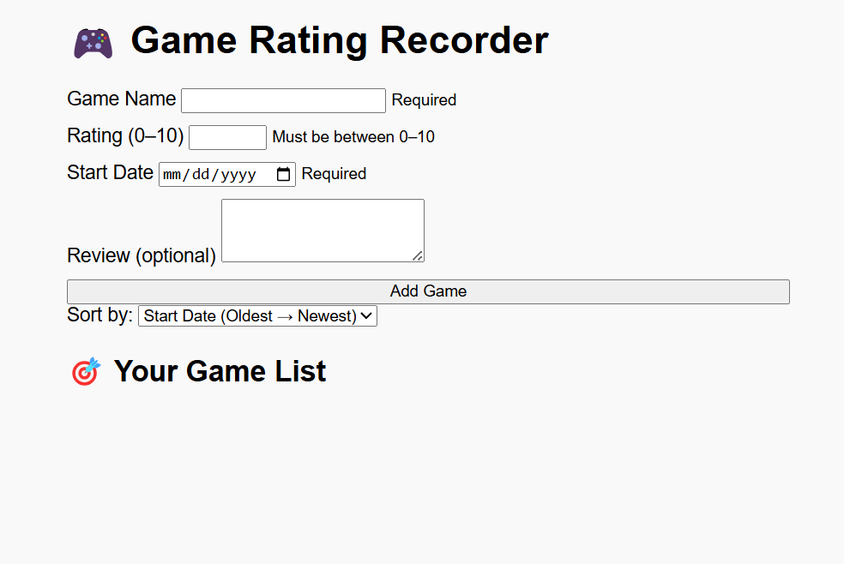
Demo Time
Notes:
Let me show you how it works. Here is the demo page for now.

Slide 5
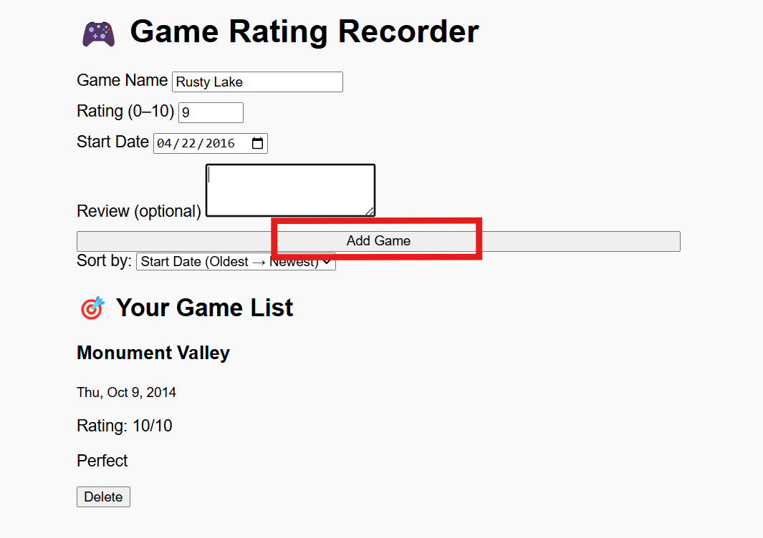
Demo Time

Slide 6
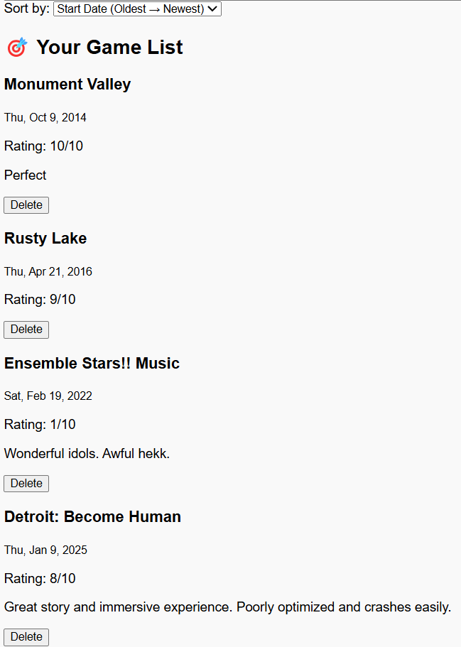
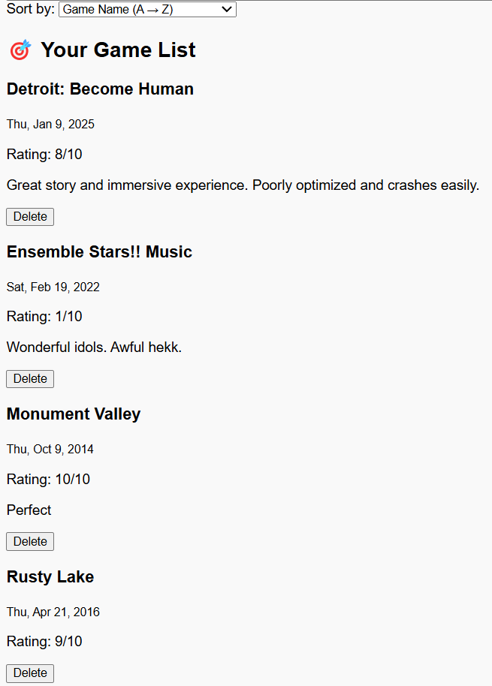
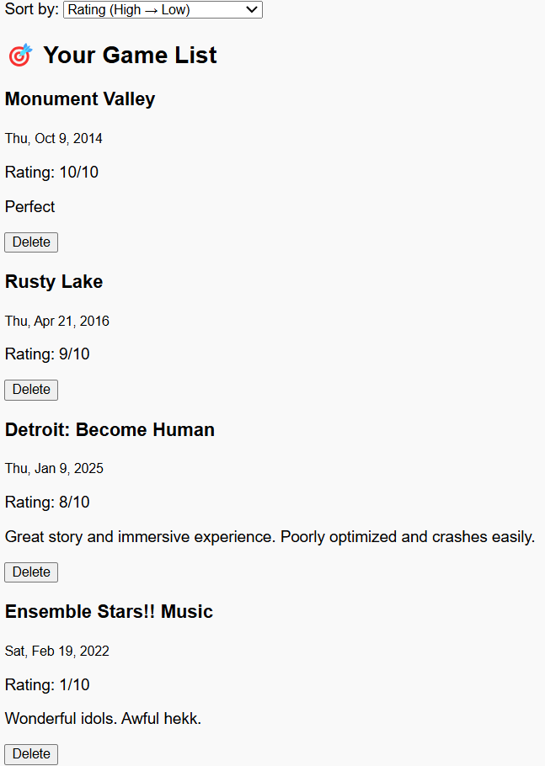
Demo Time
Sort by: Start Date
Sort by: Game Name
Sort by: Rating

Slide 7
How It’s Built
🔧 Tech:
HTML + CSS + Vanilla JS
innerHTML for DOM rendering
All user input validated before saving
Notes:
The project uses only vanilla JavaScript. All DOM updates are done with innerHTML. I also made sure form inputs are validated to prevent bad data.

Slide 8
Challenges
❗Challenges:
Figuring out how to make sorting work correctly
Validating all input fields before saving a game
Making localStorage save data correctly
Notes:
One challenge was getting the sort feature to work as expected — especially the rating sort. I also spent time making sure all inputs were validated before saving. And at first, localStorage wasn’t saving the data — I realized I forgot to update it after each change.

Slide 9
What’s Next
🛠 Planned next:
Add “Edit” button
Improve styling and layout
Polish for final submission
Notes:
Next, I’m adding an Edit button so users can update entries — that’s important for making the project more interactive and distinct from earlier assignments. I’ll also work on styling and getting everything ready for final delivery.

Slide 10
Thanks!
Do you have any questions?
🔗 GitHub: https://github.com/mtjqmszb/579-final-project/
🌐 Live App: https://mtjqmszb.github.io/579-final-project/
Notes:
Thanks for checking out my project! The code is live on GitHub and the demo is available on GitHub Pages. Let me know if you have any questions!

